Slide 1
Aetiology and Pathogenesis of Crohn’s Disease
ColoEscape 2024
Muzaffar Parker
General Surgery
Tygerberg Hospital

Slide 2
Introduction
IBD - Crohns’ Disease and Ulcerative Colitis
Symptomatic
Area of disease
Notes:
Inflammatory bowel disease (IBD) is a chronic gastrointestinal inflammatory condition that includes Crohn’s disease (CD) and ulcerative colitis (UC)
Periods of stomach discomfort, weight loss, bloody diarrhea, and inflammation and ulceration in the intestinal mucosa are characteristic of IBD
UC typically affects the colon and rectum, while CD can affect any region of the gut, it has an affinity for the terminal ileum

Slide 3
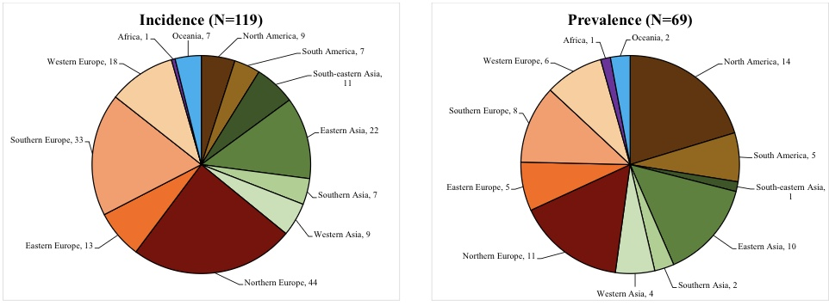
Geography
Incidence
Notes:
IBD incidence rates differ significantly both within and between different geographic regions with CD ranging from 8.9 to 17.45 and UC ranging from 4.1 to 21.47 in Europe

Slide 4
Pathophysiology
Cause of Crohn’s Disease
Genetic
Environmental
Notes:
The exact cause of IBD is not yet fully understood, but several factors are thought to contribute to the pathophysiology of the disease
These factors include dysregulation of the innate and adaptive immune systems, increased production of inflammatory mediators and disruption of tight junctions that maintain the integrity of the intestinal epithelial barrier
Environmental factors, such as antibiotics, dietary components, tobacco, and nicotine, may also play a role in initiating and exacerbating IBD by modulating host responses
IBD is characterised by recurring and significant events, including dysfunction of the epithelial barrier and an imbalance between pro- and anti-inflammatory mediators secreted by immune cells or intestinal epithelial cells (IECs)
These events are of primary importance and occur frequently in IBD. Due to the complex nature of IBD, it is challenging to develop disease models that can accurately cap the diversity of disease development and progression

Slide 5
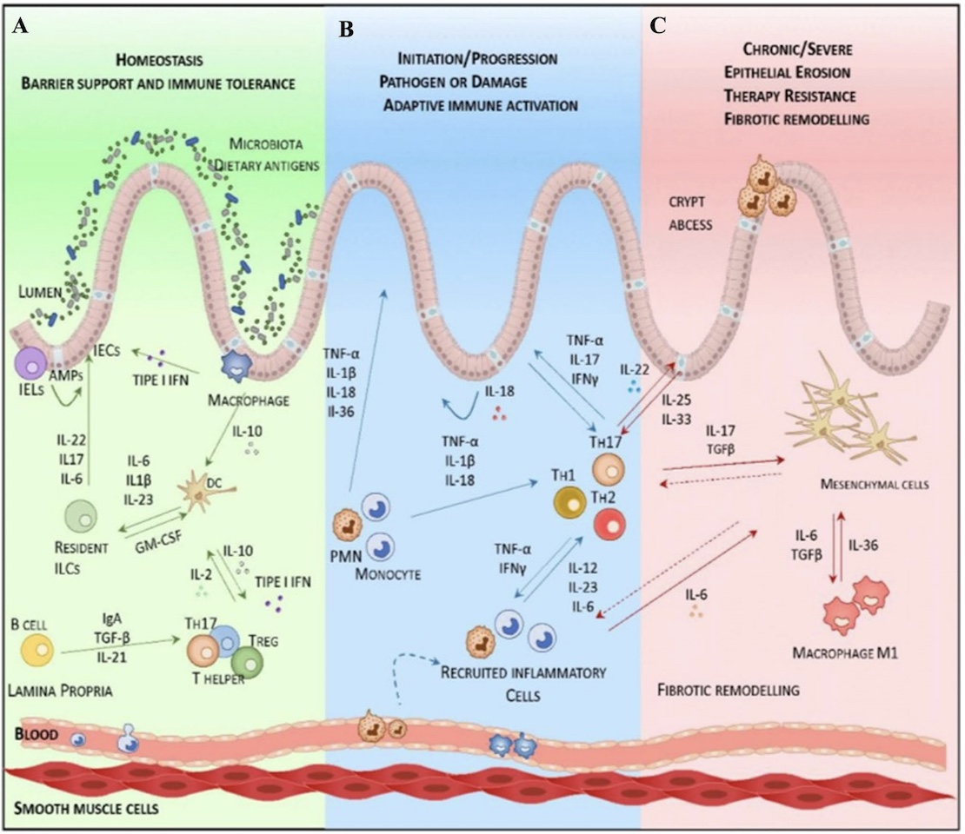
Pathophysiology
Notes:
Intestinal mucosal barrier in healthy and Inflammatory bowel disease.
A The Green Panel consistently shows the relationship and crosstalk between intestinal epithelial cells (IECs) and innate or adaptive immune cells in the state of health. Within the intestinal epithelial barrier (IEB), which includes TGF-β, retinoic acid (RA) and IL-2, there is stimulation of dendritic cells and macrophages to induce the generation of inducible regulatory T cells. Intraepithelial lymphocytes (IELs) that produce antimicrobial peptides (AMPs), B cells that overproduce IgA, macrophages, Paneth cells, and T cells collectively enhance epithelial diving by regulating the luminal contents, supporting the maintenance of a thriving ecosystem with bacteria, dietary components, and luminal factors
B The blue panel illustrates the onset and progression of IBD, wherein the disruption of crosstalk between IECs and immune cells leads to inflammation, primarily mediated by secreted pro-inflammatory cytokines. If this initial inflammation remains unresolved, pro-inflammatory cells are recruited locally, and their secreted cytokines activate pathogenic responses through adaptive (tyroxine hydroxylase) Th1/Th2 and Th17cells.
C In the pink panel, chronic inflammation is characterised by a significant pro-inflammatory response driven by the adaptive immune system, which may gradually progress towards activation of mesenchymal cells. As a result, imbalanced tissue repair processes lead to fibrotic re-modeling in advanced stages of IBD

Slide 6
Pathophysiology: Genetics
Susceptibility
Inheritance
Genome specific IBD Genes
Non-coding variation
Notes:
Susceptibility loci, including IL23R (interleukin) , IL12B, JAK2 and JAK3, have been identified in both UC and CD and the involvement of the Th (tyroxine hydrolase) 17 and IL-23 pathways is well-established in the pathogenesis of IBD
IBD is considered to have a familial component in 5–10% of individuals, while the remaining cases are considered sporadic
Phenotypic concordance among monozygotic twins is more frequent in CD (50–75%) than in UC (10–20%), highlighting a greater genetic predisposition
Recent results have shown that there are 163 IBD-associated loci, of which 110 are associated with both UC and CD, 30 are CD-specific, and 23 are UC-specific
Recent studies, which have extensively utilised GWAS (genome wide associated study) and SNP (single nucleotide polymorphisms) have uncovered a significant correlation between the IL23R gene and IBD
Disease-associated DNA regulatory elements (DREs) contribute to the aetiology of IBD through sequence variations
Compared to variants altering the coding sequences of genes, the limited effects of SNPs within DREs complicate the identification of pathogenic regulatory variants

Slide 7
Pathophysiology: Genetics
Notes:
As alluded to earlier, 163 IBD-associated loci, of which 110 are associated with both UC and CD, 30 are CD-specific, and 23 are UC-specific.
Nucleotide-binding oligomerisation domain 2 (NOD2) is a mutation that frequently occurs in patients with CD and is the first gene found to occur in about one-third of patients.
NOD2 is a member of the cytoplasmic Nod-like receptor (NLR) family and is one of the important and distinct sensing systems for detecting microbial invaders based on trigger and signalling pathways.
NLR proteins are membrane-bound receptors called toll-like receptors (TLRs) that are found in cytoplasmic compartments and are another sensing system.
NOD2 can recognise a bioactive fragment of peptidoglycan called muramyl dipeptide (MDP), which is found in the cell walls of both gram-negative and gram-positive bacteria.

Slide 8
Pathophysiology: Genetics
Notes:
GWAS has identified numerous SNPs in IL-23R that are strongly associated with CD and UC.
Recent studies, which have extensively utilised GWAS and SNPs (single nuclear polymorphisms), have uncovered a significant correlation between the IL23R gene and IBD. Susceptibility loci, including IL23R, IL12B, JAK2, and STAT3, have been identified in both UC and CD, and the involvement of the Th17 and IL-23 pathways is well established in the pathogenesis of IBD.
In addition to the genes, CARD9, IL1R2, REL, SMAD3, and PRDM1 are also susceptibility genes that regulate immune function.

Slide 9
Pathophysiology: Intestinal Barrier
Permeability
Goblet cells
Paneth Cells
Autophagy
Notes:
There is still ongoing debate on whether changes in gut permeability a primary event in the occurrence of diseases or a secondary effect that are induced by inflammation.
Increased permeability has been observed not only in patients with inflammatory bowel disease (IBD) but also in their immediate family members. This suggests that increased permeability may be a significant factor preceding the onset of disease and may also be associated with an increased risk of disease recurrence in IBD patients
Goblet cells secrete antibacterial proteins, chemokines, and cytokines that are involved in barrier maintenance as well as innate immunity
Goblet cells are specialised epithelial cells known to envelop the surface of the intestinal mucosa and maintain the barrier through mucin secretion. In addition to barrier maintenance, goblet cells also participate in innate immunity by secreting antimicrobial proteins, chemokines and cytokines
Paneth cells are highly specialised secretory epithelial cells that play an essential role in maintaining intestinal homeostasis and regulating the physiology of the small intestine and associated microbial communities
The dense granules produced by Paneth cells contain abundant antimicrobial peptides and immune-regulatory proteins that function to modulate the composition of the gut microbiota
This plays a critical role in secondary regulation of the host microvasculature, normal damage and repair mechanisms of the intestinal epithelium, and the level of intestinal inflammation
Autophagy is one of the most characteristic examples of aberrant genetic pathways and it is known to involve the formation of auto-phagosomes from fusion events between the ER-derived membrane or autophagosome precursors and lysosomes

Slide 10
Pathophysiology: Environment
Smoking
Diet
Medication
Microbiota
Notes:
The pathophysiological relationship between smoking and Crohn’s disease is evident and it is known that tobacco and nicotine can alter intestinal mucus, mucosal barrier, immunoglobulin production, and cytokine generation. This may lead to more severe symptoms, increased occurrence of relapses and ineffective treatment
Foods rich in fats, sugars, and proteins have been associated with an increased incidence of IBD
Recent reports indicate that there are changes in the composition of gut microbiota depending on whether a predominantly carbohydrate or animal protein/fat diet is consumed
The association between IBD and medications is not as strong as the link with smoking and dietary habits, but it is known that the use of oral contraceptives and non-steroidal anti-inflammatory drugs (NSAIDs) can increase the risk of developing IBD
The association between IBD and antibiotics is particularly evident when they are repeatedly administered during infancy, a sensitive period for the formation of gut microbiota, which further increases the likelihood of developing IBD
In addition, mucolytic bacterial strains are more frequently found in IBD. They contribute to the colonisation of bacteria in the vicinity of the gut epithelium, which is typically a bacteria-free zone in healthy individuals

Slide 11
Pathophysiology: Environment
Notes:
Recent research on IBD epidemiology underscores the importance of environmental factors in the pathogenesis of the disease.
Over the last 50 years, there has been a notable increase in the prevalence of CD in developed nations and the disease has gained increased recognition in less developed countries with industrialisation.
The development of IBD can be significantly influenced by food intake, which is an important environmental factor to consider.
Consuming a diet rich in fruits and vegetables could be associated with a reduced risk of CD. Conversely, fast food that is high in fat and sugar may exacerbate CD symptom.
In several Western nations, diets high in sugar have been recognised as a risk factor for CD and the use of artificial food additives in Western diets may disrupt the normal function of the intestinal wall and promote intestinal inflammation
Smoking increases the risk of CD and postoperative disease incidence.
The effects of smoking on immune responses are observed in both cellular and humoral components, and it also stimulates the production of colonic mucus.

Slide 12
Pathophysiology: Environment
Notes:
Various environmental factors, such as psychological stress, appendectomy, dietary habits, and medication use, influence the development of IBD.
Appendectomy is an independent risk factor for developing CD. Epidemiological studies have identified these environmental factors in the development of IBD, but exploring mechanistic studies of their effects on IBD disease progression remains challenging.
Traditionally, there has been an association between vitamin D and both calcium metabolism and bone health. However, awareness of its immunological role is increasing. According to research, there is a strong correlation between vitamin D deficiency and an elevated risk of developing IBD.
Recent studies have found that antibiotic use is a crucial environmental factor that affects the microbiome and, consequently, impacts the likelihood of developing IBD. Stress plays a key role in influencing the pathogenesis of CD and UC. Individuals with low-stress levels have a lower risk of disease development.

Slide 13
Pathophysiology: Immune Response
Innate Immunity
Adaptive Immunity
Cytokines and Regulatory Cells
Notes:
In the innate immune response, various types of cells are involved, such as dendritic cells, neutrophils, macrophages, natural killer cells, monocytes, and epithelial cells, and this process is triggered by the identification of microbial antigens through pattern recognition receptors, such as toll-like receptors on the cell surface and NOD-like receptors within the cytoplasm of these cells
Adaptive immunity is characterised by high specificity and a slower response time to pathogens
The type and number of T cells can influence the response, with Th1 cells induced by IL-12 producing significant amounts of IFN-γ, while Th 2 (T helper 2) cells release IL-4, IL-5, and IL-13

Slide 14
Pathophysiology: Immune Response
Notes:
NOD2 also contributes to immune tolerance, and its dysfunction can cause cell damage in patients with the NOD2 3020insC mutation. The association of the IL23R polymorphism with both CD and UC suggests that IL-23 may be involved in the shared inflammatory pathway underlying chronic intestinal inflammation.
Impaired autophagy is observed in patients with mutations in NOD2 or Atg16L1, which is usually triggered by bactericidal effects and the presentation of endogenous antigens. Dysregulation of the unfolded protein response, which is closely related to autophagy and innate immunity, may also provide clues to IBD pathogenesis.
A defective epithelial barrier and increased intestinal permeability are common features in IBD patients. The mucous layer enveloping the intestinal epithelium expresses the first physical barrier between food antigens and intestinal bacteria at the mucosal surface. Studies have demonstrated the significance of mucus in preventing bacterial infiltration and inflammation in the intestine.
The intestinal epithelium, consisting of enterocytes and specialised cells, such as goblet cells and Paneth cells, forms the second line of defence against bacterial invasion.

Slide 15
Pathophysiology: Microbiota
Notes:
Of the 1000–5000 different species in the gut, the vast majority (99%) fall under the categories of Firmicutes, Bacteroidetes, Proteobacteria, and Actinobacteria
The gut microbiome is affected by various factors, including diet, probiotics, antibiotics, exogenous enzymes, faecal microbiome transplantation and environmental factors. Coexistence with the microbiome may benefit host metabolism and gastrointestinal development.
Studies examining the gut microbiota of individuals with CD and UC in both inflamed and non-inflamed regions of the intestines have consistently reported a significant reduction in microbial diversity in the fecal microbiome of patients with IBD, compared to that of healthy controls. An abnormal immune response by the host to the gut microbiome appears to underlie the development of IBD.
Other studies have also found that the microbiome of people with IBD is more unstable than that of healthy people. The dominant Firmicutes and Bacteroidetes phyla in a healthy gut play a crucial role in producing the epithelial metabolic matrix. Conversely, individuals with CD exhibit a gut microbiota that is marked by a deficiency of Firmicutes and Bacteroidetes and an overabundance of specific gut bacterial species.
Individuals with IBD, particularly those with CD, exhibit a significant rise in the abundance of bacteria that are associated with the colonic adherent mucus layer. In CD, a sustained increment in mucosal-associated E. coli and a decrease in Firmicutes have been published. Studies have found that there is strong evidence of increased levels of E. coli in the mucous membranes of both the ileum and colon and the presence of CD in granulomas suggests that increased levels of E. coli may play a significant role in causing the disease.
The gut microbiome can have both pro-inflammatory and anti-inflammatory effects in the development of IBD. Through mostly animal models of colitis, it’s found that the gut microbiome is essential for pathogenesis. However, it is challenging to definitively establish a cause and effect correlation between the gut microbiome and IBD in humans.
Nevertheless, the gut microbiome has been shown to clearly promote the expansion of IBD. For instance, in patients with CD, there is an increase in Mycobacterium avium subsp. Paratuberculosis and adherent invasive Escherichia coli. In addition, Clostridium difficile is present at higher levels in both CD and UC patients, both during relapse and remission. Patients with CD exhibit increased bacterial counts in the mucosal region and a reduction in anti-inflammatory commensal Faecalibacterium prausnitzii. The likelihood of a single infection causing or resulting in IBD is low in both human and animal infection models.
To summarise, the pathophysiology of IBD is significantly influenced by microbial factors that impact the immune system, as well as the development and metabolism of the gastrointestinal system.

Slide 16
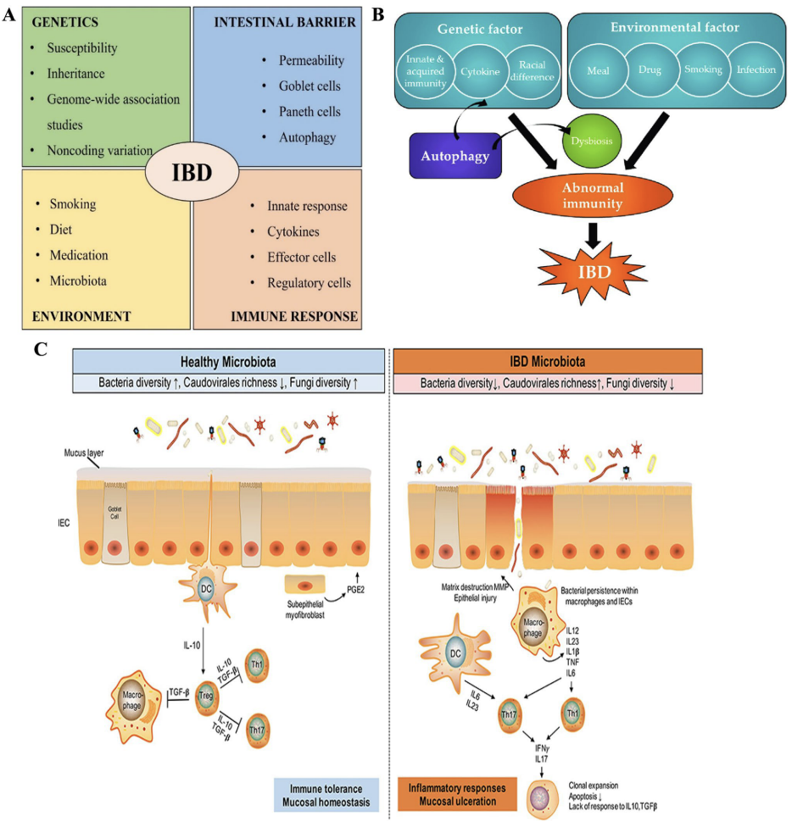
Summary
Notes:
Crohns Disease is a complex interplay between genetics, barrier function, immune response and the environment
Various mechanisms interact to produce the expression of Crohn’s disease in at risk individual

Slide 17
Thank you!

