Slide 1
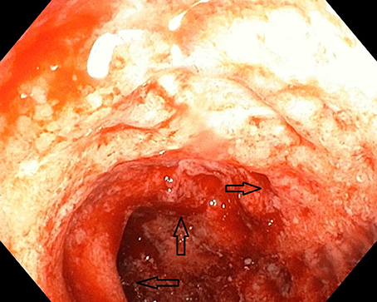
Segmental colitis associated with diverticulosis
Dr SC Sibuyi

Slide 2
PRESENTATION OUTLINE
Case presentation
Introduction
Clinical presentation
Diagnosis
Management

Slide 3
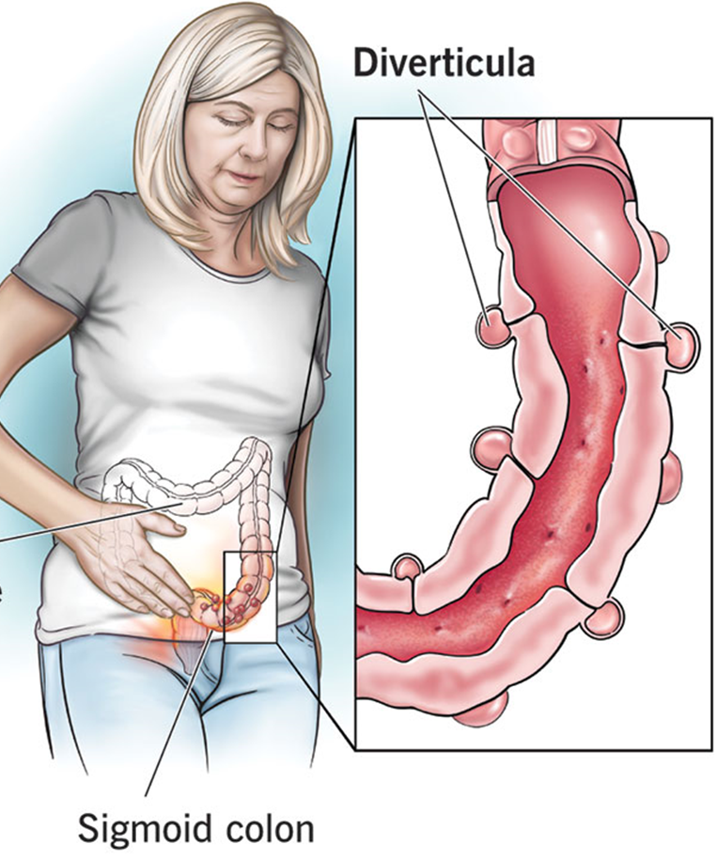
CASE PRESENTATION
57-year-old male
Presented with chronic intermittent abdominal pain for 2 months
non-bloody diarrhea, and occasional hematochezia
No constitutional symptom or history of weight loss
Background Hx
Diverticular disease
Hemorrhoids
RVD :non reactive
O/E
Vitals signs : Hemodynamic stable
localized tenderness in the left lower quadrant
No rebound tenderness or guarding
Systemic examination was otherwise unremarkable

Slide 4
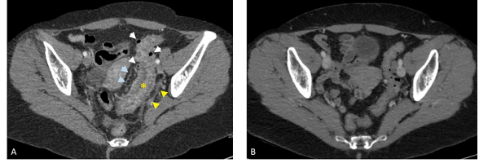
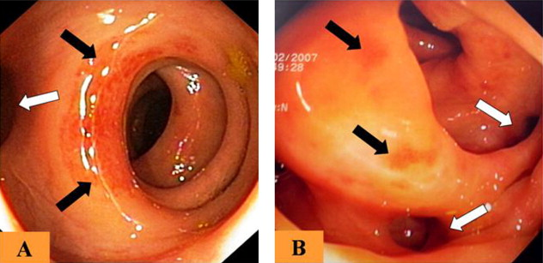
CASE PRESENTATION
Investigation
FBC : Hb= 10 g/dl and WBC 7200/mm3 / CRP=100/ urea=13/ Creat=129
Fecal calprotectin =139
stool culture =negative
CT abdomen and pelvis :
long segment of circumferential colonic wall thickening involving the sigmoid and distal descending colon in the region of colonic diverticulosis
Colonoscopy:
showed diffuse mucosal edema and hyperemia of the descending and sigmoid colon with easy friability and erosions primarily affecting the inter-diverticular colonic mucosa
The remainder of the colon and the terminal ileum were normal.
Histopathology :
features of chronic colitis including crypt distortion and inflammation in lamina propria with granuloma formation

Slide 5
CLINICAL PRESETATION OF DIVERTICULAR DISEASE
Diverticulosis
Symptomatic uncomplicated diverticular disease (SUDD)
Segmental colitis associated with diverticulosis (SCAD)
Acute uncomplicated & complicated diverticulitis

Slide 6

INTRODUCTION
Segmental colitis associated with diverticulosis (SCAD):
is an inflammatory process that affects colonic luminal mucosa in segments that are also affected by diverticulosis
The exact prevalence of SCAD unknown
Estimated between 0.25%- 1.4% in the general population
1.15% - 11.4% amongst those suffering from DD
commoner in males and usually presents in the sixth decade of life
The rarity of SCAD is multifactorial:
Milder forms go undiagnosed or are attributed to DD
more severe forms can be misdiagnosed as IBD
J. Schembri et al.Segmental colitis associated with diverticulosis: is it the coexistence of colonic diverticulosis and inflammatory bowel disease?. Annals of Gastroenterology (2017) 30, 257-261

Slide 7
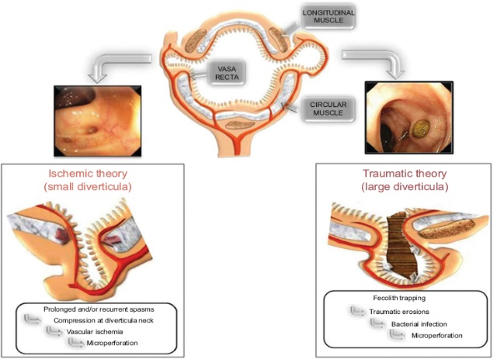
PATHOPHYSIOLOGY
Multifactorial pathogenesis
Mucosal prolapse leading to mucosal ischemia
Diverticulosis is accompanied by muscle hypertrophy and bowel shortening, which in turn lead to mucosal redundancy.
The pressure effects applied to the excessive mucosa lead to polypoid lesions and inflammatory changes characteristic of mucosal prolapse
Fecal stasis within the diverticula
Consequent dysbiosis that trigger an immune respond and exposure to intraluminal antigen and toxins

Slide 8
PRESENTATION
Male predominance and > 60 years of age
Clinical manifestations are heterogeneous:
haematochezia or intermittent rectal bleeding
lower abdominal pain
alterations to bowel habits mainly diarrhoea
Incidental during routine endoscopy for colon/ rectal cancer screening
symptoms and/or signs e.g fever, nausea, vomiting and weight loss, are rarely reported
Extra-intestinal features associated with IBD are rare with post-operative pyoderma gangrenosum recently described
Common Diagnostic Challenges and Pitfalls in Segmental Colitis Associated with Diverticulosis (SCAD).Caterina Sbarigia et al . J. Clin. Med. 2023, 12(18), 6084; https://doi.org/10.3390/jcm12186084

Slide 9

DIAGNOSIS DILEMMA
Differential diagnosis
Diverticular disease
Acute Colitis
Inflammatory bowel disease
Other forms of colitis:
drug-induced colitis, ischemic colitis, infective colitis

Slide 10
INVESTIGATION
Blood
Leucocytosis is unusual, erythrocyte sedimentation rate, C-reactive protein often non-specific
Stool
MCS :faecal bacterial/parasites are negative
Fecal calprotectin may differentiate from healthy controls or irritable bowel syndrome, but not from other forms of inflammatory bowel disease
Serological markers
pANCA and ASCA often positive in other forms of IBD (UC & Crohn’s disease) are generally negative
Immunohistochemical evaluation
Antibody to TNF alpha shows over-expression similar to the pattern in Crohn’s disease and UC
Further studies are needed to determine if this observation has relevance to the pathogenesis or represents a type of “specificity marker” in the inflammatory process

Slide 11
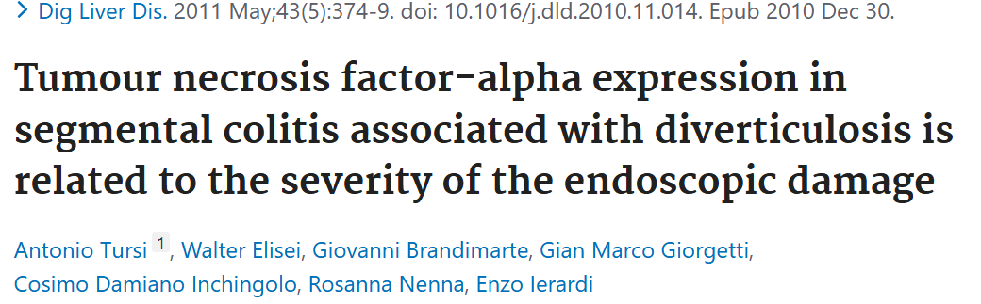
Results :
Tumour necrosis factor-α expression was significantly higher in type B (42.7%) and D (40%) compared with type A (19.1%) and C (21.1%)
Type B & D associated with UC and Crohn’s pattern respectively
TNF α expression was significantly lower in irritable bowel syndrome (8%±4) than in every type of segmental colitis associated with diverticulosis
Conclusions:
TNF-α expression in SCAD seems to be related to the severity of the endoscopic damage
This behaviour, similar to that of IBD, confirms that this disease should be considered as a subtype of IBD

Slide 12
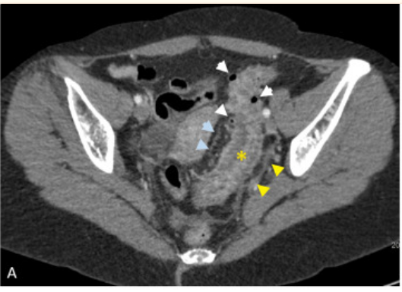
IMAGING
CT Scan:
Non-specific
Assists in ruling out DDx e.g. malignancy, infective/ ischemic colitis
Findings
long-segment circumferential colonic wall thickening involving the sigmoid and/or left colon in the region of colonic diverticulosis
engorged mesenteric vessels & mild pericolonic inflammation not centred around colonic diverticula
Segmental sigmoid colon wall thickening (yellow asterisk), mild peri-colonic inflammation (yellow arrowheads) sparing colonic diverticula (white arrowheads), and engorged vasa recta (blue arrowheads).
Sakhalkar OV, Goyal A, Abualruz AR. Segmental Colitis Associated With Diverticulosis. Cureus. 2023 May 8;15(5):e38724. doi: 10.7759/cureus.38724. PMID: 37292528; PMCID: PMC10246860.

Slide 13
ENDOSCOPIC EVALUATION
The mainstay of diagnosis
Wide range of findings:
Oedema and erythema of the inter-diverticular mucosa
Presence of erosions
Mucosal friability and ulcers
Spectrum of histological findings are variable
Unspecific chronic or acute inflammation signs to inflammatory bowel disease (IBD)-like alterations
The rectum and proximal colon are always spared, both at endoscopic and histological evaluation

Slide 14
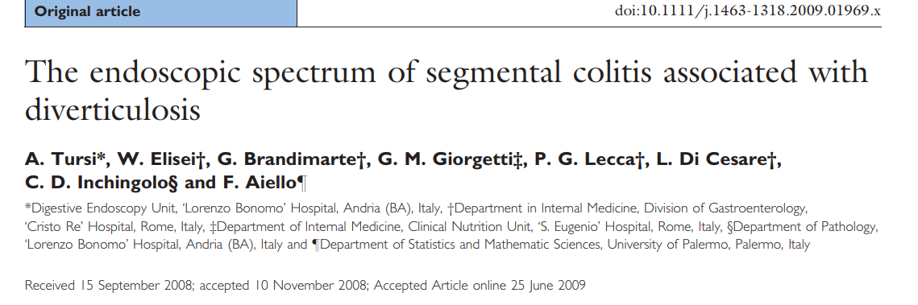
Objective: An endoscopic classification of ‘Segmental colitis associated with diverticulosis’ (SCAD)
Aim : To assess the endoscopic spectrum
of SCAD, comparing it with the histological and clinical features
Method: A prospective study performed from January 2004 to October 2007. Diagnosis of SCAD was made on the basis of specific endoscopic and histological patterns
Results: 6230 consecutive colonoscopies were performed
SCAD diagnosed in 92 ( 1.48%)
4 patterns described:
A: crescent fold ( 52.2 %)
B :Mild to moderate UC pattern( 30.4%)
C: Crohn's disease like pattern ( 10.9%)
D: Sever UC like pattern ( 6.2 %)
In patter A & B : most frequent symptom was diarrhoea
Patter C & D : most frequent symptom abdominal pain
Conclusion : Histo. patterns may range from mild to severe but clinical features didn’t show a statistically significant association with degree of endoscopic severity

Slide 15
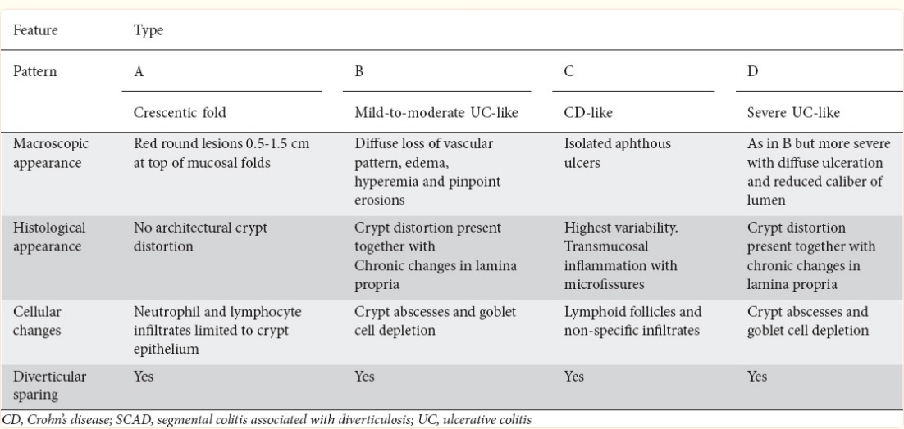
CLASSIFICATION
Schembri J, Bonello J, Christodoulou DK, Katsanos KH, Ellul P. Segmental colitis associated with diverticulosis: is it the coexistence of colonic diverticulosis and inflammatory bowel disease? Ann Gastroenterol. 2017;30(3):257-261. doi: 10.20524/aog.2017.0126. Epub 2017 Jan 31. PMID: 28469355; PMCID: PMC5411375.

Slide 16
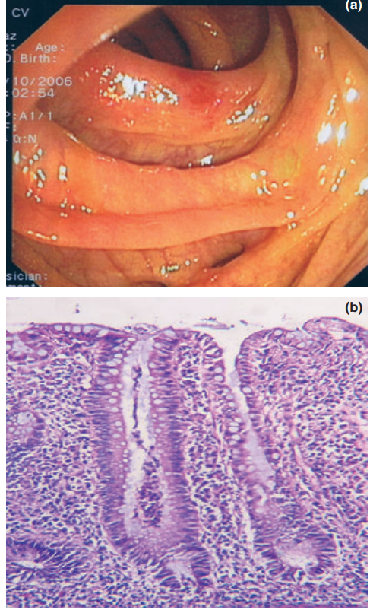
TYPE A: CRESCENTIC FOLD DISEASE
Colonoscopy
swollen red patch, without haemorrhage or ulceration, confined to the crescentic mucosal fold
The diverticular orifices are spared, as well as the vascular pattern of the colonic mucosa is spared
Histopathological pattern
shows an acute-on-chronic inflammation
Two crypt abscesses evident in the centre of the field

Slide 17
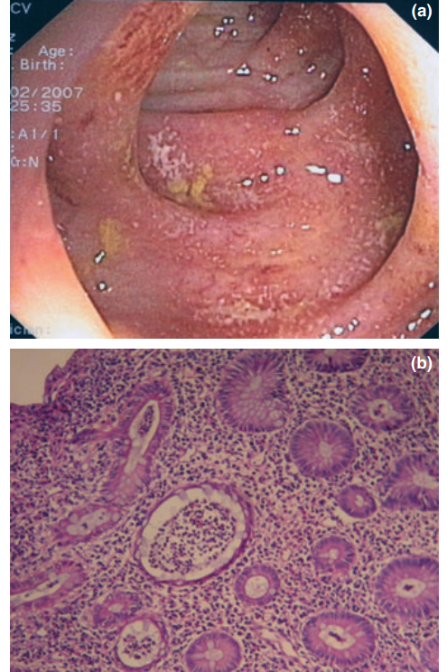
TYPE B:MILD-TO MODERATE “ULCERATIVE COLITIS-LIKE”
Colonoscopy
Patchy loss of vascular pattern, oedema and hyperaemia of the mucosa, and diffuse erosions
diverticular orifices are spared
Histopathological pattern
acute-on chronic inflammation
Two crypt abscesses are evident in the centre of the field
architectural distortion with crypts irregularly

Slide 18
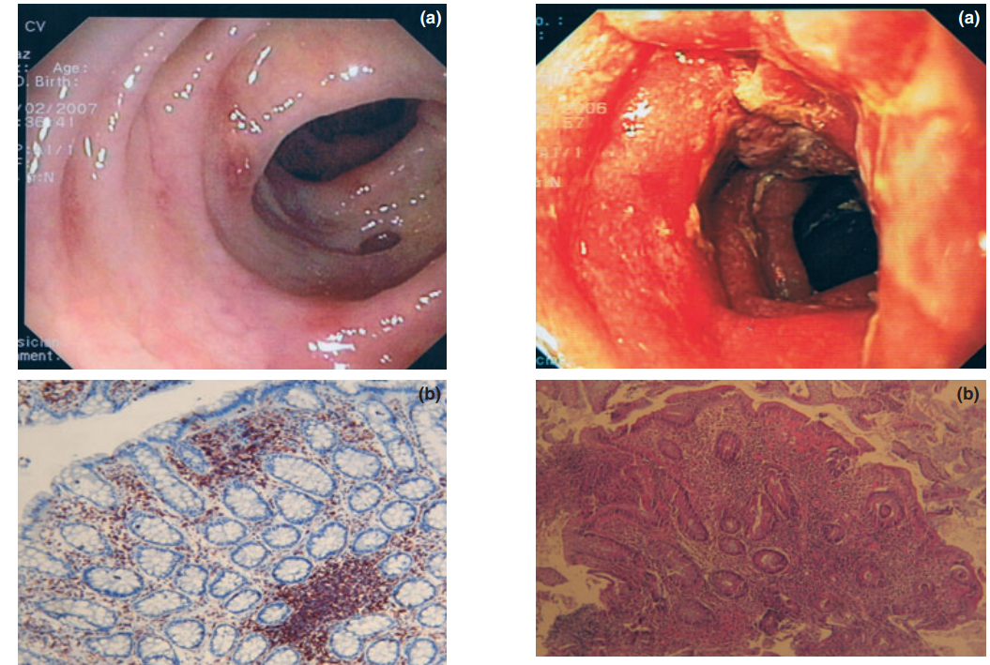
TYPE C: ‘CROHN’S DISEASE COLITIS-LIKE’
Colonoscopy pattern:
scattered aphthous ulcers, some of them on the crescentic
mucosal fold
within a normal colonic mucosa, with normal
vascular pattern
The diverticular orifices are always spared
histopathological pattern
patchy lymphoplasmacytic inflammation in the upper part of the field, without significant cryptic architectural changes, and with a lymphoid follicle

Slide 19
TYPE D:‘SEVERE ULCERATIVE COLITIS-LIKE’
Colonoscopy findings
marked oedema in the sigmoid mucosa
ulcerations & reduction of the lumen
diffuse loss of vascular patterns &hyperaemia
easy bleeding on contact
The diverticular orifices are not easy to recognize→ may be visible and spared by inflammation at maximal air inflation
Histological pattern
severe active UC (indistinguishable from classic inflammatory
bowel disease) with severe diffuse inflammatory infiltrate, crypts
irregularly arranged with architectural distortion and cryptic abscesses

Slide 20
MANAGEMENT
Evidence for treatment is limited to small non-blinded series/ case reports, clear & specific recommendations are not available
A prominent clinical feature evident in long term studies
frequency of spontaneous resolution and remission without the need for pharmacological therapy
Or with limited treatment, such as oral 5-aminosalicylate alone
Occasionally ongoing symptomatic disease or recurrent disease necessitates use of steroids, or other immunosuppressants
Rarely surgical resection for a strictured sigmoid segment/intractable disease
Hugh j Freeman. Segmental Colitis Associated with Diverticulosis (SCAD). Current Gastroenterology Reports (2023) 25:130–133.https://doi.org/10.1007/s11894-023-00871-y

Slide 21
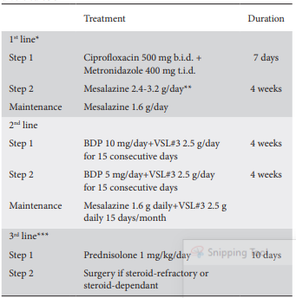
TREATMENT
Medical Management
Treatment of choice
Antibiotics & salicylates
high-fiber diet
Schembri J, Bonello J, Christodoulou DK, Katsanos KH, Ellul P. Segmental colitis associated with diverticulosis: is it the coexistence of colonic diverticulosis and inflammatory bowel disease? Ann Gastroenterol. 2017;30(3):257-261. doi: 10.20524/aog.2017.0126. Epub 2017 Jan 31. PMID: 28469355; PMCID: PMC5411375.

Slide 22
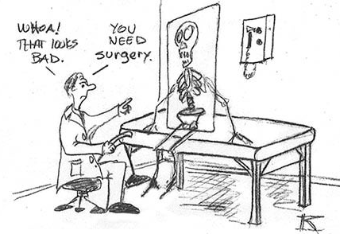
SURGICAL MANAGEMENT
Indication
Medical refractory /stricture
Surgical option
Laparoscopic
Open laparotomy

Slide 23
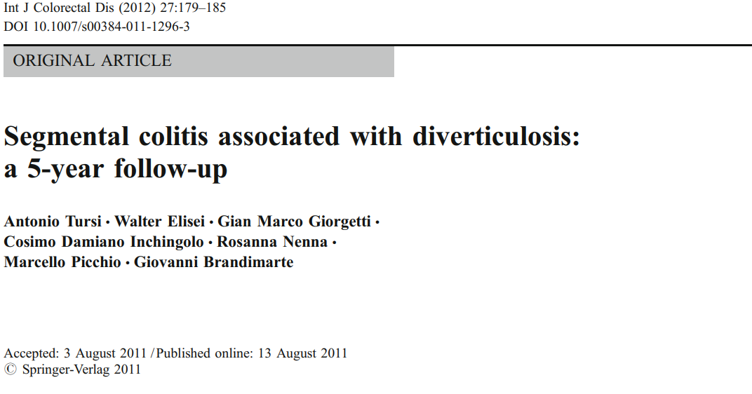
Conclusion :
SCAD B and D patients fail to maintain long-term remission, often requiring immunosuppressive treatment
SCAD A and C patients show a more benign course; however, long-term treatment guarantees longer remission also in those patients

Slide 24
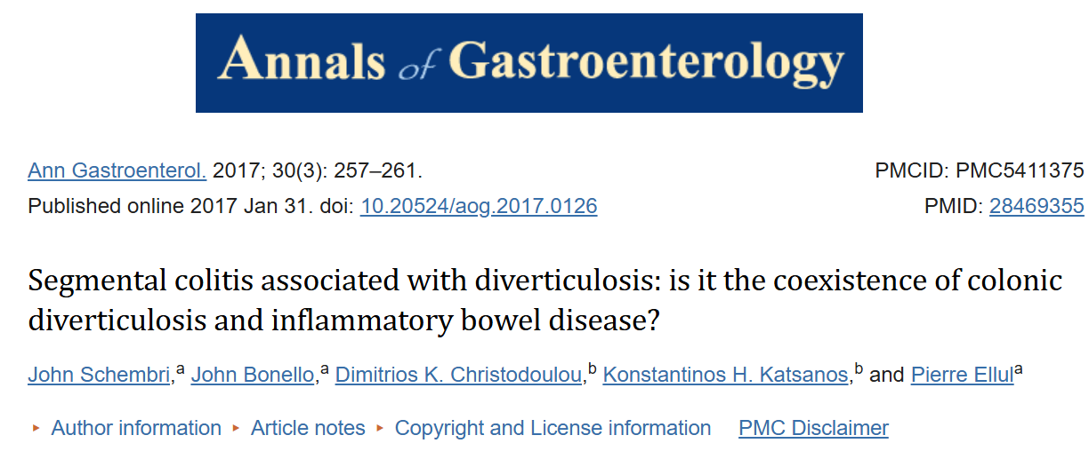
Out of the four categories, types A and C run the most benign course, whereas patients with type B or D SCAD are at a higher risk of relapse
Hence, medical treatment in the latter two subtypes should be strongly considered

Slide 25
What is SCAD & What should you do ?
Segmental inflammation surrounded by multiple diverticula
Differs from diverticulitis → the individual diverticula are not involved; histologically, this shows inflammation within the interdiverticular mucosa rather than the diverticular orifices
Benign & self-limiting, presentation is often rectal bleeding , diarrhea or abdominal pain
There are currently no guidelines for the treatment
Management is largely based on case series
Adopted from inflammatory bowel disease (IBD) treatment
Surgery is usually reserved for cases that are refractory to medical management/symptomatic strictures

Slide 26
CONCLUSION
Whether SCAD exists as a separate entity or whether it belongs on a spectrum with IBD is still unclear
SCAD is a rare diagnosis this may be due to milder forms going undiagnosed and more severe forms being misdiagnosed as IBD or diverticulitis
Although those misdiagnosed as IBD will probably respond to conventional IBD treatment, it is important to make the distinction since the natural history & prognosis of the two conditions vary significantly
Standardized endoscopic evaluation, reporting , biopsy protocol and clinical evaluation are crucial in accurate diagnosis

