Slide 1

Acute Diverticulitis:
Who needs an operation and when?
Daniel Jatileni
18/07/2024

Slide 2
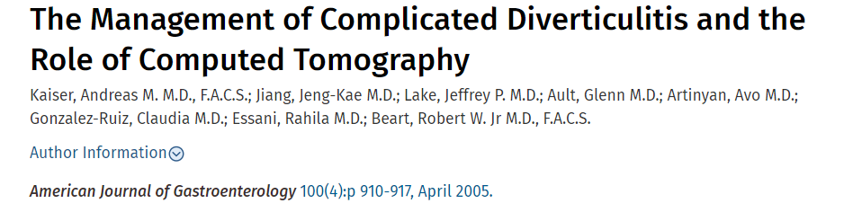
Stage 0: mild clinical diverticulitis
Stage 1a: confined pericolic inflammation
Stage 1b: confined pericolic abscess
Stage 2: pelvic or distant intra-abdominal abscess
Stage 3: generalized purulent peritonitis
Stage 4: fecal peritonitis at presentation

Slide 3
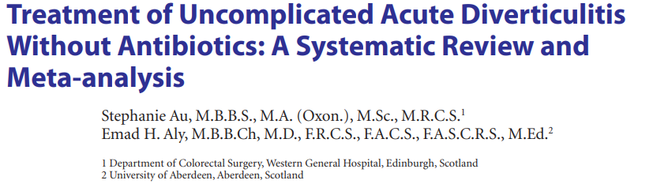

Additional treatment or intervention to settle during the initial episode (5.3% vs 3.6%; risk ratio = 1.48; p = 0.28)
Rate of readmission (risk ratio = 1.17; p = 0.26)
Need for surgical or radiological intervention (risk ratio = 0.61; p = 0.34)
Recurrence (risk ratio = 0.83; p = 0.21)
Complications (risk ratio = 0.70–1.18; p = 0.67–0.91).

Slide 4
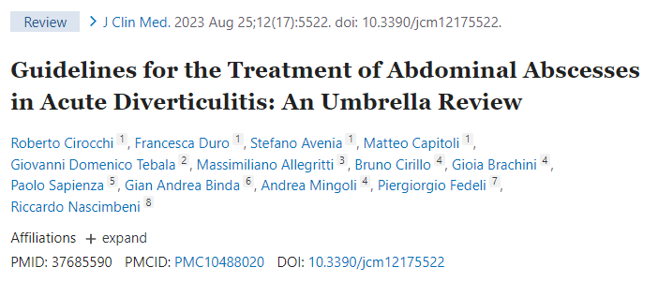

<3cm antibiotics
>3cm percutaneous drainage
Surgery is
Reserved for cases where percutaneous drainage fails
Large abscesses that cannot be accessed through percutaneous drainage
Unresponsive to antibiotic therapy.

Slide 5
Hinchey III
Laparoscopic Lavage
Resection
With Drains
Without Drains
With Stoma
Without stoma

Slide 6
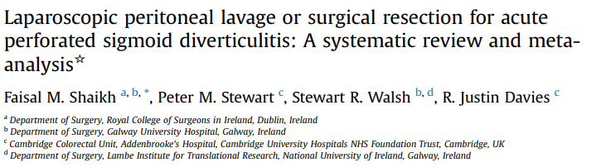
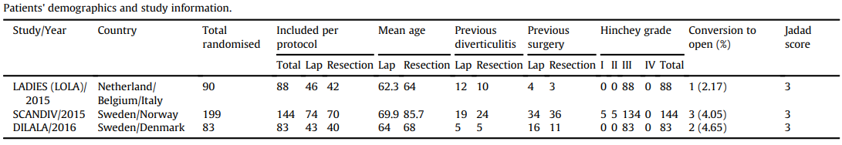
No significant difference in peri-operative mortality between LPL and SR
(OR 1.356, 95% CI 0.365 to 5.032, p ¼ 0.649),
Serious adverse events
(OR ¼ 1.866, 95% CI ¼ 0.680 to 5.120, p ¼ 0.226).
The LPL required significantly less time to complete than SR
(WMD ¼ 72.105, 95% CI ¼ 88.335 to 55.876, p < 0.0001).
The LPL group was associated with:
Higher rate of postoperative abscess formation
(OR ¼ 4.121, 95% CI ¼ 1.890 to 8.986, p ¼ 0.0004)
Subsequent percutaneous interventions
(OR ¼ 5.414, 95% CI 1.618 to 18.118, p ¼ 0.006).

Slide 7
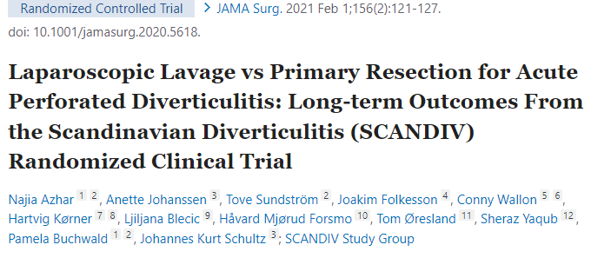
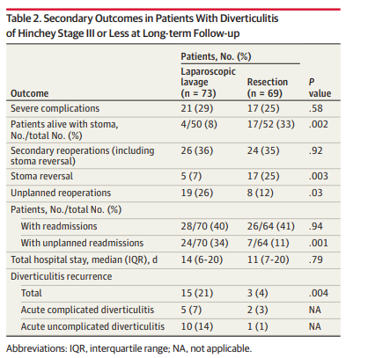
Laparoscopic lavage is faster
Cost-effective but leads to a higher reoperation rate
High recurrence rate,
Often requiring secondary sigmoid resection.

Slide 8
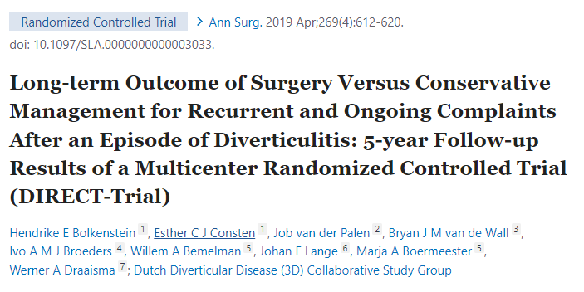
Elective sigmoidectomy resulted in a
Significantly increased QoL at 5-year follow-up
Less pain
Lower risk of new recurrences

Slide 9


Conclusion
Acute Diverticutilis: Who needs an operation and when?
Stage 1a: confined pericolic inflammation
Stage 1b: confined pericolic abscess
Stage 2: pelvic or distant intra-abdominal abscess
Stage 3: generalized purulent peritonitis
Stage 4: fecal peritonitis at presentation
Persistent symptoms

Slide 10

Photo by Stefan Els
Notes:
Cover & End Slide Option
Replace the background image:
Right-click on the slide, then choose Format Background and select Picture or texture fill. Select a new picture of your choice.
Remember to add an image attribution for e.g., Photo by Stefan Els.

