Slide 1
COLON CANCER Neoadjuvant therapy in 2024
Name
Dr Meryl Oyomno
Colorectal Surgeon
Colo Escape -SACRS CONGRESS 2024

Slide 2
“In future,
our decisions will be more important
than our incisions.”
Brendan Moran
Consultant surgeon, Peritoneal malignancy unit
Basingstoke, UK

Slide 3
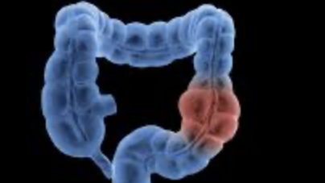
OUTLINE
Introduction
Historical standard of care for colon cancer and the paradigm shift
The Why, the Who, the What
The evidence
Current recommendations
Future options
Summary

Slide 4
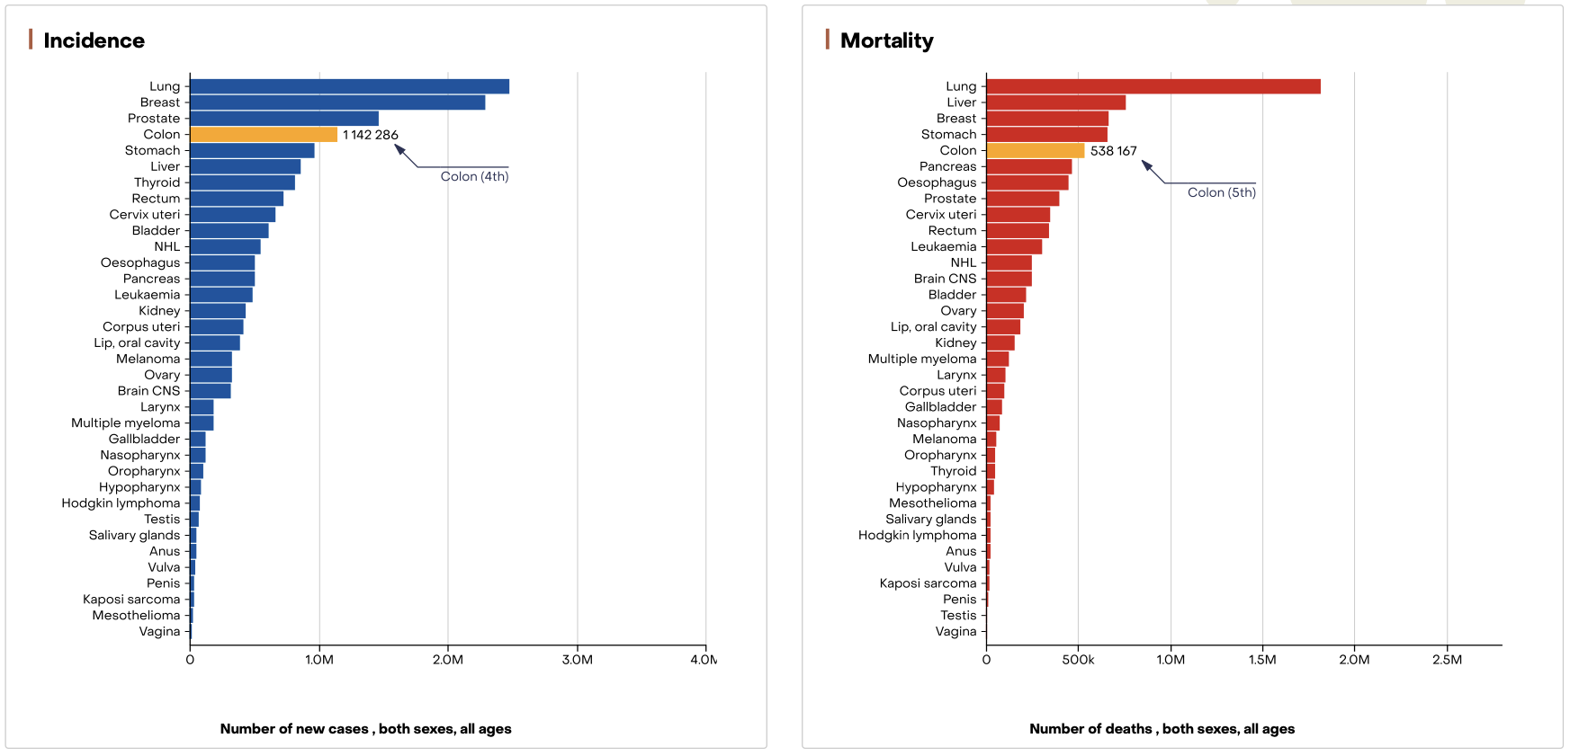
Introduction
Colon cancer:
Globally
Incidence ranked 4th
5th in Mortality
Incidence in younger patients is increasing
10 % Right sided and left sided (70%)
Neoadjuvant therapy-
NAC refers to the use of systemic anticancer treatments before surgical resection
New in colon cancer

Slide 5
The potential advantages (The why)
Historical standard of care for colon cancer/ Paradigm shift,
Resection followed by +/- adjuvant chemotherapy
Why should we do it (potential advantages)?
Early eradication of micro-metastasis,
Tumor downstaging,
Downsize the metastasis
Convert irresectable disease to become resectable (conversion therapy)
See tumor response, assess tumor biology
Reduced cancer-related systemic inflammation,
Lower toxicity due to shorter durations of chemotherapy before and after surgery,
Higher proportion of patients receiving systemic treatment (better compliance)

Slide 6
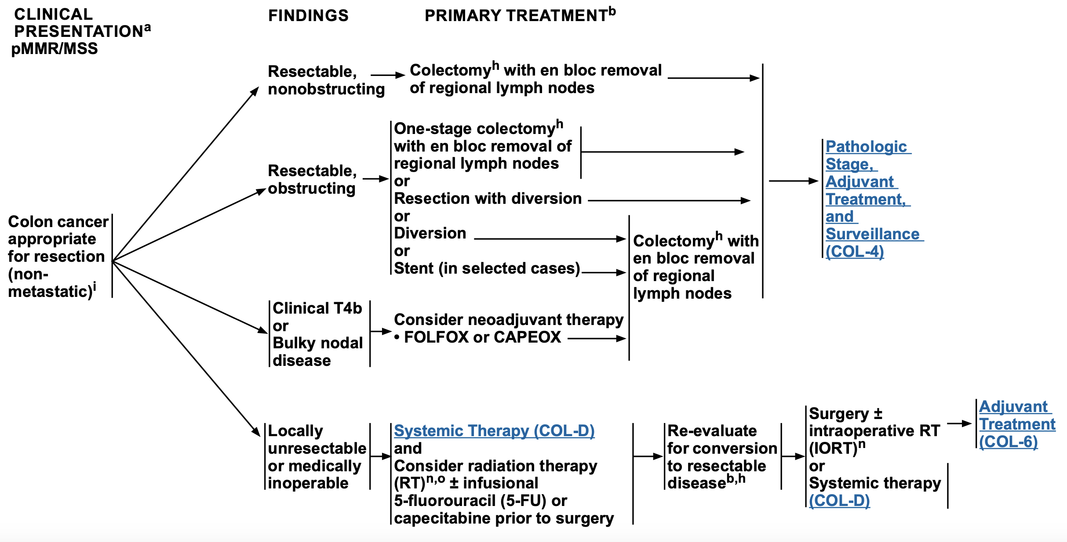
Indications (The who)
Locally advanced
Infiltrating into adjacent structures (T4b)
Bulky nodal disease
Synchronous resectable metastasis
Synchronous potentially resectable metastasis (conversion therapy)
Left sided malignant bowel obstruction
Medically inoperable patients
Aiming for cure ,not palliative patients
NCCN Guidelines Version 4.2024 pMMR/MSS Colon Cancer

Slide 7
Drugs and Agents used (The what)
If no metastasis
FOLFOX , CAPOX
If metastasis are present
FOLFIRI/ FOLFIRINOX
Local therapy for metastatic disease (e.g. ablation)
3 cycles then reassess (each cycle is ~21 days/3weeks/2 ½mo), re-assess 2 monthly
For KRAS/NRAS/BRAF wild-type unresectable synchronous metastatic disease (targeted therapy),
Bevacizumab (Avastin)
Cetuximab
Panitumumab

Slide 8
For dMMR tumours or POLE/POLD1 mutation-positive disease, use Checkpoint inhibitor immunotherapy
Nivolumab
Ipilimumab
Pembrolizumab
Dostarlimab
Neoadjuvant radiotherapy**

Slide 9
Neoadjuvant radiotherapy
RT + 5FU/ fluoropyrimidine–based chemotherapy
Indications:
T4 tumors penetrating to a fixed structure (noted on CT or intra-op) or
Patients with recurrent disease.
Surgical clips can be used to mark the area
IORT Intra-operative radiotherapy can be used
IMRT Intensity modulated radiotherapy
STRT Stereotactic ablative radiotherapy

Slide 10
Complications
Hepatotoxicity,
Irinotecan- liver steatohepatitis
Oxaliplatin - sinusoidal liver injury
Limit the number of chemotherapy cycles to avoid hepatotoxicity prior to liver resection.
Typically 3 cycles of chemo then re-imaging is done (CT scan)
Bevacizumab (Avastin) –
Poor wound healing
GIT perforation
Bleeding

Slide 11
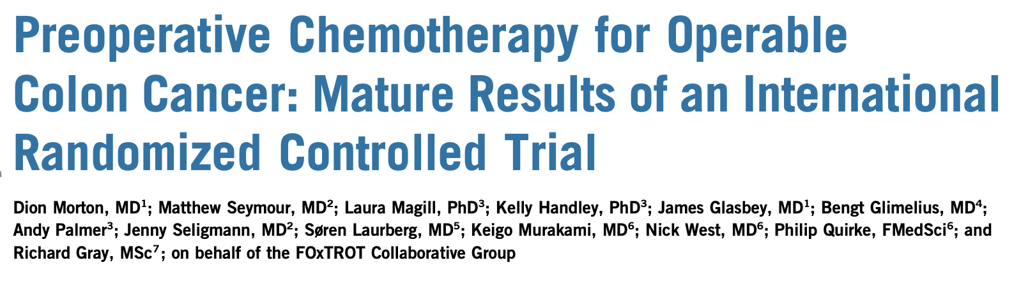
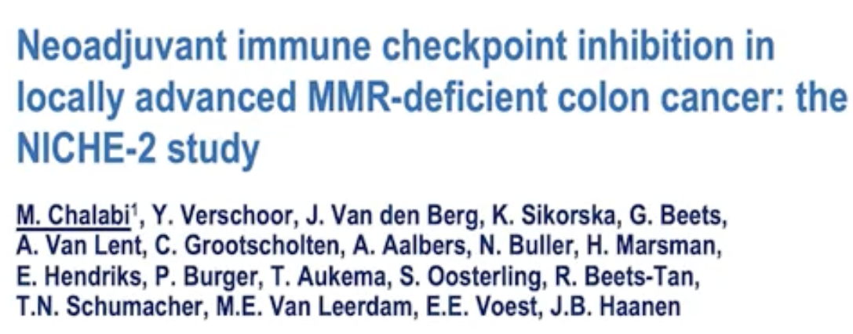
Evidence (Trials) (The why)
FOxTROT Trial
NICHE-1 Trial
NICHE-2 Trial

Slide 12
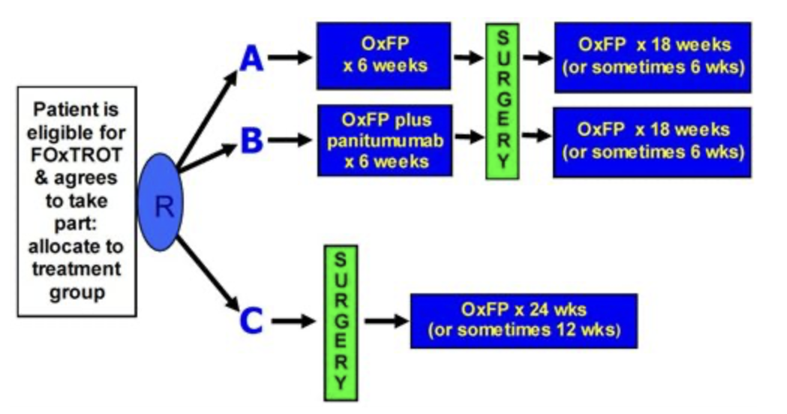
1. FOxTROT Trial (Fluorouracil Oxaliplatin and Targeted-Receptor Pre-Operative therapy)
Trial Design
Multicentre RCT
Inclusion criteria
T3 & T4, N0-2, M0
Stoma first if obstructed
Rationale:
Curative colon surgery + adjuvant chemotherapy yet still have mortality
Questions: Failure to clear loco-regional spread or
Failure to eradicate distant micro-metastases
Drugs:
5-FU/oxaliplatin or OxCap based chemotherapy
If KRAS/NRAS WT, anti-EGFR mAB, panitumumab given

Slide 13
Objectives
Primary objectives:
Decrease in 2yr recurrence
Secondary objectives:
Resection quality on outcome,
Tolerability of neoadjuvant therapies
Surgical complications

Slide 14
RESULTS
1053 patients randomized (25% T4, 75% N+)
699 to neoadjuvant chemotherapy (NAC) and 354 to the control group
Neoadjuvant gp:
28% lower recurrence rate at 2yrs with NAC
Marked T and N downstaging and histologic tumour regression
Resection was more often histopathologically complete: 94% vs 89%
Fewer residual or recurrent disease within 2 years (16.9% vs 21.5%)
Panitumumab did not enhance the benefit from NAC.
NAC had little benefit in patient with dMMR tumours

Slide 15
CONCLUSION
For operable locally advanced colon cancer, 6wks neoadjuvant chemotherapy (5FU+Ox):
Is safe
No increase in perioperative morbidity
Produces marked histopathologic down-staging,
Fewer incomplete resections,
Better 2-year disease control/disease free survival DFS.
Good response to NAC can guide postoperative (adjuvant therapy)

Slide 16
2. NICHE STUDY (Neoadjuvant Immune Checkpoint Inhibition & Novel IO combination in Early-stage Colon Cancer)
32 patients
Evaluated neoadjuvant immunotherapy in patients with dMMR/ MSI-H colon cancer.
Inclusion criteria:
Previously untreated dMMR colon ca
Stage I or II colon adenocarcinoma
Resectable tumour
No distant mets
Primary end point
Safety
3yr disease-free survival

Slide 17
RESULTS
Exclusion criteria
Bowel obstruction
Active autoimmune disease requiring immunosuppression therapy
High rates of pathologic response in early-stage colon cancers prior to resection

Slide 18
3. NICHE-2 STUDY (Neoadjuvant Immune Checkpoint Inhibition Locally Advanced Mismatch Repair Deficient Colon Cancer)
Evaluated neoadjuvant immunotherapy in patients with non-metastatic dMMR/ MSI-H colon cancer.
Drugs: Ipilimumab 1 cycle (Day 1) + Nivolumab 2 cycles (Day 1&15)
Surgery: within 6 weeks

Slide 19
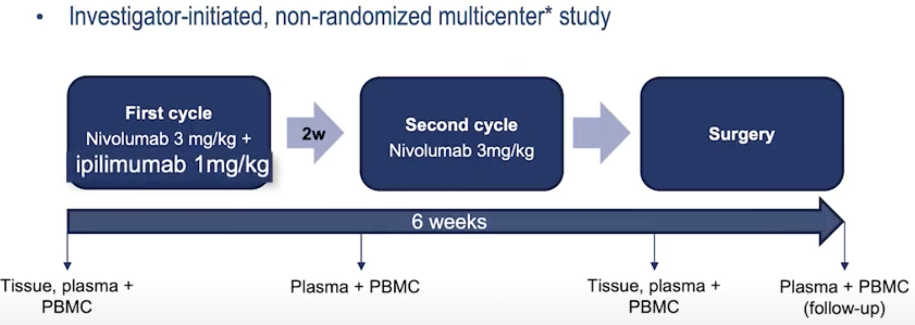
Inclusion criteria:
Previously untreated dMMR colon ca
Stage II or III colon adenocarcinoma
Resectable tumour
No distant mets

Slide 20
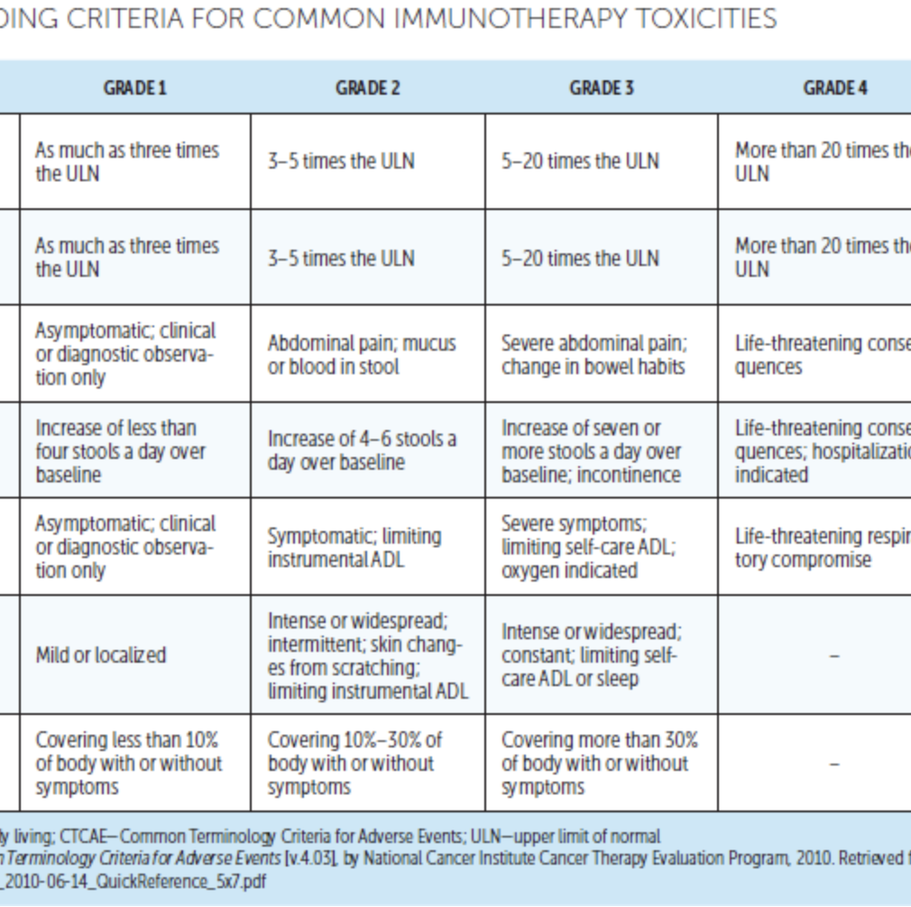
Objectives
Primary end point
Safety (<2wk delay to surgery)
3yr disease-free survival
Secondary end point
Pathologic response
Results of genomic analysis

Slide 21
Results
115 patients enrolled
113 (98%) underwent timely surgery, 2 pts surgery delayed >2wks
106 (99%) had pathologic disease response,
95% major pathologic responses (<10% residual viable tumour) and
68% complete pathological response (0% residual viable tumour)
No disease recurrence at 26 months (2yrs 2mo)
4% (5 patients) grade 3-4 immune related adverse events

Slide 22
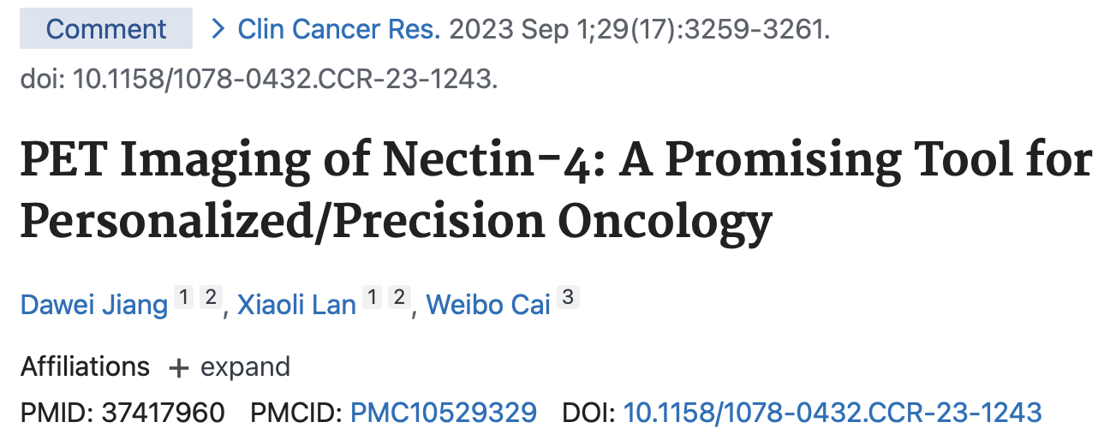
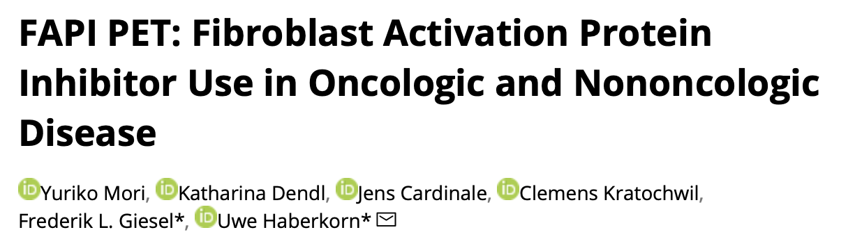
What’s new
Circulating tumour DNA
Single cell Sequencing
Radio-tracers
Fibroblast activation protein (FAP) inhibitor (FAPI) used for PET imaging is a strategy that targets the cell population in the tumour surrounding stroma, termed cancer-associated fibroblasts

Slide 23
Summary
Paradigm shift
Locally advanced colon cancer (especially left sided) your approach should be Neoadjuvant chemotherapy (NAC) prior to surgery
If present with bowel obstruction: do a transverse colon diverting colostomy then NAC prior to surgery

Slide 24
Thank you

