Slide 1
MEDICAL MANAGEMENT OF
INFLAMMATORY BOWEL DISEASE
Dr Nnete Nimrod Mokhele
Gastroenterologist

Slide 2
PRESENTATION OUTLINE
INTRODUCTION
BASICS OF IBD
TREATMENT APPROACH
DISCUSSION

Slide 3
Introduction
What is inflammatory bowel disease (IBD)?
Inflammatory bowel disease (IBD) is a term used to describe disorders that involve chronic inflammation of your digestive tract.
Prolonged inflammation results in damage to the GI tract.
The two main types of IBD are Crohn’s disease and ulcerative colitis.

Slide 4
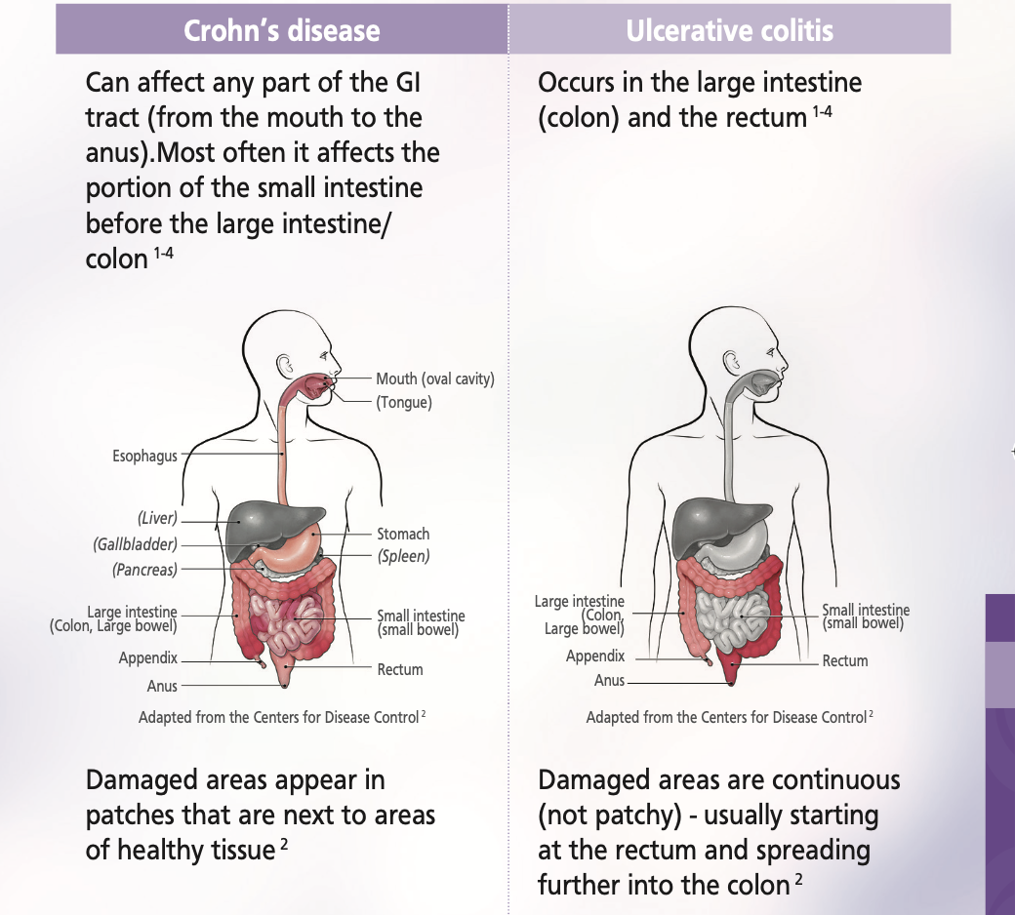

Slide 5
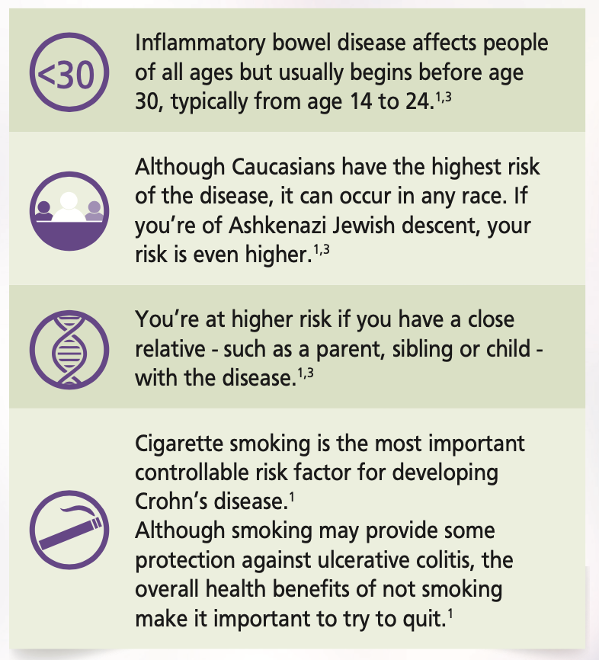
Potential risk factors
Diet
﻿﻿NSAIDS
﻿﻿Smoking
﻿﻿Infections
﻿﻿Oral Contraceptives
﻿﻿Psycho social factors

Slide 6
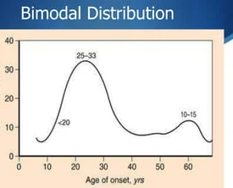
CLINICAL PRESENTATION
﻿﻿Ulcerative Colitis
- Bloody diarrhoea
- Rectum involved
- Inflammation continuous
﻿﻿Crohn's Disease
- Diarrhoea, RLQ pain, fever, weight loss
- Transmural inflammation-large ulcers, rectum spared, skip lesions
- Fistulae
- Strictures
Extraintestinal Manifestation
- Skin, Eyes, Rheumatic, Haematological, Malabsorption, Side effects

Slide 7

Medical Work -up
Clinical
Biochemical
Radiological
Endoscopic
Histopathological

Slide 8
Clinical workup – Target: Clinical remission
No symptoms (Cramps, pain, diarrhea, EIM)
Good quality of life
Happy patient
Minimize complication

Slide 9
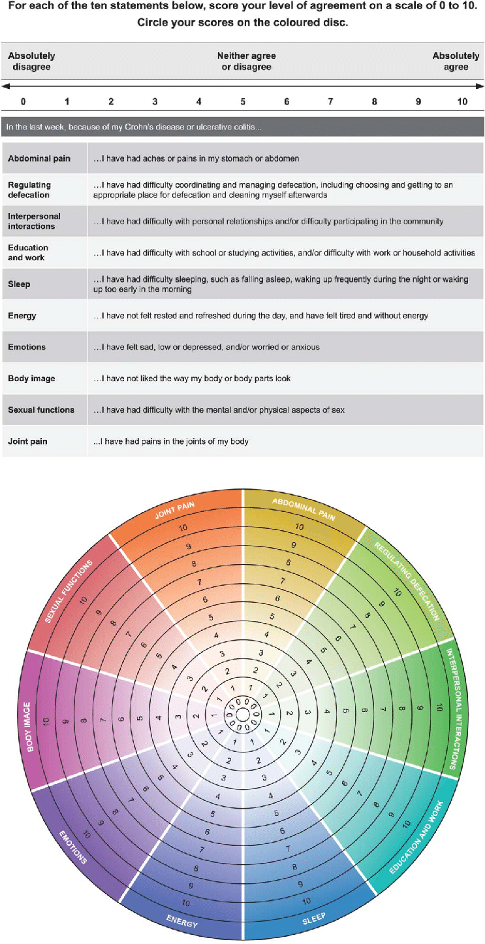
IBD DISC

Slide 10
BIOCHEMICAL WRKUP: REMISSION
Labs (FBC, U+E, LFTs, CRP, PCT, Vit B12, Vit D, Iron Studies)
Stool: Fecal Calprotectin, MCS, C diff
Extra biochemical test: Hep B, Hep C, TPMT genotype, HIV, Mantoux skin Test, QuantiFERON Gold

Slide 11
RADIOLOGICAL WORKUP: REMISSION
Chest X-ray
Abdominal X-ray
CT scan abdomen
MRE/MRI Pelvis

Slide 12
ENDOSCOPIC WORKUP: REMISSION
Gastroscopy – duodenal biopsies
Colonoscopy – terminal intubation
Surveillance colonoscopy: UC, PSC, CD Colitis

Slide 13






What are the current goals of therapy in CD and UC
Step 1: Disease control¹
Step 2: Disease modification¹
Biomarker normalisation
Endoscopic healing
Normal growth
Clinical response
Clinical remission
Returning to a normal life: disability, QoL
Preventing disease complications
Reducing long-term complications
Disease onset
Endoscopy
(STRIDE-II)²
Biomarkers
(STRIDE-II)²
QoL
(STRIDE-II)²
Oral corticosteroid use
(ECCO guidelines)³
Selection of available monitoring tools
ECCO, European Crohn’s and Colitis Organisation; QoL, quality of life; STRIDE, Selecting Therapeutic Targets in Inflammatory Bowel Disease.
Adapted from Le Berre C, et al. Gastroenterology. 2022;162:1424–38.
1. Le Berre C, et al. Gastroenterology. 2022;162:1424–38;.

Slide 14
MANAGEMENT APPROACH
Disease specific
- Crohns Colitis: Only role for 5 Asa, otherwise no benefit.
Corticosteroids
- Quick response: controls inflammation acutely (only)
5 Asa
- Only role in Ulcerative colitis (Entry therapy)

Slide 15
MANAGEMENT APPROACH
Immuno-modulatory therapy
- Entry level therapy for Crohns disease
- Lack response to 5 asa (Ulcerative colitis)
Biological therapy
- Second line therapy for Crohns disease
- Third line therapy for Ulcerative Colitis
- Complicated disease (ASUC, Stricturing and Fistulizing CD)

Slide 16

Ulcerative colitis treatment paradigms
Surgery
IFX/CsA
IFX/immunomodulators
L1: 27
L1: 20%
Biologics/small molecules
Immunomodulators
Biologics/small molecules
Severe
Moderate
Mild
Flares
B1: 61%
B1: 71%
Corticosteroid
Aminosalicylates/immunomodulators
.
Aminosalicylates
Aminosalicylates
100%
L4: 29%
CsA, cyclosporine; IFX, infliximab
Adapted from: Armuzzi A, et al. Dig Liver Dis 2016; 48:360-70.

Slide 17
Available treatment options for IBD
2012
Adalimumab
UC
2014
Vedolizumab
CD/UC
2018
Tofacitinib UC
1999
Infliximab
CD
2005
Infliximab
UC
2002
Adalimumab
CD
2013
Golimumab
UC
2016
Ustekinumab
CD
2019
Ustekinumab UC
Entyvio SmPC, version 30 November 2020. Available from: www.ema.europa.eu/en/documents/product-information/entyvio-epar-product-information_en.pdf.
Humira SmPC, version 6 May 2021. Available from: www.ema.europa.eu/en/documents/product-information/humira-epar-product-information_en.pdf.
Remicade SmPC, version 12 November 2020. Available from: www.ema.europa.eu/en/documents/product-information/remicade-epar-product-information_en.pdf.
Simponi SmPC, version 11 November 2020. Available from: www.ema.europa.eu/en/documents/product-information/simponi-epar-product-information_en.pdf.
Stelara SmPC, version 4 May 2021. Available from: www.ema.europa.eu/en/documents/product-information/stelara-epar-product-information_en.pdf
Xeljanz SmPC, version 28 January 2021. Available from: www.ema.europa.eu/en/documents/product-information/xeljanz-epar-product-information_en.pdf.
All SmPC accessed October 2021.
EMA, European Medicines Agency;
FDA, United States Food and Drug Administration;
IBD, inflammatory bowel disease; UC, ulcerative colitis.

Slide 18




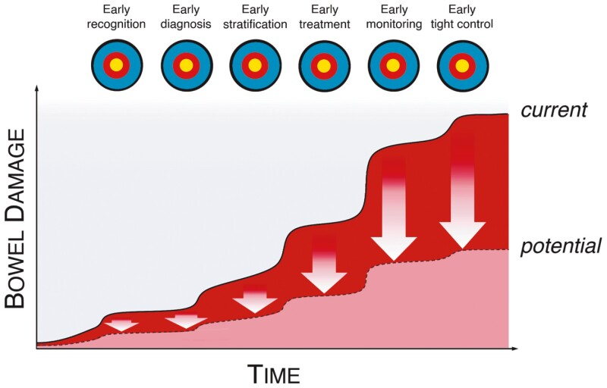


Early diagnosis and early treatment improve outcomes
Early use of biologics is associated with better clinical outcomes compared to late/conventional management
Improved clinical outcomes
Lower rates of relapse
Higher rates of clinical remission
Higher rates of mucosal healing
RWE
Ungaro, Aliment Pharmacol Ther 2020; Noor, Inflamm Bowel Dis 2021

Slide 19







EMA-approved therapies approved for IBD
ENFERMEDAD DE CROHN
COLITIS ULCEROSA
Infliximab biosimilar
SC (Remsima®)
Ustekinumab
(Stelara®)
Infliximab
(Remicade®)
Risankizumab
(Skyrizi®)
Vedolizumab
SC (Entyvio®)
Adalimumab
(Humira®)
Vedolizumab
IV (Entyvio®)
Upadacitinb
(Rinvoq®▼)
1999
2006
2007
2012
2013
2014
2016
2017
2019
2021
2022
2023
2024
Adalimumab
(Humira®)
Vedolizumab
IV (Entyvio®)
Tofacitinib
(Xeljanz®▼)
Ozanimod
(Zeposia®▼)
Etrasimod
Infliximab
(Remicade®)
Golimumab
(Simponi®)
Ustekinumab
(Stelara®)
Filgotinib
(Jyseleca®▼)
Mirikizumab
(Omvoh®)
Vedolizumab
SC (Entyvio®)
Upadacitinb
(Rinvoq®▼)
Infliximab biosimilar
SC (Remsima®)
anti-TNFs
anti-IL-12/23
Inh S1P
anti-integrinas
Inh JAK
anti-IL-23
Brazikumab
Etrolizumab
En la última etapa del desarrollo:
Guselkumab
(Tremfya®)
DISCONTINUADO
S.C. administration
Oral administration
i.v. administration
*Figure reflects EMA approval dates and only includes biologics and targeted synthetic small molecules. Other IBD treatment options include aminosalicylates, corticosteroids and immunomodulators.
CD, Crohn’s disease; EMA, European Medicines Agency; IV, intravenous; SC, subcutaneous; UC, ulcerative colitis.

Slide 20
SAFETY
Safest
VEDO
anti-IL
S1PR
Patient-specific considerations
influencing safety profile
Age
Disease classification
Disease presentation
Disease phenotype and inflammatory burden
Comorbidities
Concurrent medications
(drug-interactions)
Conception plans
JAKi
Anti-TNF
Thiopurine
Thiopurine/anti-TNF combo
STEROIDS
Inadequate treatment of CD and UC is an adverse event and should be balanced with risks of therapies on an individual basis
Figure 1 from Bhat S et al. 2023
CD, Crohn’s disease; IL, interleukin; JAKi, Janus kinase inhibitor; RCT, randomised control trial; RWE, real-world evidence; S1PR, sphingosine-1-phosphate receptor;
TNF, tumour necrosis factor; UC, ulcerative colitis; VEDO, vedolizumab.Bhat S et al. Inflamm Bowel Dis 2023; doi: 10.1093/ibd/izad120

Slide 21
LETS HAVE A DISCUSSION
THANK YOU

Slide 22
MONITORING OF THERAPY
5 asa
- Renal function, liver, intolerance
Immunomodulator therapy
- Hematological effects (HB, Macrocytosis, Cytopenia: Aza)
- Liver (Aza, MTX)
Biological therapy
- Drug specific

