Slide 1


How I do an IPAA ileal pouch–anal anastomosis (IPAA)
Peter Taylor
Colo Escape
2024

Slide 2

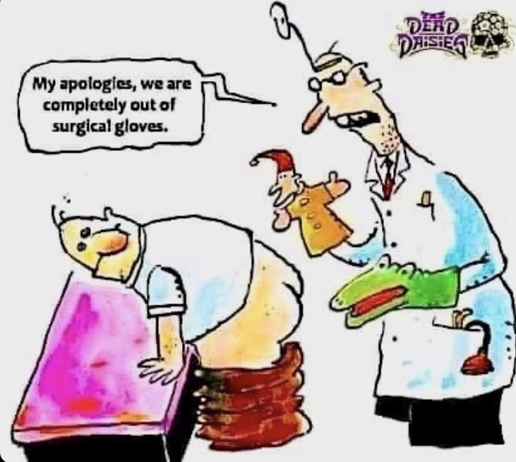
Spelling
Pronunciation
I am not an expert

Slide 3
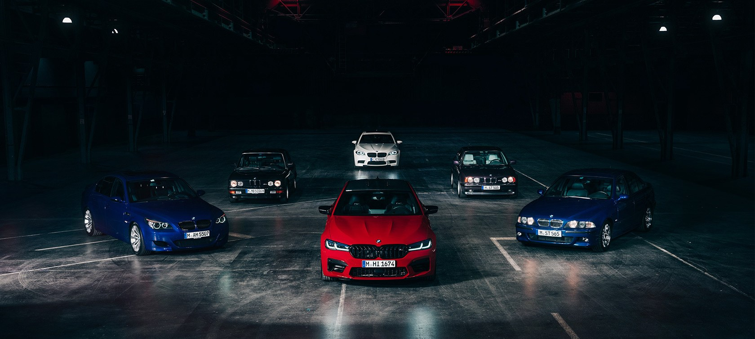
The journey of the BMW M5
(Landmark Colorectal Trials)

Slide 4

Not everyone appreciate/Not appropriate

Slide 5

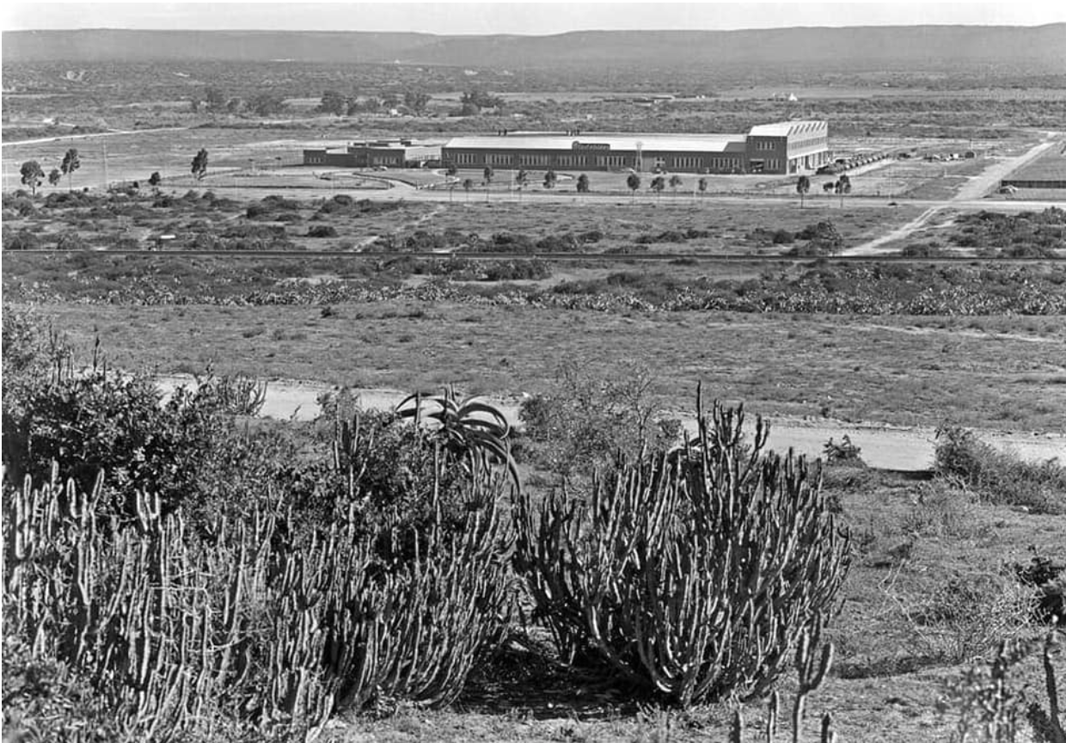
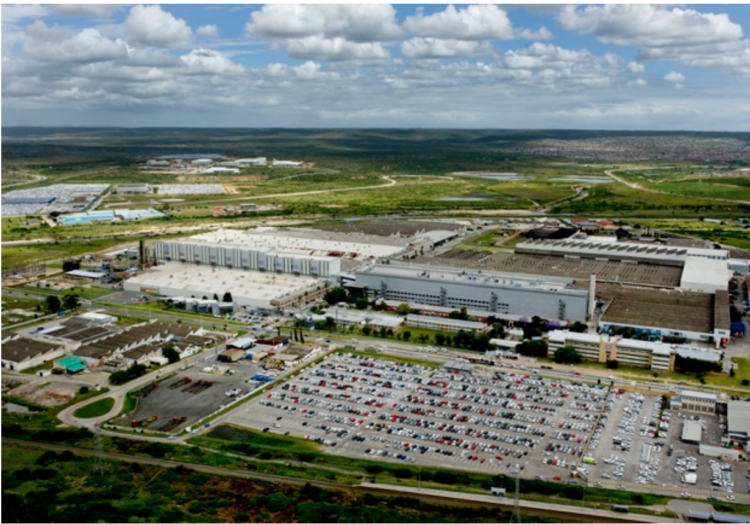
1947 foundation was laid for VW plant.
750 000 VW was made in 2023
710 Cars per day
Largest Private employer in the
Nelson Mandela Bay Metro

Slide 6
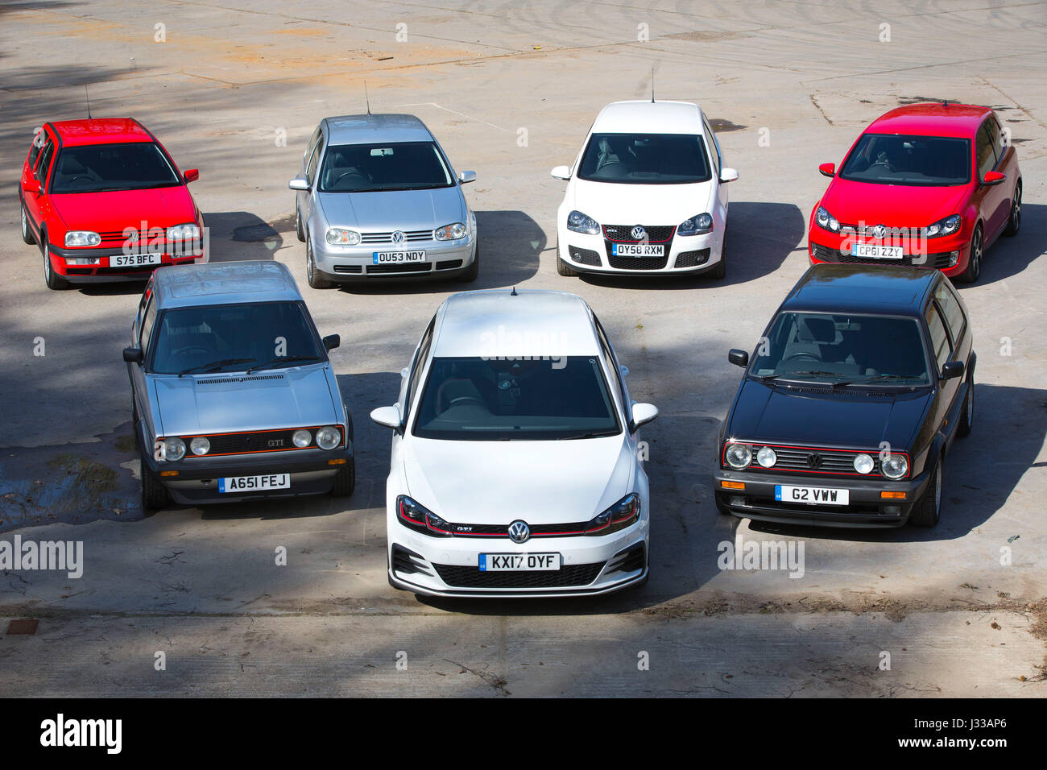
It is appropriate to talk about the iconic
Volkswagen Golf GTI
(entertain me for a few slides)

Slide 7
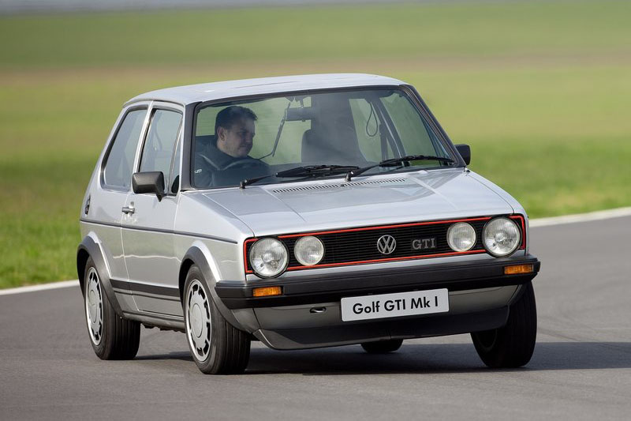
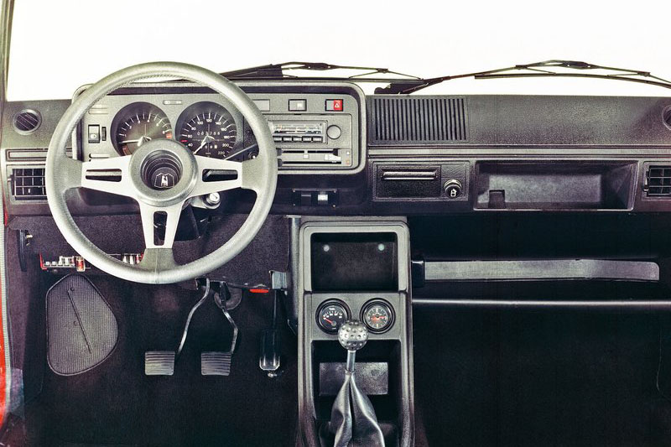
Where it started
1975 Golf GTI Mk1 83kw, 140 n.m
Open IPAA
Dr Bebington taught me
You're not interested

Slide 8
Indications For surgery in UC:
You don’t really want to hear this
Indication for surgery in Ulcerative colitis
Acute: Acute severe colilis (sepsis/Perforation/Bleeding)/Toxic colon
Chronic: Medical refractory UC, SE of medication, Growth retardation in children, Dysplasia, Cancer
Think twice about Crohn’s disease, decrease continence/Pelvic floor , Obese, Radiotherapy and Age.

Slide 9
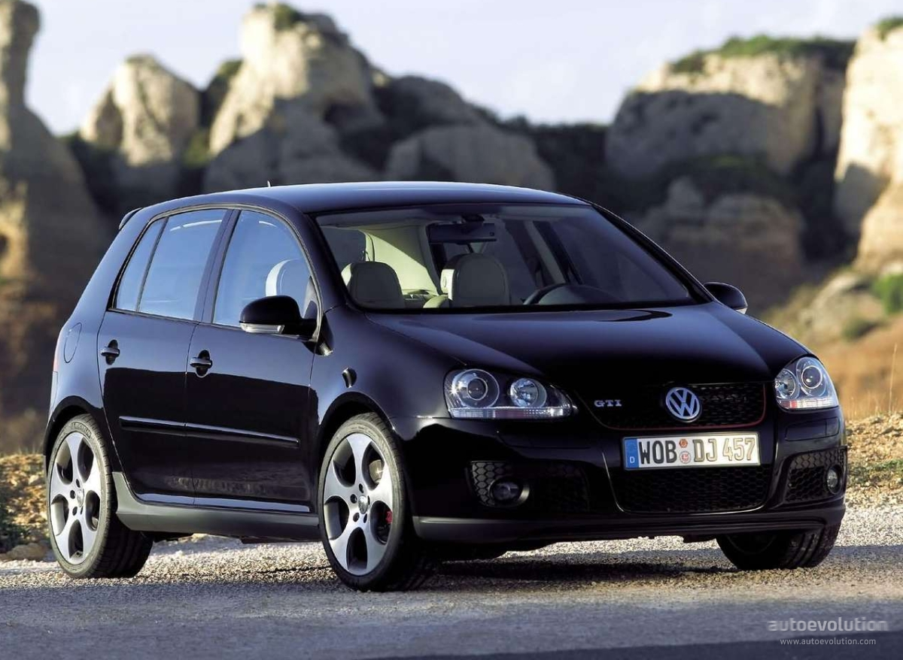
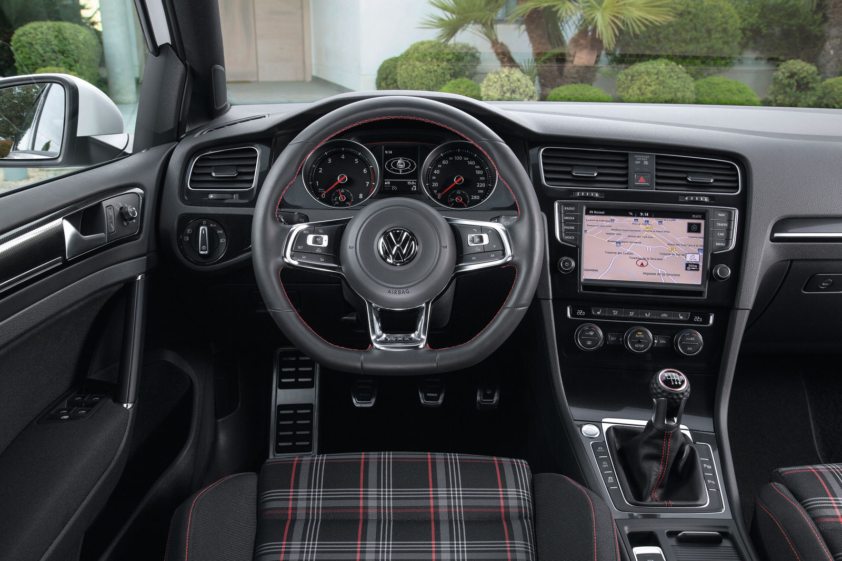
What changed it all
Golf 5 GTI / Laparoscopic IPAA/ Me
147kw, 280n.m.

Slide 10
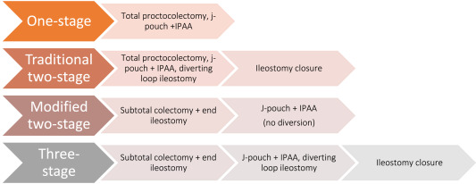
Do you really want to talk about Surgical Options when considering a IPAA

Slide 11
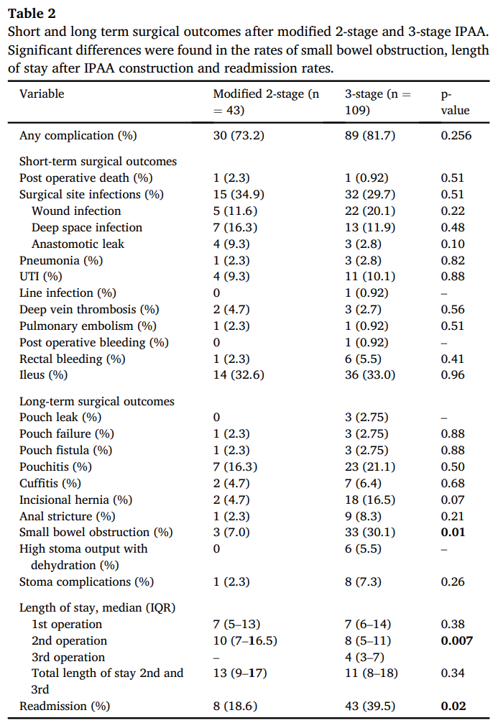
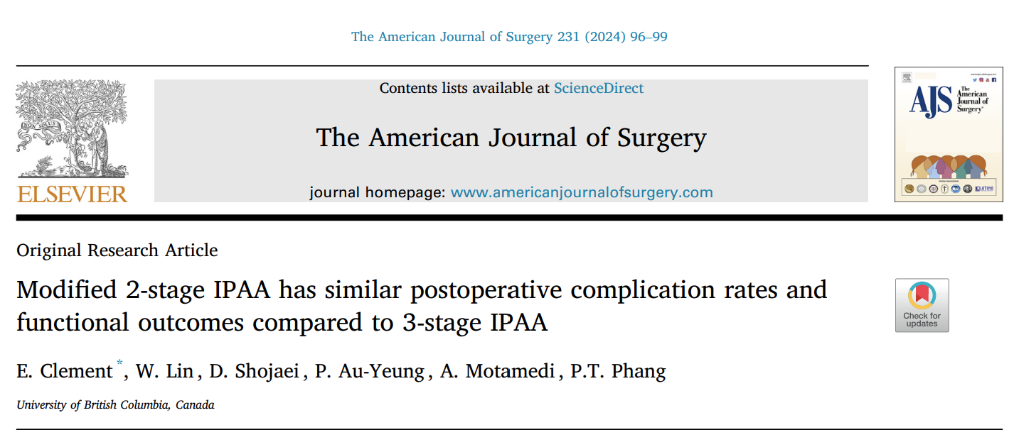
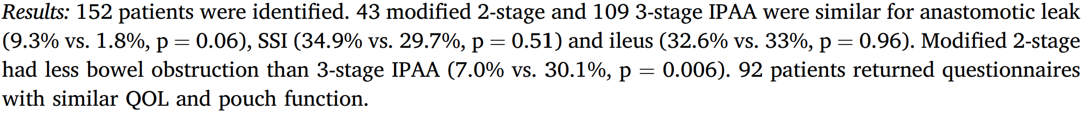

Slide 12

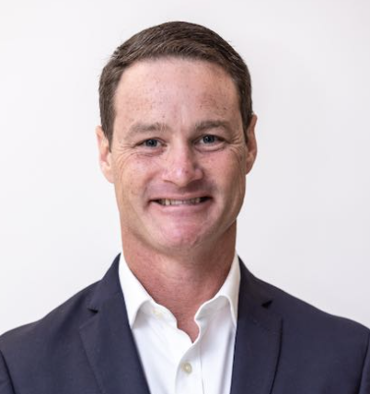
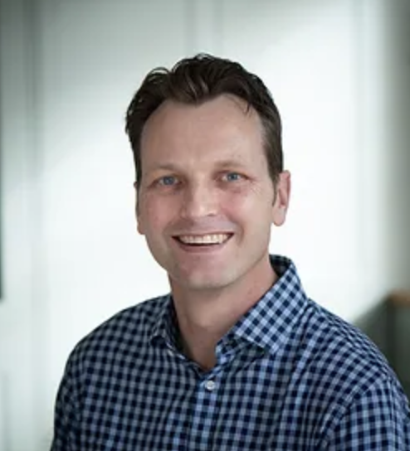

You really want to talk about :
Fully electric 2026 Golf 9 GTI/ Robotic IPAA

Slide 13


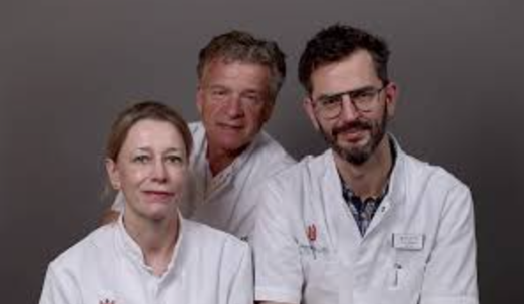
Settle for 2024 Golf 8GTI / IPAA at UMC
180kw 370n.m

Slide 14
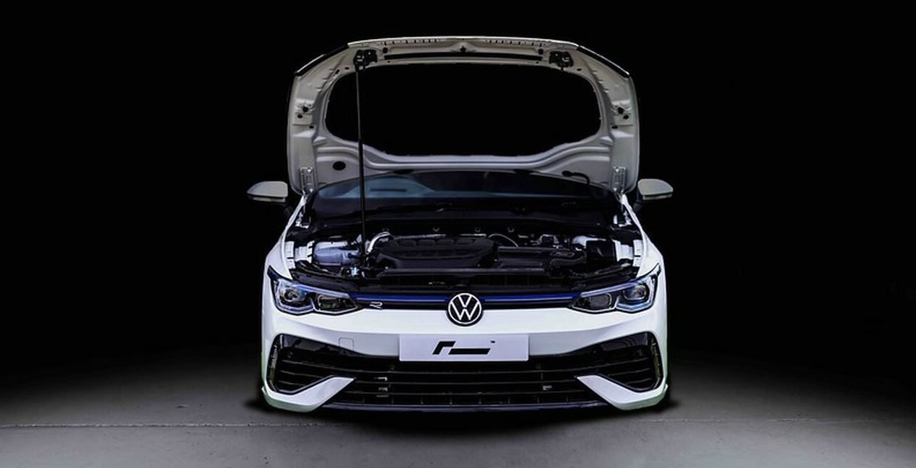
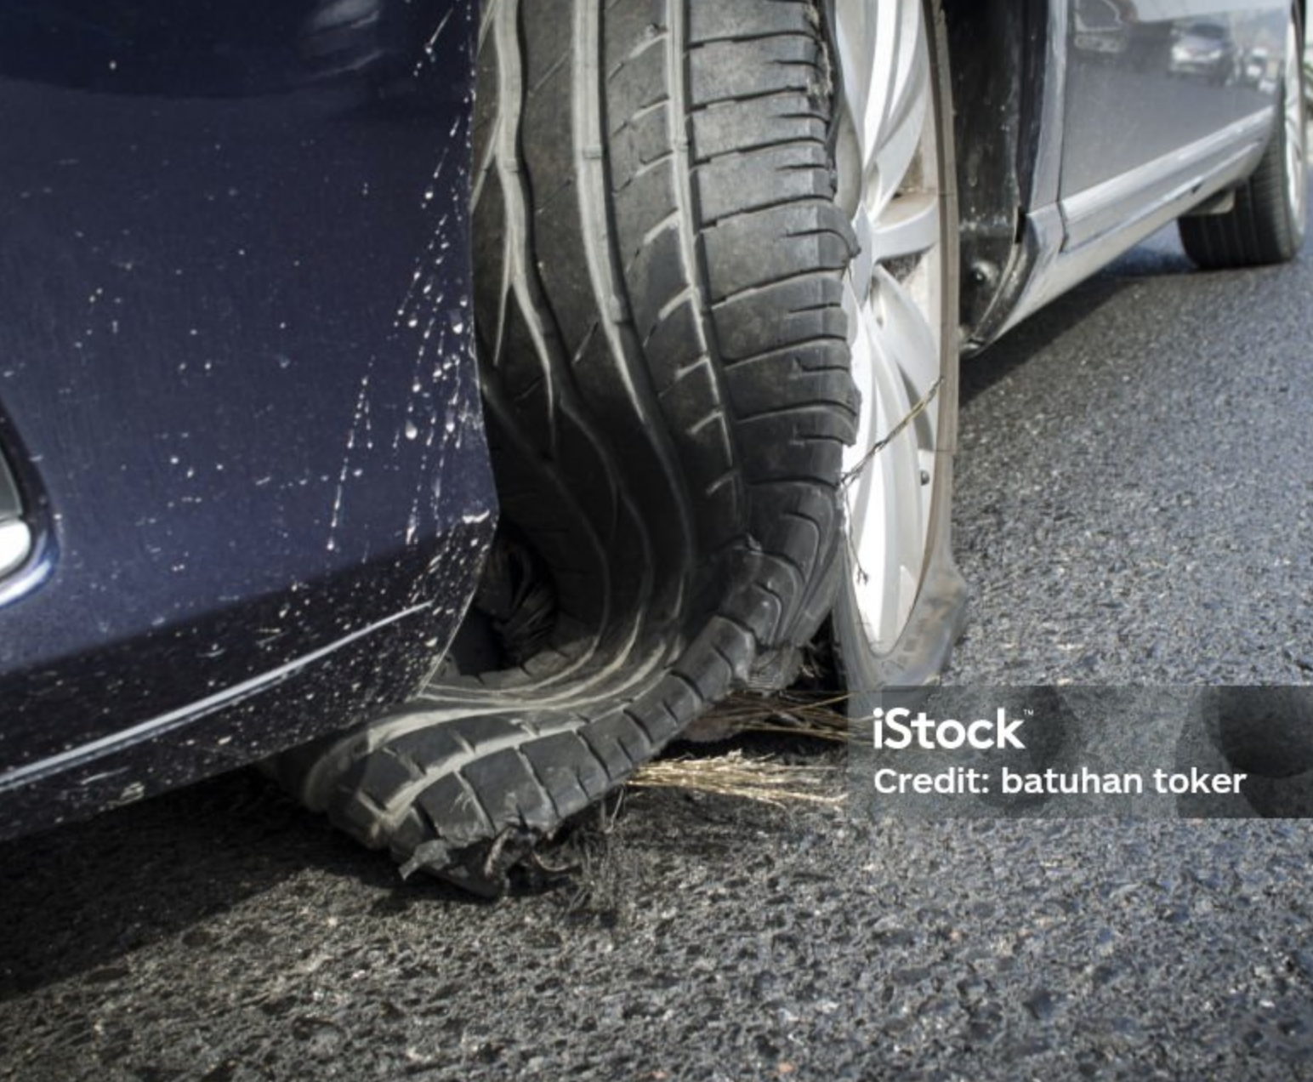
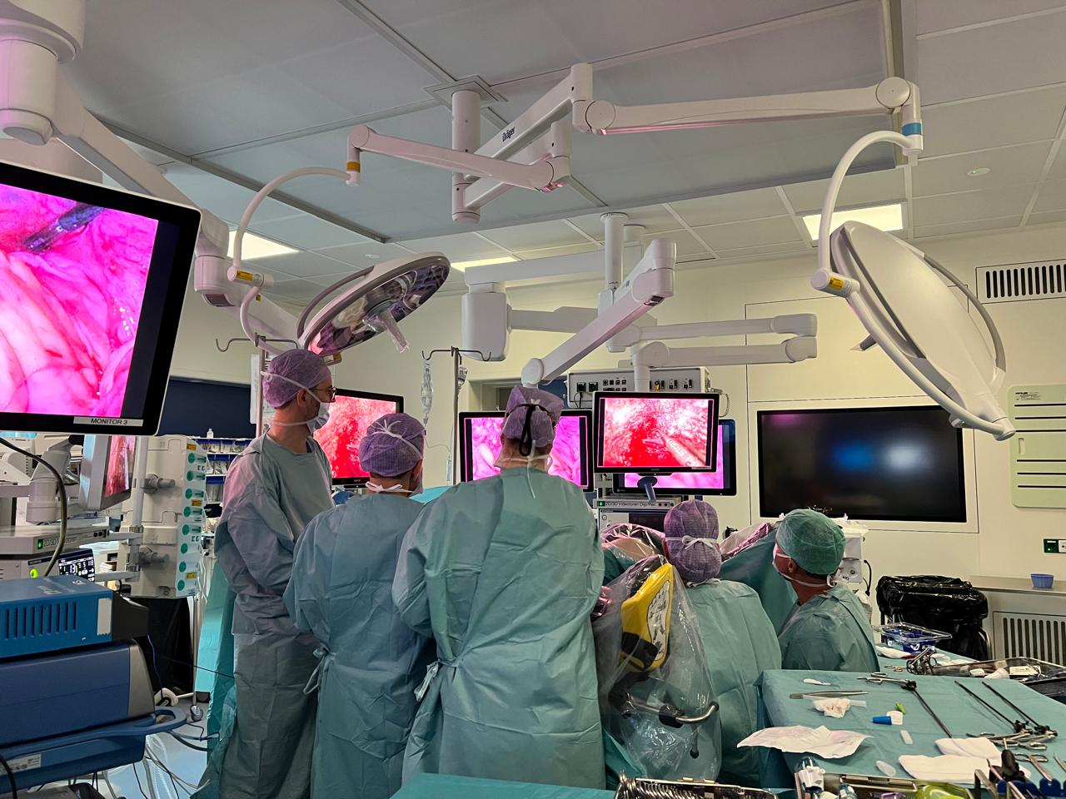
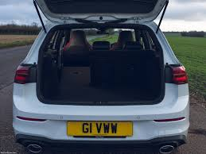
Transabdominal
Trans-anal

Slide 15

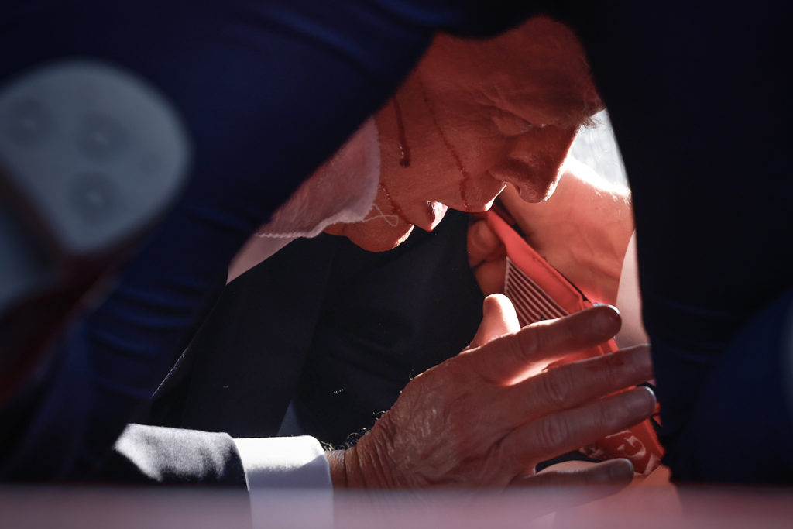
Disclaimer
Make Trans anal surgery great again
IBD is safe to start
You might miss the target when you start with some bleeding
Please ask Robo Tim : Where is Tamis Tim?

Slide 16
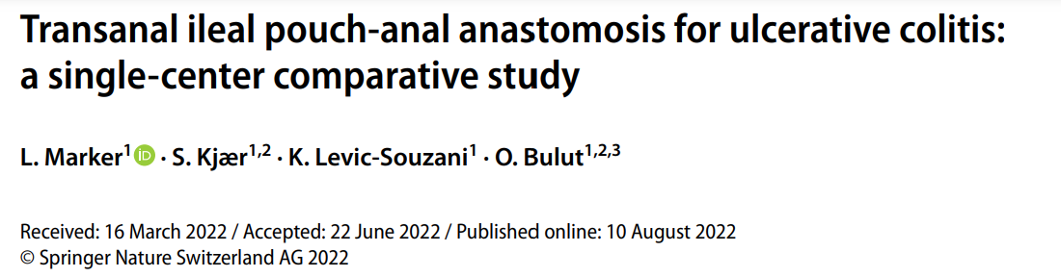
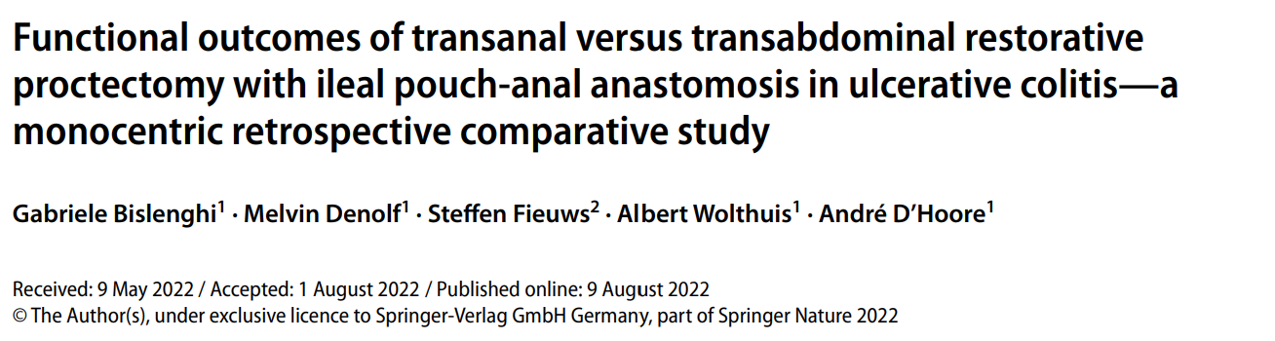
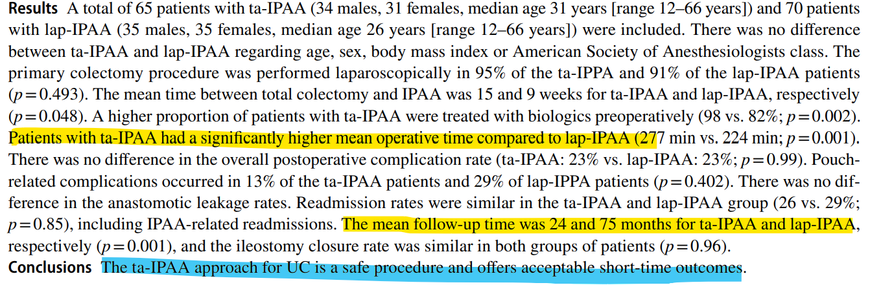
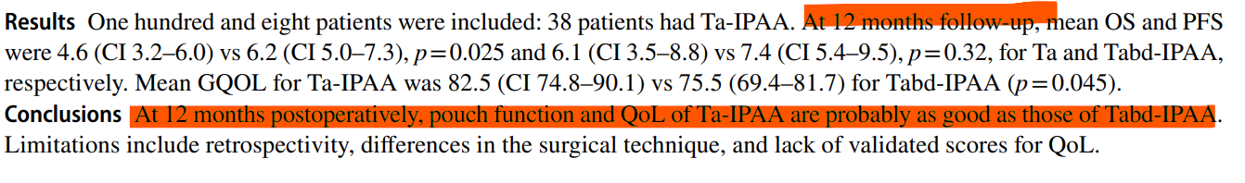

Slide 17
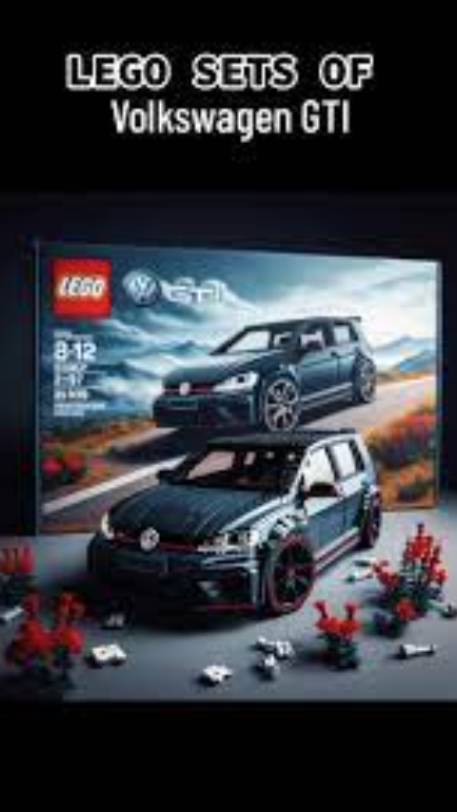
STEPS
Trans abdominal
Trans Anal
Pouch Creation

Slide 18
Steps: Abdominal
Depending on where you start (close ileostomy/single port/Alexis)
Adhesiolysis
Full Mobilization of small bowel mesentery to third part of duodenum (ALL)
Proximal ligation of Ileocolic Vessels (ALL)
Small anterior / Posterior transverse peritoneal incision (All)
If still needed: Peritoneal tissue right of SMA is excised

Slide 19
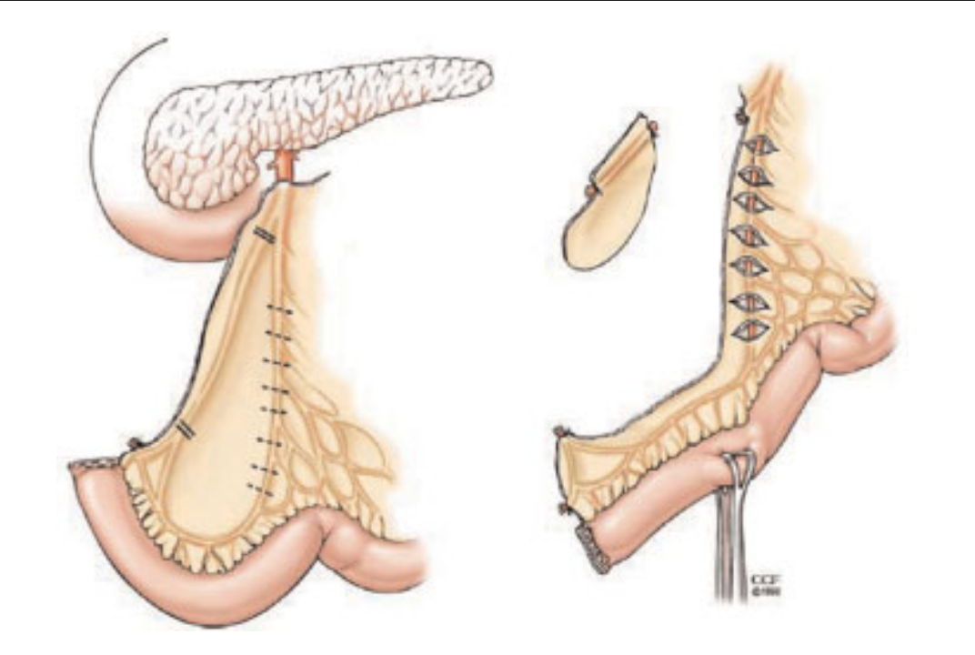

Slide 20
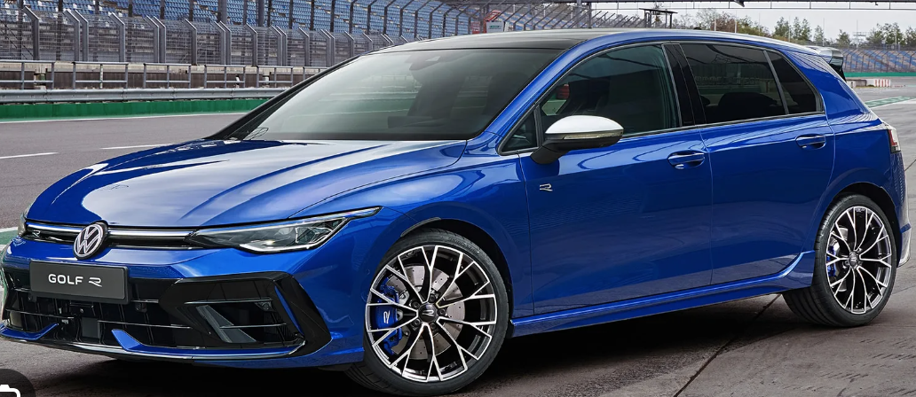
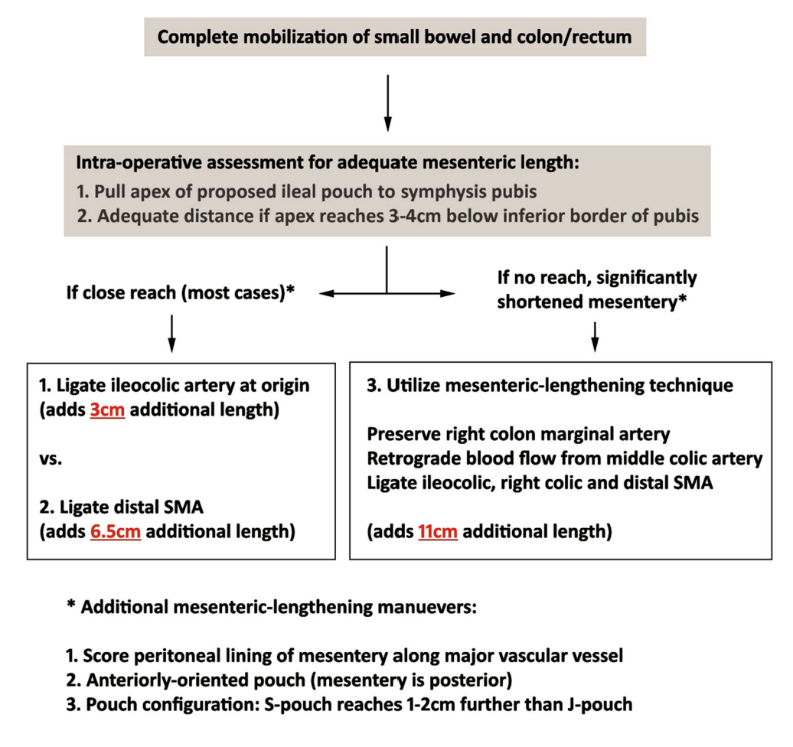
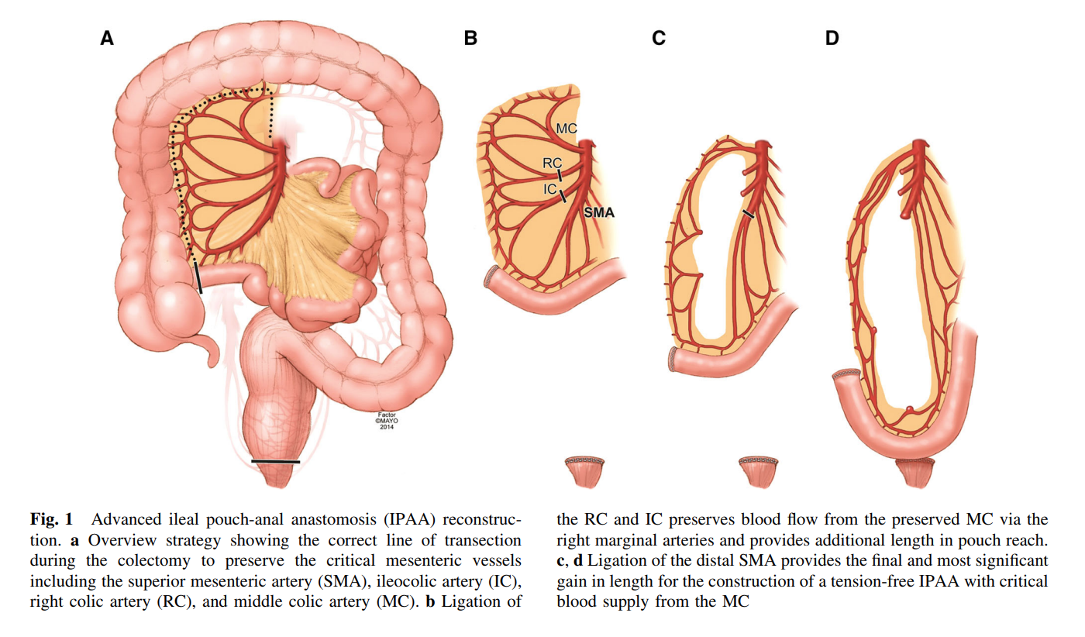
For the Experienced Driver
Need more length / GOLF R -line
Must be one stage

Slide 21
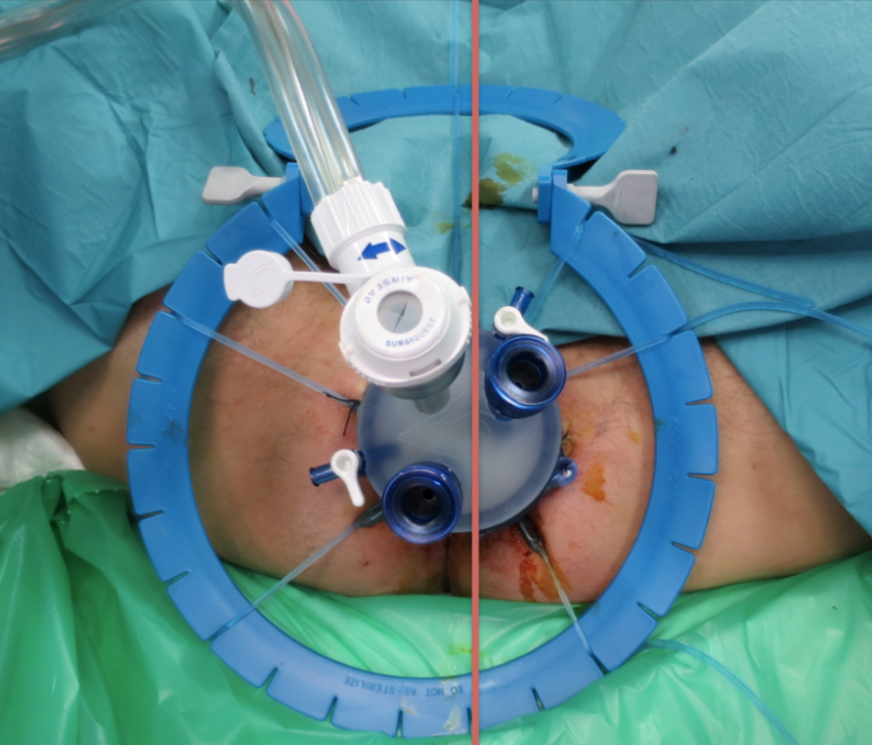
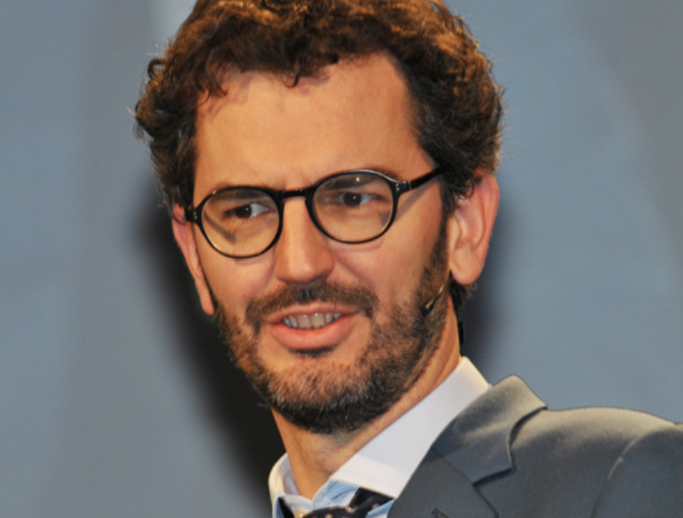
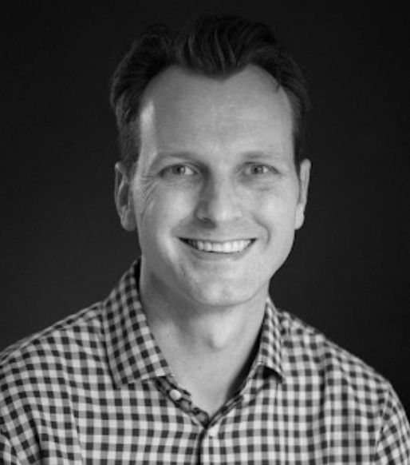
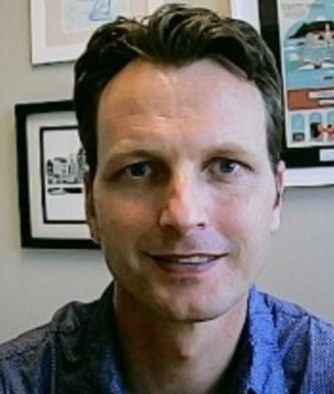
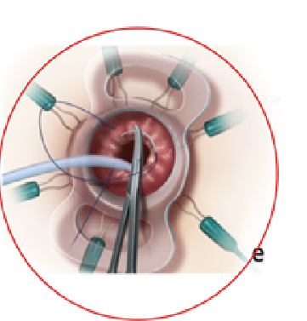
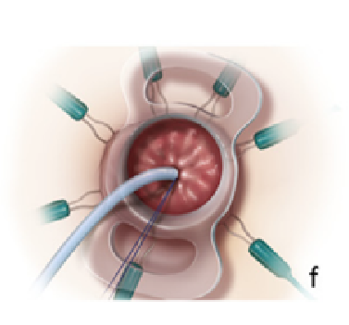
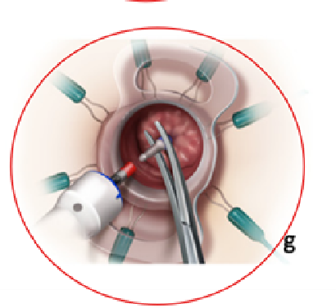
Steps:
Trans Anal (few notes)
Equipment (proctoscope)
Purse string / 2cm above dendate
Close to rectal dissection if no CA
Full thinness bites for cuff(E)
Thick tissue circular stapler (AMC)
Interrupted suturing of line (full thickness)

Slide 22
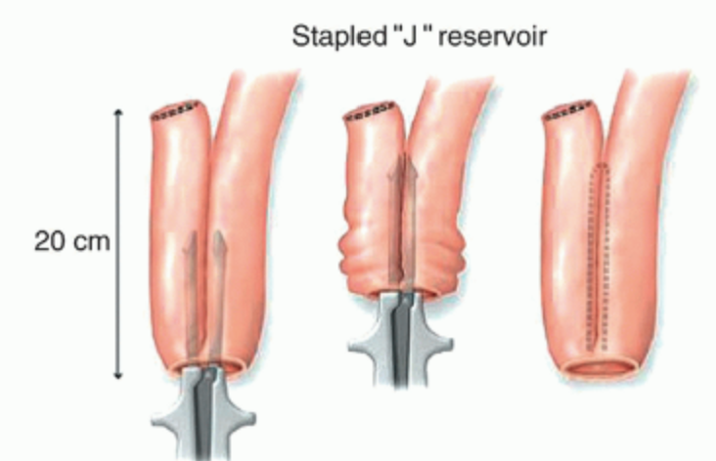
Steps: Pouch Creation
Establish length
Side to Side stapler: J pouch with 1 stapler (AMC)
Oversew everted staple line(AMC)
Purse string for Anvill in enterotomy with long suture to grasp from below
Pitfalls that I will talk about later

Slide 23
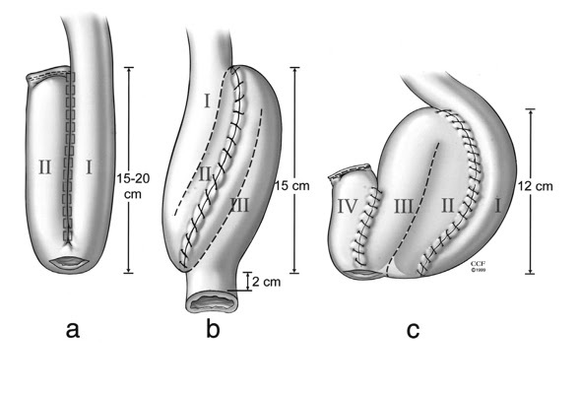
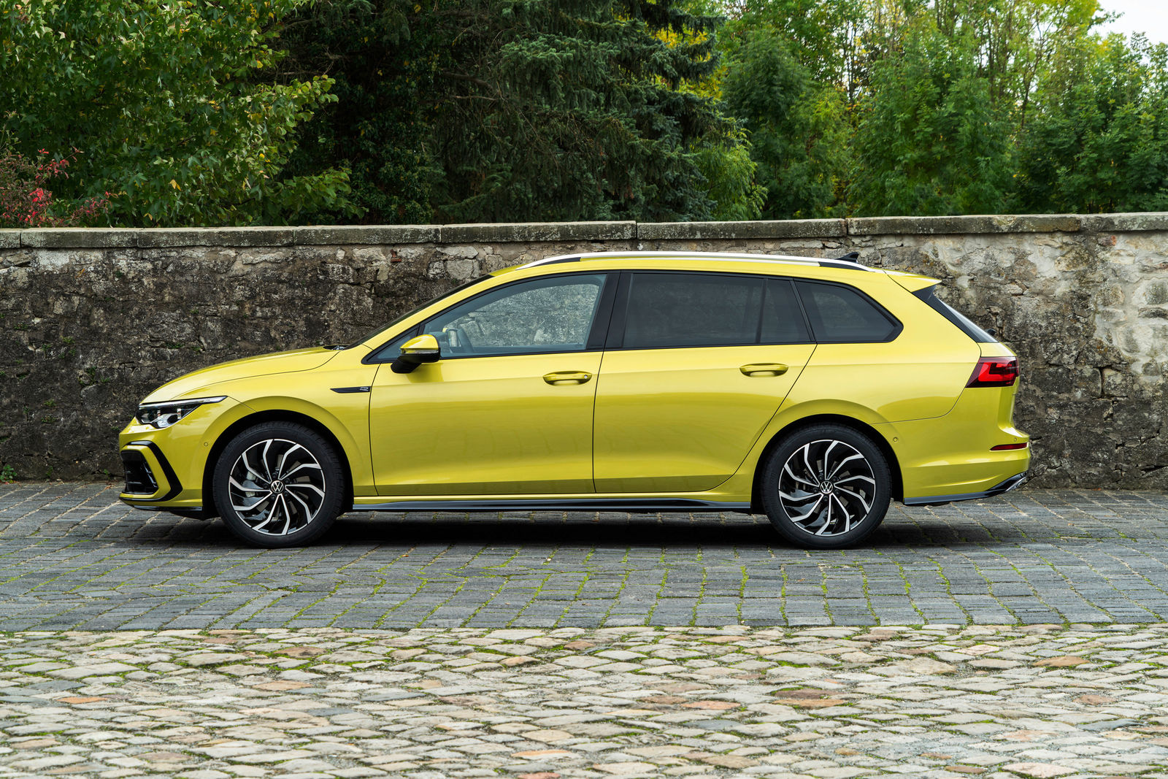
Pouch Creation: Does Size Matter?

Slide 24
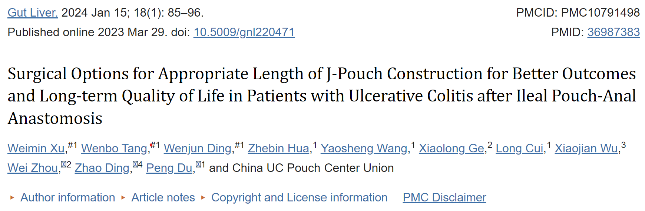
The median lengths of the patients’ short and long pouches were 14.0 cm and 22.0 cm respectively.
Patients with a short J pouch configuration were less likely to achieve significantly improved long-term QOL (p=0.015) and were prone to develop late postoperative complications (p=0.042), such as increased defecation frequency (p=0.003) and pouchitis (p=0.035).
A short ileal pouch was an independent risk factor for the development of late postoperative complications (odds ratio, 3.100; 95% confidence interval, 1.519 to 6.329; p=0.002) and impaired long-term QOL improvement (odds ratio, 2.221; 95% confidence interval, 1.218 to 4.050, p=0.009)

Slide 25

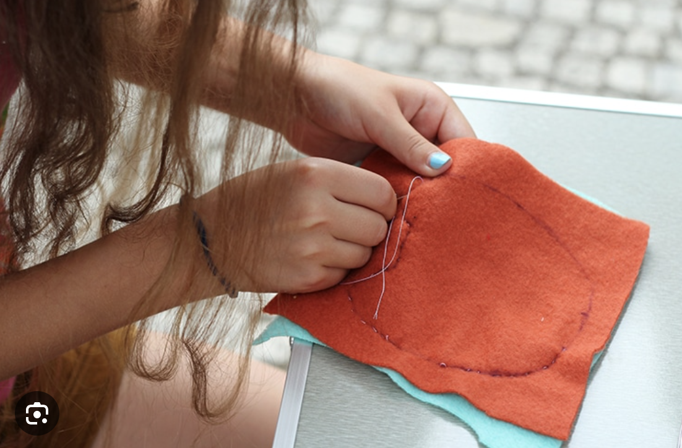
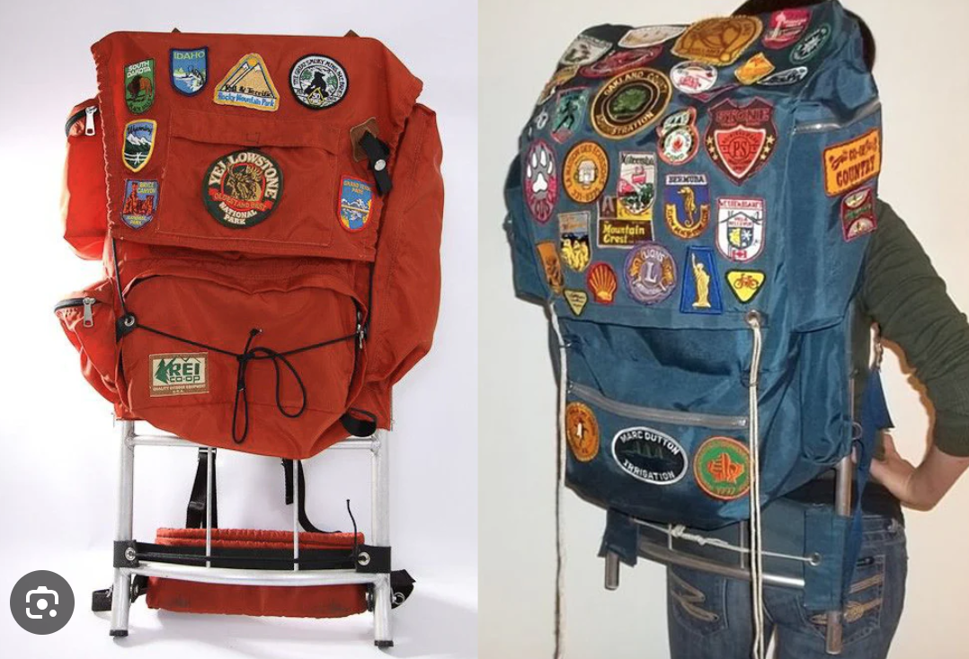
Oversewing

Slide 26
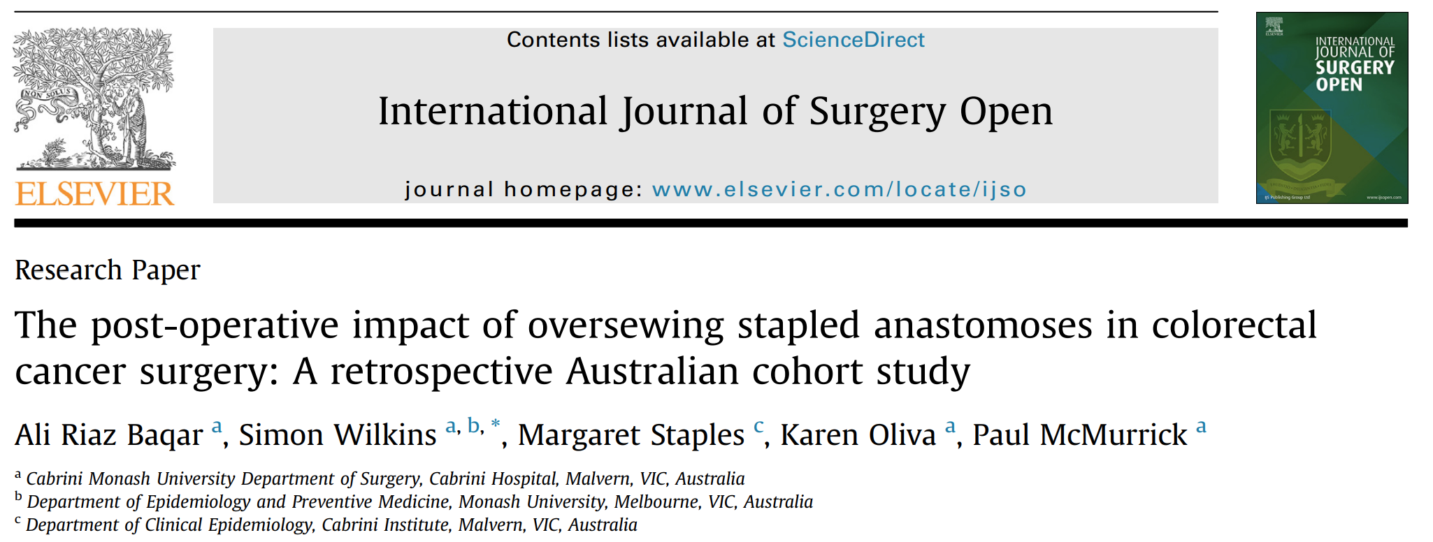

Slide 27
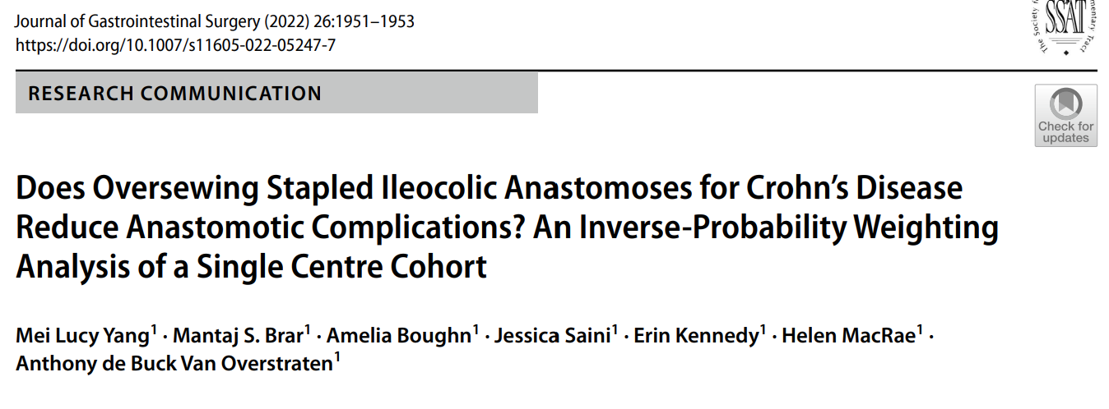

Conclusion was that oversewing stapled ileocolic anastomosis significantly reduces the odds of anastomotic leak and decrease the odds of reoperation due to septic complication

Slide 28
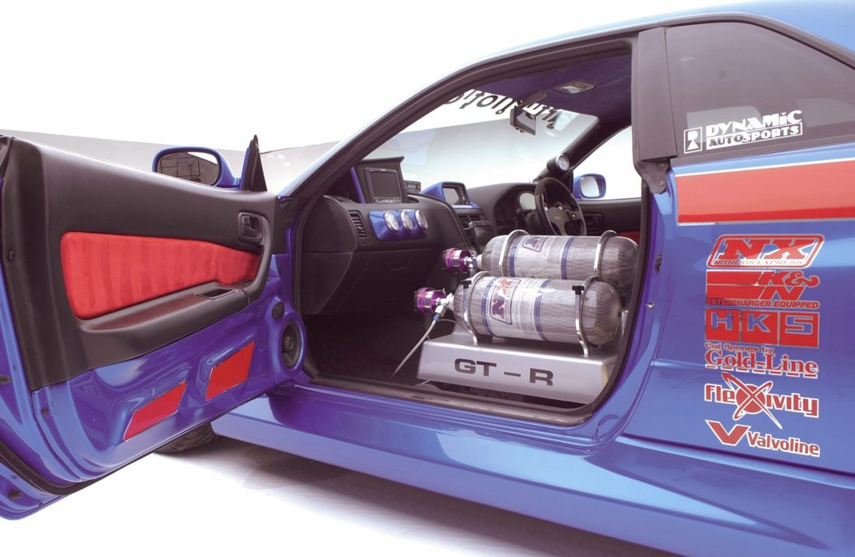
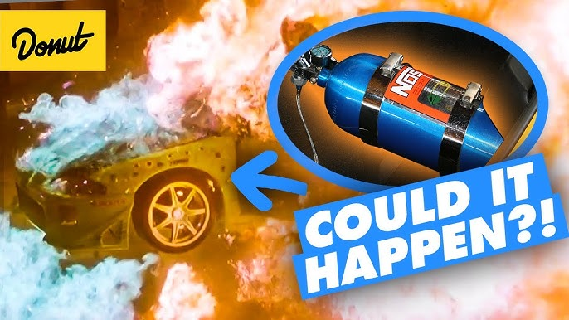
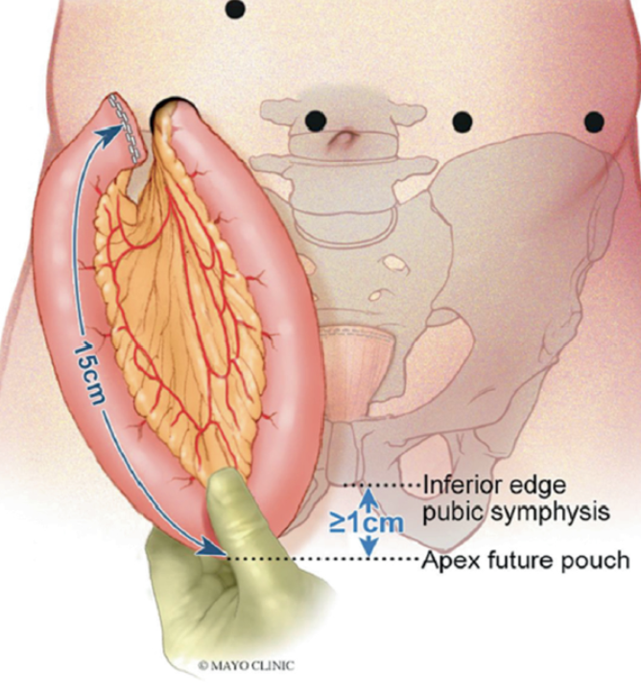
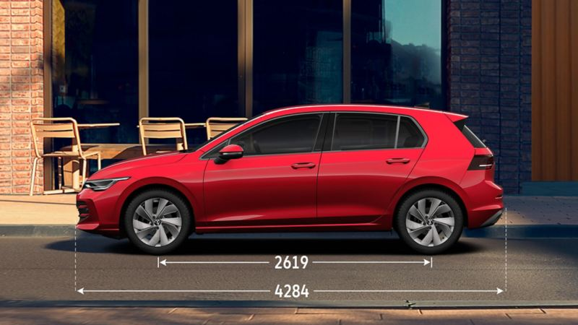
Pitfalls and Potholes :
Lenth, perfusion and tension free, is everything, it’s the NOS you need.

Slide 29
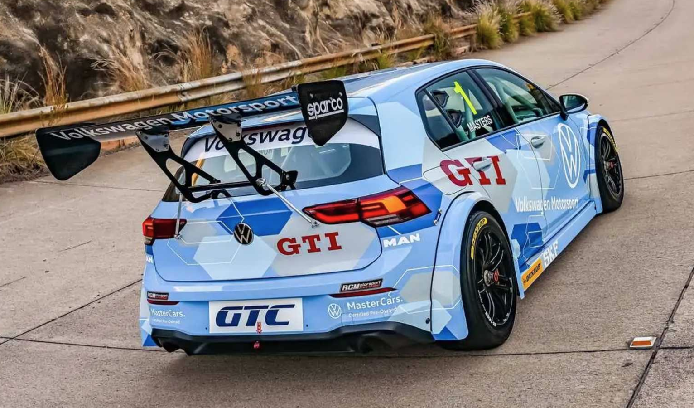





Potholes / Just NOT COOL BRO

Slide 30



Remember:
It’s not that easy and can go VERY wrong VERY Quickly
IPAA-related complications were anastomotic leakage (1–17%), pelvic sepsis (2–18%), fistula (1–30%), stricture (1–34%), pouchitis (11–61%), and Crohn's disease of the pouch (0–18%). Pelvic sepsis (r = 0.51, P < 0.05) and fistula (r = 0.63, P < 0.01) were correlated with pouch failure

Slide 31

Nothing wrong with a VW Polo

Slide 32







IF you FAIL
Gert is going to scream on you and ask:
Why is your pouch not working?? (next talk)

Slide 33



