Slide 1

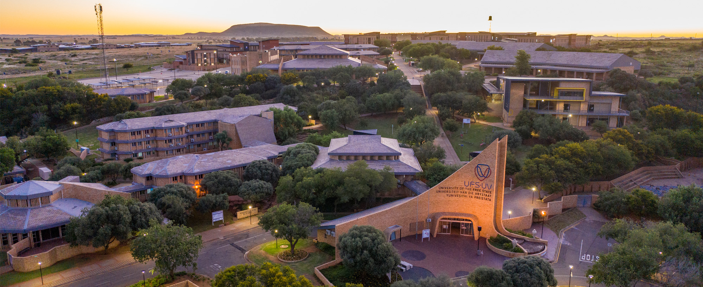

Doctor, my pouch won’t work, now what?
www.ufs.ac.za
G vd Merwe
ColoEscape 2024

Slide 2

Notes:
Discalaimers:
This is a digital art image of Supertubes.
There are those who say it is the best break in the world to surf.
Much like this claim, most of what I will discuss comes down to experience rather than science.
Additionally, like with surfing I have not had much experience in dealing with pouches, and the las time I did, it nearly killed me

Slide 3

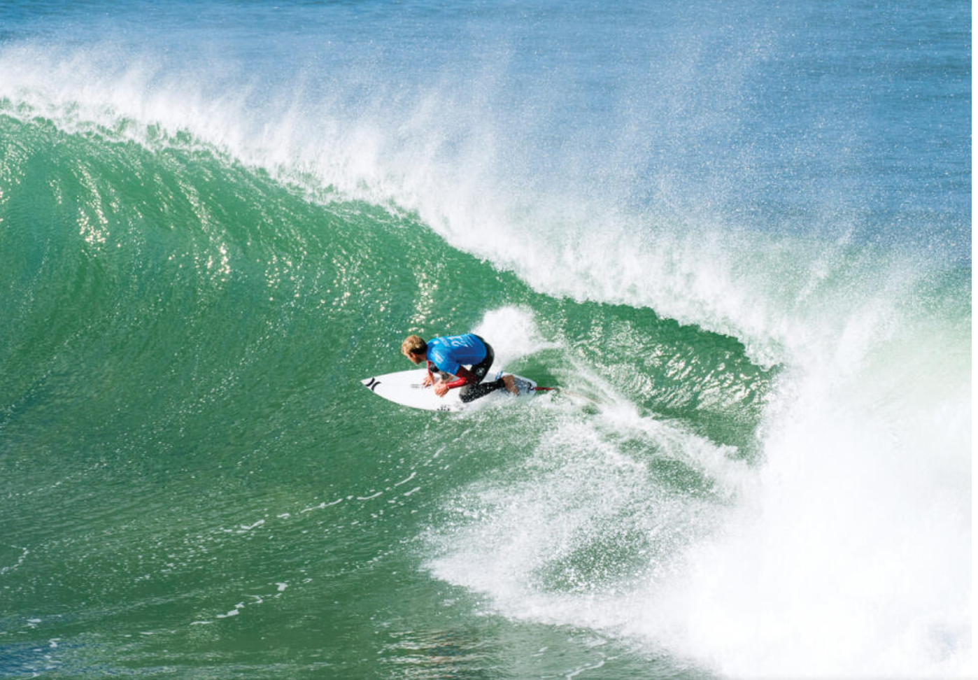
Notes:
Pouches like Supertubes, are not for beginners. It will be easier for some, just like a regular should find supertubes easier than a goofy

Slide 4


G.O.A.T.
Notes:
Kelly Slater is an 11 times Wolrd surf league Champion, the most ever, and this is him surfing Supertubes. Given my lack of experience, I will be quoting the Kelly Slaters of the Colorectal surgery world

Slide 5
Introduction
RP is a QOL intervention to provide long-term stoma-free living for people with:
UC refractory to medical treatment
UC with dysplasia (?malignancy)
FAP
Complications not uncommon with:
Leak rates of up to 1-17%
Failure rates at 5 and 10 yrs 7,7% and 10,3% respectively
(Heuthorst et Al Ann Surg Open (2021)2:e074)
Notes:
And unfortunately, there is data for management of constipation.

Slide 6

Notes:
So when we are faced with someone who’s pouch won’t work, we should identify the reasons, as we afterall offered this as an alternative to living with a stoma

Slide 7

Notes:
Beware of labeling everything Crohn’s pouchitis. Wipeout…

Slide 8
Evaluation
Detailed history
Pouchoscopy & Biopsies
Imaging:
CT Abdomen & pelvis
Pelvic MRI
Contrast enema
Defaecogram
Examination under anaesthesia
Manometry/ balloon expulsion test
Lan et al. Gastroenterology & Hepatology; 2023(19):1
Notes:
History: Stool frequency, Seepage/continence, Dyschezia, Straining, digitation, Haematochezia. Review prior operation notes and histology
Biopsy protocol

Slide 9
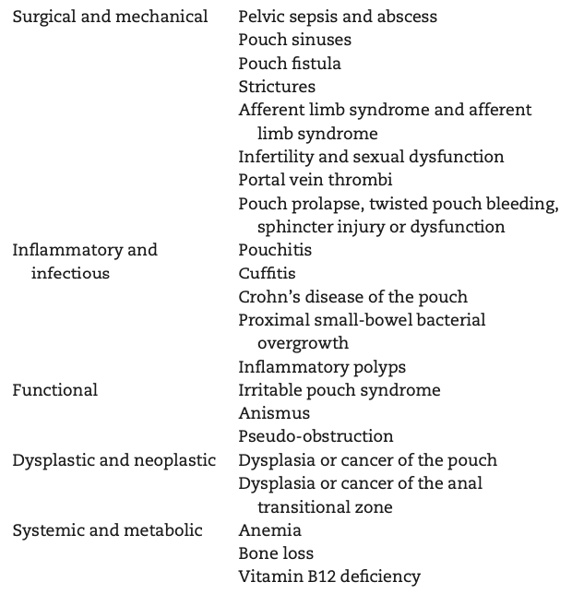
Classification of common pouch disorders
Khan et al. Gastroenterology Report, 6(4), 2018, 246–256

Slide 10
Classification of common pouch disorders
Khan et al. Gastroenterology Report, 6(4), 2018, 246–256

Slide 11
In a patient with pouch dysfunction
Introduce ileostomy as a concept early in the conversation

Slide 12
Problems “proximal” to the pouch
Notes:
Patients may have adhesive bowel obstruction not related to the pouch.

Slide 13
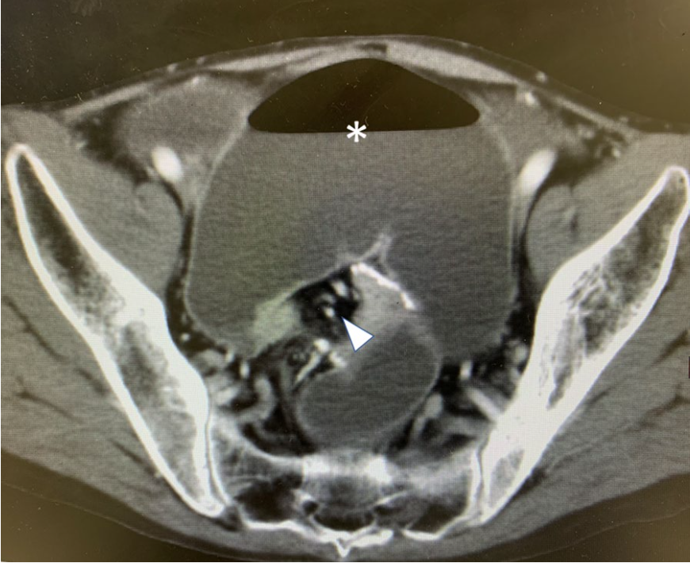
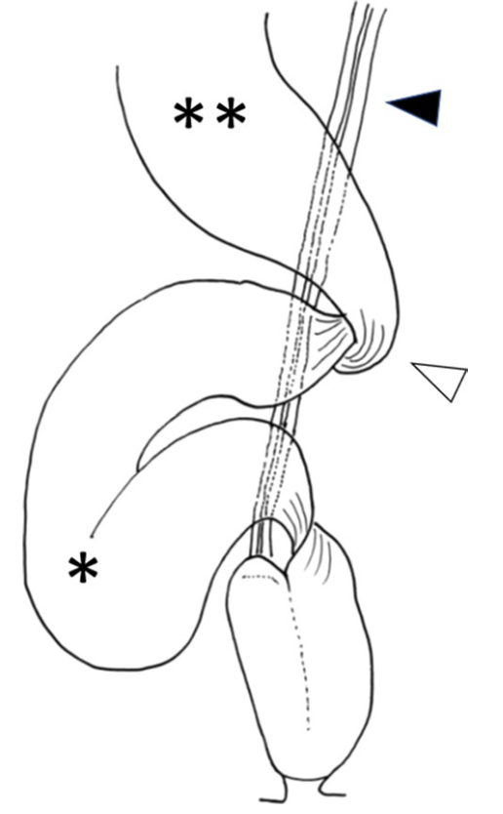
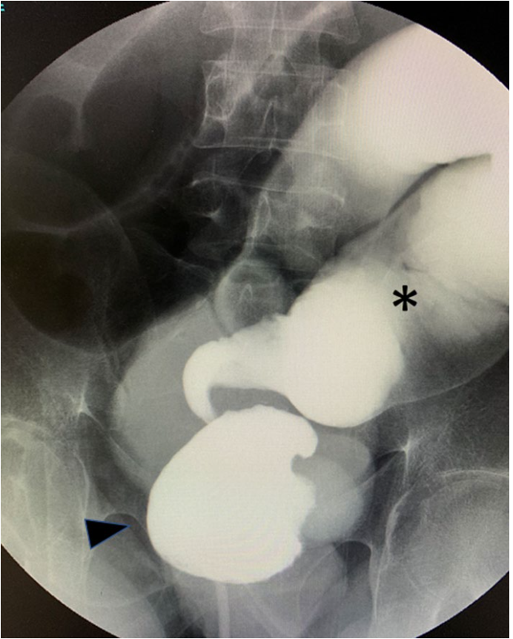
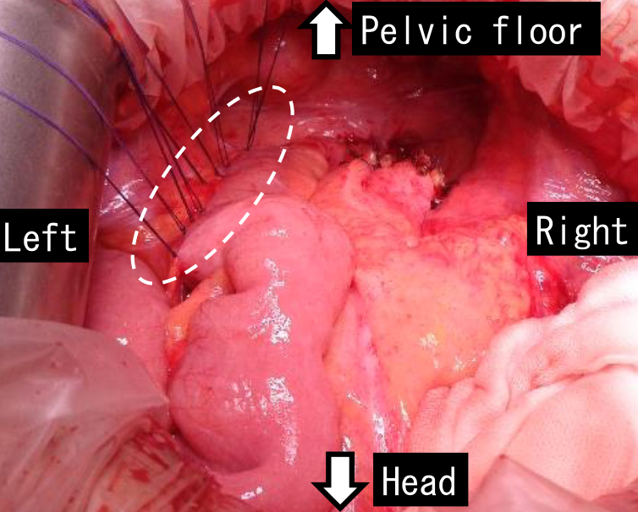
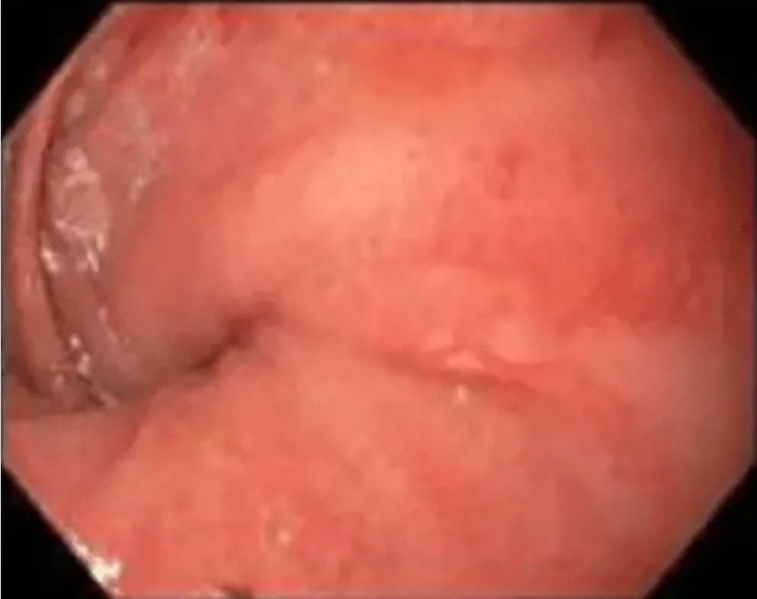
Pouch volvulus
Itabashi et al. surg case rep (2020) 6:218
Notes:
This is really a problem of lack of adhesion of the SB mesentery to the retroperitoneum

Slide 14
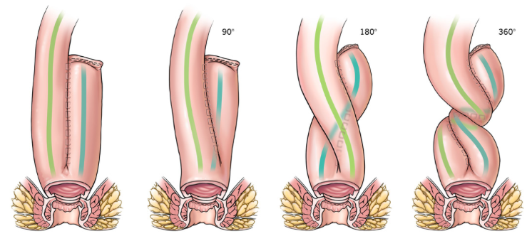
Rotated pouch/ mesentery
Holubar SD. Diseases of the Colon and Rectum 2018(61):5

Slide 15
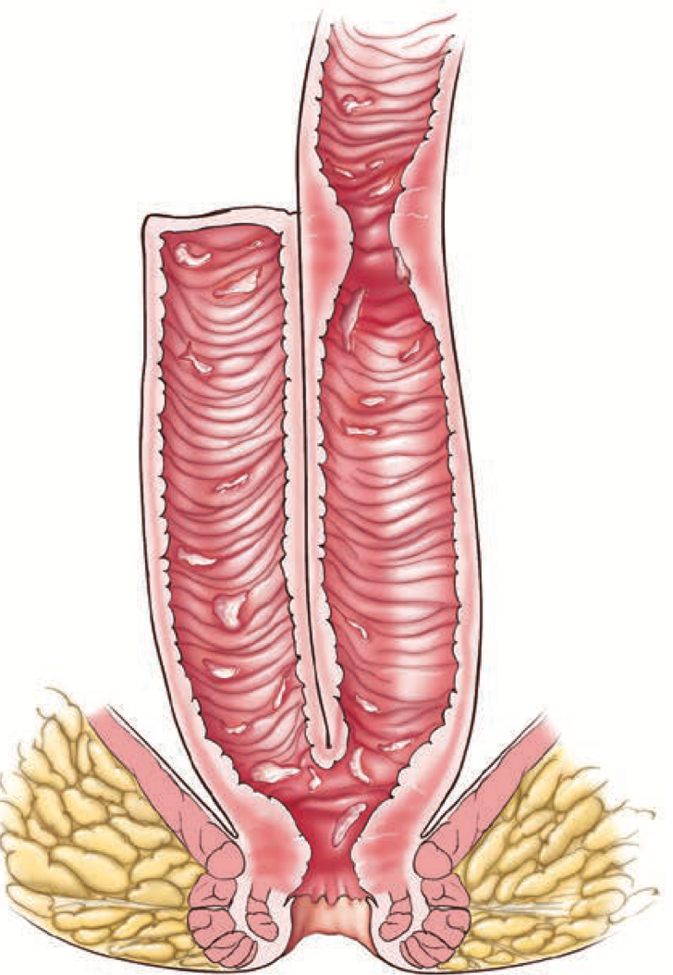
Afferent limb stricture
Holubar SD. Diseases of the Colon and Rectum 2018(61):5

Slide 16
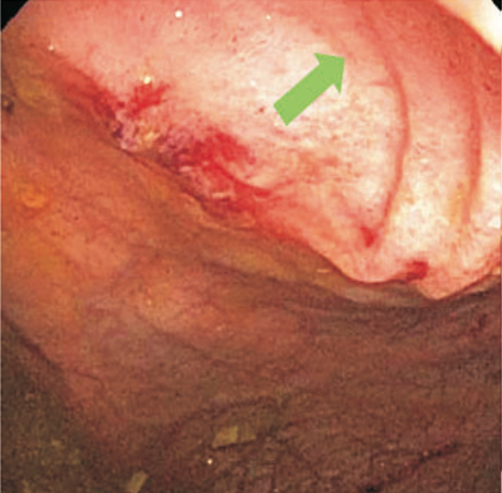
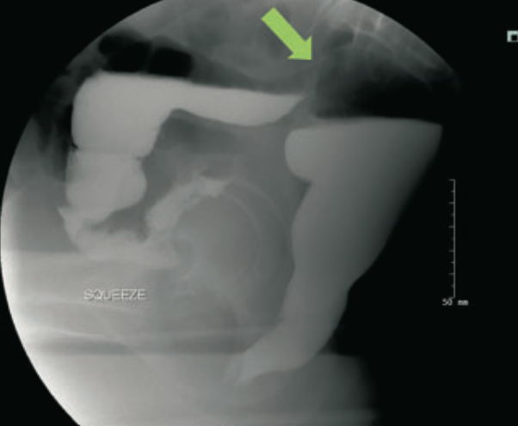
Afferent limb syndrome
Angulation resulting in poor pouch filling:
Displacement of pre-pouch ileum posterior to the pouch
With adhesions- fixed sharp angulation

Slide 17
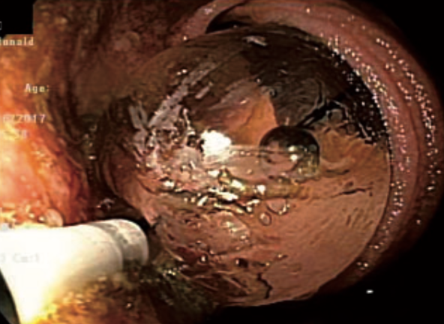
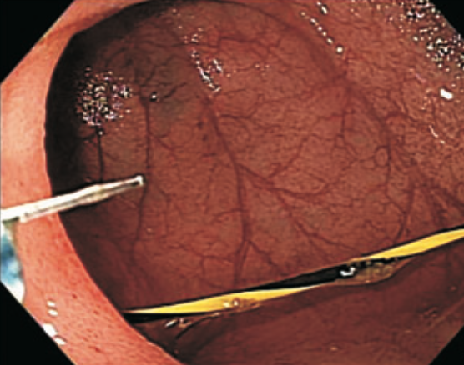
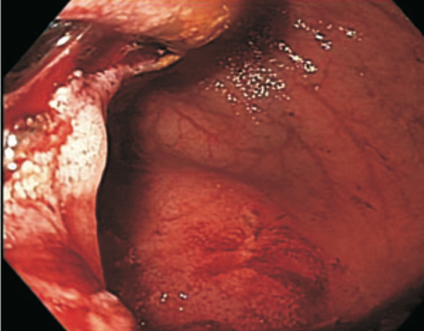
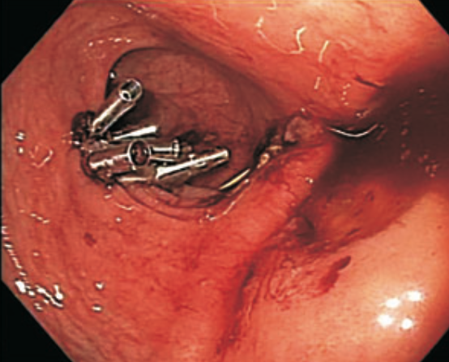
ALS Management
Surgical management:
Adhesiolysis
Pouch-pexy to Pelvic sidewall
Pouch-ileal anastomosis
Hassan T Kirat et al; Inflamm Bowel Dis 2011; 17(6)

Slide 18
SIBO
Alone or in combination with any of the above
Management:
Diet (Low FODMAP/ elemental)
Oral antibiotics (Rifaximin)
FMT

Slide 19
Problems with the pouch body

Slide 20
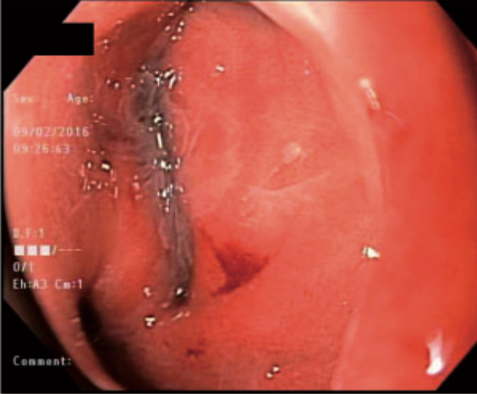
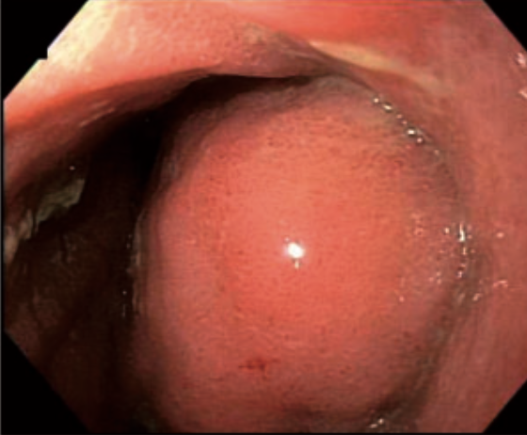
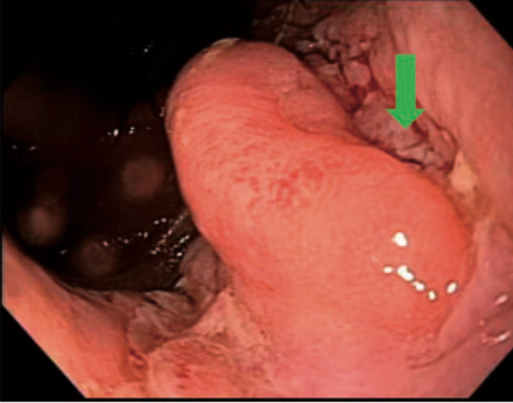
Prolapse
Pouch prolapse
Full thickness
Mucosal prolapse
Pouchocoele

Slide 21
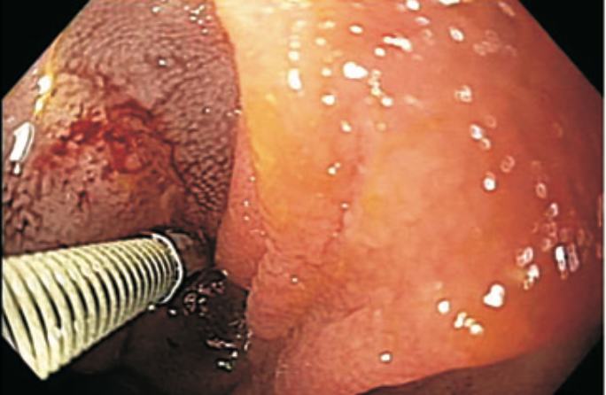
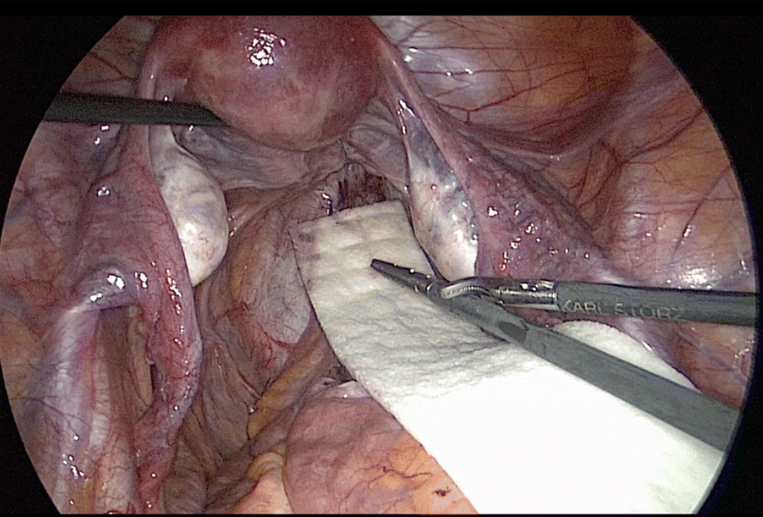
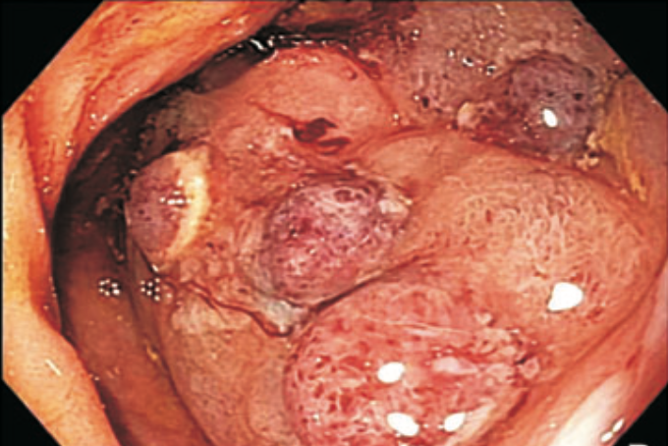
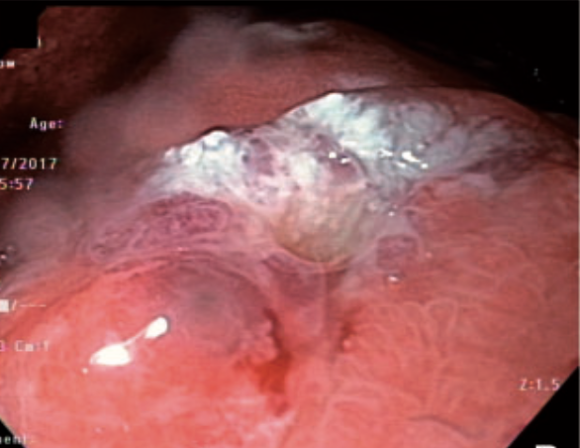
Prolapse management
Notes:
Endoscopic management: Mucosal prolapse: Sclerotherapy, Rubber band ligation, Hot snare of polypoid mucosal prolapse

Slide 22
Anastomotic complications

Slide 23
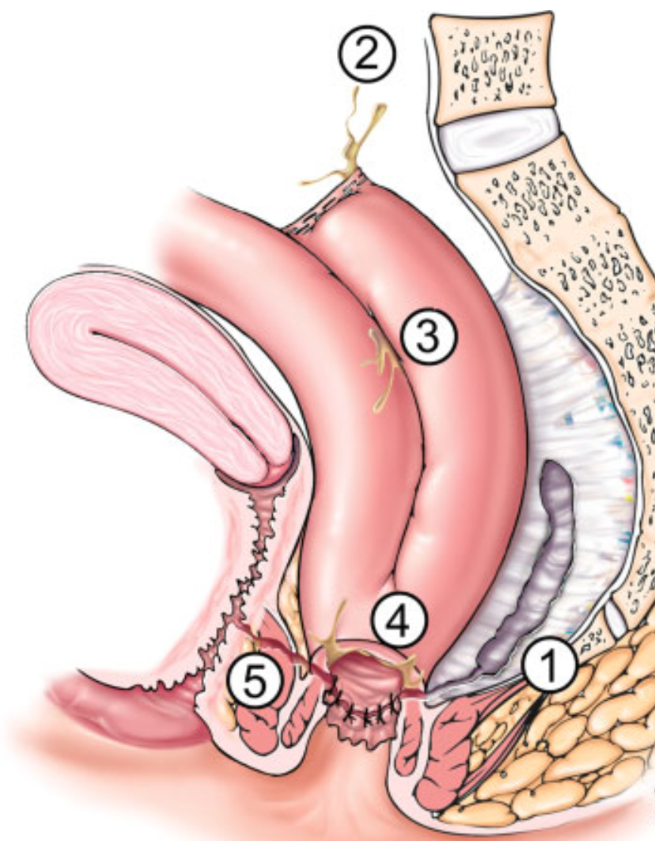
Anastomotic leaks
Presacral sinus
Tip of J
Pouch body
Pouch anal anastomosis
Pouch vaginal fistula

Slide 24
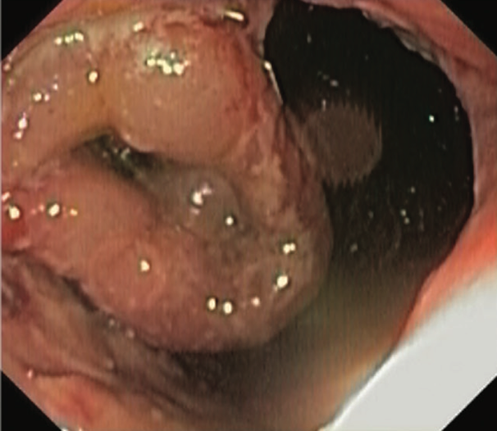
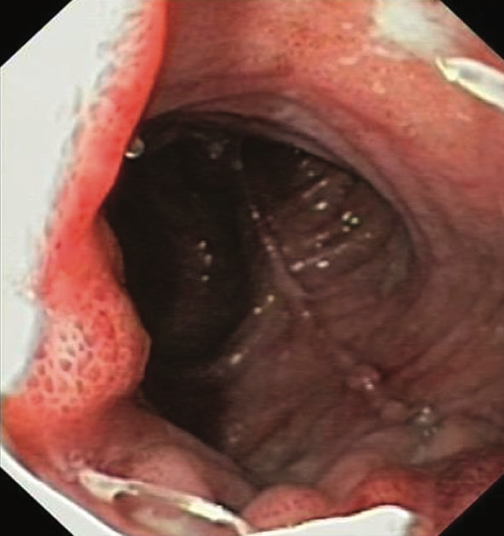
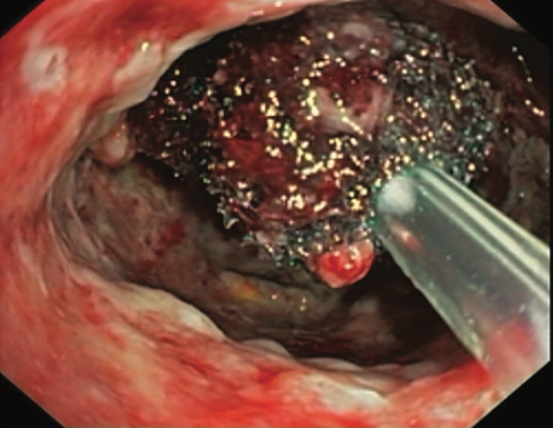
Pouch-anal leak management
Wasman et al. Journal of Crohn's and Colitis, 2019, 1537–1545

Slide 25
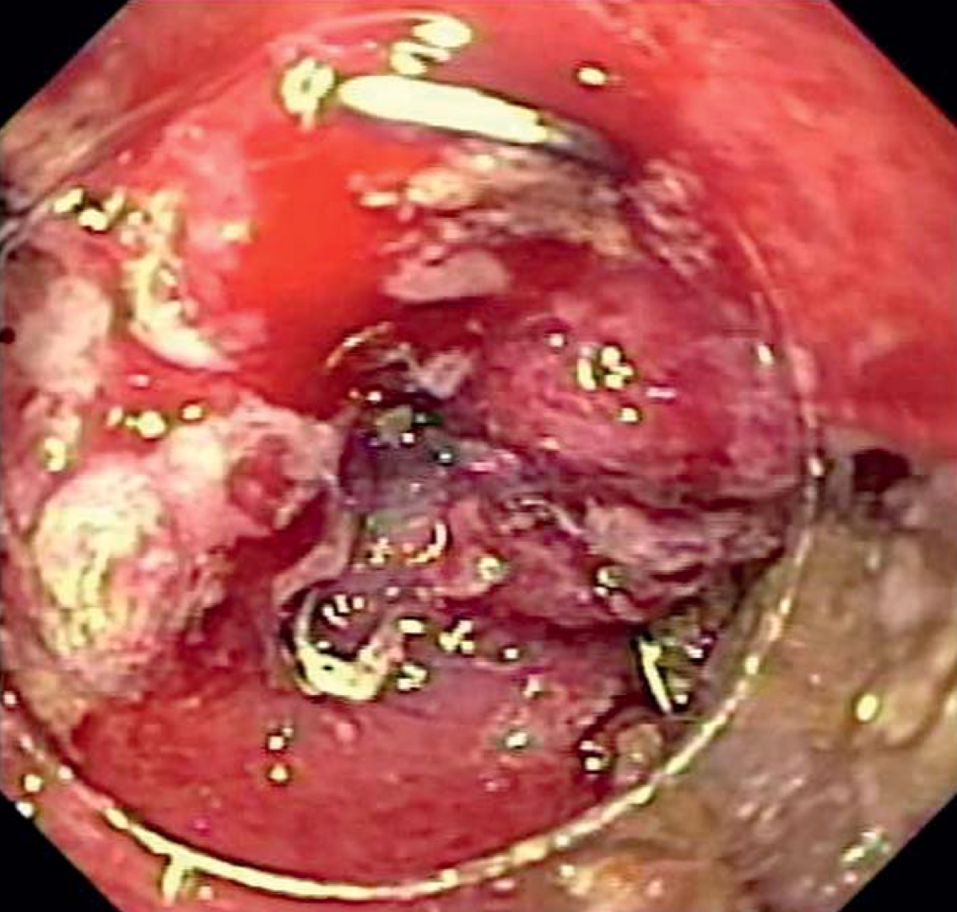
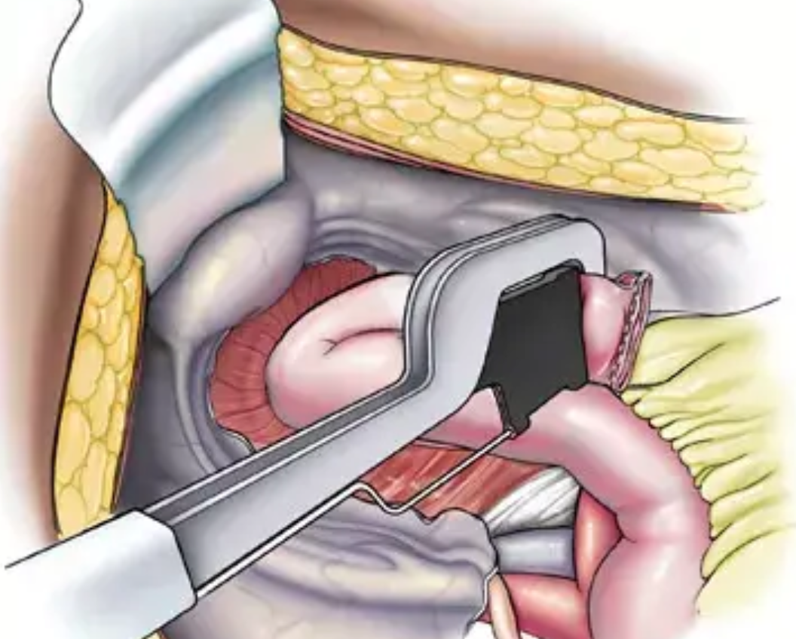
Tip of J- leak management
Holubar SD Diseases of the Colon & Rectum 66(1):p 97-105, January 2023.

Slide 26
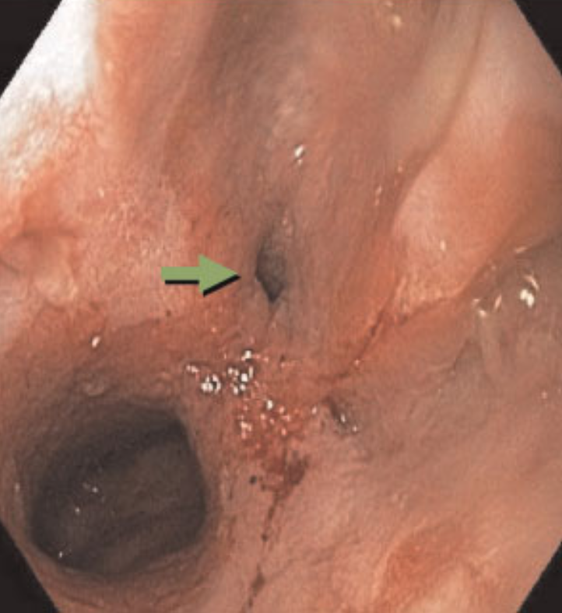
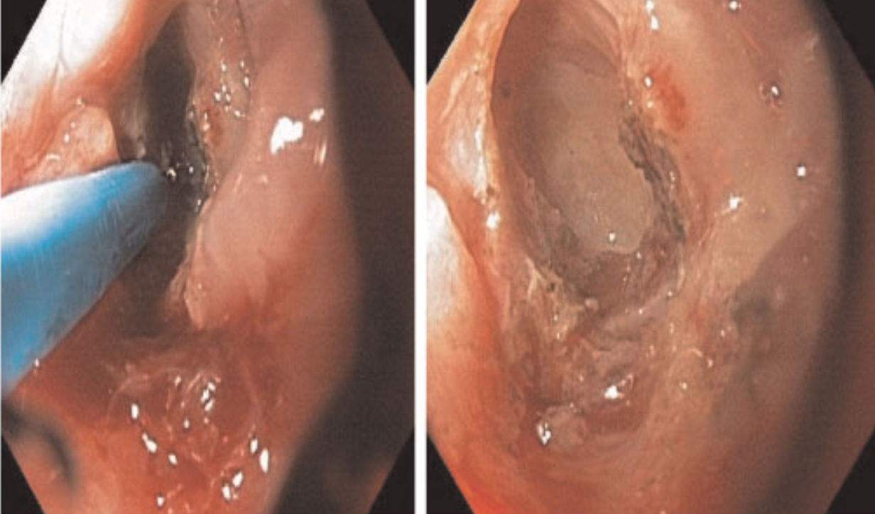
Presacral sinus management

Slide 27
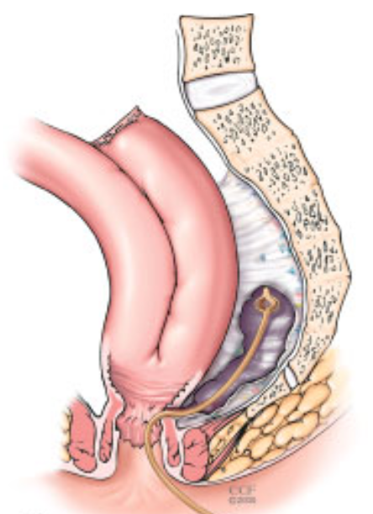
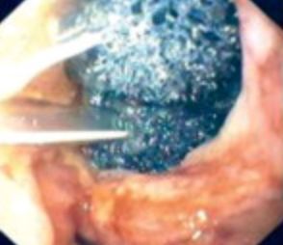
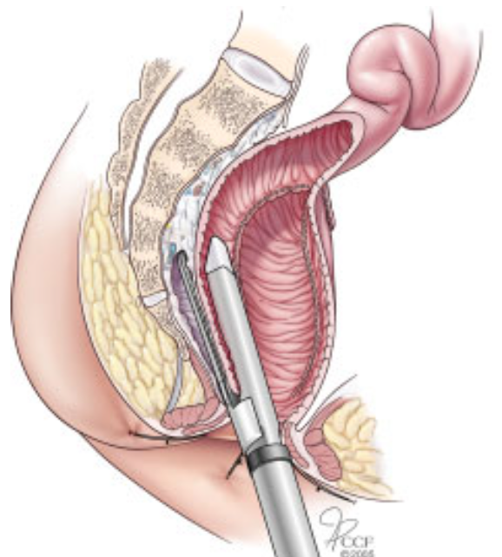

Slide 28
Efferent limb syndrome/ Pouch outlet obstruction

Slide 29
Causes
Long rectal cuff in J-Pouch
Long efferent limb in S-Pouch
Anastomotic stricture

Slide 30
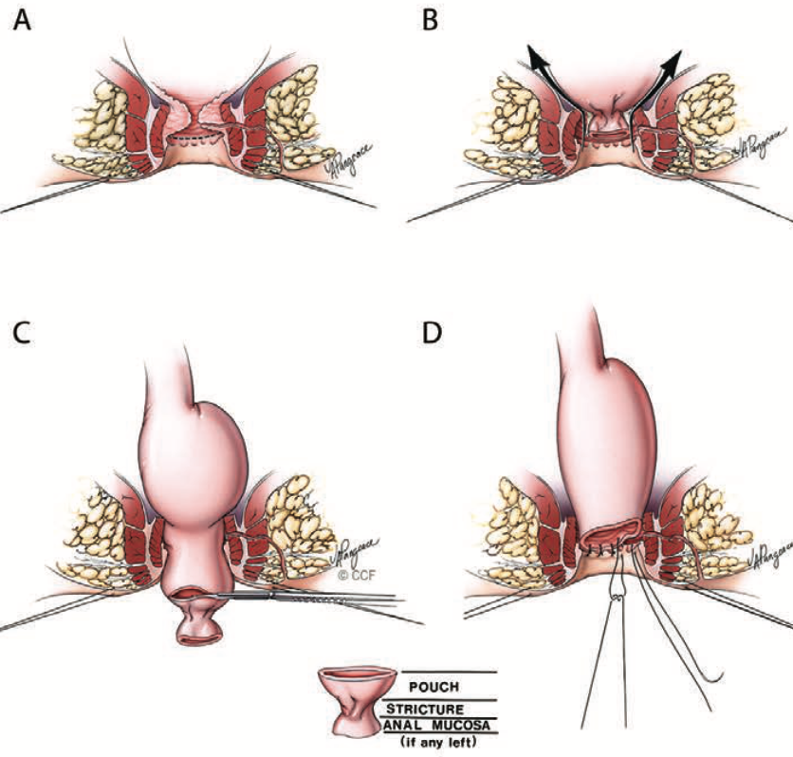
Management
Pouch Advancement
Holubar SD. Diseases of the Colon and Rectum 2018(61):5

Slide 31
Functional problems

Slide 32
ODS
All investigations except ARM and BET in normal limits
Manage with biofeedback training

Slide 33
Pouch neoplasia
Annual surveillance for pouch neoplasia
Manage endoscopically/ resection

Slide 34
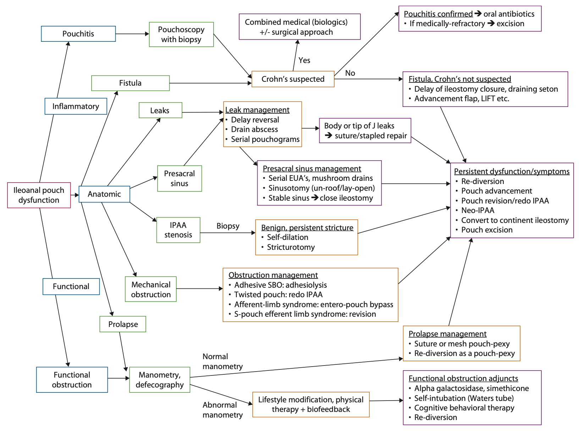
Pouch complicaitons
Holubar et el. Dis Colon Rectum 2018; 61: 532–536

Slide 35
Summary
Careful assessment
Various endoscopic and surgical options
Introduce the discussion of ileostomy early
Ultimately IPAA is a QOL intervention
Ileostomy may improve QOL in dysfunctional stoma

Slide 36

Notes:
If we can stick to this, we and our patients may be stoked with the result…

