Slide 1
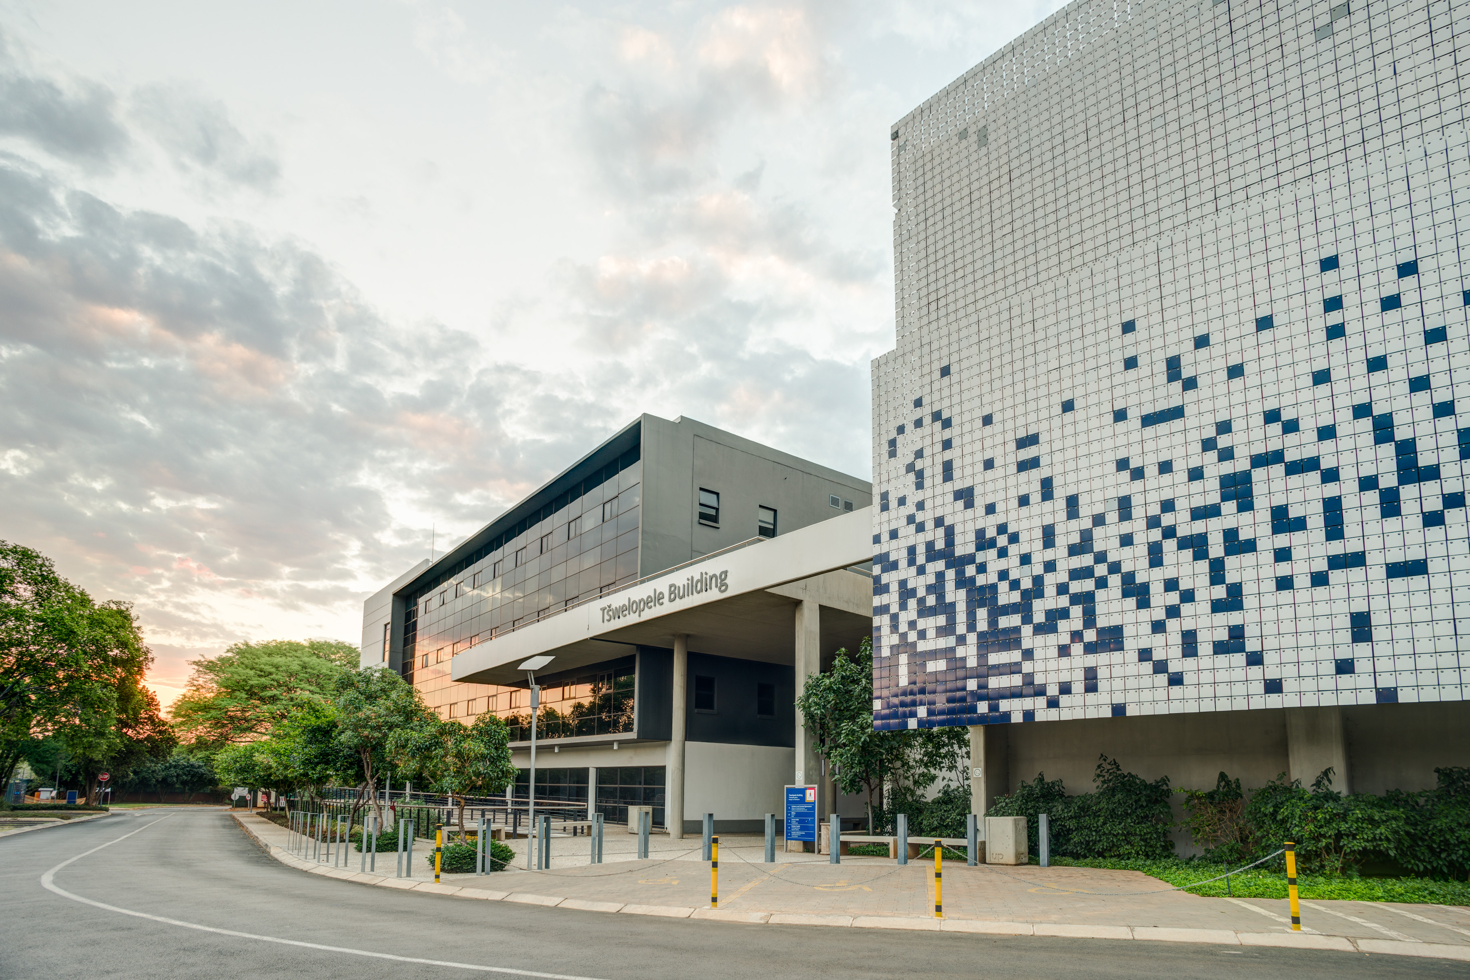

ILEORECTAL ANASTOMOSIS FOR ULCERATIVE COLITIS: WHAT DOES THE DATA SAY
Presenter : Dr. Thiathu Ravele

Slide 2
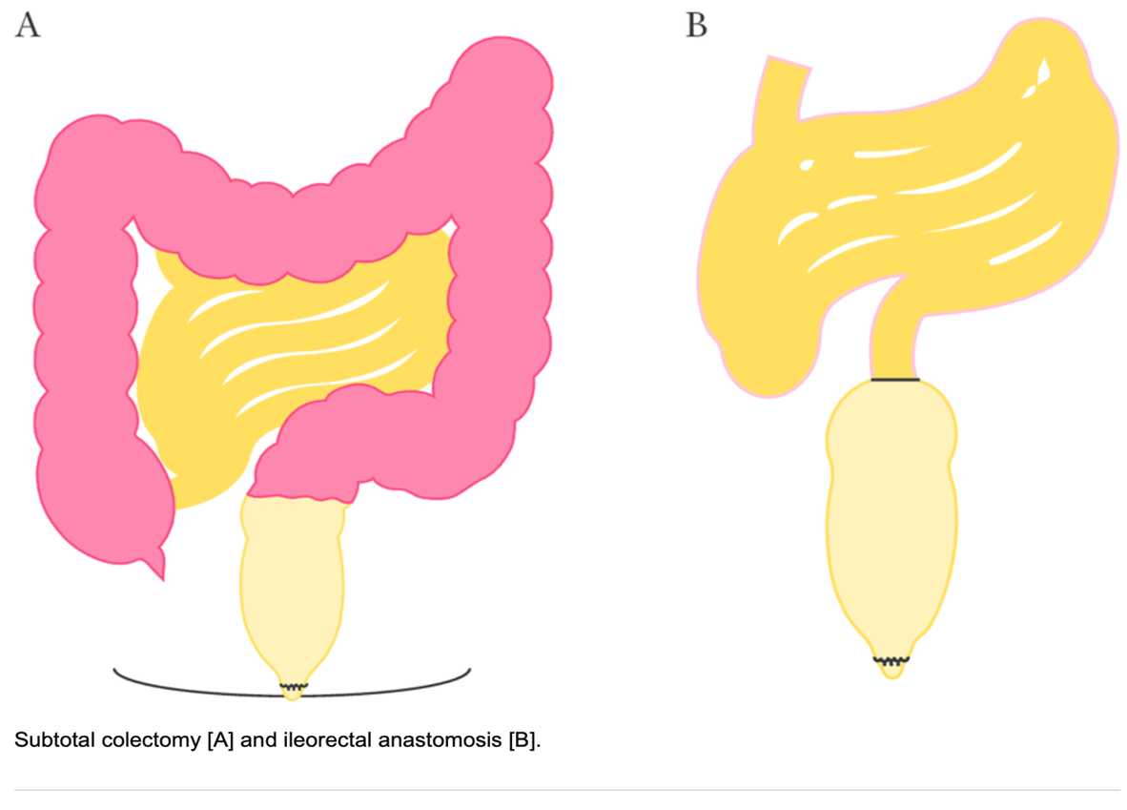
Contents
Introduction
Indication of surgery
Surgery emergency vs Elective
Evidence

Slide 3
Introduction
Ulcerative colitis is primarily treated by medical therapy, but surgery may be required in patient with refractory to medical therapy and complication
IRA-was first described in 1950s by Stanley Aylett became the leading proponent of the procedure to avoid permanent stoma
Proportion of patient requiring colectomy for acute severe ulcerative colitis estimated to be 10% at ten years after diagnosis
Still concern about remaining rectum and high failure rate due to persistent proctitis and fear of dysplasia and cancer developing has led to abandonment of IRA
Comparative analysis of patient in UK and Sweeden ulcerative colitis found that IRA accounted 7.7% and 59% of all restorative procedure
Data from centers using IRA –safe with functionality and risk of failure comparable to IPAA

Slide 4
Advantages & Disadvantages of IRA
Advantages
Less complicated
Less frequent bowel movement
Non pelvic surgery
Preserve fertility
Avoidance of permanent stoma
Disadvantages
Proctitis
Need for anti-inflammatory medication
Need for surveillance –cancer risk

Slide 5
Indication of surgery
When to offer IRA :
Emergency surgery
Colonic perforation
Massive LGITB
Toxic megacolon
Elective surgery
Chronic active disease
Steroid dependent disease
Stricture formation without obstruction
Dysplasia with associated mass

Slide 6
Which patients not suitable for IRA
Severe proctitis
Poor rectal compliance
Faecal incontinence
Anoperineal disease
Presence of dysplasia or carcinoma
Poor nutritional status
UC with PSC

Slide 7
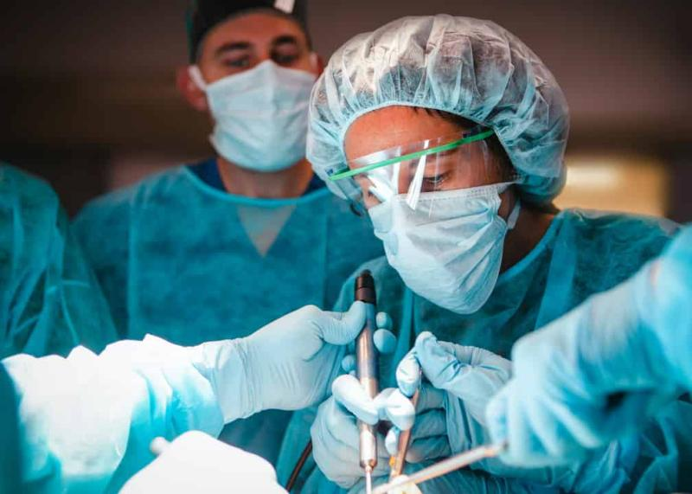
Emergency surgery : When?
To treat fulminant state
Restoration of previous state of health
Primary procedure
Total abdominal colectomy + end ileostomy +rectal stump left behind
Avoid pouch formation
Able to discontinue medication

Slide 8
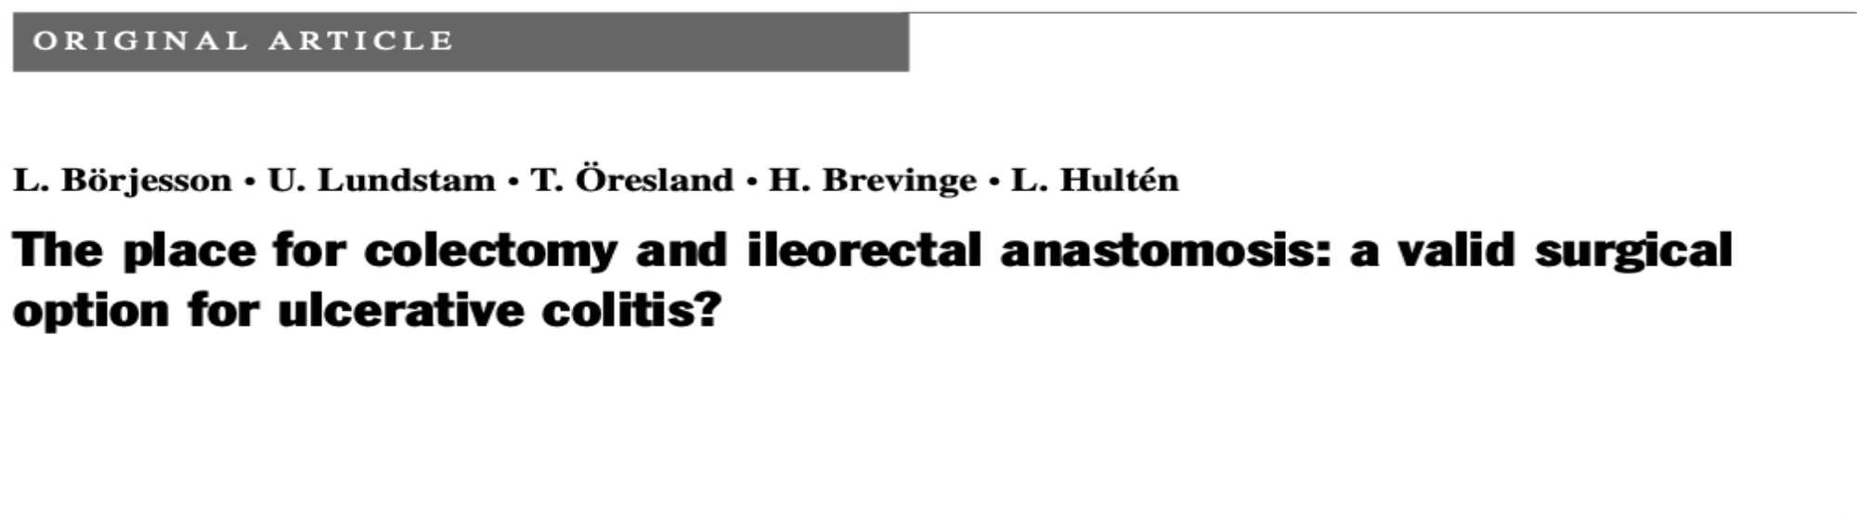
32 patients
Colectomy and IRA -1997-2003
Two stage and single stage procedure
Follow up-yearly rectoscopy
Few post operative complication-28%
Long term outcome unpredictable -40-50% will require rectal excision
Evidence

Slide 9
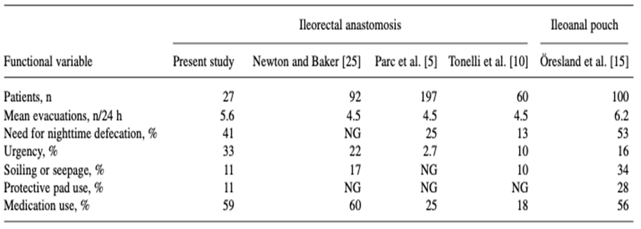

Slide 10
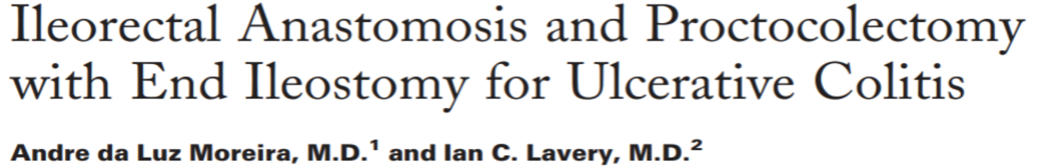
1996-2010
IRA-can be considered in selected patients(young female with no dysplasia)
Cancer risk and surveillance – Basil Morson(1967) mucosal dysplasia as premalignant state and 6-12 months rectal biopsy
Rectal function and QOL-Rupert et al –in 1959 –cause of failure preservation of rectosigmoid

Slide 11
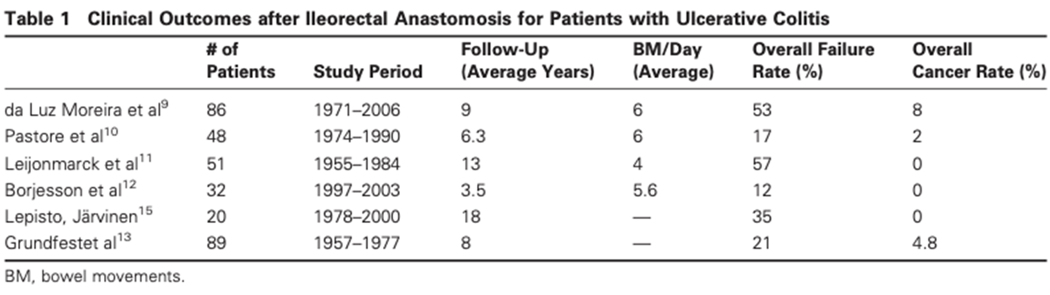

Slide 12
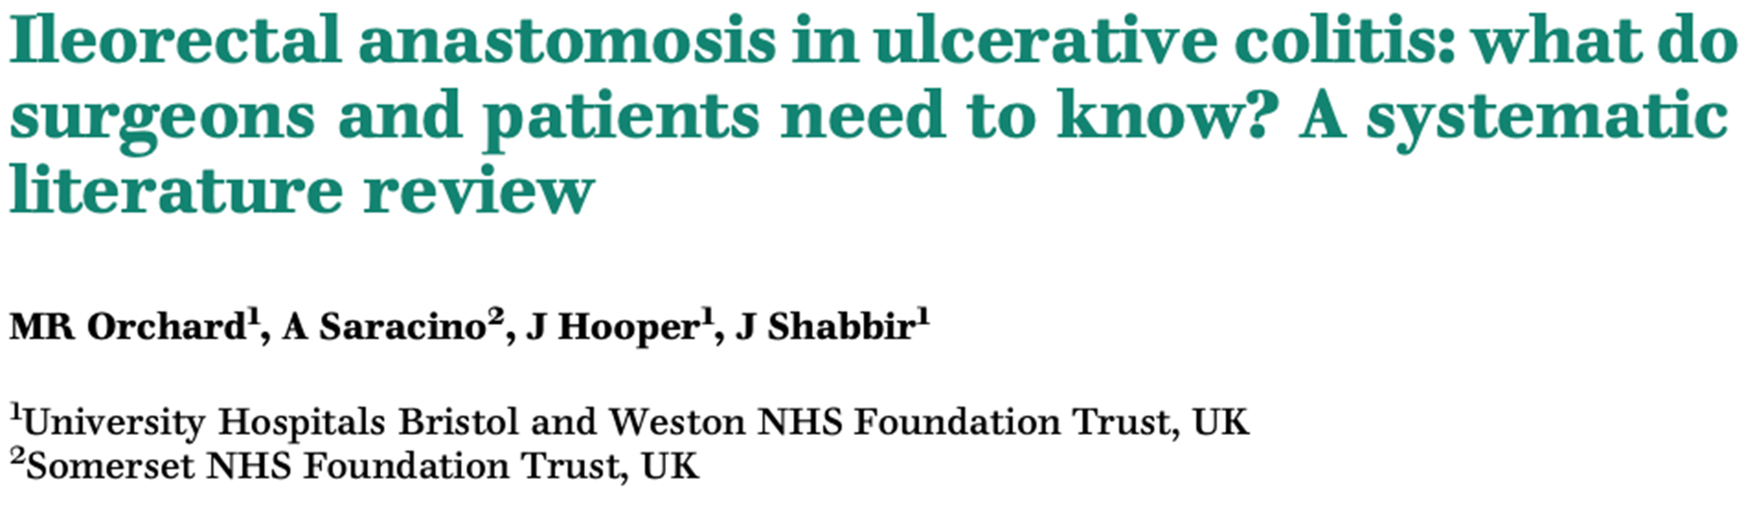

Slide 13
Cancer risk
<5% in 10years
Oder age and > 10years after diagnosis
Dysplasia
PSC
Quality of life
-Sexual function
-Bowel function
Post operative complication
Anastomotic leak/fistula
IRA
Surveillance
-flexible sigmoidoscopy to detect
-Dysplasia or cancer
Failure rate
Need for defunctioning ileostomy/completion proctectomy
Cancer or intractable proctitis

Slide 14
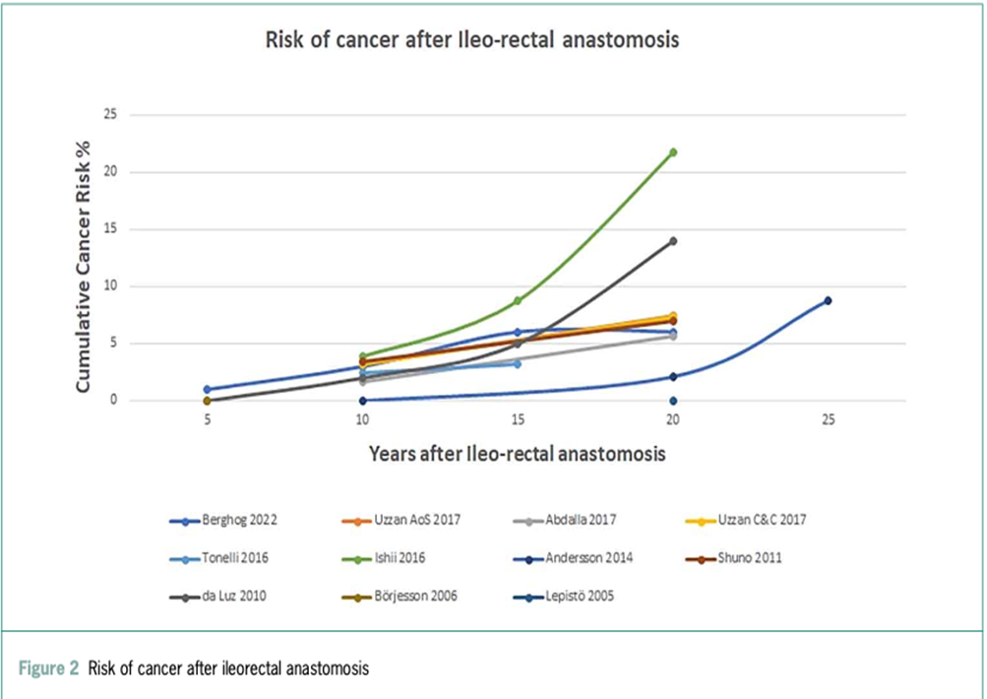
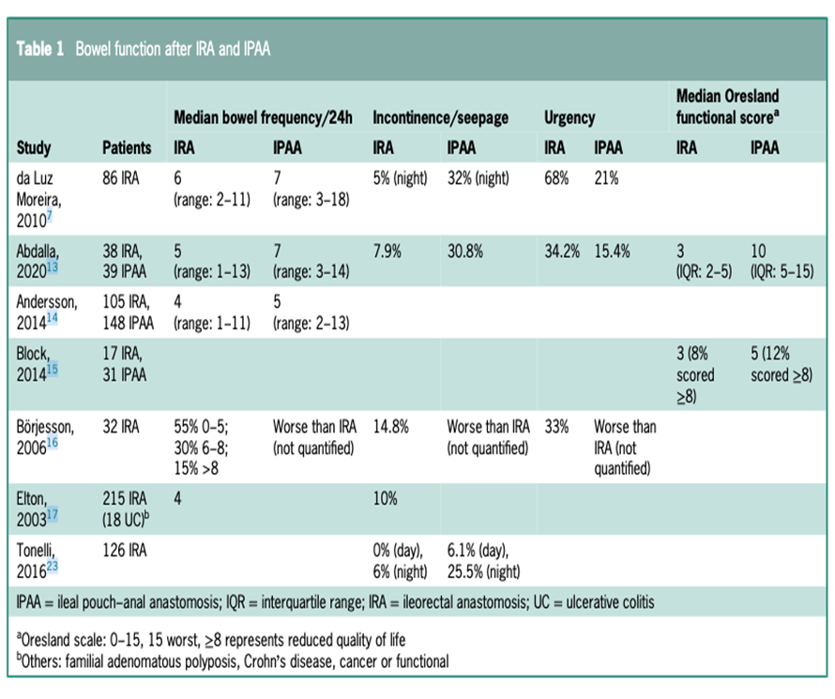

Slide 15
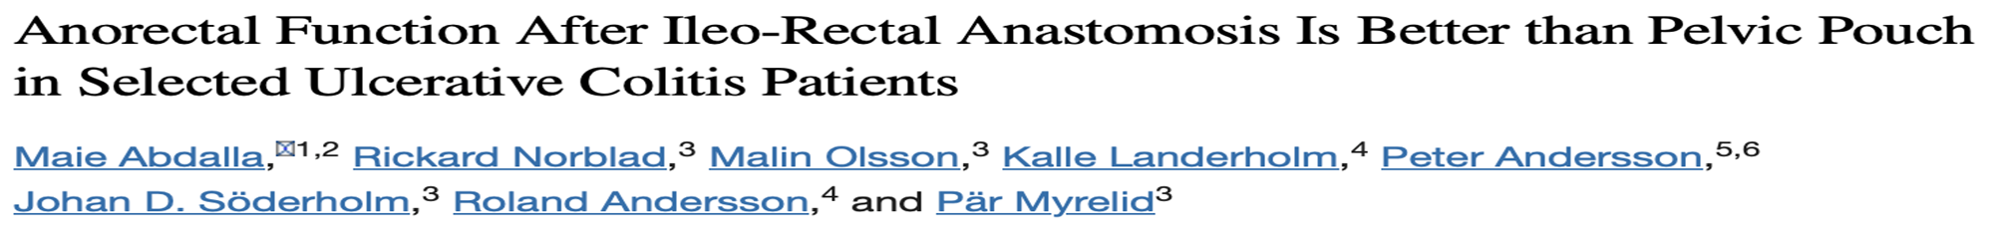

143 patients
1996-2006
IRA has overall better function
In selected patient has a role and strict endoscopic surveillance very important

Slide 16
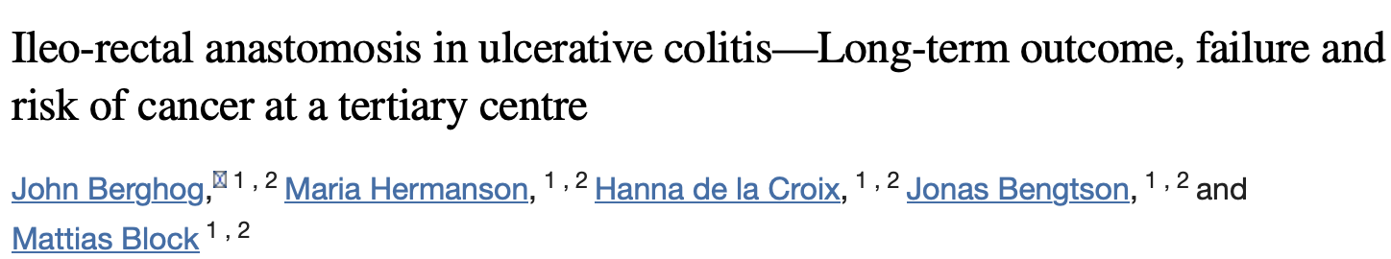
1972-2019
183 patients
IRA failure rate 25% and 35% at 5years and 10years respectively
Rectal cancer 3% and 6% at 10years and 15years respectively
IRA remain restorative option after colectomy in ulcerative colitis, even if the failure rate raises concern
Surveillance endoscopy mandatory

Slide 17
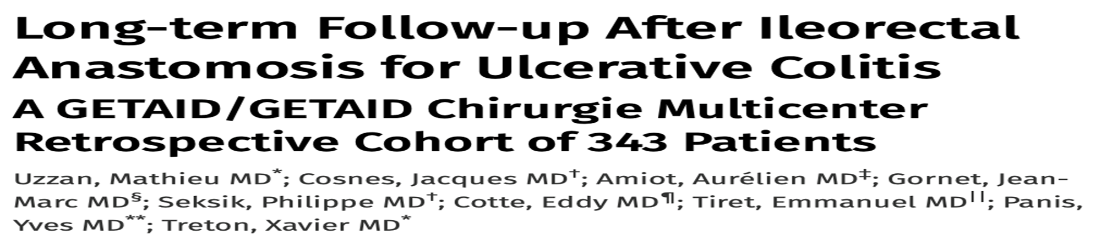
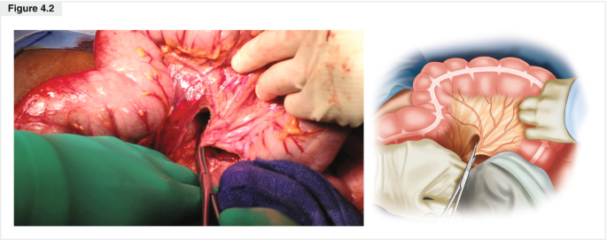
1960-2014
IRA failure rate 27% and 40% at 10 and 20years respectively
Median survival without IRA failure 26.8years
Failure is higher if IRA done for refractory disease

Slide 18
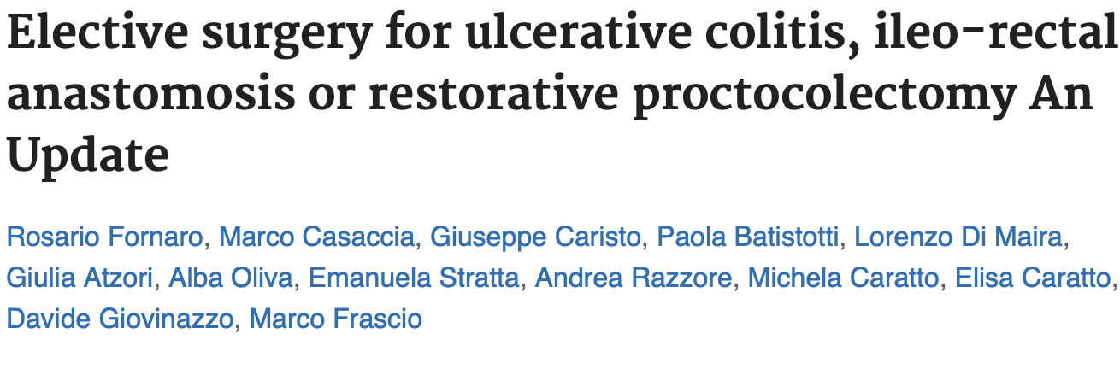
IRA less invasive compared to IPAAA
Less complication
No pelvic dissection so less pelvic nerve injury
Preserve fertility in young female
Cumulative cancer risk 6-14% and 4.2 respectively

Slide 19
Conclusion
Today IPAA is the gold standard
IRA is indicated in selected patients with normal sphincter tone, absence of severe perineal disease, rectum does not actively involve by the disease, absence of dysplasia or cancer.
In patients who refuse an ileostomy, and it can be proposed as a possible interim procedure in young women,
No need a pelvic dissection and because the risk of infertility is minimal or absent when compared to IPAA.
Patients undergoing IRA must be adequately informed about the risk of recurrent proctitis, cancer,
Surveillance with annual endoscopy with rectal biopsies.

Slide 20
References
1. Dai N, Haidar O, Askari A, Segal JP. Colectomy rates in ulcerative colitis: a systematic review and meta-analysis. Dig Liver Dis 2023;55: 13–
2. Berghog Hermanson M, de la Croix H et al, ileorectal anastomosis in ulcerative colitis, long term outcome, failure and cancer risk at tertiary centre, colorectal dis 2022;24:1535-1547
3. Mann CC, colectomy and ileorectal anastomosis in ulcerative colitis, world J surg 1998 ;12:155-159
4.Aylett SO, Diffuse ulcerative colitis and its treatment by ileorectal anastomosis. Dis colon rectum 37:503-501
5.Abdalla M, Norblad M, Olsson M et al, anorectal function after ileorectal anastomosis is better than pouch in selected ulcerative colitis, Dig Dis Sci 2020;65:250-259
6.Da luz Morreira A , Kiran RP , Lavery I , clinical outcome of ileorectal anastomosis for ulcerative colitis .Br J surg 2010;97(1):65-69

Slide 21

The End

