Slide 1
Comparing international guidelines for neo adjuvant therapy in rectal cancer
Dr.Amged Mohammedsalih
ColoEscape -19/07/2024

Slide 2
-NCCN Guidelines Version 2.2024
-ESMO Guidelines 2018
-The ASCRS Guidelines for Rectal Cancer 2023
-NICE guideline15 December 2021
-Japanese Society for Cancer of the Colon and Rectum (JSCCR)
guidelines 2019.

Slide 3

Rectal cancer clinical presentation
T3, Nany; T1-2, N1-2; T4,Nany or locally unresectable or medically inoperable
Without suspected or proven DM.
*Workup include MMR/MSI, RAS, BRAF
With suspected or proven DM.
*workup include MMR/MSI testing
pMMR/MSS
dMMR/MSI-H
Proficient MMR/MMS
Deficient MMR/MSI high/Pole/Pold1 mutation

Slide 4
REC-3
R.C without suspected or proven distant metastasis:
pMMR/MSS
dMMR/MSI-H
TNT:
1-L-C chemo/RT OR SCRT→Chemotherapy,12-16w(FOLFOX or CAPOX, consider FOLFIRINOX)→Restaging.
2-Chemotherapy 12-16w(FOLFOX or CAPOX, consider FOLFIRINOX)→ CRT OR SCRT→Restaging.
3-Chemotherapy 12-16w for non T4 disease eligible for sphincter-sparing surgery (FOLFOX or CAPOX)→Restaging
Response ≤20%→LCRT OR SCRT.

Slide 5
REC-3
- R.C without suspected or proven distant metastasis:
T3, Nany; T1-2, N1-2; T4,Nany or locally unresectable or medically inoperable
pMMR/MSS
dMMR/MSI-H
Rec-14
1-Neoadjuvant/Definitive immunotherapy(preferred): Check point inhibitor immunotherapy/6 months→ If no cCR, persistent disease at 6 months→LC chemo/RT(capecitabine/ 5-FU) OR SCRT.
2-TNT: LC Chemo/RT(capecitabine/5-FU) OR SCRT→ Chemotherapy(FOLFOX or CAPOX, consider FOLFIRINOX)→Restaging.

Slide 6
Rectal cancer clinical presentation
RC Without suspected or proven DM.
RC With suspected or proven DM.
Tany, Nany, M1
Proficient MMR/MMS
Deficient MMR/MSI high/Pole/Pold1 mutation
Unresectable
Resectable
Synchronous liver only and/or lung metastasis: (REC-8)
(I) Chemotherapy (preferred)(FOLFOX(pre) OR CAPOX(pre) OR 5-FU-leucovorin OR capecitabine →restaging: consider holding radiation if cCR OR SCRT OR CRT(5-FU/capecitabine).
(II)SCRT OR CRT (5-FU/capecitabine) →FOLFOX OR CAPOX(pre) OR 5-FU/leucovorin OR capecitabine OR FOLFIRINOX→Restaging.

Slide 7
Rectal cancer clinical presentation
RC Without suspected or proven DM.
RC With suspected or proven DM.
Proficient MMR/MMS
Deficient MMR/MSI high/Pole/Pold1 mutation
Unresectable
REC-9
Resectable
Synchronous liver only and/or lung metastasis:
FOLFIRI OR FOLFOX OR CAPOX OR FOLFIRINOX+/- bevacizumab.
FOLFIRI OR FOLFOX+/- panitumumab or cetuximab(KRAS/NRAS/BRAF WT only)→Reassess
if resectable→ SCRT(pre) OR CRT (5-FU/capecitabine)→Surgery.

Slide 8
Rectal cancer clinical presentation
RC Without suspected or proven DM
RC With suspected or proven DM.
Proficient MMR/MMS
Deficient MMR/MSI high/Pole/Pold1 mutation
Resectable
REC-16
U.R
Resectable synchronous liver only and/or lung only metastasis:
Primary treatment: Checkpoint immunotherapy(pre)→Restaging: consider holding RT if cCR, but if not→ SCRT(pre) OR CRT(5-FU/capecitabine)→surgery.

Slide 9
Rectal cancer clinical presentation
RC Without suspected or proven DM.
*Workup include MMR/MSI, RAS, BRAF, HER
RC With suspected or proven DM.
Tany, Nany, M1
Proficient MMR/MMS
Deficient MMR/MSI high/Pole/Pold1 mutation
Resectable
U.R
Synchronous abdominal/peritoneal metastasis:
If non-obstruction: If candidate for immunotherapy and no prior immunotherapy received:
Checkpoint inhibitor immunotherapy→Re-evaluate (2-3months).

Slide 10
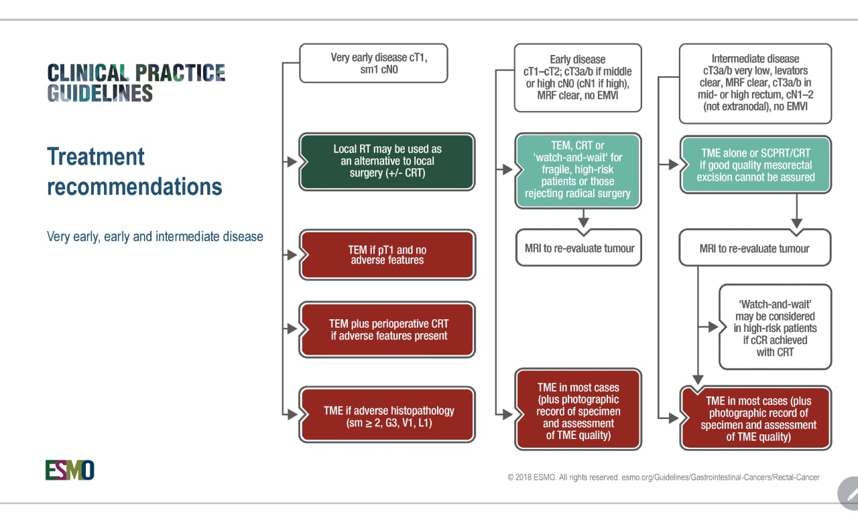
© 2018 ESMO

Slide 11
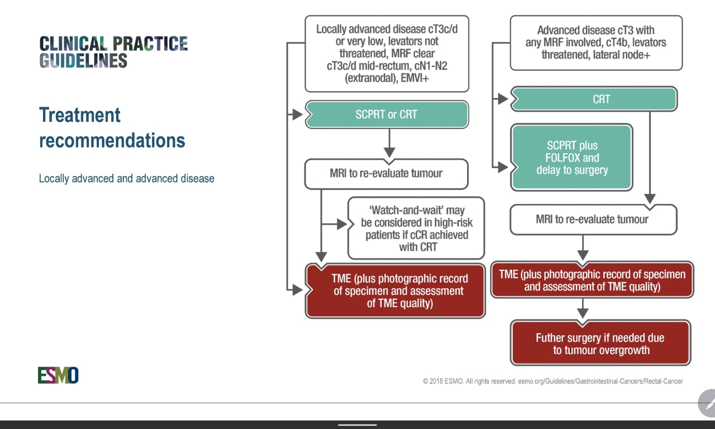
© 2018 ESMO

Slide 12
The ASCRS Clinical Practice Guidelines for the Management of
Rectal Cancer 2023 Supplement
1. Tumors of the upper rectum should typically be treated with initial surgical resection.
Strength of recommendation: conditional, based on moderate- quality evidence.

Slide 13
The ASCRS Clinical Practice Guidelines for the Management of
Rectal Cancer 2023 Supplement
2. TNT is typically recommended for stage II or III mid or low rectal adeno ca, particularly to maximize the chance of having a cCR and/or pCR response.
Strength of recommendation: conditional, based on high-quality evidence.

Slide 14
NICE guideline
Published: 29 January 2020 ,Last updated: 15 December 2021
Preoperative treatment for people with rectal cancer
1.3.3
Offer preoperative RT or CRT to people with rectal cancer that is
cT1-T2, cN1-N2, M0, or cT3-T4, cNany, M0.

Slide 15
NICE guideline
Published: 29 January 2020 ,Last updated: 15 December 2021
People with metastatic colorectal cancer in the liver
1.5.4
Consider perioperative systemic anti-cancer therapy if liver resection is a suitable treatment.
People with metastatic colorectal cancer in the lung
1.5.7
Consider metastasectomy, ablation or stereotactic radiation therapy for those are
suitable for local treatment.

Slide 16
Japanese Society for Cancer of the Colon and Rectum (JSCCR) guidelines 2019 for the treatment of colorectal cancer
For rectal cancer with a high risk of local recurrence, preoperative CRT is recommended
(Recommendation 2/Evidence level B)
Preoperative chemotherapy alone (without radiation) is not recommended
(Recommendation2/Evidence level C)
The efficacy and safety of neoadjuvant chemotherapy for resectable liver metastasis have not been established
(No recommendation/Evidence level C).

Slide 17
For unresectable locally advanced or recurrent rectal cancer without distant met. CRT directed to resection is recommended for cases in which R0 resection is expected if minor shrinkage is achieved
(Recommendation2/Evidence level B)

Slide 18
Watch and wait
Incorporated into NCCN & ESMO though availability depend on institution.
Patient selection is key.
TNT is critical to use in w & w.

Slide 19
Comparison
Guideline | Eligibility | Radiotherapy | Chemotherapy | Sequencing
NCCN | All Res. stage II - IV except T3 N0 high rectum if MRF- | SCRT ≠T4, bulky Tum or concern CRM, also concern in low rectal disease Stage IV? | FOLFIRINOX vs FOLFOX/ CAPOX alone. Pt. factors? Performance? disease status? Stage IV? | Not established yet
ESMO | -T3 c/d or very low and T3c/d Mid N1-2, EMVI+ -T3-a/b high N1? | SCRT-the standard. CRT- risk in R0/CRM | CT alone is not REC for localized non metastatic | ….
ASCRS | stage II or III (mid/low) rectal adeno ca. Concern (high) T4/EMRV+ Posterior thr. MRF. | CRT rather than SCRT | Used but details not mentioned | Consolidation is more preferable.
NICE | cT1-T2, cN1-N2, M0 cT3-T4, any cN, M0 | SCRT or CRT | Used in liver met. only | ....
JSCCR | -High risk L.R -Unresectable L.A when R0 expected. | CRT | C.T alone is not REC | …..

Slide 20
Comparison
Guideline | Eligibility | Radiotherapy | Chemotherapy | Sequencing
NCCN | All Res. stage II - IV except T3 N0 high rectum if MRF- | SCRT ≠T4, bulky Tum or concern CRM, also concern in low rectal disease Stage IV? | FOLFIRINOX vs FOLFOX/ CAPOX alone. Pt. factors? Performance? disease status? Stage IV? | Not established yet
ESMO | -T3 c/d or very low and T3c/d Mid N1-2, EMVI+ -T3a/b N0 (mid/upper)? -T3-a/b mid/high N1-2? | SCRT-the standard. CRT- risk in R0/CRM | CT alone is not REC for localized non metastatic | ….
ASCRS | stage II or III (mid/low) rectal adeno ca. Concern (high) T4/EMRV+ Posterior thr. MRF. | CRT rather than SCRT | Used but details not mentioned | Consolidation is more preferable.
NICE | cT1-T2, cN1-N2, M0 cT3-T4, any cN, M0 | SCRT or CRT | Used in liver met. only | ....
JSCCR | -High risk L.R -Unresectable L.A when R0 expected. | CRT | C.T alone is not REC | …..

Slide 21
Comparison
Guideline | Eligibility | Radiotherapy | Chemotherapy | Sequencing
NCCN | All Res. stage II - IV except T3 N0 high rectum if MRF- | SCRT ≠T4, bulky Tum or concern CRM, also concern in low rectal disease Stage IV? | FOLFIRINOX vs FOLFOX/ CAPOX alone. Pt. factors? Performance? disease status? Stage IV? | Not established yet
ESMO | -T3 c/d or very low and T3c/d Mid N1-2, EMVI+ -T3a/b N0 (mid/upper)? -T3-a/b mid/high N1-2? | SCRT-the standard. CRT- risk in R0/CRM | CT alone is not REC for localized non metastatic | ….
ASCRS | stage II or III (mid/low) rectal adeno ca. Concern (high) T4/EMRV+ Posterior thr. MRF. | CRT rather than SCRT | Used but details not mentioned | Consolidation is more preferable.
NICE | cT1-T2, cN1-N2, M0 cT3-T4, any cN, M0 | SCRT or CRT | Used in liver met. only | ....
JSCCR | -High risk L.R -Unresectable L.A when R0 expected. | CRT | C.T alone is not REC | …..

Slide 22
Comparison
Guideline | Eligibility | Radiotherapy | Chemotherapy | Sequencing
NCCN | All Res. stage II - IV except T3 N0 high rectum if MRF- | SCRT ≠T4, bulky Tum or concern CRM, also concern in low rectal disease Stage IV? | FOLFIRINOX vs FOLFOX/ CAPOX alone. Pt. factors? Performance? disease status? Stage IV? | Not established yet
ESMO | -T3 c/d or very low and T3c/d Mid N1-2, EMVI+ -T3a/b N0 (mid/upper)? -T3-a/b mid/high N1-2? | SCRT-the standard. CRT- risk in R0/CRM | CT alone is not REC for localized non metastatic | ….
ASCRS | stage II or III (mid/low) rectal adeno ca. Concern (high) T4/EMRV+ Posterior thr. MRF. | CRT rather than SCRT | Used but details not mentioned | Consolidation is more preferable.
NICE | cT1-T2, cN1-N2, M0 cT3-T4, any cN, M0 | SCRT or CRT | Used in liver met. only | ....
JSCCR | -High risk L.R -Unresectable LARC when R0 expected. | CRT | C.T alone is not REC | …..

Slide 23
Comparison
Guideline | Eligibility | Radiotherapy | Chemotherapy | Sequencing
NCCN | All Res. stage II - IV except T3 N0 high rectum if MRF- | SCRT ≠T4, bulky Tum or concern CRM, also concern in low rectal disease Stage IV? | FOLFIRINOX vs FOLFOX/ CAPOX alone. Pt. factors? Performance? disease status? Stage IV? | Not established yet
ESMO | -T3 c/d or very low and T3c/d Mid N1-2, EMVI+ -T3a/b N0 (mid/upper)? -T3-a/b mid/high N1-2? | SCRT-the standard. CRT- risk in R0/CRM | CT alone is not REC for localized non metastatic | ….
ASCRS | stage II or III (mid/low) rectal adeno ca. Concern (high) T4/EMRV+ Posterior thr. MRF. | CRT rather than SCRT | Used but details not mentioned | Consolidation is more preferable.
NICE | cT1-T2, cN1-N2, M0 cT3-T4, any cN, M0 | SCRT or CRT | Used in liver met. only | ....
JSCCR | -High risk L.R -Unresectable L.A when R0 expected. | CRT | C.T alone is not REC | …..

Slide 24
Comparison
Guideline | Eligibility | Radiotherapy | Chemotherapy | Sequencing
NCCN | All Res. stage II - IV except T3 N0 high rectum if MRF- | SCRT ≠T4, bulky Tum or concern CRM, also concern in low rectal disease Stage IV? | FOLFIRINOX vs FOLFOX/ CAPOX alone. Pt. factors? Performance? disease status? Stage IV? | Not established yet
ESMO | -T3 c/d or very low and T3c/d Mid N1-2, EMVI+ -T3a/b N0 (mid/upper)? -T3-a/b mid/high N1-2? | SCRT-the standard. CRT- risk in R0/CRM | CT alone is not REC for localized non metastatic | ….
ASCRS | stage II or III (mid/low) rectal adeno ca. Concern (high) T4/EMRV+ Posterior thr. MRF. | CRT rather than SCRT | Used but details not mentioned | Consolidation is more preferable.
NICE | cT1-T2, cN1-N2, M0 cT3-T4, any cN, M0 | SCRT or CRT | Used in liver met. only | ....
JSCCR | -High risk L.R -Unresectable L.A when R0 expected. | CRT | C.T alone is not REC | …..

Slide 25
Comparison
Guideline | Eligibility | Radiotherapy | Chemotherapy | Sequencing
NCCN | All Res. stage II - IV except T3 N0 high rectum if MRF- | SCRT ≠T4, bulky Tum or concern CRM, also concern in low rectal disease Stage IV? | FOLFIRINOX vs FOLFOX/ CAPOX alone. Pt. factors? Performance? disease status? Stage IV? | Not established yet
ESMO | -T3 c/d or very low and T3c/d Mid N1-2, EMVI+ -T3a/b N0 (mid/upper)? -T3-a/b mid/high N1-2? | SCRT-the standard. CRT- risk in R0/CRM | CT alone is not REC for localized non metastatic | ….
ASCRS | stage II or III (mid/low) rectal adeno ca. Concern (high) T4/EMRV+ Posterior thr. MRF. | CRT rather than SCRT | Used but details not mentioned | Consolidation is more preferable.
NICE | cT1-T2, cN1-N2, M0 cT3-T4, any cN, M0 | SCRT or CRT | Used in liver met. only | ....
JSCCR | -High risk L.R -Unresectable L.A when R0 expected. | CRT | C.T alone is not REC | …..

Slide 26
Comparison
Guideline | Eligibility | Radiotherapy | Chemotherapy | Sequencing
NCCN | All Res. stage II - IV except T3 N0 high rectum if MRF- | SCRT ≠T4, bulky Tum or concern CRM, also concern in low rectal disease Stage IV? | FOLFIRINOX vs FOLFOX/ CAPOX alone. Pt. factors? Performance? disease status? Stage IV? | Not established yet
ESMO | -T3 c/d or very low and T3c/d Mid N1-2, EMVI+ -T3a/b N0 (mid/upper)? -T3-a/b mid/high N1-2? | SCRT-the standard. CRT- risk in R0/CRM | CT alone is not REC for localized non metastatic | ….
ASCRS | stage II or III (mid/low) rectal adeno ca. Concern (high) T4/EMRV+ Posterior thr. MRF. | CRT rather than SCRT | Used but details not mentioned | Consolidation is more preferable.
NICE | cT1-T2, cN1-N2, M0 cT3-T4, any cN, M0 | SCRT or CRT | Used in liver met. only | ....
JSCCR | -High risk L.R -Unresectable L.A when R0 expected. | CRT | C.T alone is not REC | …..

Slide 27
Comparison
Guideline | Eligibility | Radiotherapy | Chemotherapy | Sequencing
NCCN | All Res. stage II - IV except T3 N0 high rectum if MRF- | SCRT ≠T4, bulky Tum or concern CRM, also concern in low rectal disease Stage IV? | FOLFIRINOX vs FOLFOX/ CAPOX alone. Pt. factors? Performance? disease status? Stage IV? | Not established yet
ESMO | -T3 c/d or very low and T3c/d Mid N1-2, EMVI+ -T3a/b N0 (mid/upper)? -T3-a/b mid/high N1-2? | SCRT-the standard. CRT- risk in R0/CRM | CT alone is not REC for localized non metastatic | ….
ASCRS | stage II or III (mid/low) rectal adeno ca. Concern (high) T4/EMRV+ Posterior thr. MRF. | CRT rather than SCRT | Used but details not mentioned | Consolidation is more preferable.
NICE | cT1-T2, cN1-N2, M0 cT3-T4, any cN, M0 | SCRT or CRT | Used in liver met. only | ....
JSCCR | -High risk L.R -Unresectable L.A when R0 expected. | CRT | C.T alone is not REC | …..

Slide 28
Comparison
Guideline | Eligibility | Radiotherapy | Chemotherapy | Sequencing
NCCN | All Res. stage II - IV except T3 N0 high rectum if MRF- | SCRT ≠T4, bulky Tum or concern CRM, also concern in low rectal disease Stage IV? | FOLFIRINOX vs FOLFOX/ CAPOX alone. Pt. factors? Performance? disease status? Stage IV? | Not established yet
ESMO | -T3 c/d or very low and T3c/d Mid N1-2, EMVI+ -T3a/b N0 (mid/upper)? -T3-a/b mid/high N1-2? | SCRT-the standard. CRT- risk in R0/CRM | CT alone is not REC for localized non metastatic | ….
ASCRS | stage II or III (mid/low) rectal adeno ca. Concern (high) T4/EMRV+ Posterior thr. MRF. | CRT rather than SCRT | Used but details not mentioned | Consolidation is more preferable.
NICE | cT1-T2, cN1-N2, M0 cT3-T4, any cN, M0 | SCRT or CRT | Used in liver met. only | ....
JSCCR | -High risk L.R -Unresectable L.A when R0 expected. | CRT | C.T alone is not REC | …..

Slide 29
Comparison
Guideline | Eligibility | Radiotherapy | Chemotherapy | Sequencing
NCCN | All Res. stage II - IV except T3 N0 high rectum if MRF- | SCRT ≠T4, bulky Tum or concern CRM, also concern in low rectal disease Stage IV? | FOLFIRINOX vs FOLFOX/ CAPOX alone. Pt. factors? Performance? disease status? Stage IV? | Not established yet
ESMO | -T3 c/d or very low and T3c/d Mid N1-2, EMVI+ -T3a/b N0 (mid/upper)? -T3-a/b mid/high N1-2? | SCRT-the standard. CRT- risk in R0/CRM | CT alone is not REC for localized non metastatic | ….
ASCRS | stage II or III (mid/low) rectal adeno ca. Concern (high) T4/EMRV+ Posterior thr. MRF. | CRT rather than SCRT | Used but details not mentioned | Consolidation is more preferable.
NICE | cT1-T2, cN1-N2, M0 cT3-T4, any cN, M0 | SCRT or CRT | Used in liver met. only | ....
JSCCR | -High risk L.R -Unresectable L.A when R0 expected. | CRT | C.T alone is not REC | …..

Slide 30
Comparison
Guideline | Eligibility | Radiotherapy | Chemotherapy | Sequencing
NCCN | All Res. stage II - IV except T3 N0 high rectum if MRF- | SCRT ≠T4, bulky Tum or concern CRM, also concern in low rectal disease Stage IV? | FOLFIRINOX vs FOLFOX/ CAPOX alone. Pt. factors? Performance? disease status? Stage IV? | Not established yet
ESMO | -T3 c/d or very low and T3c/d Mid N1-2, EMVI+ -T3a/b N0 (mid/upper)? -T3-a/b mid/high N1-2? | SCRT-the standard. CRT- risk in R0/CRM | CT alone is not REC for localized non metastatic | ….
ASCRS | stage II or III (mid/low) rectal adeno ca. Concern (high) T4/EMRV+ Posterior thr. MRF. | CRT rather than SCRT | Used but details not mentioned | Consolidation is more preferable.
NICE | cT1-T2, cN1-N2, M0 cT3-T4, any cN, M0 | SCRT or CRT | Used in liver met. only | ....
JSCCR | -High risk L.R -Unresectable L.A when R0 expected. | CRT | C.T alone is not REC | …..

Slide 31
Comparison
Guideline | Eligibility | Radiotherapy | Chemotherapy | Sequencing
NCCN | All Res. stage II - IV except T3 N0 high rectum if MRF- | SCRT ≠T4, bulky Tum or concern CRM, also concern in low rectal disease Stage IV? | FOLFIRINOX vs FOLFOX/ CAPOX alone. Pt. factors? Performance? disease status? Stage IV? | Not established yet
ESMO | -T3 c/d or very low and T3c/d Mid N1-2, EMVI+ -T3a/b N0 (mid/upper)? -T3-a/b mid/high N1-2? | SCRT-the standard. CRT- risk in R0/CRM | CT alone is not REC for localized non metastatic | ….
ASCRS | stage II or III (mid/low) rectal adeno ca. Concern (high) T4/EMRV+ Posterior thr. MRF. | CRT rather than SCRT | Used but details not mentioned | Consolidation is more preferable.
NICE | cT1-T2, cN1-N2, M0 cT3-T4, any cN, M0 | SCRT or CRT | Used in liver met. only | ....
JSCCR | -High risk L.R -Unresectable L.A when R0 expected. | CRT | C.T alone is not REC | …..

Slide 32
Comparison
Guideline | Eligibility | Radiotherapy | Chemotherapy | Sequencing
NCCN | All Res. stage II - IV except T3 N0 high rectum if MRF- | SCRT ≠T4, bulky Tum or concern CRM, also concern in low rectal disease Stage IV? | FOLFIRINOX vs FOLFOX/ CAPOX alone. Pt. factors? Performance? disease status? Stage IV? | Not established yet
ESMO | -T3 c/d or very low and T3c/d Mid N1-2, EMVI+ -T3a/b N0 (mid/upper)? -T3-a/b mid/high N1-2? | SCRT-the standard. CRT- risk in R0/CRM | CT alone is not REC for localized non metastatic | ….
ASCRS | stage II or III (mid/low) rectal adeno ca. Concern (high) T4/EMRV+ Posterior thr. MRF. | CRT rather than SCRT | Used but details not mentioned | Consolidation is more preferable.
NICE | cT1-T2, cN1-N2, M0 cT3-T4, any cN, M0 | SCRT or CRT | Used in liver met. only | ....
JSCCR | -High risk L.R -Unresectable L.A when R0 expected. | CRT | C.T alone is not REC | …..

Slide 33
Comparison
Guideline | Eligibility | Radiotherapy | Chemotherapy | Sequencing
NCCN | All Res. stage II - IV except T3 N0 high rectum if MRF- | SCRT ≠T4, bulky Tum or concern CRM, also concern in low rectal disease Stage IV? | FOLFIRINOX vs FOLFOX/ CAPOX alone. Pt. factors? Performance? disease status? Stage IV? | Not established yet
ESMO | -T3 c/d or very low and T3c/d Mid N1-2, EMVI+ -T3a/b N0 (mid/upper)? -T3-a/b mid/high N1-2? | SCRT-the standard. CRT- risk in R0/CRM | CT alone is not REC for localized non metastatic | ….
ASCRS | stage II or III (mid/low) rectal adeno ca. Concern (high) T4/EMRV+ Posterior thr. MRF. | CRT rather than SCRT | Used but details not mentioned | Consolidation is more preferable.
NICE | cT1-T2, cN1-N2, M0 cT3-T4, any cN, M0 | SCRT or CRT | Used in liver met. only | ....
JSCCR | -High risk L.R -Unresectable L.A when R0 expected. | CRT | C.T alone is not REC | …..

Slide 34
Comparison
Guideline | Eligibility | Radiotherapy | Chemotherapy | Sequencing
NCCN | All Res. stage II - IV except T3 N0 high rectum if MRF- | SCRT ≠T4, bulky Tum or concern CRM, also concern in low rectal disease Stage IV? | FOLFIRINOX vs FOLFOX/ CAPOX alone. Pt. factors? Performance? disease status? Stage IV? | Not established yet
ESMO | -T3 c/d or very low and T3c/d Mid N1-2, EMVI+ -T3a/b N0 (mid/upper)? -T3-a/b mid/high N1-2? | SCRT-the standard. CRT- risk in R0/CRM | CT alone is not REC for localized non metastatic | ….
ASCRS | stage II or III (mid/low) rectal adeno ca. Concern (high) T4/EMRV+ Posterior thr. MRF. | CRT rather than SCRT | Used but details not mentioned | Consolidation is more preferable.
NICE | cT1-T2, cN1-N2, M0 cT3-T4, any cN, M0 | SCRT or CRT | Used in liver met. only | ....
JSCCR | -High risk L.R -Unresectable L.A when R0 expected. | CRT | C.T alone is not REC | …..

Slide 35
Comparison
Guideline | Eligibility | Radiotherapy | Chemotherapy | Sequencing
NCCN | All Res. stage II - IV except T3 N0 high rectum if MRF- | SCRT ≠T4, bulky Tum or concern CRM, also concern in low rectal disease Stage IV? | FOLFIRINOX vs FOLFOX/ CAPOX alone. Pt. factors? Performance? disease status? Stage IV? | Not established yet
ESMO | -T3 c/d or very low and T3c/d Mid N1-2, EMVI+ -T3a/b N0 (mid/upper)? -T3-a/b mid/high N1-2? | SCRT-the standard. CRT- risk in R0/CRM | CT alone is not REC for localized non metastatic | ….
ASCRS | stage II or III (mid/low) rectal adeno ca. Concern (high) T4/EMRV+ Posterior thr. MRF. | CRT rather than SCRT | Used but details not mentioned | Consolidation is more preferable.
NICE | cT1-T2, cN1-N2, M0 cT3-T4, any cN, M0 | SCRT or CRT | Used in liver met. only | ....
JSCCR | -High risk L.R -Unresectable L.A when R0 expected. | CRT | C.T alone is not REC | …..

Slide 36
Comparison
Guideline | Eligibility | Radiotherapy | Chemotherapy | Sequencing
NCCN | All Res. stage II - IV except T3 N0 high rectum if MRF- | SCRT ≠T4, bulky Tum or concern CRM, also concern in low rectal disease Stage IV? | FOLFIRINOX vs FOLFOX/ CAPOX alone. Pt. factors? Performance? disease status? Stage IV? | Not established yet
ESMO | -T3 c/d or very low and T3c/d Mid N1-2, EMVI+ -T3a/b N0 (mid/upper)? -T3-a/b mid/high N1-2? | SCRT-the standard. CRT- risk in R0/CRM | CT alone is not REC for localized non metastatic | ….
ASCRS | stage II or III (mid/low) rectal adeno ca. Concern (high) T4/EMRV+ Posterior thr. MRF. | CRT rather than SCRT | Used but details not mentioned | Consolidation is more preferable.
NICE | cT1-T2, cN1-N2, M0 cT3-T4, any cN, M0 | SCRT or CRT | Used in liver met. only | ....
JSCCR | -High risk L.R -Unresectable L.A when R0 expected. | CRT | C.T alone is not REC | …..

Slide 37
Conclusion
Neo-adjuvant treatment of rectal cancer has evolved in the past few years.
With the introduction of TNT and small molecules we now have several options,
is a "one size fits all" approach still justifiable??
Thanks

Slide 38
Current evidence on TNT for rectal cancer
1- Induction CT before CRT for systemic control:
PRODIGE-23
FOLFIRINOX (6) →CRT(50Gy)→TME→mFOLFOX(6). V STANDARD.
cT3-4M0.
Results:
- pCR: 27.5% v 11.7%
- DFS(3 years): 75.7% v 68.5%
- High compliance 92% completed the 6 cycles of FOLFIRINOX
with 45% grade 3-4 adverse events.

Slide 39
Resent updated long-term outcomes:
Absolute increase in 5 years:
- DFS 7.6%
- O.S 6.9%
- Distant metastasis free survival 9.9%
- Cancer specific survival 5.7%
* Expellant for fit patient with advanced RC with high-risk features.

Slide 40
2-consolodiation CT after CRT for better tumor response
The Timing of RC Response to Chemoradiation Trial:
(Garcia-Agular et all)
RT→ response & pCR v Fibrosis & pos op complications
Standard Arm: CRT (50Gy)→TME
3 TNT Arms: CRT→2, 4 or 6 cycles of FOLFOX→TME
*The pCR increases 18%, 25%, 30% and 38% respectively.
* No significant difference in surgical difficulty or pos op complications.

Slide 41
CAO/ARO/AIO-12 Trial: (German group trial)
Explored the efficacy of consolidation v induction CT in TNT for rectal cancer
FOLFOX(3) ↔ CRT(50Gy)→TME
pCR in Consolidation 25% v 17% in Induction group, (standard is 15%).
No significant difference in: 3Y DFS, Local recurrence or distant metastasis.
* Suggest that consolidation was a preferred TNT approach for Or. Pr.

Slide 42
OPRA: look at the feasibility of W & W in patients treated with TNT.
Induction C.T→CRT v Consolidation C.T →CRT
Either w &w(in cCR) or TME (nCR or iCR)
* The 5-year TME-free survival was high in consolidation 54% v 39%
in addition, the regrowth rate after w&w is low 27% v 40%.
* Allow organ preservation in ~50%.
* No difference in other oncological outcomes.

Slide 43
3-Role of short-course Radiotherapy in TNT
POLISH II
Evaluate whether pre op SCRT and CCT were superior to CRT in cT3-4 RC.
TNT Arm: SCRT(5×5)→3(FOLFOX)→TME V Standard Arm: CRT→TME
- Lower acute toxicity 75% v 83%.
- Similar R0 Re. 77% v 71%
- No significant difference in OS or DFS
* No superiority of TNT.

Slide 44
RAPIDO:
Aims to reduce DM without compromising locoregional control.
High risk om MRI: cT4 / N2 / LLNs(+).
Ex.G: 5×5 Gy→ CAPOX(6) OR FOLFOX(9)→TME.
S.G: CRT→TME→CAPOX(8) OR FOLFOX(12).
-Primary end point: 3 years DRTF.
-2nd E.P: TNT compliance, pCR, OS, Toxicity,……

Slide 45
Conclusion: 3 years, Ex.G : S.G
- ↓DRTF: 23.7% v 30.4%.
- ↑pCR: 28.4% v 14.3%.
- ↑cCR: 14 Pts. v 11 Pts.
- ↓D.M: 20% v 26.8%.
- O.S : No difference.

Slide 46
RAPIDO in 5 years:
L.R rate was higher in the TNT arm 10.2% v 6.1%
despite improvement of DRTF 27.8% v 34% and DM rate 23% v 30.4%.
More often increase Mesorectal breach in TNT 11% v 6%
consequently, Locoregional recurrence in those patients 21% v 4%.
** Although RAPIDO has short-treatment duration, ↓DM, ↑pCR
the higher rate of LR without improvement in OS may limit its routine use
in high-risk patients.

Slide 47
STELLAR:
T3-4, N(+), low/mid rectal cancer.
-SCRT→CAPOX(4)→TME→CAPOX(2)
-CRT→TME→CAPOX(6)
The trial report that:
- Although G ¾ adverse event was ↑ in the TNT G, 17.6% v 4.1%
the compliance for neo adj CT reached 98%.
- The combined pCR and sustained cCR was higher in TNT 21.8% V 12.3%.
- No significant difference in MFS or LR
- improved OS: 86.5% v 71.5%.
(need careful interpretation; short follow up 35m, DM & LR not improved)

Slide 48
4-Induction FOLFOX Aiming omission of Radiotherapy
PROSPECT Trial
Fibrosis→ Toxicity, fibrosis, damage anal sphincter.
The aim is to investigate whether Neo adj CT(FOLFOX) could replace Neo adj CRT
- Stage II &III low rectal cancer suitable for sph. Preservation.
- Low /moderate risk of recurrence(T2N+,T3N+/-, excludeT4N2).
- Patients achieved ≥ 20% response→TME without CRT.
- Selective CRT for non responder.

Slide 49
Among 58 patients in Ex. Group at 5 years:
-The P.E Point was: DFS, which met the non-inferiority 80.8% v 78.6%.
- 91% were able to omit the CRT.

Slide 50
5-Molecular Targeted Agent in TNT
Is currently controversial.

Slide 51
INOVA PHASE II Trial
CRT→(12w)FOLFOX/bevacizumab→CRT/bevacizumab→TME.
cT3 low rectal cancer.
pCR was higher in TNT 23.8% v 10% CRT arm.

Slide 52
TRUST Trial
Investigated DFS after induction(6) FOLFOXIRI+bevacizumab→CRT.
cT4/3
2Years DFS 80.45% and pCR 36.4%
* Phase III is warranted to formally investigate oncological outcomes.

