Slide 1


Amoebic Colitis
Dr IC Ramsaroop
UKZN
Notes:
Good evening
My name is Isabella Ramsaroop, I am a registrar at UKZN and today I will be talking to you about amoebic colitis

Slide 2
Agenda
Epidemiology
Transmission
Clinical Spectrum
Amoebic Liver Abscess
Amoebic Colitis
Notes:
For the Scope of todays talk we will be primarily focusing on Amoebic colitis

Slide 3
Introduction
Amoebic colitis – invasive parasitic infection of colonic mucosa by protozoan Entamoeba histolytica
90% Remain Asymptomatic
10% Symptomatic – overcomes mucosal barrier of the colon and invades the lamina propria
~10% of the Global population are affected
~100 000 deaths from dysentery or liver abscess/ annum
Moran P, et al. Amoebiasis: Advances in Diagnosis, Treatment, immunology features and the interaction with the intestinal ecosystem. Int J Mol Sci 2023
Notes:
Amoebiasis is caused by a protozoa called Entamoeba
The WHO estimates 10% of the global population to have Entamoeba, ~50million cases documented per annum, of which 90% remain asymptomatic
It accounts for ~100 000 deaths per annum and amoebic liver abscess is the most common presentation

Slide 4
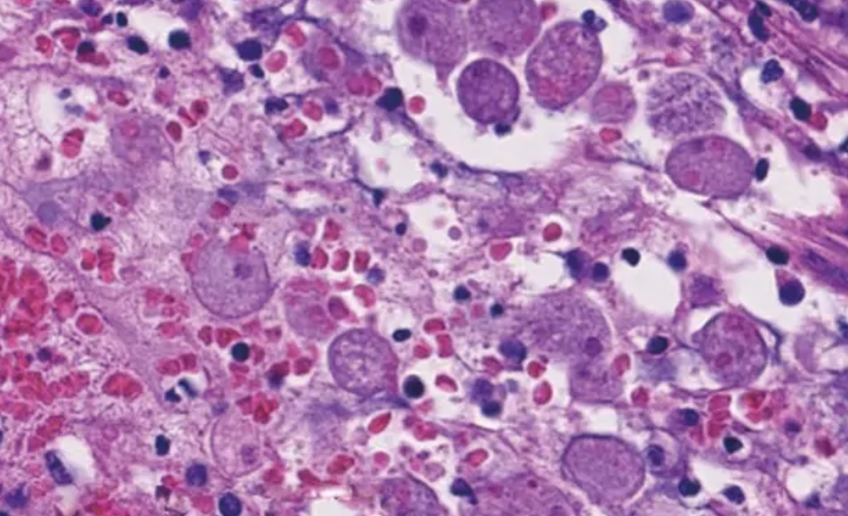
Entamoeba
Entamoeba
Dispar
Histolytica
Moshkovskii
Bangladeshi
Hartmanni
Moran P, et al. Amoebiasis: Advances in Diagnosis, Treatment, immunology features and the interaction with the intestinal ecosystem. Int J Mol Sci 2023
Notes:
Entamoeba is a category B Infection meaning it has a low infectious dose, it is environmentally stable, its resistance to chlorine and ease of dissemination makes it highly contagious
Most of the Entamoeba subclasses – are not pathologic in humans, however E. Histolytica is known to be pathologic in humans and responsible for most invasive amoebiasis; and subspecies like dispar have been associated with non-pathogenic colonization

Slide 5
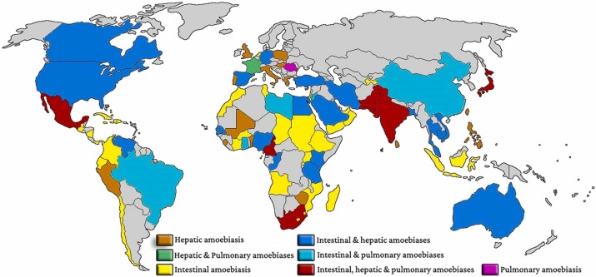
Epidemiology
Nasrallah J, et al. Updates on the worldwide burden of amoebiasis: a case series and literature review. J of Infection & public health, Vol 15, Iss 10, 2022
Notes:
Entamoeba is endemic in most low-middle income countries and sub-tropical areas with the highest incidences being reported in India, Mexico, Africa and parts of central and south America
It tends to occur in poor socioeconomic conditions where sanitation systems are not the best
When they do occur in high income countries – it is more commonly observed in migrants, travellers and men who have coitus with men

Slide 6
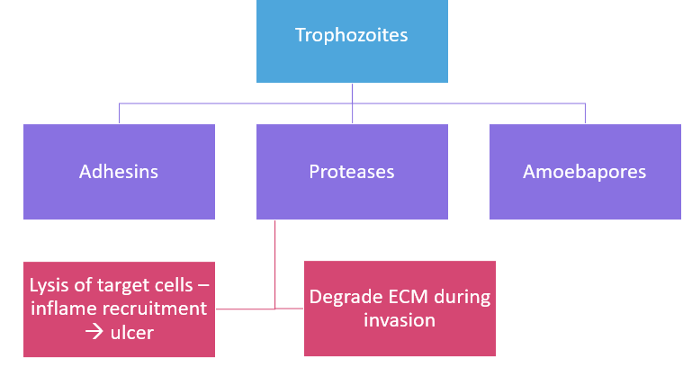
Transmission
Ingestion of Cysts
Encystation in the Terminal Ileum
Division of cyst 4 → 8-Trophozoites
Trophozoites → colonize the colon
Encystation
Excretion of Cysts
Begum S, et al. Entamoeba Histolytica. Parasite of the month Vol 37, Issue 7, P676-677 July 2021
Notes:
Amoebiasis exists in 2 states: the cyst stage which is viable in the environment for weeks to months, known as the infective form
And the invasive form – which is the trophozoite stage
Cysts are ingested in faecally contaminated food/ water and once they reach the terminal ileum encystation occurs, during this phase the division of cells occur from 4 to 8 cells and maturation into Trophozoites occurs
Trophozoites enter the colon where they can take 2 paths – encystation occurs and gets excreted in stool OR trophozoites invade the mucosa through 3 mechanisms
Adhesins allow adhesion to the colonic epithelium by galactose-n-acetylgalactosamine
Amoebapores create pores in the lipid bilayer resulting in cytolysis of infected cells and disruption of tight junction
Proteases – degrade target cells causing inflammatory recruitment and ulcer formation or degrade the ECM allowing invasion
Trophozoites spread haematogenically via portal circulation

Slide 7
Clinical Presentation
Asymptomatic
90% of cases
Colonic
Acute proctocolitis [Dysentry]
Chronic Non-Dysenteric colitis
Extra-Intestinal
Hepatic Abscess
Pleuropulmonary disease
Amoeboma
Rare
Appendicitis
Peri-anal cutaneous amoebiasis/ ulceration
Rectovaginal Fistula
Fulminant Amoebic colitis with perforation
Toxic Megacolon
Peritonitis
Brain Abscess
Genitourinary disease
Pericardial effusion
Kantor M, et al. Entamoeba Histolytica: updates in clinical manifestation, pathogenesis and vaccine development. Can J Gastroenterol Hepatol 2018;
Notes:
Clinically most asymptomatic patients are colonized by the non-pathogenic subspecies
Invasive disease is most commonly due to entamoeba histolytica and can present with colonic or extra-intestinal manifestations

Slide 8
Symptomatology
 | INTESTINAL | HEPATIC | PULMONARY | OTHER
Fever | X √ | √ | √ | √
Pain | √ | X | X | X/√
Dysentry | √ | X | X | X
Abdominal Tenderness | √ | X/√ | X | X
Weight loss | √ | X/√ | X /√ | √
Abscess | √ | √ | √ | √
Cough, Haemoptysis | X | X | √ | X
Fatigue | √ | √ | √ | √
Kantor M, et al. Entamoeba Histolytica: updates in clinical manifestation, pathogenesis and vaccine development. Can J Gastroenterol Hepatol 2018;
Notes:
Patients with amoebic colitis present with abdominal cramp pain and tenderness; dysentery; and whilst a fever can present in the acute phase – it is not always present in intestinal disease

Slide 9
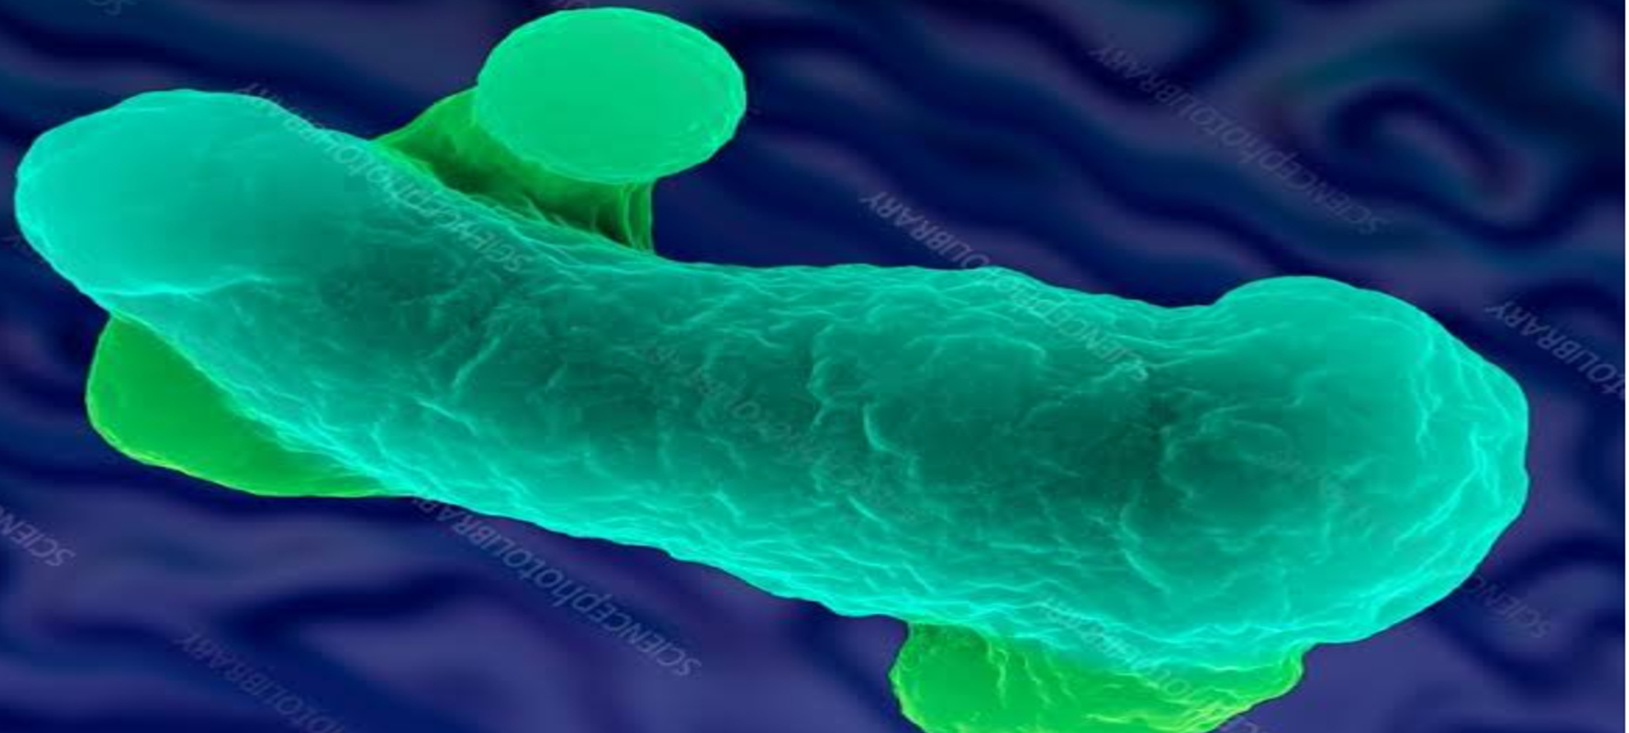
Risk Factors for Severe Disease
Strain of Entamoeba
E. Histolytica = pathogenic
E. Moshkovskii = potential pathogenicity
E. Dispar = Non-pathogenic
E. Bangladeshi
Host Factors
Genetic susceptibility
Age: <3 years; >40years
Immune suppression, steroids, alcohol, malnutrition, HIV
Pregnancy
Kantor M, et al. Entamoeba Histolytica: updates in clinical manifestation, pathogenesis and vaccine development. Can J Gastroenterol Hepatol 2018;
Notes:
It is estimated that ~10% of the global population have entamoeba present, but certain factors can aid predicting invasive disease
The first and strongest predictor is infection with Entamoeba histolytica subspecies, there has been evidence that genetic susceptibility plays a role in endemic areas; ages <3 or >40 years old; pregnancy and immunosuppression most particularly steroids and HIV and strong predictors of severe and invasive disease

Slide 10
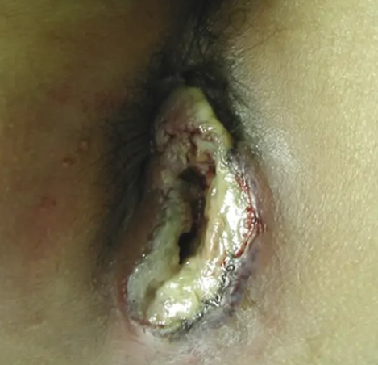
Intestinal Amoebiasis
Acute Proctocolitis [Dysentry]
Chronic Non-Dysenteric Colitis
Toxic Megacolon
Fulminant Amoebic Colitis with Perforation
Appendicitis- rare
Amoeboma
Perianal Cutaneous Amoebiasis/ ulcers
Abdominal Cramps/ pain
Fever
Anorexia & Vomiting
Dysentry
Abdominal pain/ cramps
PR bleeding [not dysentery]
Anorexia/ vomiting
Acutely ill/ toxic
Pyrexia
Intestinal bleeding
Perforation/ peritonism
Paralytic ileus
MODS
Pseudotumoral lesion
Palpable mass
Abdominal pain
Bowel obstruction
Flask-shaped ulcers on Colo
Kantor M, et al. Entamoeba Histolytica: updates in clinical manifestation, pathogenesis and vaccine development. Can J Gastroenterol Hepatol 2018;
Notes:
The spectrum of intestinal disease is wide ranging from acute proctocolitis to Fulminant amoebic colitis
Acute proctocolitis - Stool is bulky and acidic, with scanty exudate – as opposed to bacillary dysentery where it is scanty and alkaline massive exudate
Stool may have Leyden crystals which are disintegrated eosinophils

Slide 11
Toxic Megacolon: Jalan Score
Radiological Evidence of Colonic dilataion
Transverse colon >6cm
3 of the Following
Fever >38,6◦C
Tachycardia >120bpm
1 of the Following
Altered mental status
Electrolyte abnormality
Leukocytosis >10,5
Anaemia
Dehydration
Hypotension
Notes:
When assessing a patient for Amoebic colitis – The Jalan score can aid in diagnosing toxic megacolon, and these include radiological evidence of colonic dilatation, features of systemic inflammation, and complications from sepsis or dehydration

Slide 12
Investigations
 | INTESTINAL | HEPATIC | PULMONARY | OTHER
Microscopy | √ | X/√ | √ | √
Culture | √ | X/√ | X/√ | √
Counter-immuno-electrophoresis | X | √ | √ | √
IFA | X | √ | √ | √
ELISA | X | √ | √ | √
Latex | X | √ | √ | √
Haemagglutination | X | √ | √ | √
Rapid Diagnostic Tests | √ | √ | √ | √
PCR-based methods | √ | √ | √ | √
Anatomo-pathological | √ | √ | √ | √
Parija SC, Mandal J. Laboratory methods of identification of Entamoeba Histolytica and its differentiation from look-alike entamoeba spp. Trop Parasitol 2014;
Notes:
Collecting 3 Stool samples on 3 separate days within a 10 day period is your first line investigation when working a patient up for amoebic colits
The range of Serological tests available for diagnosing amoebic infection but it is to note that antibodies appear after 5-7days, when utilizing antibody based testing

Slide 13
Laboratory Investigations
 |  | Sensitivity (%) | Specificity (%)
Microscopy | Faeces – colitis | 30-50 | 10-50
 | Liver aspirate - abscess | <5% | 100
Serology | Faeces – colitis | 40-60 | 90
 | Liver aspirate - abscess | 95 | 98
Antigen Detection | Faeces – colitis | 80-99 | 86-98
 | Liver aspirate - abscess | 40-100 | 90-100
Polymerase Chain Reaction | Faeces – colitis | 80-100 | 85-100
 | Liver aspirate - abscess | 80-100 | 90-100
Parija SC, Mandal J. Laboratory methods of identification of Entamoeba Histolytica and its differentiation from look-alike entamoeba spp. Trop Parasitol 2014;
Notes:
The advent of newer technologies like PCR and antigen detection have improved diagnostic sensitivity and specificity compared to traditional microscopy and serology
However the gold standard for amoebic colitis remains ulcer margin biopsy during sigmoidoscopy or colonoscopy

Slide 14
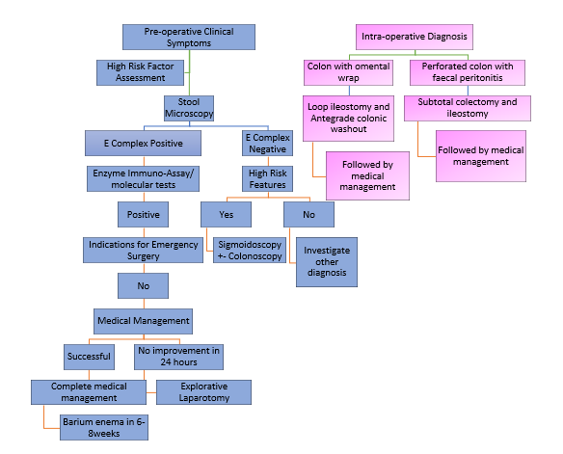
Diagnostic Approach
Notes:
When working a patient up for amoebic colitis it can be a pre-op or intra-operative diagnosis
A high index of suspicion in patients starts with the clinical symptoms: patients with bulky stool dysentery in an endemic area, or recent travel to an endemic area, or men who have sex with men should be the start of the assessment; assessing for high risk factors like immunosuppression should alert the clinician to risk of invasive disease
Stool samples for microscopy should be sent; correction of dehydration and electrolytes and if shocked – acute resuscitation methods implored
If E complex is present, molecular or ELISA testing and titres performed; if present; patient should be assessed for any indications for operative management; if none are present medical management is the first line management; if patients do not improve within 24 hours consideration for a laparotomy; if they do then 6-8 weeks apon completion of treatment a barium enema should be performed to assess for strictures
If stool sampling is negative but there is high suspicion for amoebic colitis a sigmoidoscopy should be performed and ulcer margin biopsied; a complete colonoscopy is contra-indicated in the acute colitic episode due to risk of perforation
If biopsies are negative than other causes of colitis should be investigated
More often than not we are not lucky to have pre-op diagnosis – and intra-operative diagnosis and management has to be undertaken, which we shall discuss shortly

Slide 15
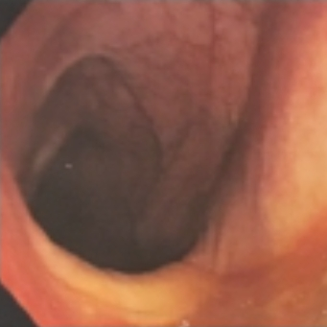
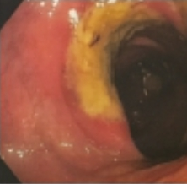
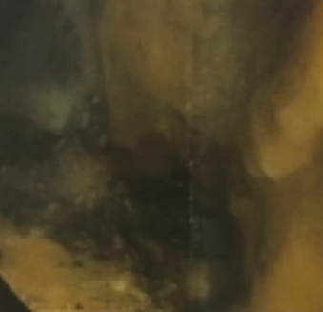
Sigmoidoscopy/ Colonoscopy
Caecum
Sigmoid
Rectum
Ascending Colon
Appendix
Normal Mucosa
Inflamed Mucosa
Necrotic Mucosa
Horiki N, et al. Endoscopic Findings and lesion distribution in amebic colitis. J Infect Chemother 2015
Notes:
At times the amoebic colitis is diagnosed during lower scopes for colitis or other indications, but there are certain highly suggestive features one can look out
Firstly amoebic colitis prefers the …
You will have areas of normal mucosa with intervening inflamed mucosa; and worst case areas of necrotic mucosa

Slide 16
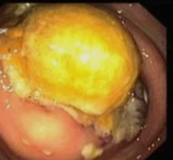
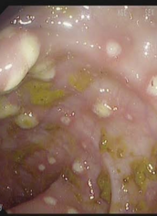
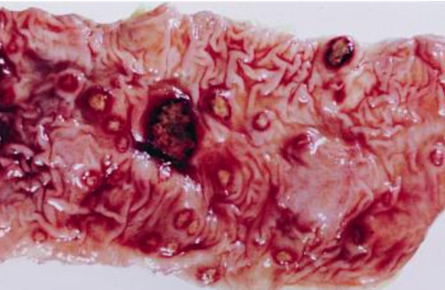
Amoeboma
Flask-shaped Ulcers
Nodular lesions with yellow exudate on them
Horiki N, et al. Endoscopic Findings and lesion distribution in amebic colitis. J Infect Chemother 2015
Notes:
An amoeboma is an inflammatory pseudotumoural mass that may occur, but more commonly flask-shaped ulcers or nodular lesions with yellow exudates

Slide 17
Radiological Diagnosis
 | INTESTINAL | HEPATIC | PULMONARY | OTHER
CT SCAN | X | √ | √ | √
MRI | X | √ | √ | √
ULTRASOUND | X | √ | √ | √
RADIOGRAPHY – XRAY | X | √ | √ | √
RECTOSIGMOIDOSCOPY | √ | X | X | X
COLONOSCOPY | √ | X | X | X
Notes:
Radiological imaging can aid in diagnosis of amoebiasis and its complications but most of the signs are not specific

Slide 18
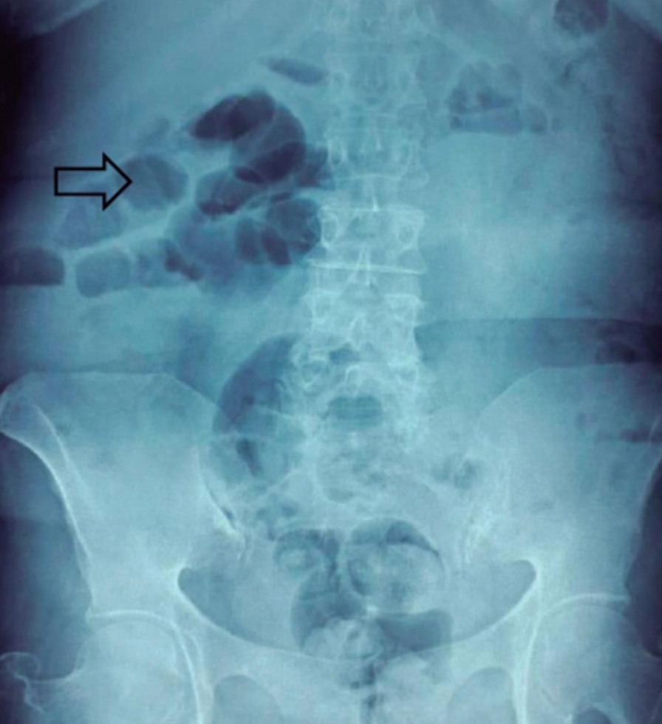
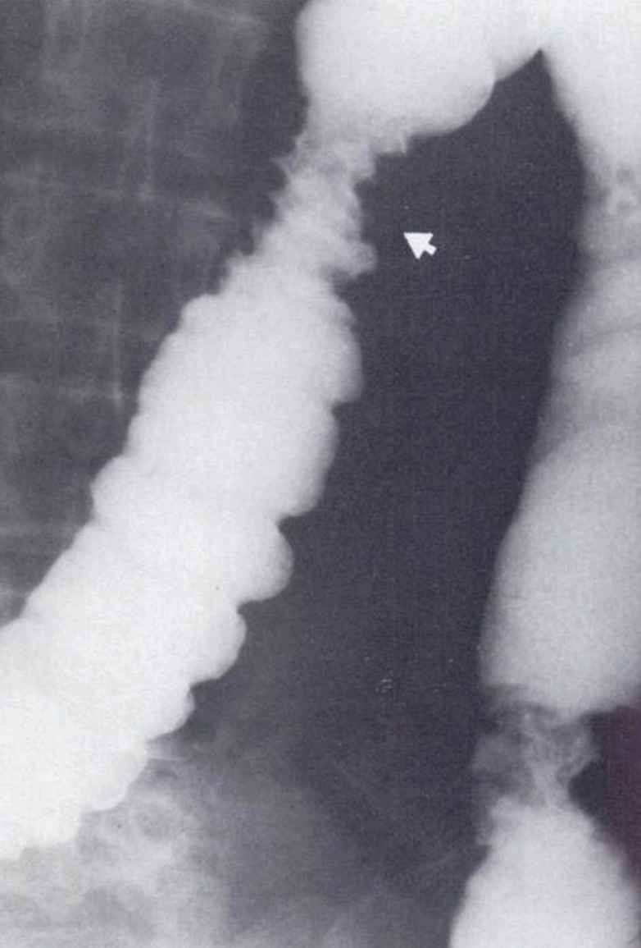
XRays
AXR: non-specific
Gas distension non-involved segment
Involved segment not visualized
Fixed placement of colon

Slide 19
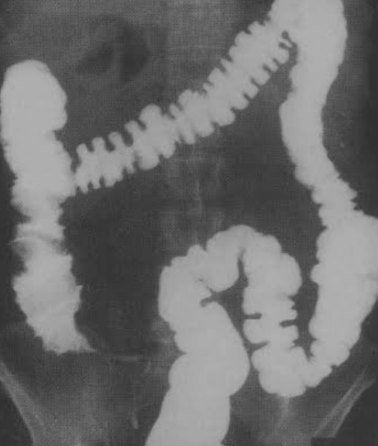
Fulminating Amoebic Colitis
Thumbprinting – non-specific
Intra-peritoneal free air
Retro-peritoneal mottling
Non-specific Toxic Megacolon

Slide 20
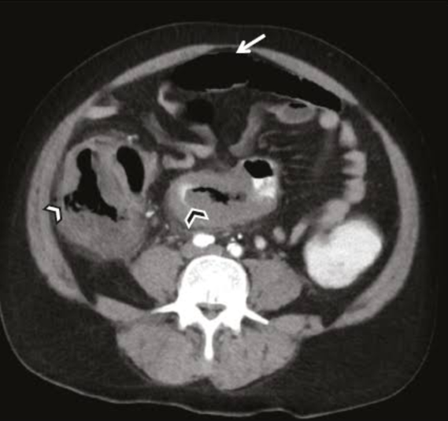
CT Imaging
Target Sign of Pancolitis
Omental Wrapping
Discontinous bowel necrosis = enhancing & non-enhancing bowel wall [Ischaemic Phenomenon]
Features of Perforation; Associated Liver Abscess; Amoeboma
Submucosal ulcers with intramural dissection of contrast
Stockinger ZT, et al. Colonic ameboma: its appearance on CT: report of a case. Dis Colon Rectum 2024
Notes:
In a study by Luvuno et al submucosal ulcers with intramural dissection of contrast has been shown to be pathognomic of amoebic colitis

Slide 21
Management
Prevention
Eradicate Intestinal Carriage
Eliminate Invasive Disease
Endemic Amoebiasis
Amoebicials and Luminal Agents
Surgical Management

Slide 22



Prevention
Clean & Disinfect Toilet Regularly
Wash Fruit & Veg before eating
Cook Meat & Veg properly
Boil Drinking water
Avoid Ice Cubes & drinking Fountains
Avoid unpasteurized dairy products

Slide 23

Eliminate Invasive Disease
Metronidazole
35-50mg/kg/d divided 3 doses
5-10 Days
750mg tds PO
Alternates
Nitazoxabide
Chloroquine
Tinidazole
Emetine
Gonzales MLM, et al. Antiamoebic drugs for treating amoebic colitis. Cochrane database Syst Rev 2019

Slide 24
Eliminate Intestinal Carriage
Tinidazole
50mg/kg/day
3-5 Days
2g daily PO
Alternates
Paromomycin
Diloxanide Furoate
Iodoquinol
Nitazoxanide
Gonzales MLM, et al. Antiamoebic drugs for treating amoebic colitis. Cochrane database Syst Rev 2019

Slide 25

Asymptomatic Carriage
Paromomycin
25-35mg/kg/day divided doses PO
Alternates
Iodoquinol
7 Days
Diloxanide fuorate
To Treat or Not to Treat?
Gonzales MLM, et al. Antiamoebic drugs for treating amoebic colitis. Cochrane database Syst Rev 2019
Notes:
This comes down to endemic vs non-endemic
The WHO recommends

Slide 26
Surgical Management
Perforated Amoebic Colitis
Massive GI Bleed
Toxic Megacolon
Acute Abdomen
Emergent Explorative Laparotomy
Notes:
As stated earlier, most-often an intraoperative diagnosis is made during an explorative laparotomy for acute abdomen
Or if diagnosed pre-op the patient presents with indications for emergency laparotomy like…

Slide 27
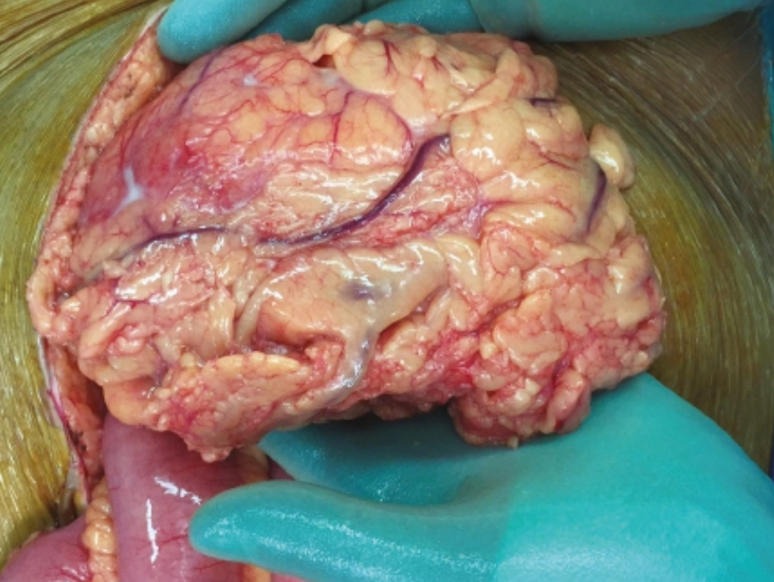
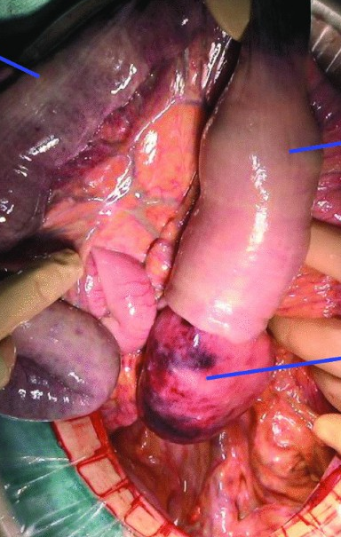
Intra-operative Management
Contained
Faecal Peritonitis
Ileostomy and Colectomy; Medical management
Ileostomy, anterograde washout
Medical management
Luvuno FM Role of intra-operative prograde colonic lavage and decompressive loop ileostomy in the management of transmural amoebic colitis. Br J surg
Notes:
You could be presented with 2 situations
The first is colon wrapped by omental, or contained perfs with no contamination – in a study by Luvuno et al, and further proven by Wagner et al, and Singh et al, [all local studies] Ileostomy and antegrade colonic lavage offers the patient best prognosis
Patients with uncontained perforation or faecal contamination an ileostomy with subtotal colectomy as opposed to Repair is recommended due to high incidence of breakdown due to amoebae
Dismantlign of wraps → leads to increased risk of contamination

Slide 28
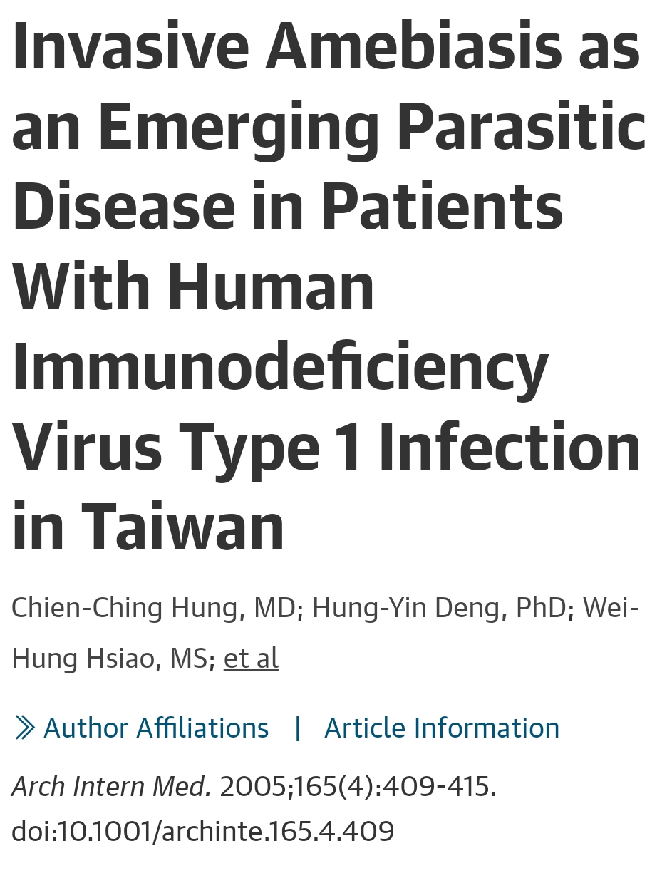
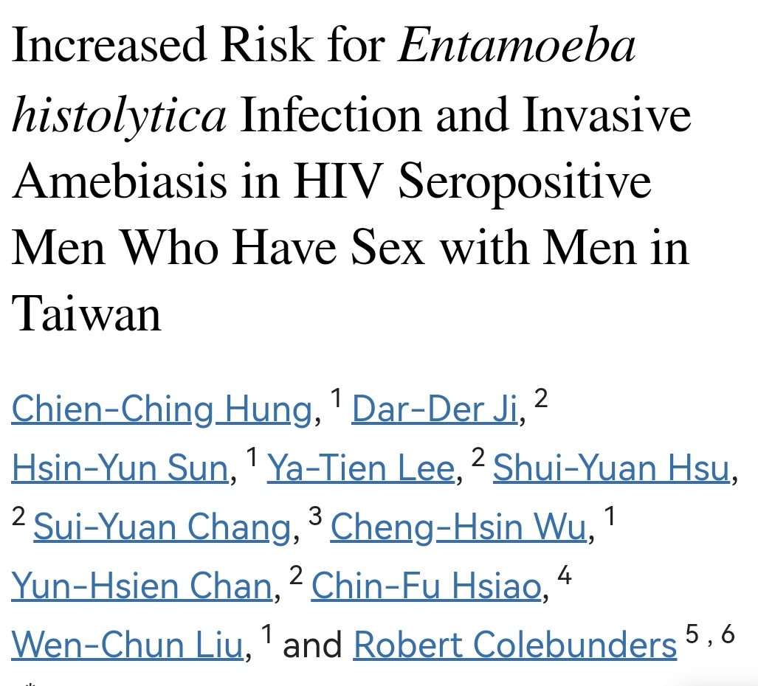
HIV and Amoebic Colitis
Notes:
HIV has been associated to be a major risk factor for developing invasive and severe disease
Another complication present in patients with HIV and amoebic colitis is a higher incidence of amoebic appendicitis prone to perforation– and if not treated have a higher risk of complications like abscess formation, EC fistulas and post-operative complications

Slide 29
Take Home Messages
Active Management of Invasive disease or disease in high risk populations in Endemic areas
Amoebicial Tissue agent + Intra-luminal agent recommended
Intra-operative management depends of patient stability and presence of faecal peritonitis
Active management of invasive and asymptomatic disease in Non-endemic Areas; Always screen for concomitant liver abscess
No peritonitis + wrapping = ileostomy & washout; Faecal Peritonitis = Colectomy and ileostomy

Slide 30
References
Wagener M, Naidoo M. Fulminant Amoebic colitis: the role of surgery and the operative approach. Gastroenterol Hepatol Endosc 1: DOI:10,15761/GHE,1000125
Luvuno FM Role of intra-operative prograde colonic lavage and decompressiove loop ileostomy in the management of transmural amoebic colitis. Br J Surg 77: 156-159
Isida H IS, Murata N, Hashimoto D. Fulminant Amoebic colitis with perforation successfully treated by staffed surgery: a case report. J of Gastroenterology 38: 92-96
Mewa Kinoo S, Singh B. Fulminant Amoebic colitis in the era of computed tomography scan: A case report and review of the literature. SA J of Radiology. 2018
Parija SC, Mandal J. Laboratory methods of identification of Entamoeba Histolytica and its differentiation from look-alike entamoeba spp. Trop Parasitol 2014; 4:90
Bercu TE, Petri WA. Amoebic colitis: new insights into pathogenesis and treatment. Curr Gastroenterol Rep 2007; 9:429
Stanley SL. Amoebiasis. Lancet 2002; 361:1025
Kantor M, Abrantes A, et al. Entamoeba Histolytica: updates in clinical manifestation, Pathogenesis, and vaccine development. Can J Gastroenterol Hepatol 2018: 4601420

Slide 31
THANK YOU

