Slide 1
Applied Rectal anatomy
Dr JH Koekemoer
ColoEscape 2024

Slide 2
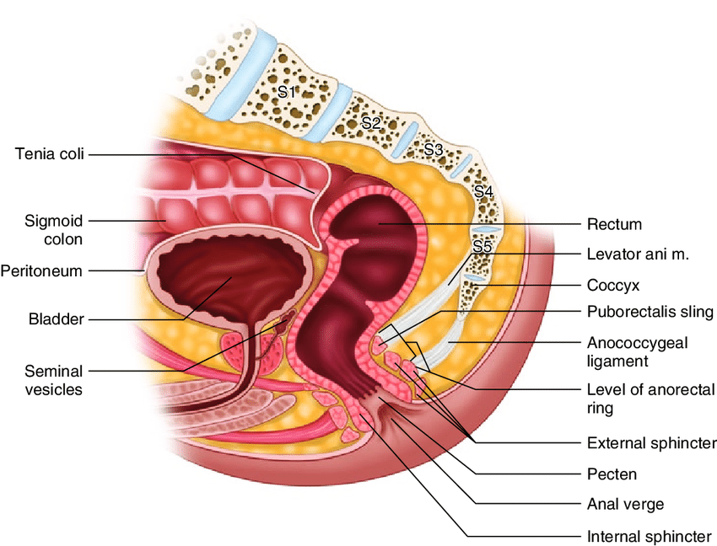
Introduction
Notes:
Distal part of large gut
Continuous with sigmoid colon
Ends where it passes through the puborectalis muscle
Continues as the anal canal
It descends with saccrococcygeal cancavity
First running posteriorly
Then curving anteriorly
Rectum is often defined as extending approximately 15 cm above anal verge

Slide 3
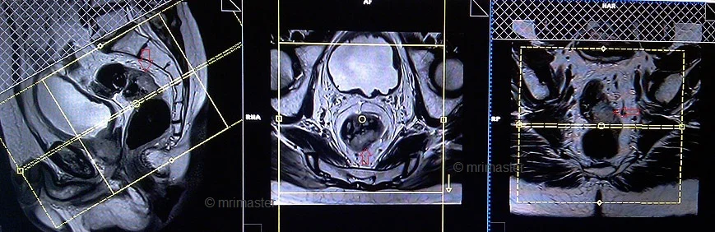
https://mrimaster.com/plan-rectal-ca-pelvis

Slide 4
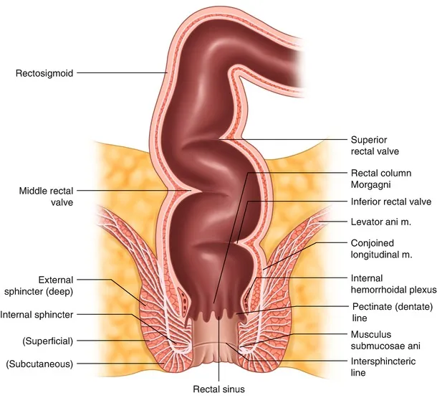
Notes:
The rectum deviates in three lateral curves
Upper - convex to the right
Middle (most prominent) - convex to the left
Lower - convex to the right
Ends of the rectum are in the median plane

Slide 5
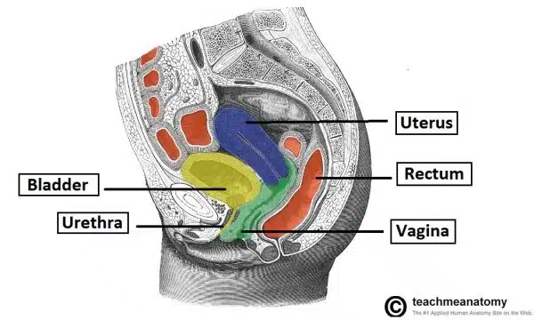
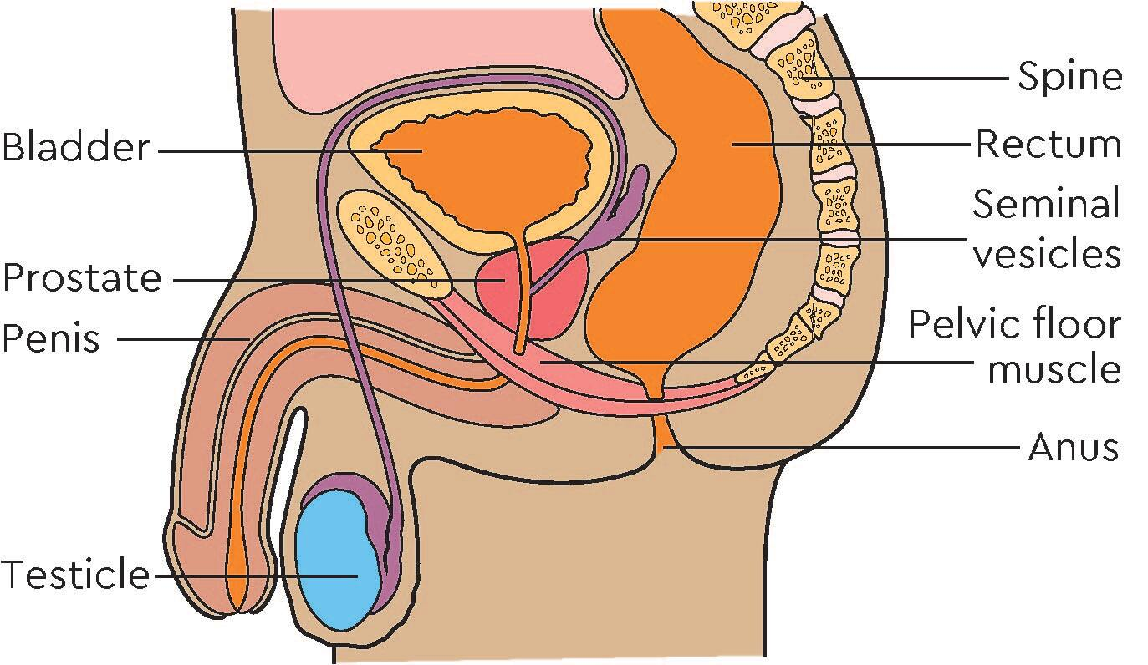
Relations
Notes:
Anterior male: Rectovesical pouch, Sigmoid colon, Ileum Bladder Prostate Seminal vesicles
Female : Rectouterine pouch
Sigmoid colon Ileum Vagina Cervix
Posterior : Sacrum and coccyx Piriformis Coccygeus Levator ani Sacral plexus

Slide 6
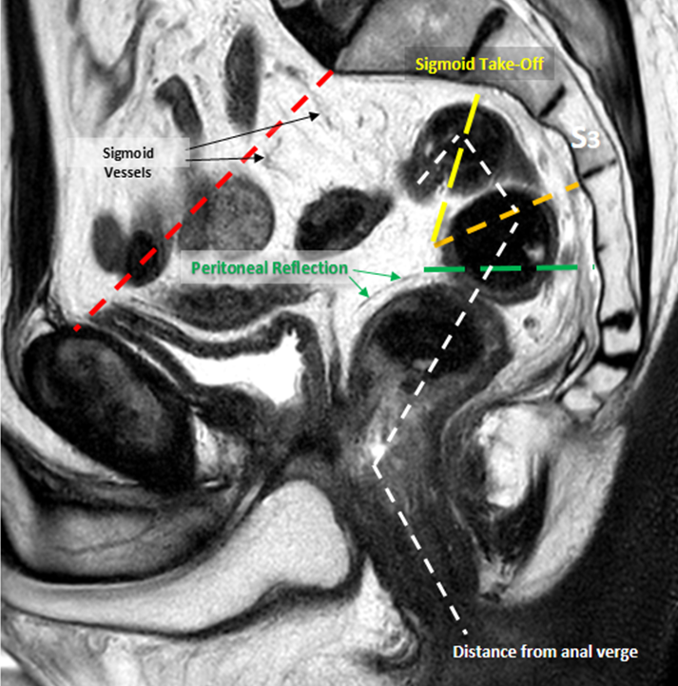
4-5cm
Parts | Distance from AV
Upper rectum | 11-15cm from AV
Middle rectum | 7-11cm from AV
Lower rectum | Up to 7cm from AV
Notes:
The traditional definition of the rectum relies mostly on its gross anatomy. More specifically, the transition from the sigmoid to the rectum is marked by the coalescence of taeniae coli, the loss of appendices epiploicae and the fusion of the surgical mesocolon. These landmarks are found approximately at the level of the sacral promontory, or 15 cm from the AV [4-9]. In addition, given the possible clinical benefits, it is helpful to divide the rectum into three parts—upper, middle and lower—measuring the distance from the AV. These measurements are best done with rigid sigmoidoscopy and MRI
The distance from anal verge to insertion of pubo rectalis sling is 4-5cm, lower rectum is defined as distance from puborectalis sling insertion up to 7cm, middle rectum 7-11cm and upper rectum 11-15cm.
Important to note that these measurements are affected by age and somatometric differences and controversy exist as to where the rectum starts and ends, many suggesting that the take-off of the sigmoid colon on MRI should define the recto-sigmoid junction

Slide 7
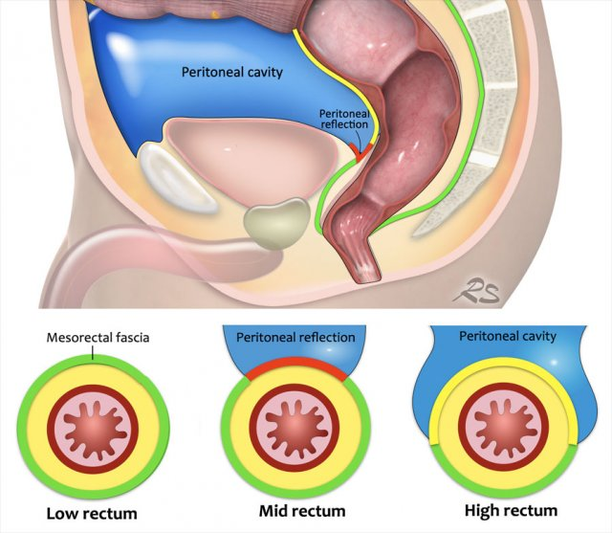
Peritoneal covering and anterior peritoneal reflection
Notes:
The rectum exhibits a unique pattern with regards to its peritoneal cover.
- With the upper third covered anteriorly and lateral, the middle only anteriorly, while the lower part is extraperitoneall.
A Peritoneal fold is formed surrounding the rectum, The deepest and most clinically important part is the anterior peritoneal reflection, or Douglas Pouch.
The anterior peritoneal reflection is important in local staging, since rectal tumors invading the anterior peritoneal reflection are staged as T4a lesions
- these lesions are at greater risk for peritoneal spread with obvious treatment implications
Furthermore locally advanced rectal cancers located at or above the anterior peritoneal reflection can not be reliably targeted with radiation, since they are
1. More mobile than extra-peritoneal tumors
2. Carries a Higher risk of inadvertent radiation of small bowel loops and radiation enteritis

Slide 8
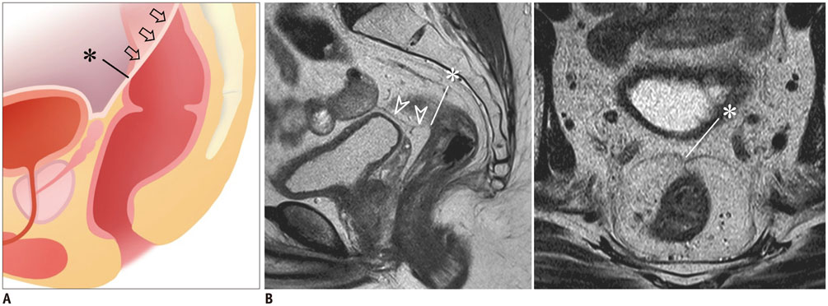
Peritoneal covering and anterior peritoneal reflection
Seagull sign
Notes:
Due to the implications off the position of tumours relative to the peritoneal reflection it is important to identify these structures during evaluation.
The anterior peritoneal reflection is easily seen on MRI in 82-90% of patients
- easily identified in the presence of fluid in the pelvic cul-de-sac
- anterior peritoneal attachment onto the anterior rectal wall exhibits a V-shaped sign on axial MRI - found at 10.9 cm from the AV in both sexes – referred to ass the seagull sign

Slide 9
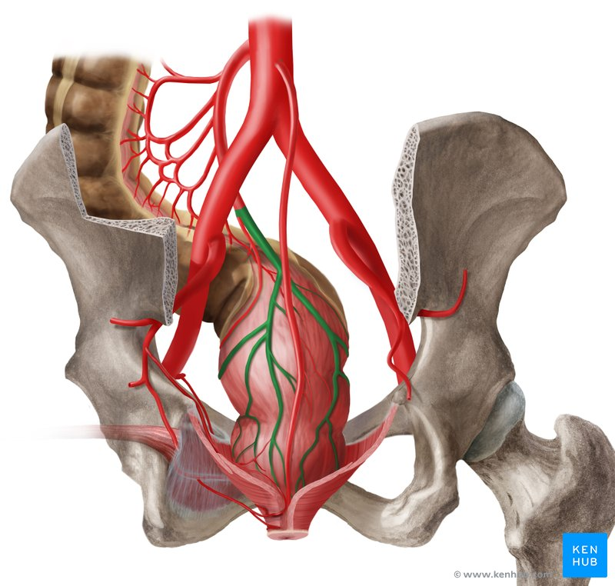
Rectal blood supply
Superior rectal artery
Notes:
The superior rectal artery is a Terminal branch of the inferior mesenteric artery
- deemed to become the SRA when it crosses the common or internal iliac artery on the left side of the pelvis
- at the level of the S2 or S3 vertebra it divides into a number of small branches that approach the rectum from the posterior aspect
- These branches descend across the sides of the rectum, providing supply for its superior two-thirds. But can as supply as far inferiorly as the internal anal sphincter.
The superior rectal artery serves as a anatomic landmark during TME and dissection into the posterior plane is carried out posterior to this pedicle, important relationships to the superior rectal artery is the ureter lateral to its course and the superior hypogastric plexus deep to the dissection plane.

Slide 10
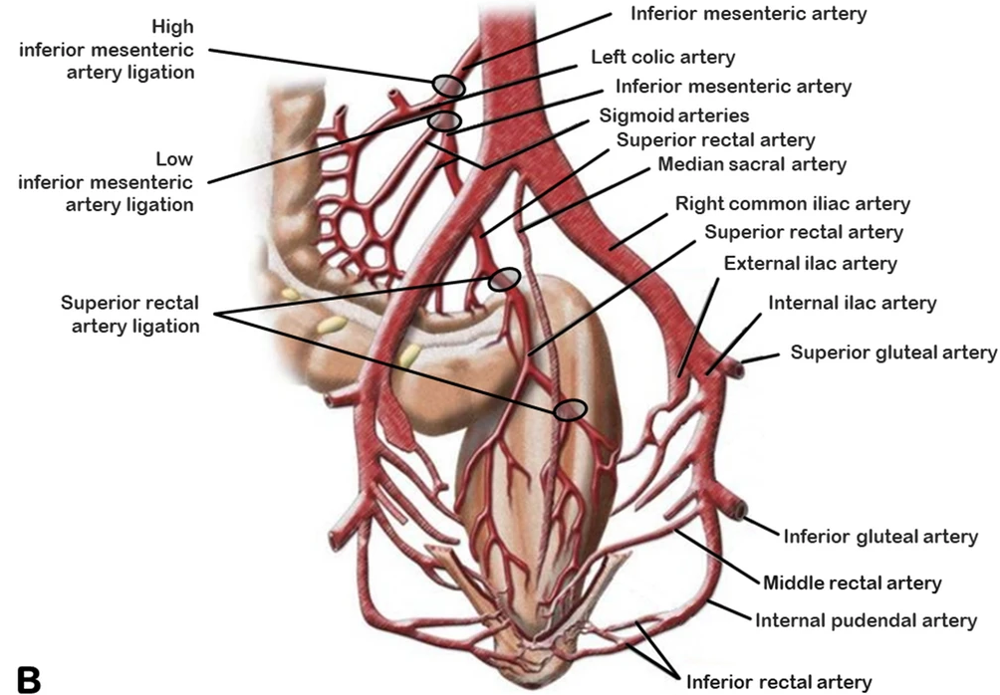

Rectal blood supply
Notes:
MRAs are inconsistent as regards their existence, origin and distribution
- Can originate from internal pudendal artery, posterior gluteal or diectly from the internal iliac artery
- The usual route for the MRA to approach the rectum was provided by the lateral ligaments of the rectum (the rectal stalks)
The internal pudendal artery gives rise to the IRA below the levator ani muscle
- As it reaches the anorectal junction, the IRA divides into 4 main branches for the distal part of the rectum, the anal canal, and the internal and external anal sphincter
- In the rectal wall, it creates anastomotic loops with the MRA (when they exist) or the SRA in the submucosa
During a low colorectal anastomosis, ligation of SRA and MRA results in the loss of middle and upper mesorectal collaterals, the arterial supply of the anastomosis relies on a weak network of small collaterals found close to the rectal wall and increases the risk of anastomotic leak

Slide 11
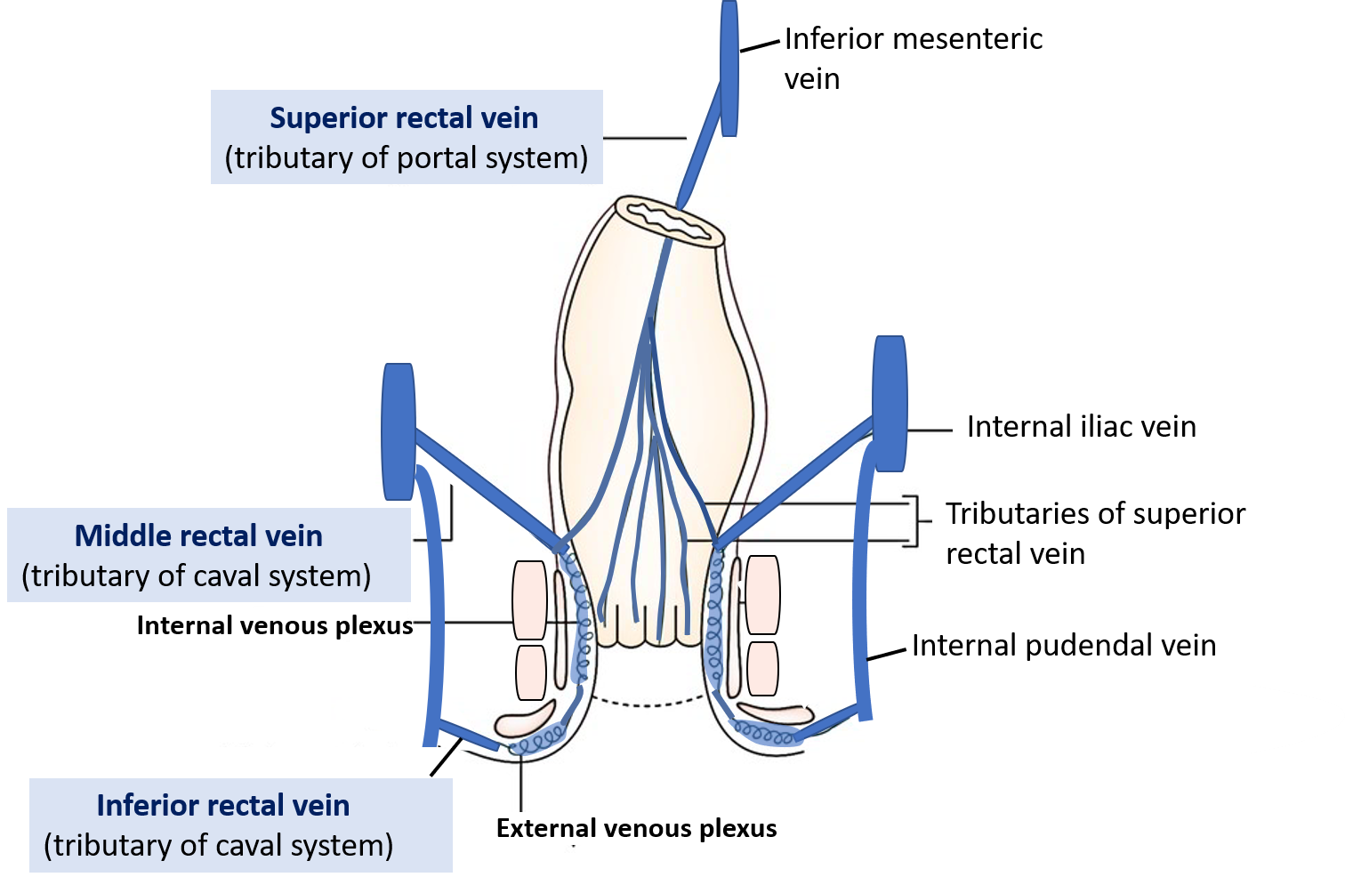
Venous drainage
Notes:
Venous drainage follow the arterial system
- with the middle and upper rectum, draining mainly through the superior rectal vein
- lower and the middle rectum drain mainly through the inferior rectal veins to the systemic circulation via the internal iliac artery
It is thus important to note that tumors of the upper and middle rectum are most often metastasize to the liver and
tumors of the lower middle tend to metastasize primarily to the lungs

Slide 12
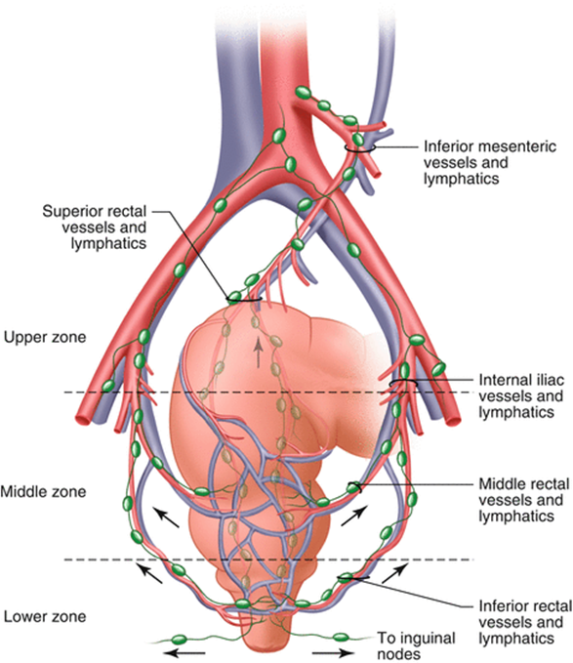
Rectal lymphatics and lymph nodes
Notes:
The majority of rectal lymph nodes are embedded inside the fatty mesorectum.
- Lymphatic drainage of the rectum is determined by relationship to peritoneal reflection and rectal surface with
- Tumors located above the peritoneal reflection spreading along the SRA and rarely spread along MRA
- Those below the peritoneal reflection appear to be mainly distributed in the SRA and secondarily in the MRA and IRA
- Lateral tumours seem to spread along SRA and MRA distribution on the ipsilteral side sparing the contralateral side
- whereas posterior tumours mainly spread along SRA distribution bilaterally
Tumors located in the lower rectum, and especially those with their lower limit less than 5 cm from the DL could potentially spread to internal iliac arteries

Slide 13
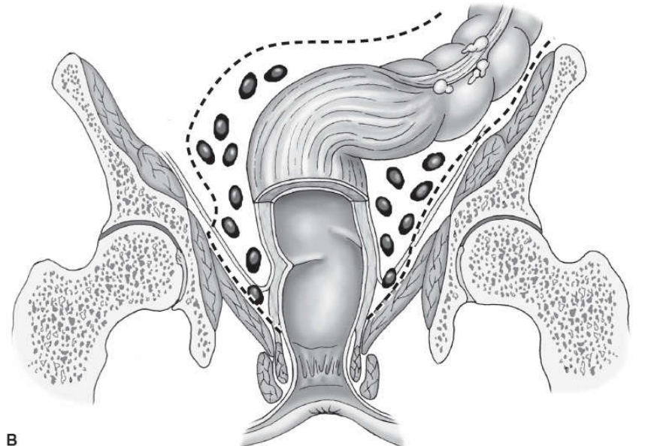
Mesorectum and surrounding fascias
Notes:
The rectum is surrounded by an fatty envelope called “meso”, in which vessels, nerves and lymph nodes are embedded
- transition from the mesosigmoid to mesorectum is generally defined by the “sigmoid take off
During development of the primitive hindgut, upon returning to the abdomen, mesorectum loosely adheres to the devoloping sacrum creating a avascular surgical plane, famously referred to as the holy plane of rectal surgery by Dr Heald in the 1980s. This plane forms the basis of TME

Slide 14
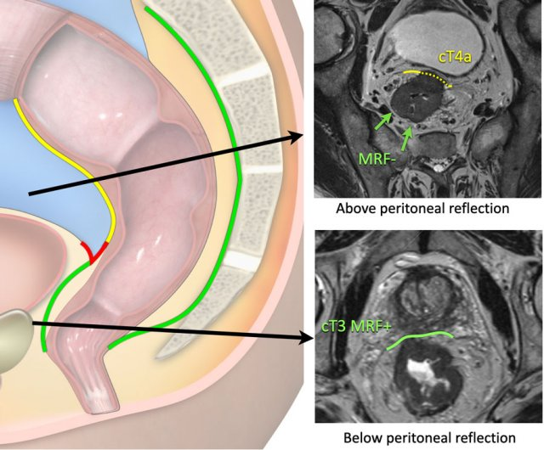
Mesorectum and surrounding fascias
Notes:
On this cross-sectional imaging, the bifurcation of the superior rectal vessels as it enters the proximal mesorectum is adjacent to the inferior portion of the pouch of Douglas approximately at the level of S3 – mid rectum
- At this point, the proximal part of the rectum is covered by the mesorectum only laterally and posteriorly
The Rectum circumferentially encased distal to the anterior peritoneal reflection
In the lower part, however, the anterior wall is only rudimentarily covered, as the mesorectum almost become fused with the rectal wall
The distribution of the mesorectal volume could imply modifications in the treatment of rectal cancer as it can potnetially influence the T-staging
- locally advanced cancer located anteriorly in the lower rectum, where mesorectal fat cover is thin, have a higher lielyhood of local infiltration into neighboring viscera

Slide 15
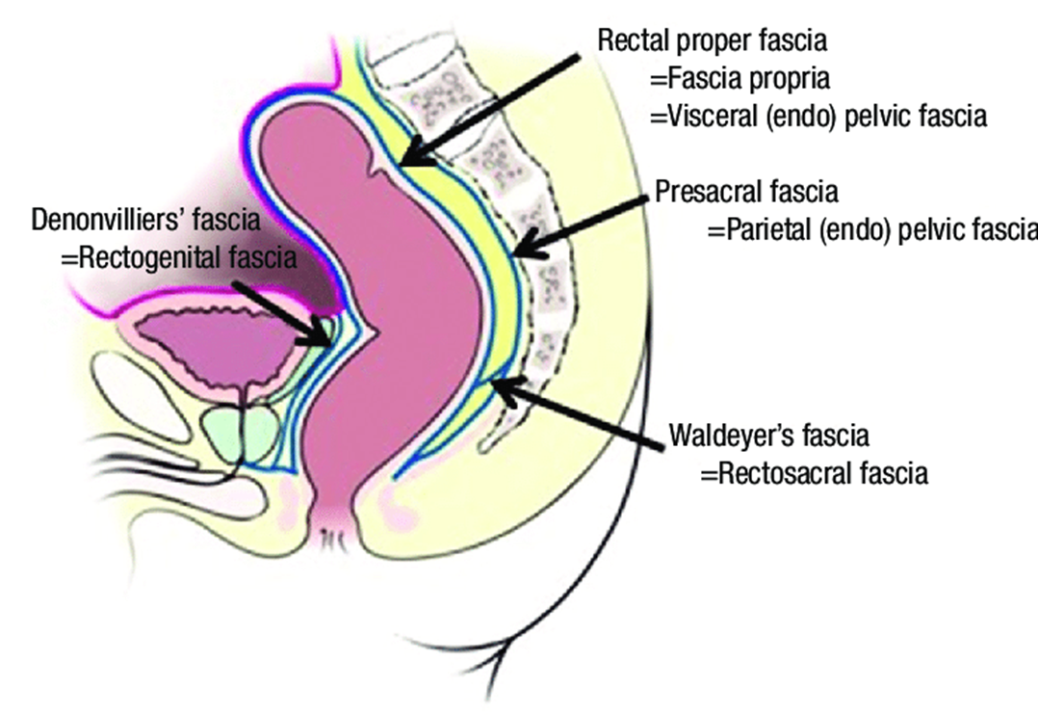

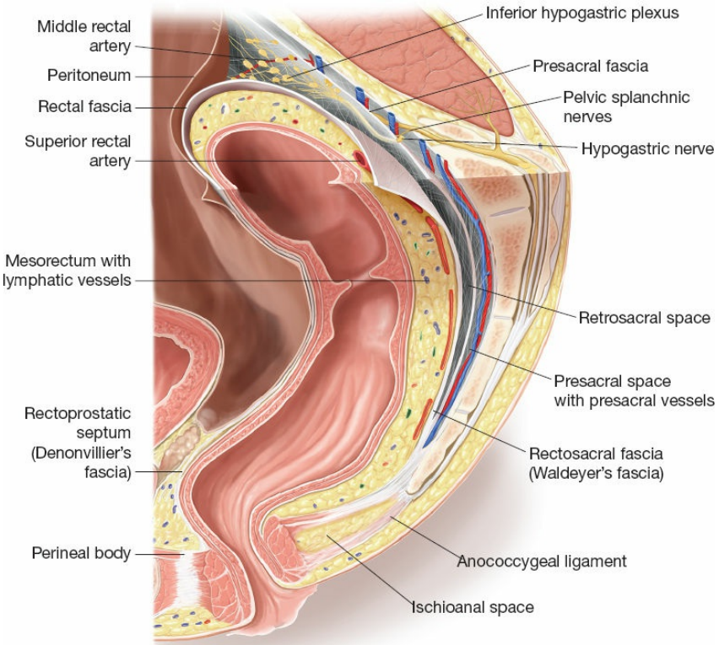

Surrounding fasciae
Notes:
In most posterior aspect lies the presacral fascia, which covers the sacral bone and its venous plexus, extending to the pelvic floor to cover the proctococcygeus muscle, where at the level of the levator ani muscle fuses with the mesorectal fascia
On the posteroinferior side of the rectum the rectosacral fascia (Waldeyer’s fascia) may be recognized.
- thickening of the presacral fascia that descends to meet the mesorectal fascia about 3-5 cm from the anorectal junction
- can originate from S2 S3 S4
- Function appears to be the anchorage of the rectum with the sacral bone
Separation of the mesorectum from the parietal fascia must be done with caution, violation of the parietal pelvic fascia may result in injury of the presacral venous plexus
Recognition and dissection of the Waldeyers fascia close to its anchoring on the rectal wall increases the mobility of the distal rectum and ensures dissection along the correct plane and dissection can be achieved to level of pelvic floor
Denonvillier’s fascia can be found between the anterior side of the rectum and the prostate and seminal vesicles,
- Inside this fascia, nerve fibers from the hypogastric nerve and small vessels leading to the prostate and male genital organs
- When dissecting close to or at Denonviller’s fascia below anterior reflexion, neurovascular involvement is almost inevitable, since small nerve fibers and vessels are sheathed in it, resulting in some degree of urogenital dysfunction.

Slide 16
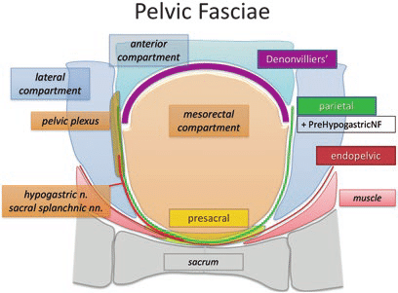

Surrounding fasciae
Notes:
Ventrally to the presacral fascia lies the parietal pelvic fascia
- It encases the hypogastric nerves and the pelvic splanchnic nerves, which run through the lateral pelvic walls
- As it descends towards the levator ani muscle it fuses with the presacral fascia, making it difficult to separate them

Slide 17
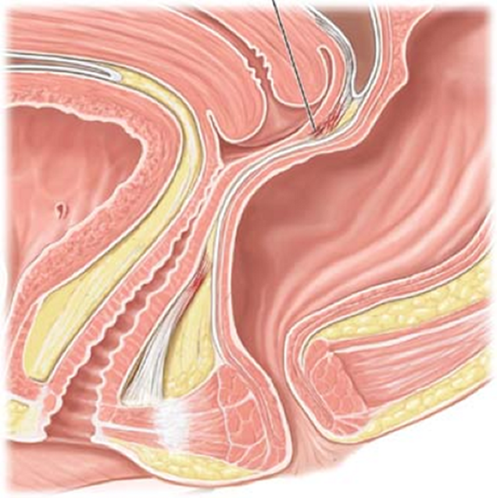
Surrounding fasciae
Rectovaginal septum
Anterior Petal
Posterior petal
Notes:
The rectovaginal septum consists of 2 thin elements
- one anterior and one posterior petal
- the posterior petal originates from the pelvic diaphragm (from the arcus tendineus), ascends in close contact with the rectum and reaches the peritoneum where it eventually fuses with rectum - some researchers are of the opinion that this constitutes the mesorectal fascia
- The anterior petal is fundamentally Denonvillier’s fascia, which originates from the pelvic floor and courses upward, adheres to the back of the vagina and continues its cephalic to adhere to the back of the uterus

Slide 18
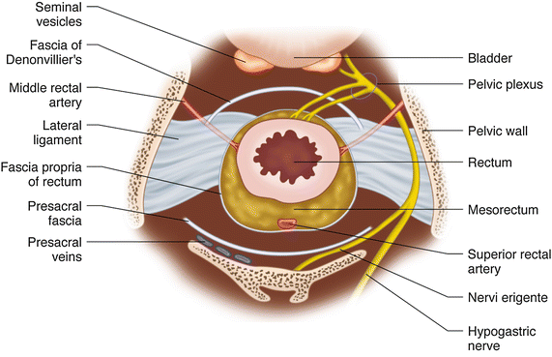
Surrounding fasciae
Notes:
Laterally to the rectum we may find the lateral ligaments
- Connects rectum to pelvic wall
- Can be unilateral, bilateral, lateral / posterolateral or posterior
- in those cases where the middle rectal artery runs through them, there is a higher risk of having accompanying lymphatics towards the lateral pelvic wall, possibly connecting the mesorectal group of lymph nodes with those of the internal iliac artery or the internal obturator artery

Slide 19
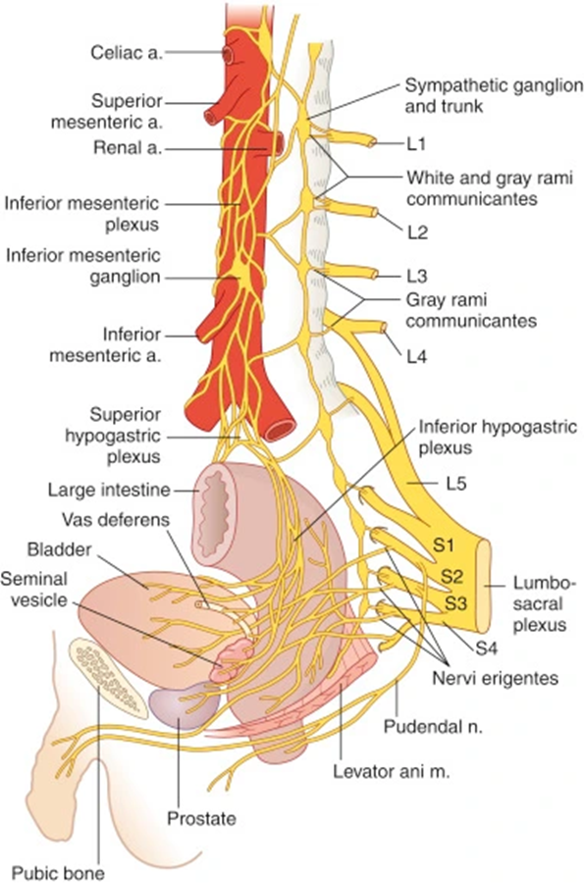
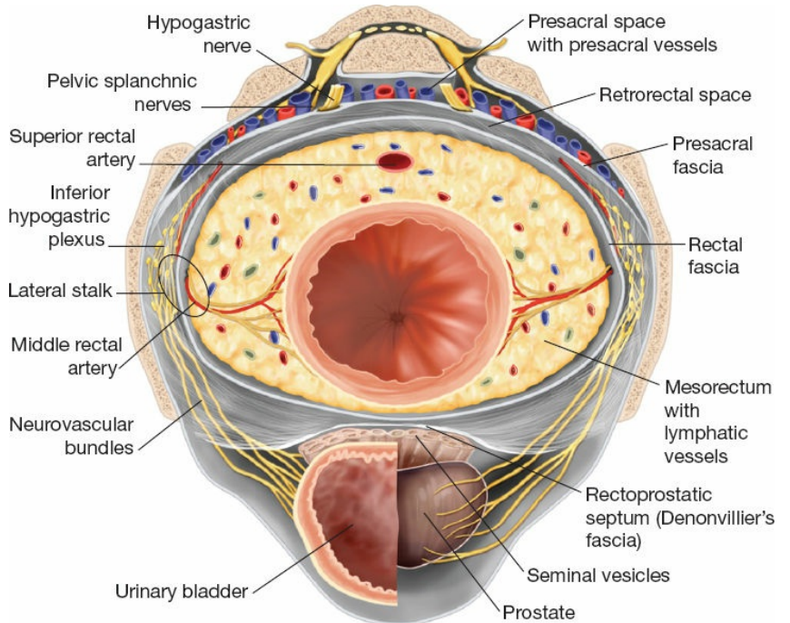






The rectum and its nerve supply
Notes:
The innervation of the rectum can basiccaly be distinguished into two interacting systems, one internal and one external.
- the internal system (or intestinal nervous system) consists of a interconnected network formed between the myenteric (or Auerbach’s plexus) and the submucosal (or Meissner’s plexus)
The external system is the autonomous nervous system, sympathetic and parasympathetic
Sympathetic pre-ganglionic fibers start from the first three lumbar vertebrae which enter the sympathetic chain following a downward course to provide the abdominal visceral nerves and contribute to the pre-aortic plexus.
the pre-aortic plexus continue to form the inferior mesenteric plexus which runs with the IMA and its branches
Post-ganglionic fibers follow the IMA and superior rectal artery to innervate the upper rectum
Nerve fibers starting from the superior hypogastric plexus ,located just below the aortic bifurcation, will enter the pelvis and divide into 2 parts
2 hypogastric nerves follow a parallel course to the ureter over the lateral sides of the pelvis,
The left hypogastric nerve is often located behind the origin of the SRA
The distal parts of the hypogastric nerves are located about 2-4 cm below the peritoneum
Parasymphatetic, pelvic splanchnic nerves fibers (nervi erigentes) join the hypogastric nerves and radiate towards the middle and lower rectum, forming the inferior hypogastric plexus, essentially a “T-junction” that lies close to the posterolateral aspect of the rectum near the pelvic wall
the fibers separate into those that innervate proximal hindgut and those that innervate the middle and lower rectum
The latter following a descending course, running first close to the ureters and the urinary bladder, innervating them, and then turning downwards at the posterior side of the seminal vesicles and the prostate to reach the lower rectum
Potential injury to these nerves during TME can occur
inferior mesenteric plexus commonly injured at the origin of the IMA – 1-1.5cm stump iadequate to avoid this complication
The superior hypogastric plexus can be injured when entering the retrorectus plane - injury at this point may cause symptoms of bowel dysfunction ranging from constipation and intermittent defecation with tenesmus to incontinence
During dissection of the retrorectal space injury to the hypogastric nerves could result in anorectal incontinence and urogenital dysfunction
special care should be taken both at the anterior-inferior aspect of the rectum, where nerve fibers for the internal anal sphincter from the pelvic plexus run along the neurovascular bundle, and at the anterior-lateral aspect, where nerve fibers innervate internal anal sphincter
the inferior hypogastric plexus may be injured At the level of the lateral rectal ligaments
Injury to parasympathetic innervation during low anterior resection might result in defecation disorders, a syndrome known as “low anterior resection syndrome”
During dissection of the lateral aspects of the rectum one should stay close to lateral mesorectal wall to minimize risk of injuring these structures
Denonvillier’s fascia may jeopardize the integrity of nerves radiating from the hypogastric nerves to the urogenital area – urogentital fallout

Slide 20
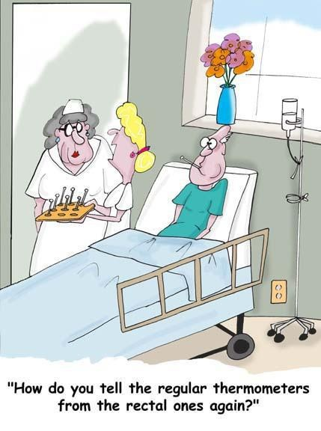
Thank you

