Slide 1
No Bowel Prep (NBP) prior to colorectal surgery: a debate
Dr S. S. Khoza
July 2024- ColoEscape

Slide 2

Elective colorectal surgery
Resection and primary anastomosis/ Hartmann’s procedure/ APR
Diverticular disease; CRC; IBD
Typical patient:
  Loss of weight
  History of abdominal pains
  Change of bowel habits
  Anxious

Slide 3


Typical/ index patient

Slide 4
ADEs of MBP = Distorts ERAS
Distressful to patient + elderly+ organ damage ➔ $↑$ASA score
Distressful to patient + elderly+ organ damage ➔ ↑ASA score
Admission prior surgery ➔ Time consuming
Dehydration
Prolonged starvation period
Electrolyte imbalance ➔ seizures/ status epilepticus
Liquifies stool ➔ spillage and contamination
Bacterial translocation

Slide 5
ADEs Oral antibiotics
Allergic reaction
Abdominal pains, nausea, vomiting, diarrhea
Multiple doses at night
Clostridium difficile

Slide 6

Paradigm shift
Wille-Jorgensen P., et al. 2005. Pre-operative mechanical bowel cleansing or not? An updated meta-analysis
  MBP vs NMBP
  AL 6% $≠$ 3.2%
  SSI 7.4% $≠$5.4%
  Mortality 1% $≠$ 0.61%
Güenaga K.F., et al. 2011; Mechanical Bowel Preparation for Elective Colorectal Surgery; Cochrane Library
  MBP vs NMBP
  AL 4.4% $≠$ 4.5%
  SSI 9.6% $≠$ 8.5%

Slide 7
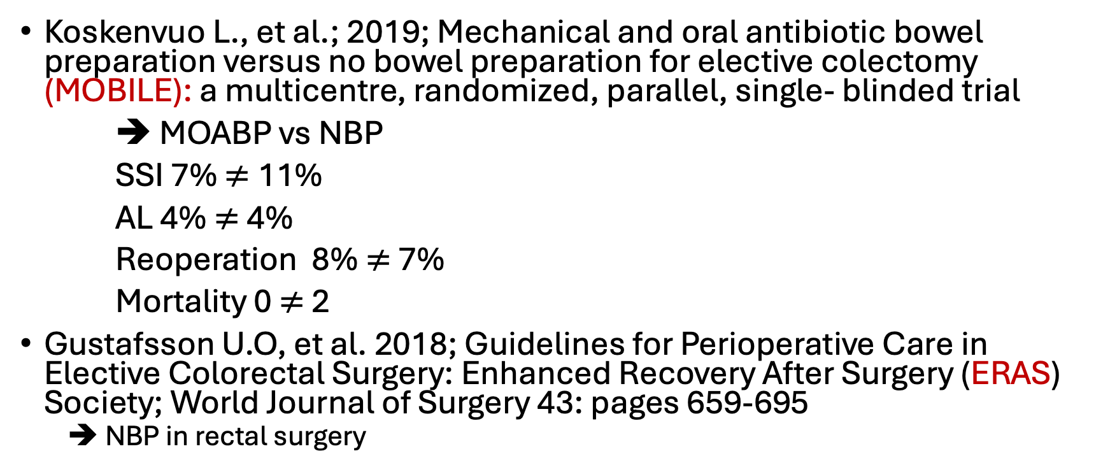
Paradigm shift
Koskenvuo L., et al.; 2019; Mechanical and oral antibiotic bowel preparation versus no bowel preparation for elective colectomy (MOBILE): a multicentre, randomized, parallel, single- blinded trial
➔ MOABP vs NBP
SSI 7% $≠$11%
AL 4% $≠$ 4%
Reoperation 8% $≠$ 7%
Mortality 0 $≠$ 2
Gustafsson U.O, et al. 2018; Guidelines for Perioperative Care in Elective Colorectal Surgery: Enhanced Recovery After Surgery (ERAS) Society; World Journal of Surgery 43: pages 659-695
  ➔ NBP in rectal surgery

Slide 8


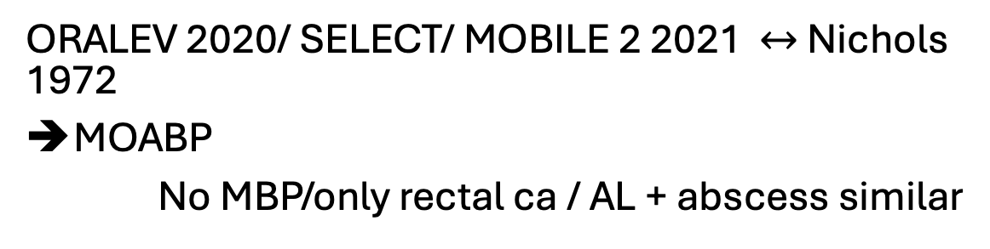
Going back in time
ORALEV 2020/ SELECT/ MOBILE 2 2021 $↔$ Nichols 1972
MOABP
No MBP/only rectal ca / AL + abscess similar

Slide 9
Controversy persists into the future
Gu S., et al. 2021. Are colorectal patients willing to accept an increased risk of surgical site infection to avoid mechanical bowel preparation? Implications for future trial design
➔ Patient centered + autonomy
Woodfield J.C., et al; 2021. Strategies for Antibiotic Administration for Bowel Preparation Among Patients Undergoing Elective Colorectal Surgery:
➔ AL ; Mortality; deep peritoneal collection; pneumonia; UTI; LOS
Frountzas M., et al. 2024; The Impact of Mechanical Bowel Preparation and Oral Antibiotics in Colorectal Cancer Surgery (MECCA Study): A Prospective Randomized Clinical Trial
➔AL
Intraabdominal sepsis
mortality

Slide 10
Conclusion
NMBP = cost-effective
NMBP = preserve physiology & mental health
⚓️ Against the routine use of bowel prep
Patient’s autonomy
Mitigate ADEs of MOABP

Slide 11
References
Bednarski B; 2023; Overview of colon resection; UpToDate
Bhat A.F., et al. Mechanical bowel versus no preparation in elective colorectal surgery: A prospective randomized study; 2016; Internationa Journal of Surgery Open, Volume 2, Pages 26-30
Deo S.V.S., et al. 2012. A Review of Controversies in the Management of Colorectal Cancers; Indian J Surg 74 (3): Pages 221-227
Frountzas M., et al. 2024; The Impact of Mechanical Bowel Preparation and Oral Antibiotics in Colorectal Cancer Surgery (MECCA Study): A Prospective Randomized Clinical Trial
Gu S., et al. 2021. Are colorectal patients willing to accept an increased risk of surgical site infection to avoid mechanical bowel preparation? Implications for future trial design; Colorectal Disease; 42(3): pages 322-328
Güenaga K.F., et al. 2011; Mechanical Bowel Preparation for Elective Colorectal Surgery; Cochrane Library
Gustafsson U.O, et al. 2018; Guidelines for Perioperative Care in Elective Colorectal Surgery: Enhanced Recovery After Surgery (ERAS) Society; World Journal of Surgery 43: pages 659-695
Koskenvuo L., et al.; 2019; Mechanical and oral antibiotic bowel preparation versus no bowel preparation for elective colectomy (MOBILE): a multicentre, randomized, parallel, single- blinded trial
Ricciardi R., et al. 2023; Enhanced recovery after colorectal surgery; UpToDate
Rollins K.E., et al; 2018; Impact of Mechanical Bowel Preparation in Elective Colorectal Surgery: A meta-analysis; World Journal of Gastroenterology 24 (4): pages 519-536
Van’t Stant; 2014; The State of Mechanical Bowel Preparation in Colorectal Surgery
Wille-Jorgensen P., et al. 2005. Pre-operative mechanical bowel cleansing or not? An updated meta-analysis
Woodfield J.C., et al; 2021. Strategies for Antibiotic Administration for Bowel Preparation Among Patients Undergoing Elective Colorectal Surgery: A Network Meta-analysis. JAMA Surgery, 2022; 157 (1): 34-41

Slide 12
THANK YOU

