Slide 1
Surgical Management FAP
Nsizwenye Ntokozo Mkhwanazi
Groote Schuur
Colorectal
ColoEscape

Slide 2
Introduction
Familial Adenomatous Polyposis
Inherited Colorectal Polyposis Syndrome
Mutation APC gene
Autosomal Dominant inheritence
1% of all CRC
100% penetrance
Preventive Colectomy Standard of care
Debate
Extent/Timing/Endoscopic Surveillance

Slide 3
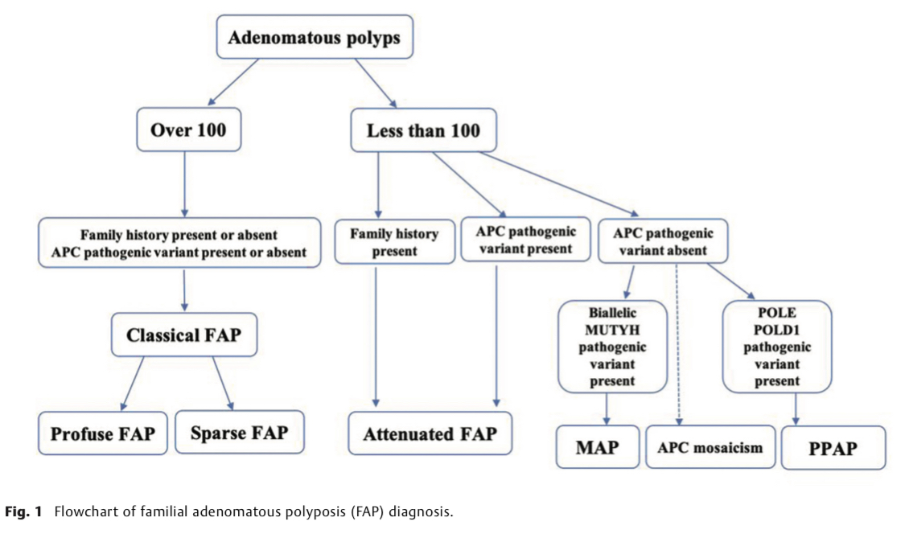
The phenotypic spectrum

Slide 4
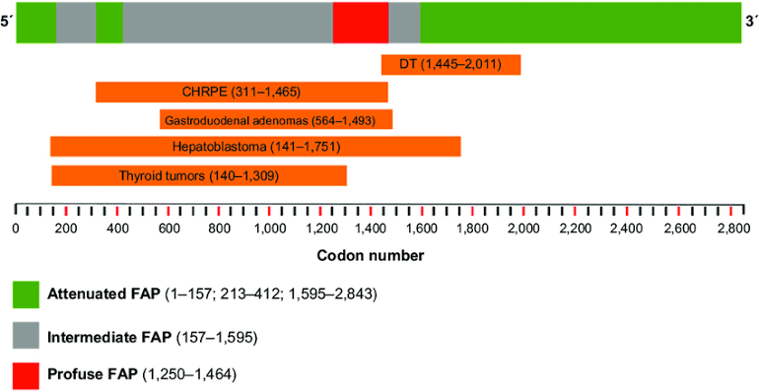
The Genotypic spectrum

Slide 5
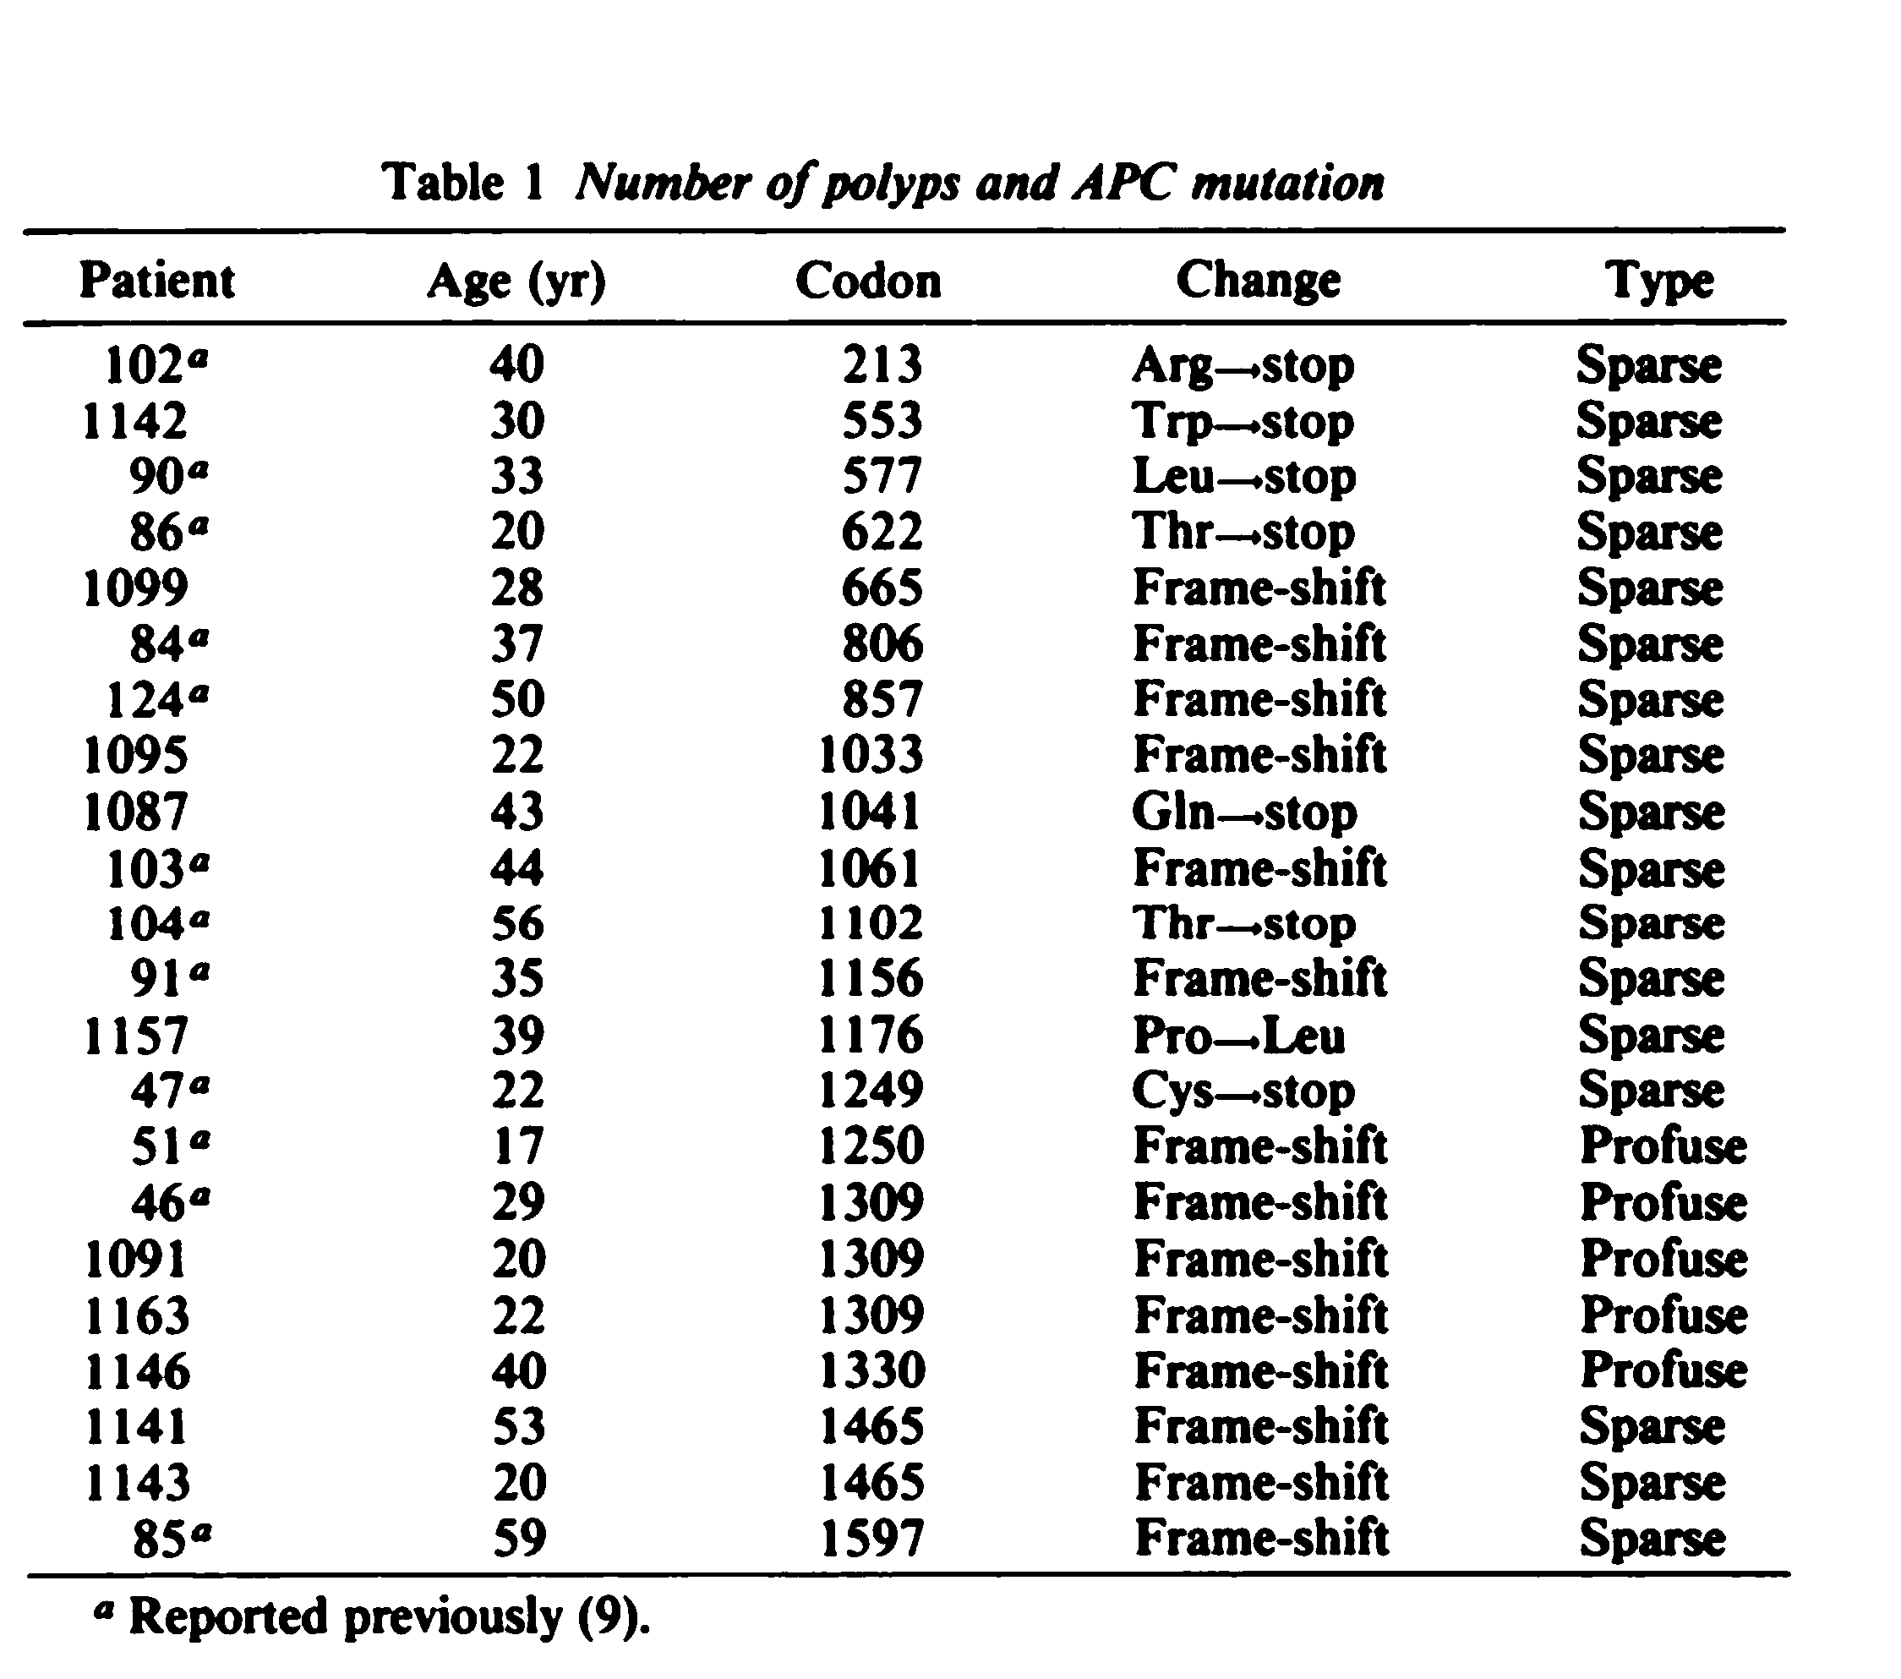
Nagase et al

Slide 6
Pre-op surveillance in FAP
Endoscopic Surveillance 12-14 years
Interval 1-2 years, typical FAP
Interval 2-3 years, attenuated FAP
Extra-intestinal survaillance age 25-30/ diagnosis of polyps
Gastroduoedenoscopy at 25 (6months-5 years)
Annual U/S neck
Abdominal exam/CT 3 years if high risk for desmoid tumors

Slide 7
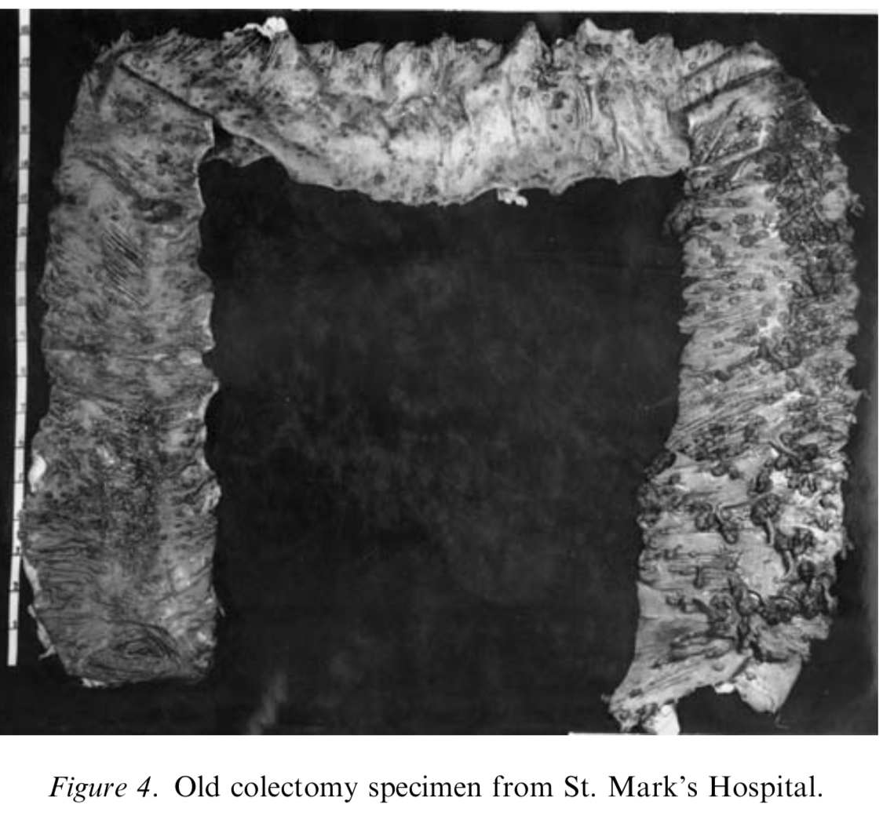
Thinking about FAP ; Why Operate?
Without Surgery
100% risk of CRC by age 40
Prevent development of Cancer
Operate for cancer
Staging/prognosis factored on the surgery

Slide 8
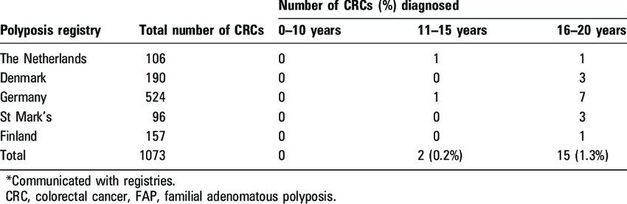
Thinking about FAP; When to operate?
Age
Phenotype
Mutations at 1309
Risk of Desmoid
Endoscopically Uncontrollable Polyps
Symptoms

Slide 9
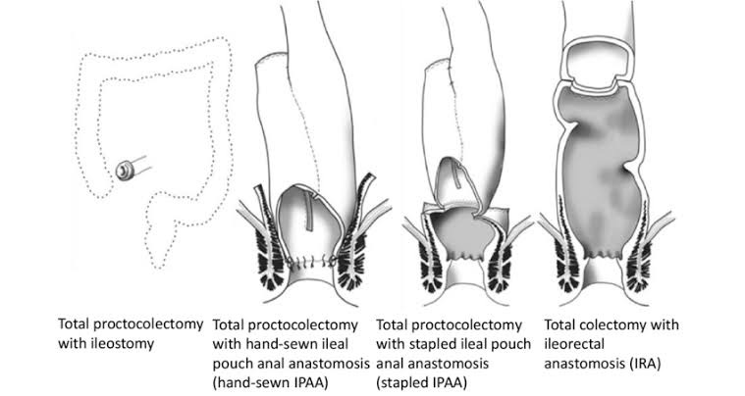
Surgery for FAP

Slide 10
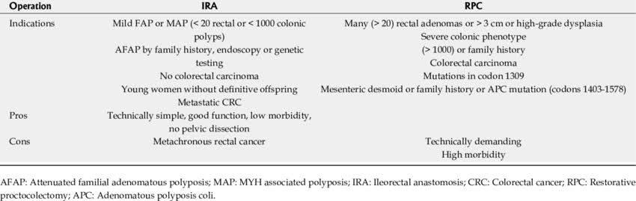
Surgical Options

Slide 11
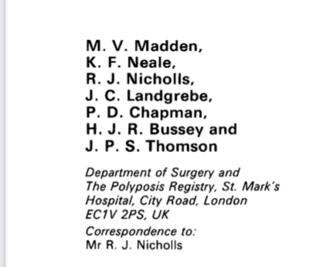
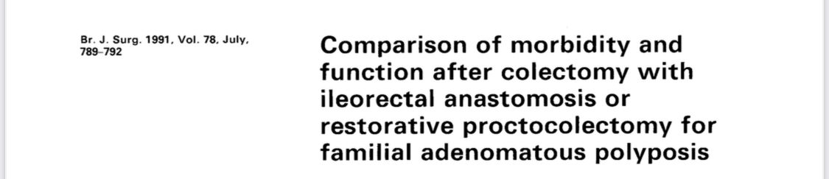
Funtional outcomes

Slide 12
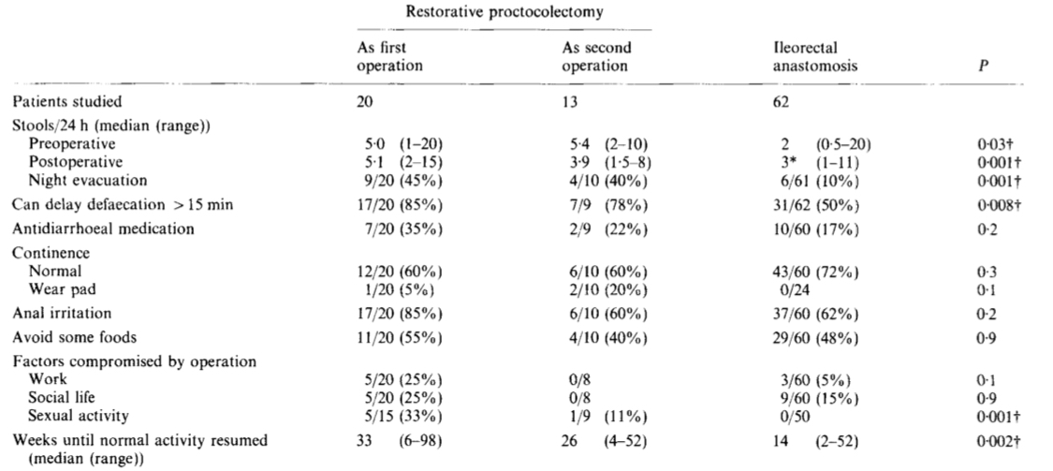
Functional Outcomes

Slide 13
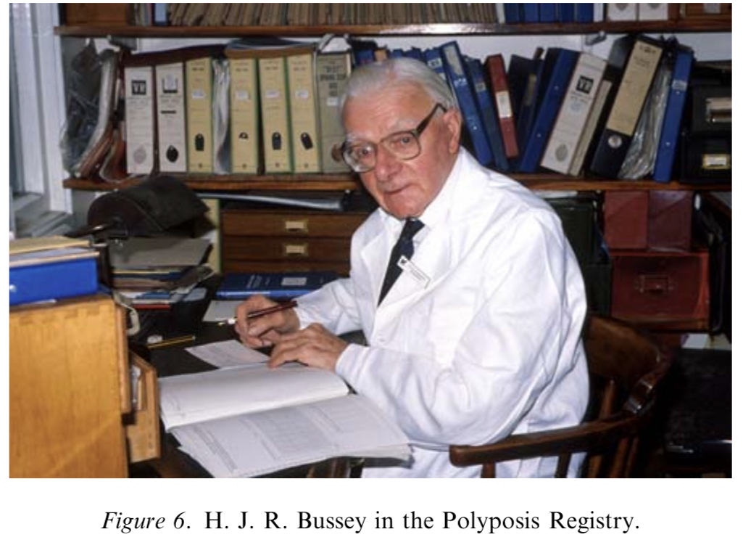
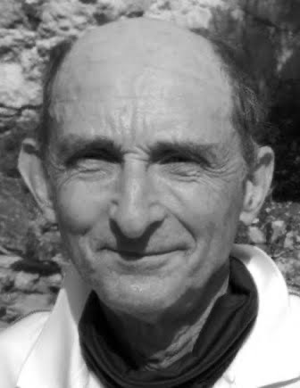
Can we trust these Gentlemen?

Slide 14
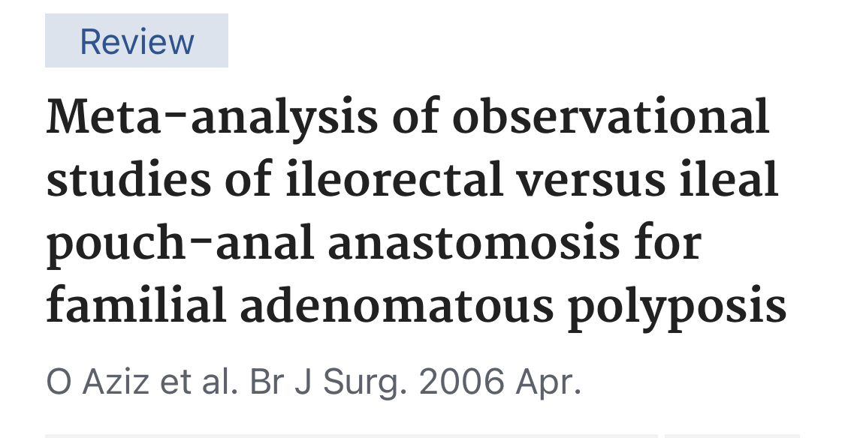
O. Aziz ; a metanalysis
Bowel frequency reduced in IRA
Less return to surgery in 30 days
Rectal cancer diagnosed only in IRA (5%)
Re-operation in the rectum
O Aziz et al.

Slide 15
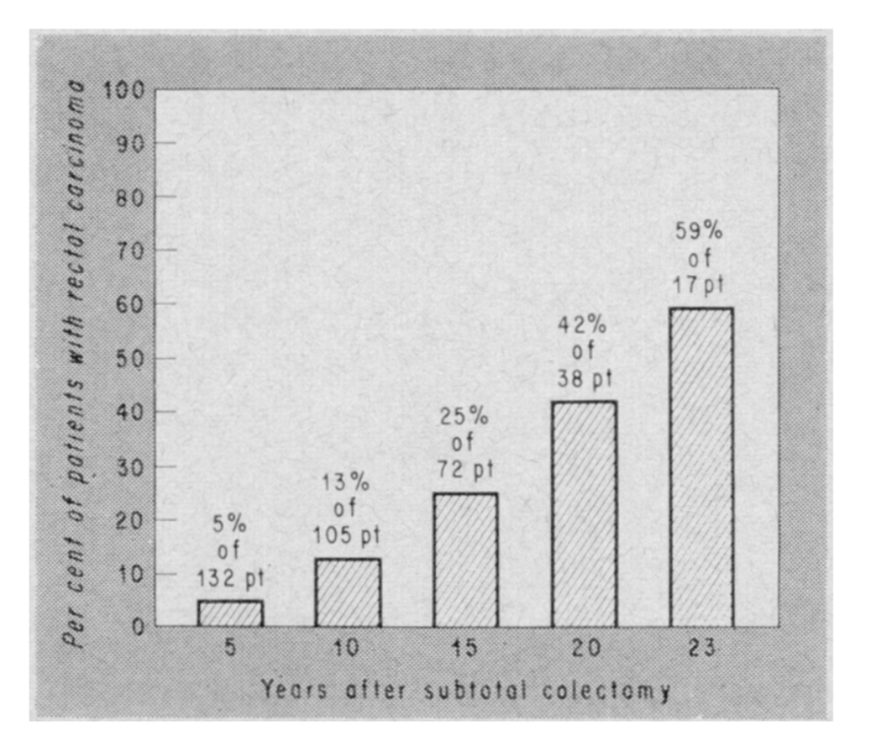
Mayo Clinic and Cancer Scare
Charles G. Moertel,

Slide 16
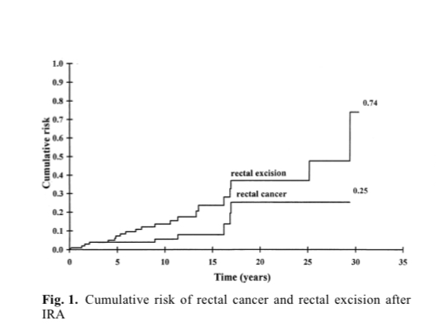
A finnish tragedy.
Cumulative Rectal cancer
25.2% in 20 Years
Cumulative Rectal Excision
36.6% in 20 years
Heiskanen

Slide 17
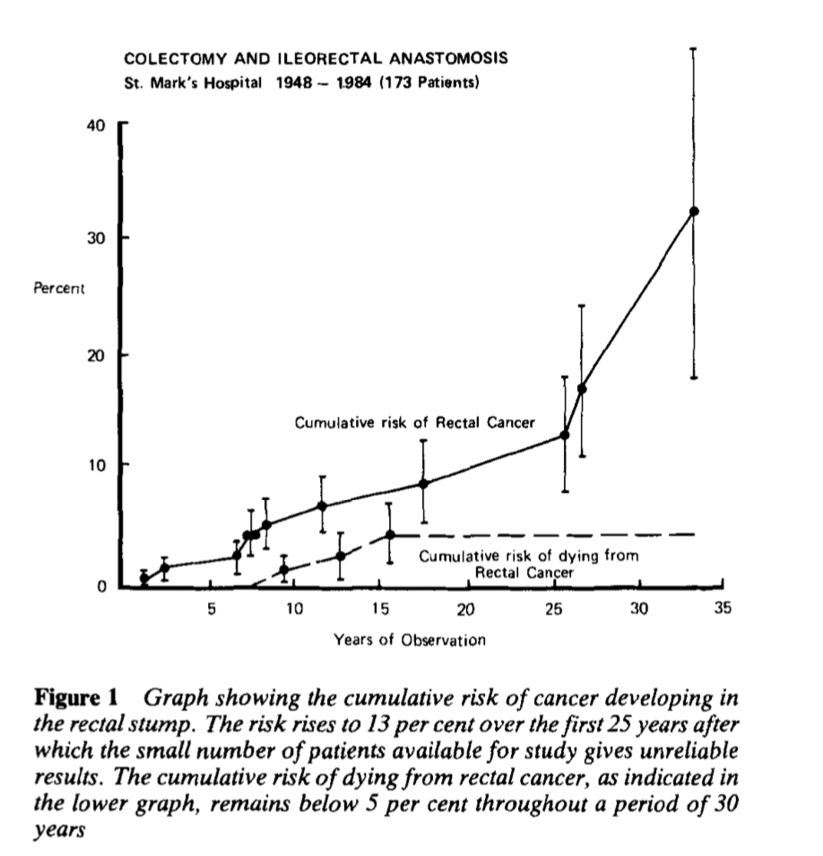
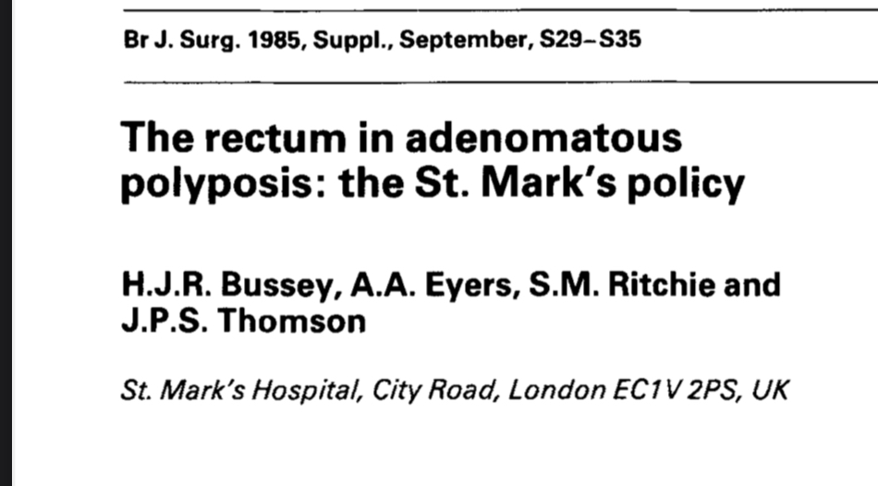
“Patience and diligence like faith, removes Mountains”

Slide 18
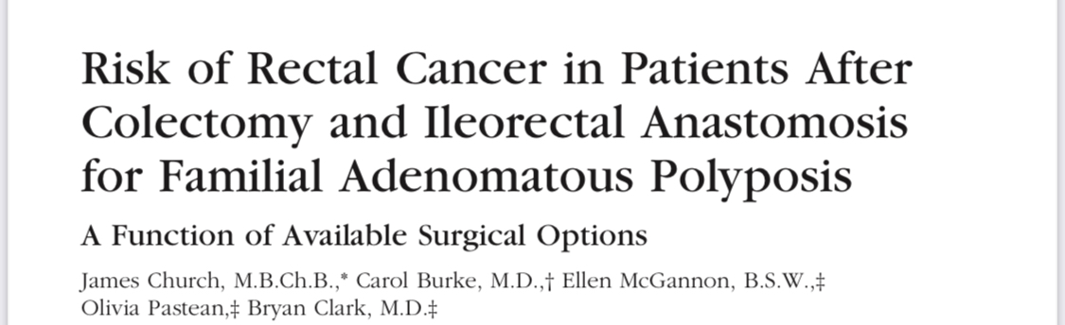
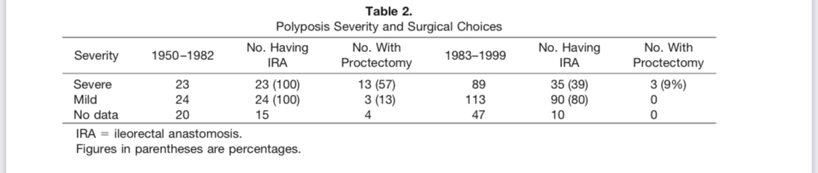
Cleveland.

Slide 19
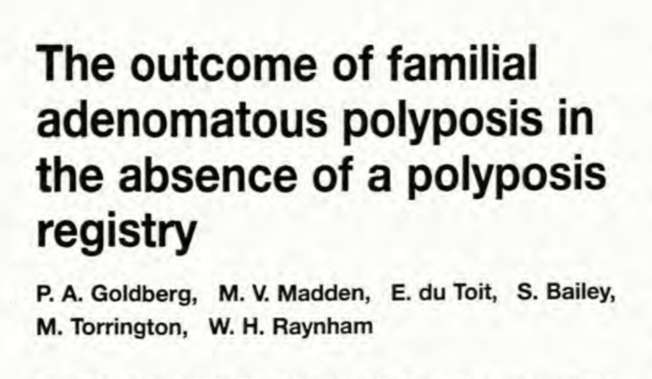
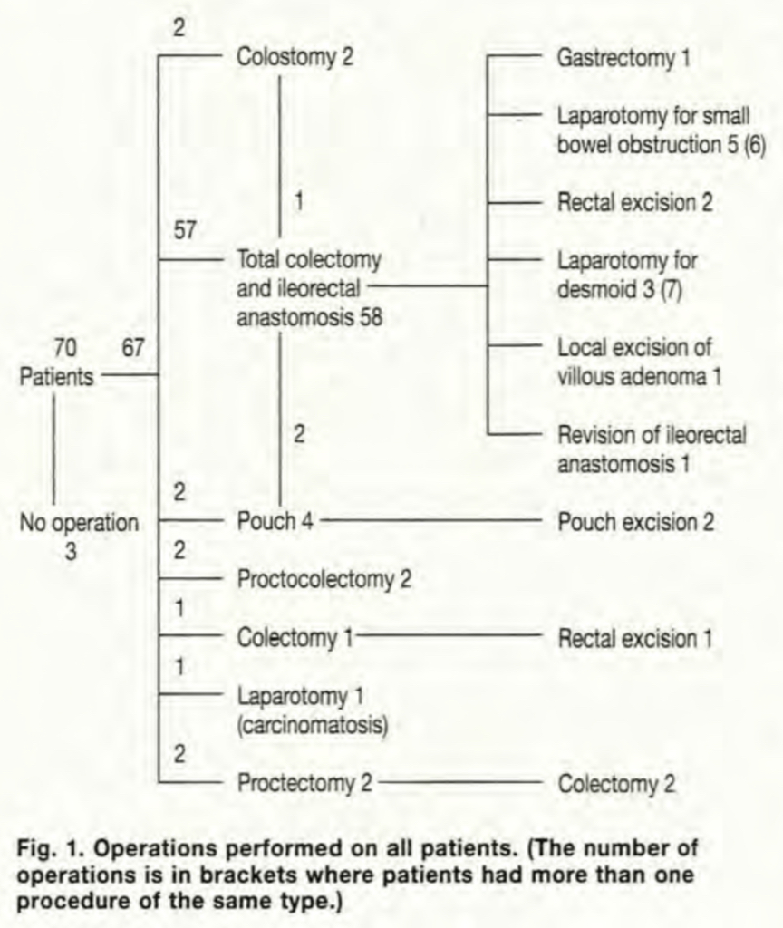
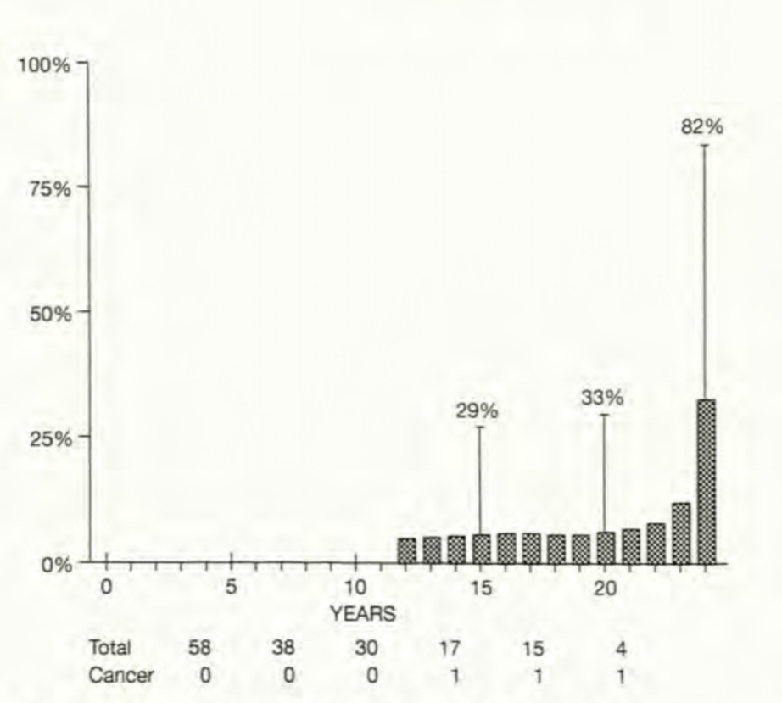

Slide 20
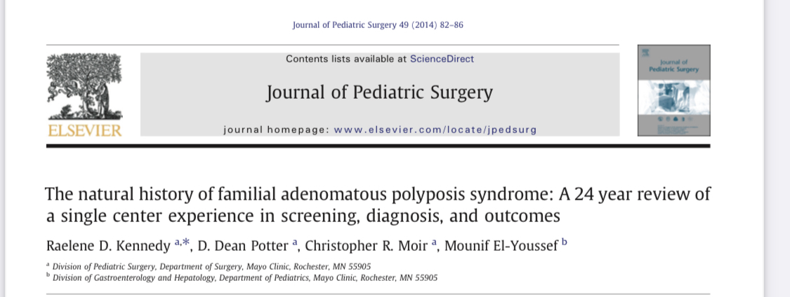
The Mayo Clinic; excellence in Dogma!
Follow up problems
Advanced stages.

Slide 21
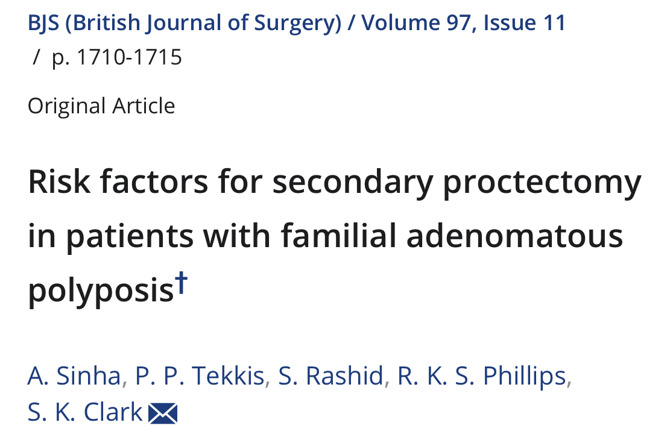
Predictors of rectal Ca
Genotype
Age of the rectum
Polyp burden in the rectum
Colon cancer at IRA

Slide 22
Minimally Invasive Surgery
Increasing use to perfom colectomy
Safe, Feasible
Experienced hands
Thought to reduce surgical trauma
Reduced risk of desmoids
Both IPAA/IRA feasible.

Slide 23
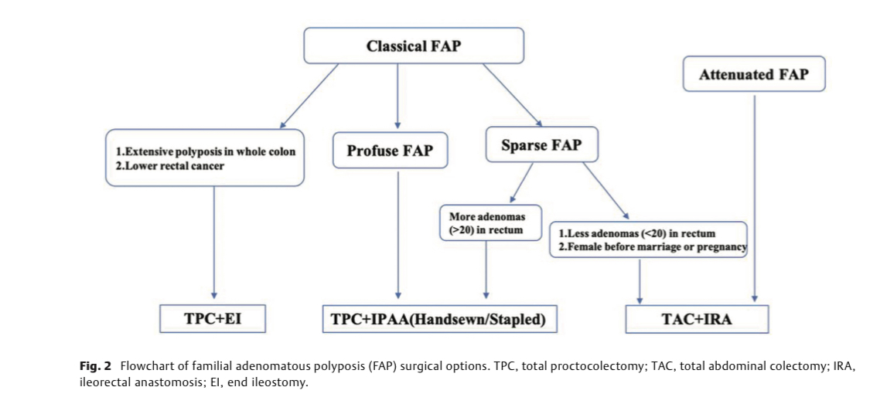

Slide 24
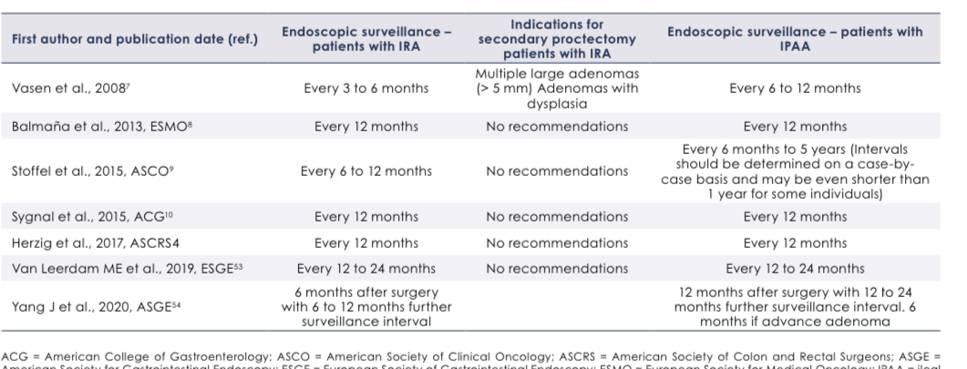
Endoscopic Surveillance post Colectomy

Slide 25
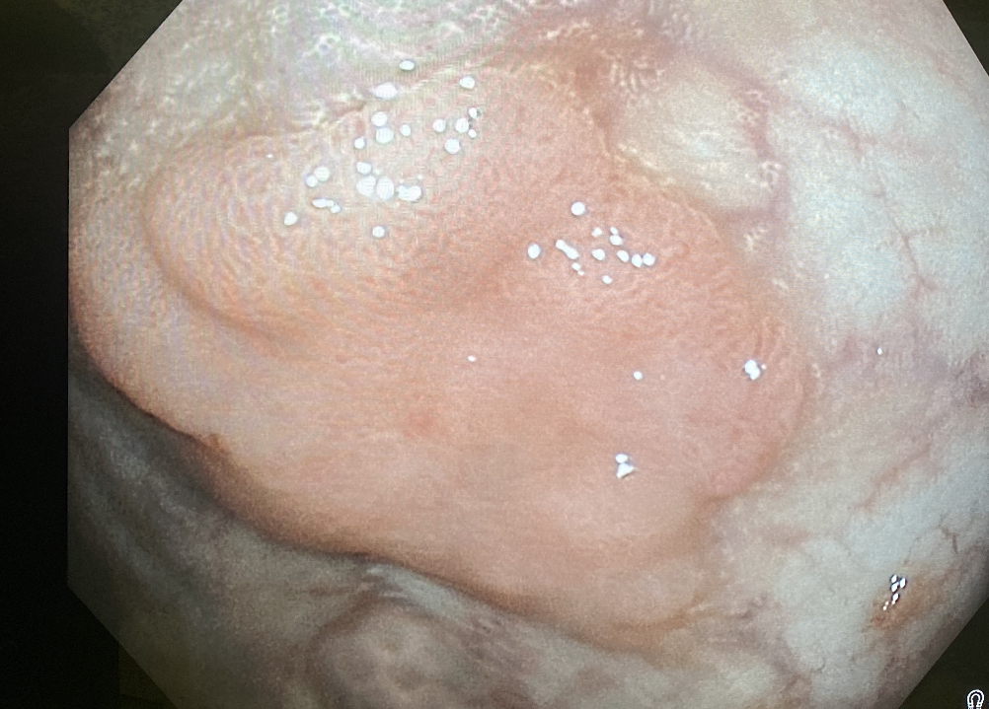
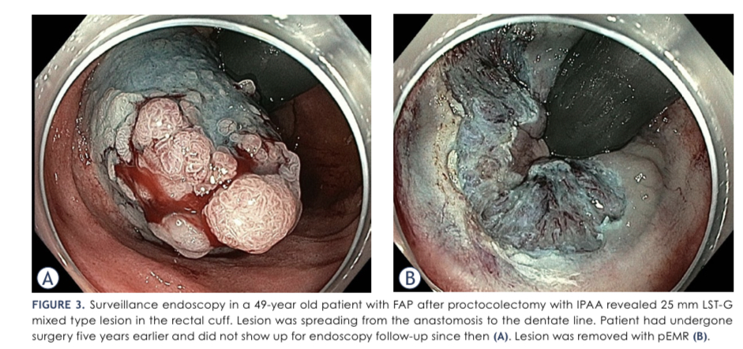
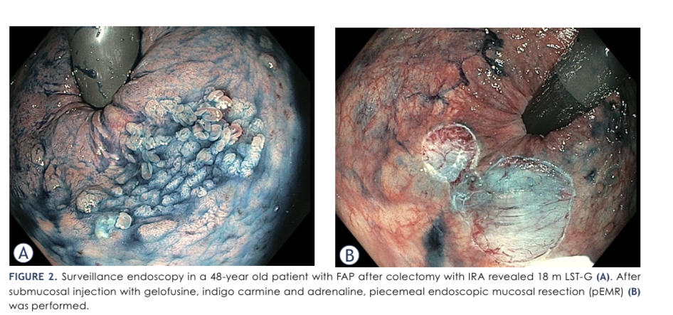

Slide 26
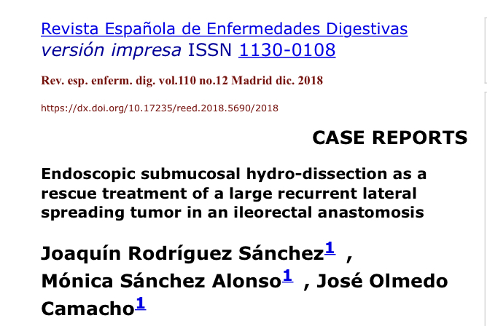
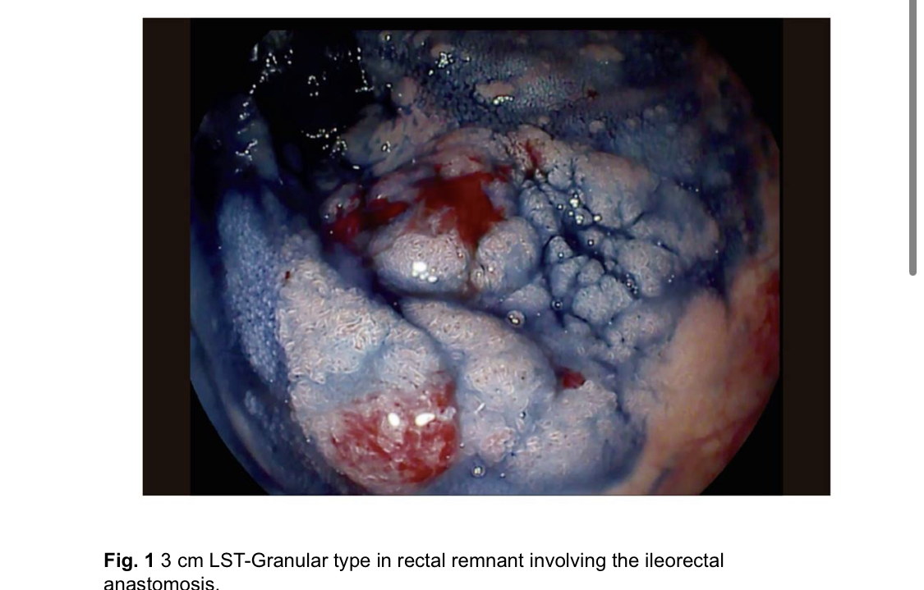

Slide 27
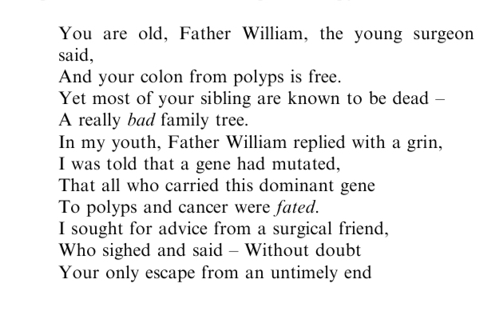
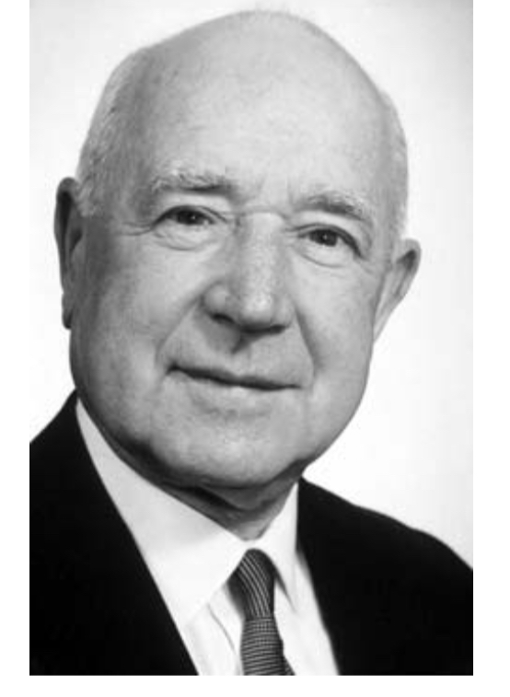
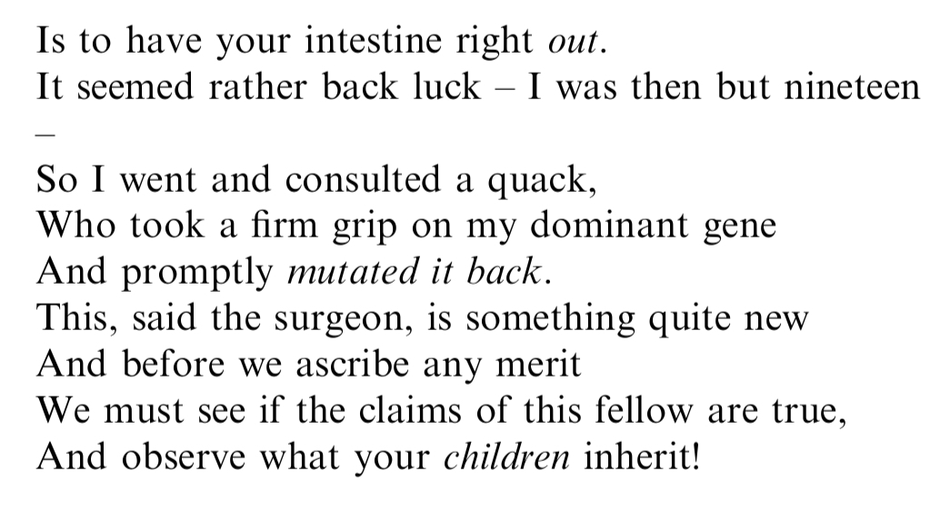
The ever elusive dream of gene therapy.
IMG_F6A4C5753205-1

Slide 28
