Slide 1
Investigations for Fecal Incontinence
James Pattinson
21/07/2024

Slide 2
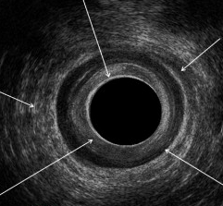
1. Which letter is the internal sphincter?
A
B
E
C
D

Slide 3
2. Which letter is the external sphincter?
A
B
E
C
D

Slide 4
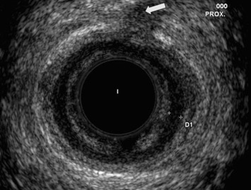
3. Diagnosis?

Slide 5
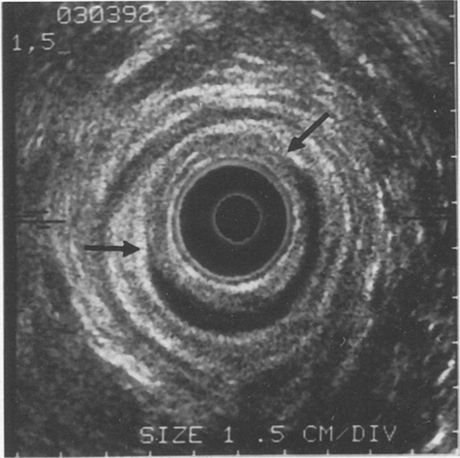
4. Diagnosis?

Slide 6
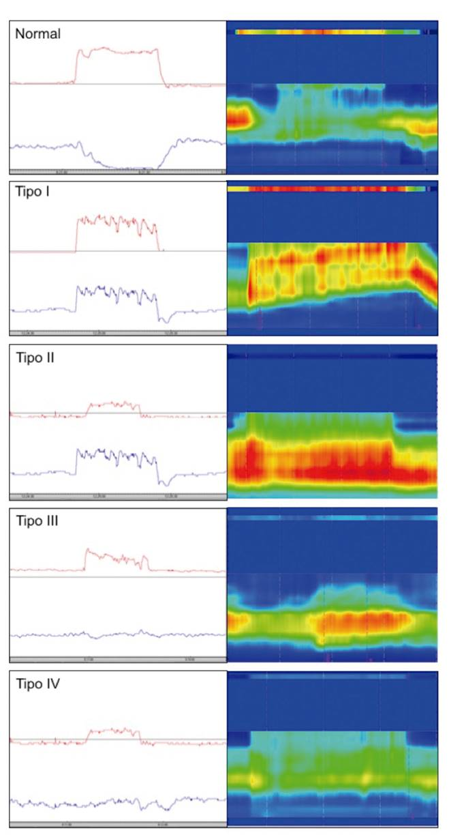
5. Manometry on push. Diagnosis?
Rectal
Anal

Slide 7
6. Manometry on push. Diagnosis?
Rectal
Anal

Slide 8
7. Manometry on push. Diagnosis?
Rectal
Anal

Slide 9
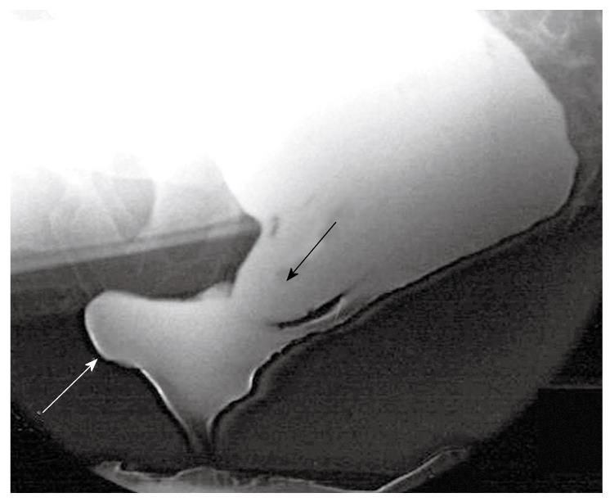
8. Diagnosis?

Slide 10
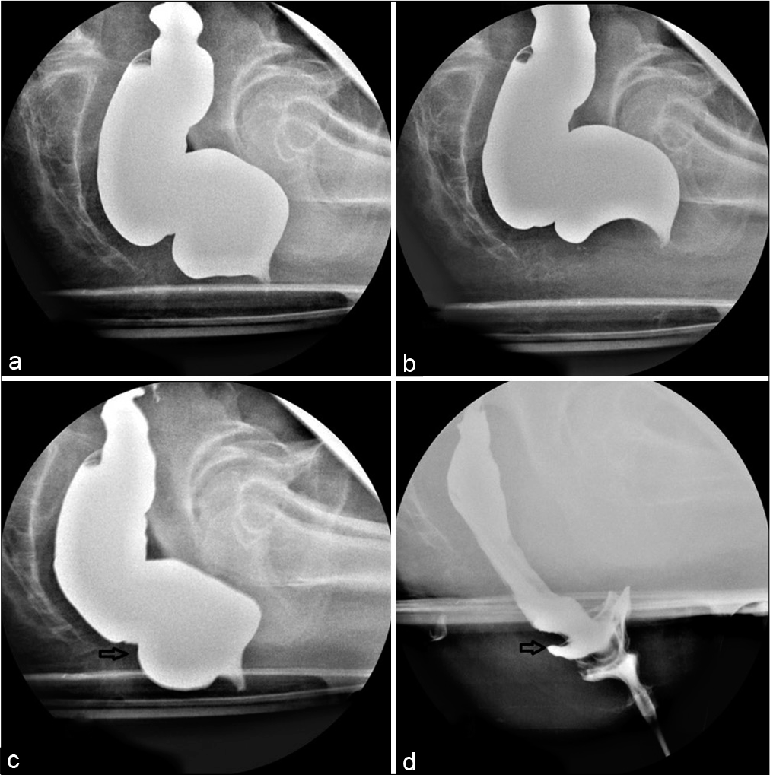
9. Diagnosis?

Slide 11
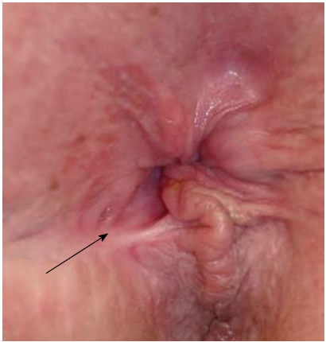
10. Diagnosis?

Slide 12
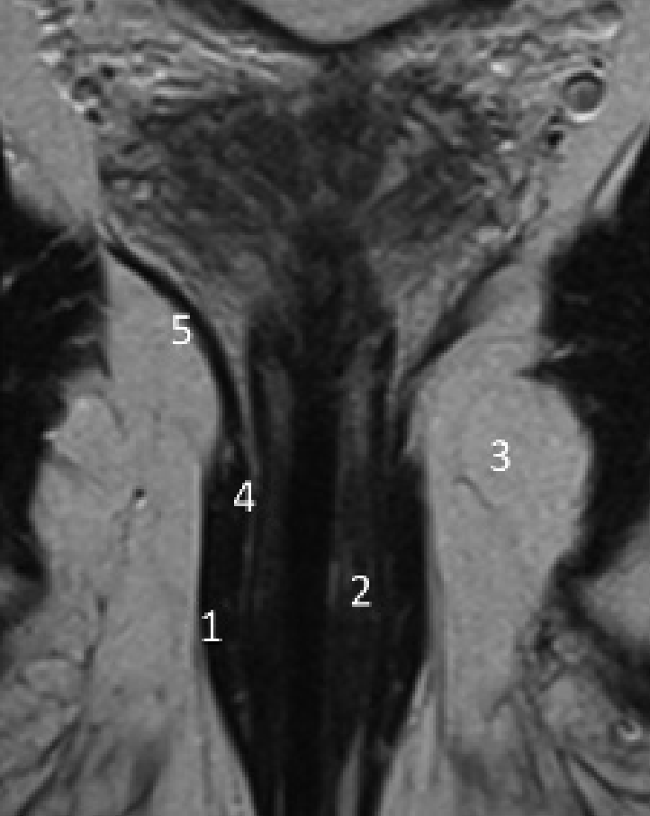
11. Which number is levator ani

Slide 13
12. Which number is internal sphincter?

Slide 14
13. Which number is puborectalis?

Slide 15
14. Which number is external sphincter?

Slide 16
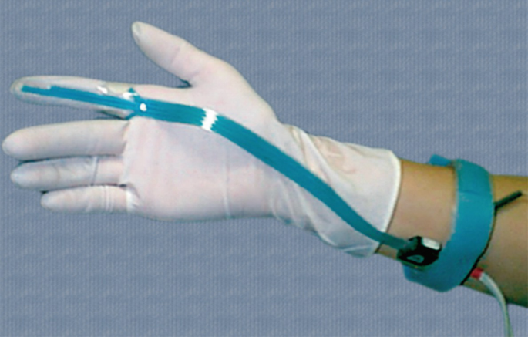
15. What is this?

Slide 17
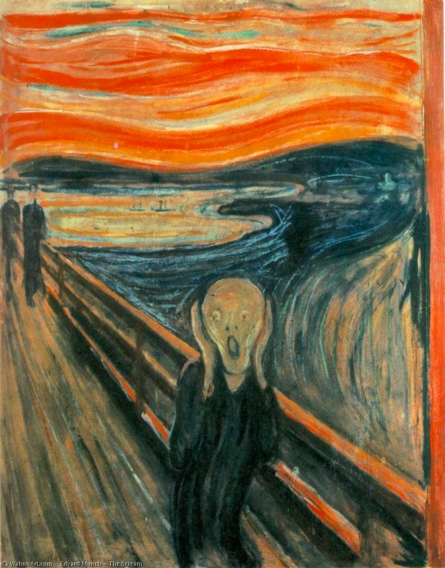
16. Which artist painted this famous work?

Slide 18
17. What is a misocapnic?

Slide 19
18. What do Reginald Dwight and Gordon Sumner have in common?

Slide 20
19. What position does Taylor Swift’s boyfriend play?

Slide 21
20. What is the national animal of Scotland?

Slide 22
Investigations for Fecal Incontinence
James Pattinson
21/07/2024

Slide 23
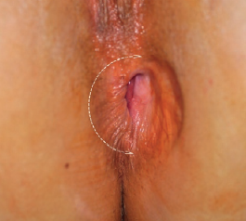
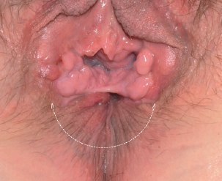

Slide 24
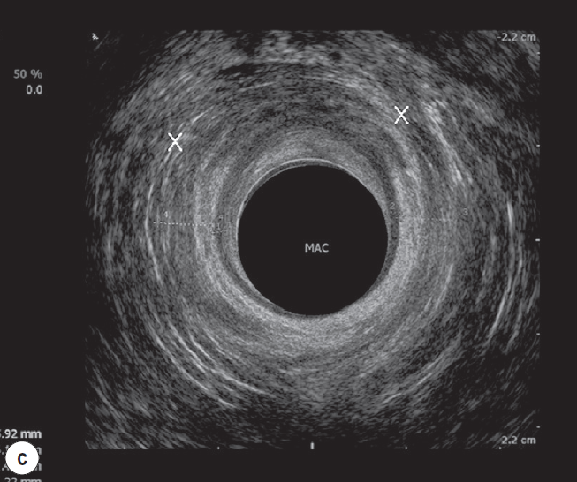
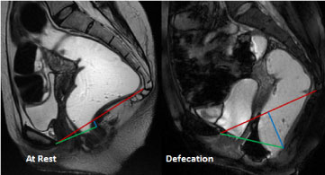
Investigations
Coeliac disease antigen
Examination under anaesthesia
MC&S
Fecal calprotectin
Colonoscopy
Ano-rectal manometry
Balloon expulsion test
Endo-anal ultrasound
Trans-perineal ultrasound
Standard MRI
Plain defecography
MR defecography
Electro-physiological assessment (Anal EMG)

Slide 25
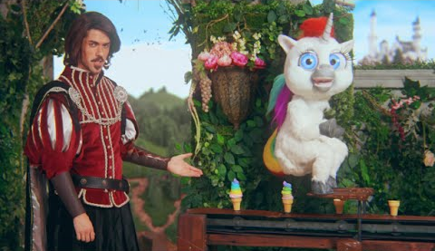

Slide 26

3
RAIR

Slide 27
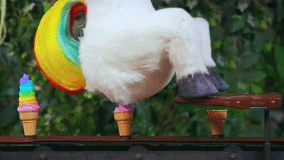
Maintenance of Fecal Continence
Pelvic floor
Sphincters
Sensation
Stool consistency
Rectal capacity
Rectal compliance
Neural pathways

Slide 28
MC&S
Fecal Calprotectin
Coeliac antigen
Endoscopy
Manometry
Defecography
Manometry
Defecography
Trans-perineal ultrasound
EUA
Endoanal ultrasound
MRI

Slide 29
1. Which letter is the internal sphincter?
A
B
E
C
D

Slide 30
2. Which letter is the external sphincter?
A
B
E
C
D

Slide 31
3. Diagnosis?
External sphincter injury

Slide 32
4. Diagnosis?
Internal sphincter injury

Slide 33
5. Manometry on push. Diagnosis?
Rectal
Anal
Normal

Slide 34
6. Manometry on push. Diagnosis?
Rectal
Anal
ODS

Slide 35
7. Manometry on push. Diagnosis?
Rectal
Anal
Poor sphincter tone

Slide 36
8. Diagnosis?
Rectocele

Slide 37
9. Diagnosis?
Rectal intussusception

Slide 38
10. Diagnosis?
Keyhole deformity

Slide 39
11. Which number is levator ani

Slide 40
12. Which number is internal sphincter?

Slide 41
13. Which number is puborectalis?

Slide 42
14. Which number is external sphincter?

Slide 43
15. What is this?
EMG

Slide 44
16. Which artist painted this famous work?
Edvard Munch

Slide 45

17. What is a misocapnic?

Slide 46

18. What do Reginald Dwight and Gordon Sumner have in common?

Slide 47

19. What position does Taylor Swift’s boyfriend play?

Slide 48
20. What is the national animal of Scotland?

