Slide 1
Rectal prolapse surgery
Perineal and abdominal approach
Rouxzanne Roos
Dr George Mukhari Academic Hospital
Colorectal
Colo Escape 2024

Slide 2
What is it?
Who gets it?
Who should we repair?
How should we repair?
Abdominal, perineal, rectopexy, resection, lateral stalk division, mesh, open, laparoscopic or robotic
Notes:
Should we repair? No head to head comparison from Cochrane review but surgery is the only cure
Recurrence, incontinence, constipation,
Recurrence: abdominal mesh repair best, but possibility of major complications
Perineal safest with regards to peri operative risk, but with minimally invasive probably able to offer to high risk patients
Not burning any bridges with this approach
Constipation: probably adding a resection would benefit patient
Incontinence: pt with decreased tone on manometry and rectal prolapse will probably benefit, from an incontinence point of view, if increased or normal tone with incontinence probably wont benefit, other underlying pathology contributing to incont, will still offer surgery
Abdominal vs perineal

Slide 3
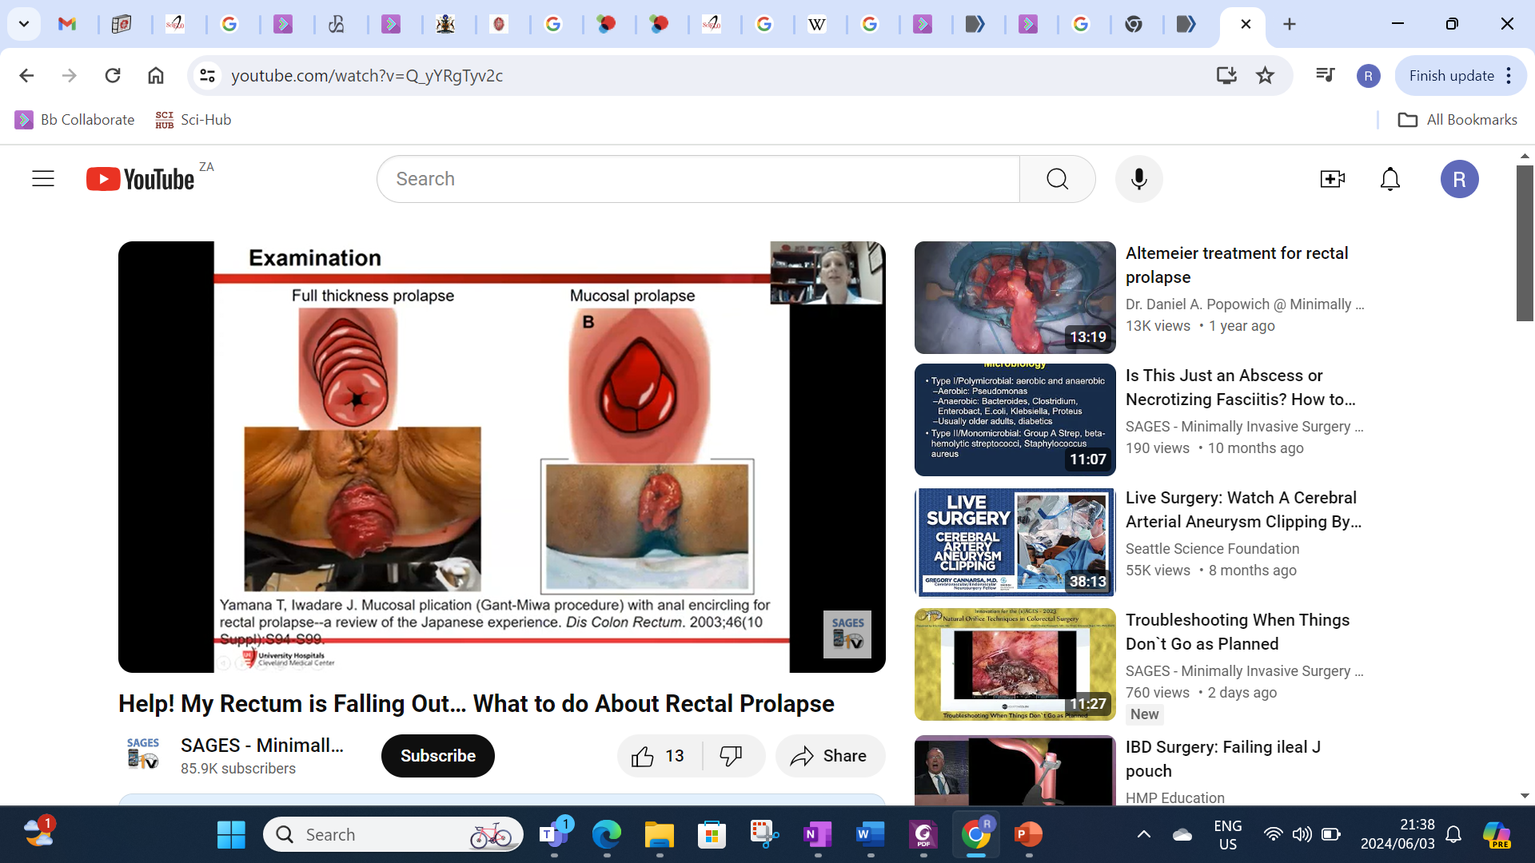
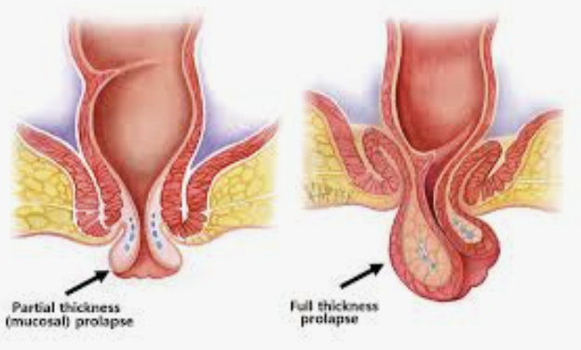
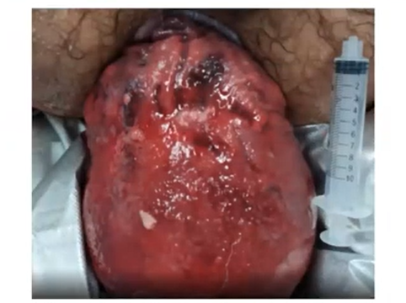
Notes:
Occurs when a mucosal or full thickness layer of rectal tissue protrudes through the anal orifice
Faecal incontinence, constipation and rectal ulceration are common
3 different clinical entities are under the umbrella term prolapse and the management for each differs
Full thickness rectal prolapse complete procidentia
Mucosal prolapse partial procidentia
Internal prolapse (internal intussusception) occult rectal prolapse a "telescoping" of the bowel on itself internally, without protruding through the anal verge

Slide 4
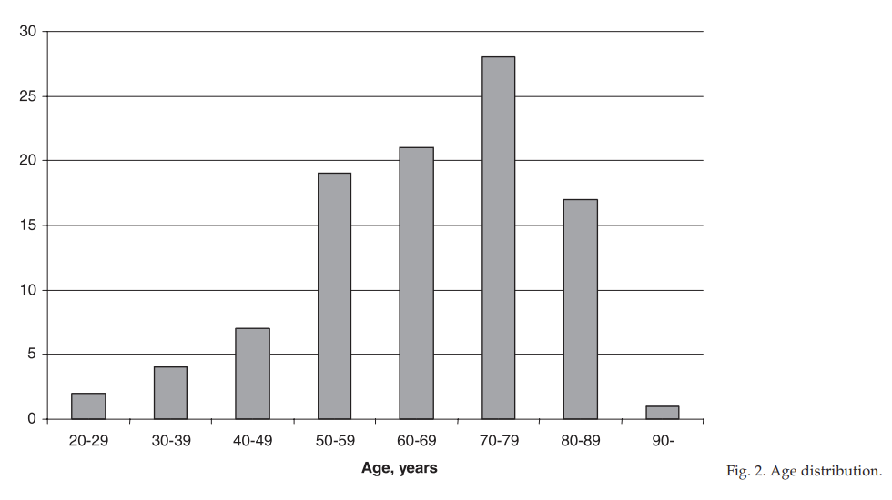
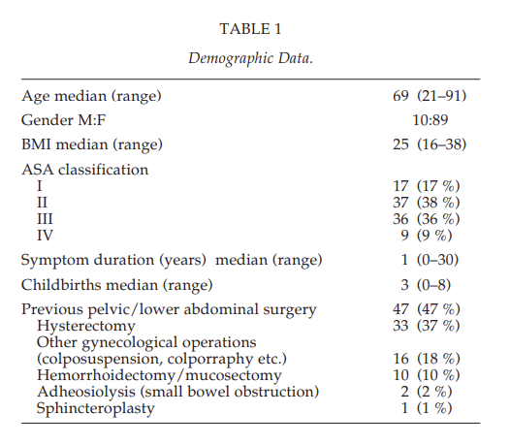
Aetiology
2.5 per 100 000 population
9:1
Median age: 69
50% concomitant cardiovascular disease and 15% psychiatric illness
Males: younger, low surgical risk
redundant sigmoid colon
diastasis of the levator ani
loss of the vertical position of the rectum and its sacral attachments
deep cul de sac (1912- Moschcowitz)
EPIDEMIOLOGIC ASPECTS OF COMPLETE RECTAL PROLAPSE M. V. Kairaluoma, I. H. Kellokumpu Pelvic Floor Research and Therapy Unit, Department of Gastroenterological Surgery, Finland
NSQIP-based comparative analysis of over 12,000 patients. Jon D. Vogel et al, American journal of Surgery 2020
Notes:
Women aged 50 years and older are six times as likely as men to present with rectal prolapse.
Peak incidence is the seventh decade in women, whereas the relatively few men afflicted with the syndrome may develop prolapse at the age of 40 years or younger.
One striking characteristic of young male patients is their tendency to have psychiatric disorders, and many are institutionalized.
Young male patients with procidentia also tend to take constipating medications and report significant symptoms related to bowel function
Contrary to the common assumption that rectal prolapse is a consequence of multiparity, 35% of patients with rectal prolapse are nulliparous
Among 12,220 patients, 978 (8%) were male and 11,242 (92%) were female. Males were younger, 56 (38–73) vs. 71 (58–83) years, less often white (83% vs. 71%), had lower ASA scores, and underwent more laparoscopic (33% vs. 27%), more open (33% vs. 29%), and less perineal (33% vs 44%) procedures (all p < 0.05). Morbidity (9.9% vs. 10.0%), reoperation (3.4% vs. 3.1%), and readmission (5.7% vs. 6.0%) were not different for males and females. In subgroup analysis by surgical procedure type, there remained no outcome differences. Propensity matched analysis revealed no difference in the use of laparoscopic, open, or perineal procedures.
Conclusions
Males with rectal prolapse are younger, have a different racial distribution, a lower surgical risk profile, and undergo different surgical procedures than females, which appears to be driven by patient age and surgical risk assessment

Slide 5
Surgeon preference
Patient factors
Recurrence complications
Peri-operative risk
Elderly female
Erectile dysfunction
Young male
Notes:
Choice of surgical approach The choice of approach is largely influenced by surgeon preference as well as patient factors, including comorbidity, age, gender and sexual activity. Most surgeons prefer perineal procedures in elderly or frail patients and abdominal approaches in fit patients,14 although there is increasing evidence that laparoscopic procedures are safe even in the very elderly.15 The choice of procedure should also take into account the presence of concurrent genital prolapse, constipation, evacuatory difficulties, faecal incontinence and history of pelvic floor injury.16 Resection rectopexy has traditionally been recommended for patients who have both constipation and rectal prolapse, Men tend to be offered perineal procedures in view of the potential for erectile dysfunction from rectal mobilisation during abdominal approaches.

Slide 6

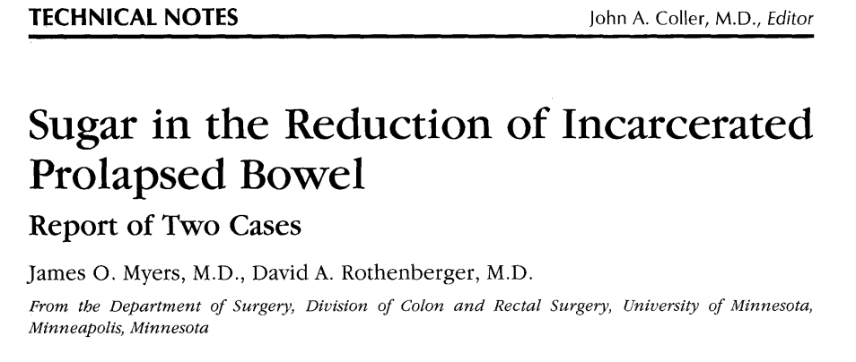
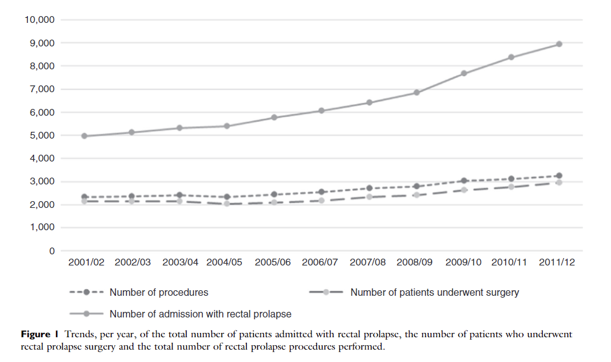

Conservative mx
Pour some sugar- assist with reduction
High fibre diet
Laxative use
Straining prevention
Others: TCA
Epidemiological trends in surgery for rectal prolapse in England 2001–2012: an adult hospital population-based study Y. El-Dhuwaib Colorectal Disease
Notes:
lthough conservative treatment with increased fibre and bulking laxatives may improve symptoms to some extent, the definitive treatment for full-thickness rectal prolapse is almost exclusively surgical. Indeed, the Cochrane Library's review on prolapse surgery failed to identify any trials comparing surgery to non-operative management.13 Surgical repair may be undertaken either from an abdominal or perineal approach. There is also the option of concurrent resection being undertaken either by abdominal (resection rectopexy) or perineal (Altemeier's procedure) approaches.

Slide 7
History of surgical procedures for rectal prolapse
Thiersch 1891
Delorme 1900
Altemeier
Rectal mobilization
Suture rectopexy 1959
Mesh procedures
Ripstein
Resection Frykman Goldberg
Ventral mesh rectopexy 2004
Open
Laparoscopic 1992
Robotic

Slide 8
Perineal approaches
less perioperative morbidity
Decreased pain
reduced length of hospital stay
Advantage of sparing the pelvic nerves
higher recurrence rate
data unclear on this point
properly executed perineal operation may yield the same good long-term results as an abdominal procedure
Failed previous transabdominal repair
Prior pelvic surgery
Prior pelvic radiation therapy
Young males
High surgical risk
Notes:
It is generally believed that the perineal approach results in less perioperative morbidity and pain and a reduced length of hospital stay.
These advantages have been considered to be offset by a higher recurrence rate, but data are unclear on this point, however, and a properly executed perineal operation may yield the same good long-term results as an abdominal procedure.
●Failed previous transabdominal repair
●Prior pelvic surgery
●Prior pelvic radiation therapy
●Young males, in order to minimize the risk of erectile dysfunction. There is little, if any, risk of damage to the hypogastric nerves with the perineal procedures.

Slide 9
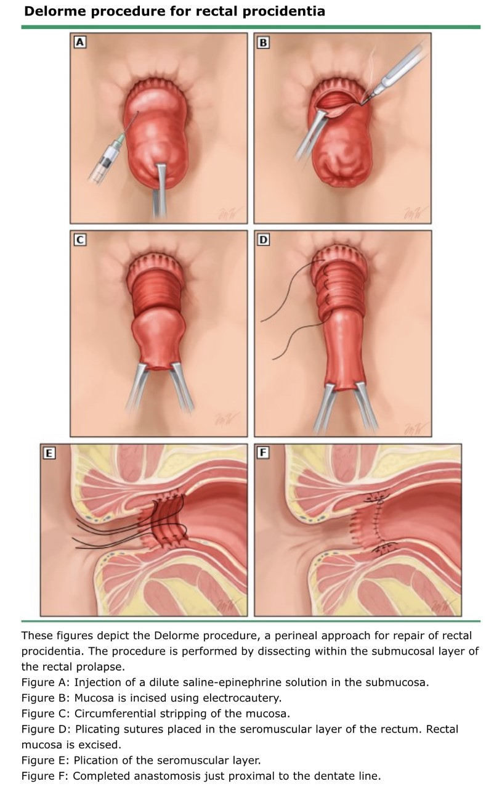
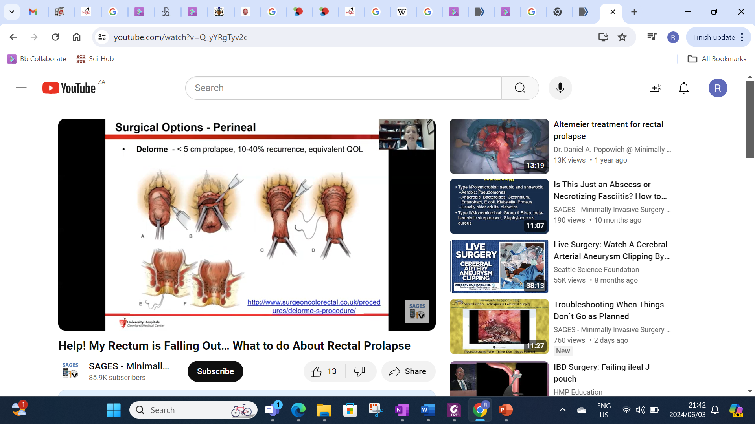
Delorme
adrenaline based solution submucosal injection
1-2cm below dentate line
Mucosa incised circumferentially
Down to muscularis propria
Sleeve of mucosa resected
Plication of MP
Anastomosis
Madiba TE, Surgical management of rectal prolapse. Arch Surg 2005; 140: 63–73
Notes:
Delorme procedure — for rectal procidentia <3 to 4 cm
Performed by dissecting within the submucosal layer of the rectum. The principle components of this procedure include:
●The redundant rectum is prolapsed through the anal canal
●The dentate line is identified, and epinephrine-based solution is injected into the submucosa to aid in hemostasis.
●The mucosa is incised circumferentially to the submucosal layer at a level of approximately 1 to 2 cm proximal to the dentate line. A sleeve resection of the mucosa is continued proximally until the tube of redundant mucosa is resected
●The exposed muscularis propria is plicated using a series of interrupted nonabsorbable sutures.
●A hand-sewn anastomosis with absorbable sutures between the proximal mucosa at the level of transection and the incision proximal to the dentate line.
Some surgeons perform a postanal repair and levatorplasty too.
Youssef et al showed this addition improved functional outcomes and decreased recurrences compared with performing a Delorme procedure alone

Slide 10
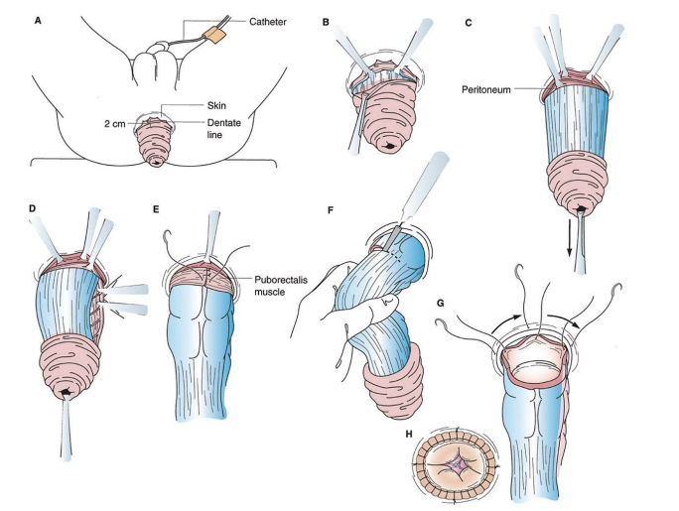
Perineal Rectosigmoidectomy
circular incision is made on the prolapsed rectum 2 cm proximal to the dentate line
peritoneal attachment released
Mesorectum/sigmoid divided
Stay sutures in four quadrants
coloanal anastomosis
Fiser, Steven M, Surgical Procedures, Operative | Clinical Medicine | Outline Seventh edition. | Philadelphia : Wolters Kluwer, [2022]
Notes:
Altemeier perineal rectosigmoidectomy is the most frequently performed perineal procedure.
For rectal procidentia with a length of ≥3 to 4 cm.
The principle components of this procedure include:
●Redundant rectum is prolapsed through the anal canal
●The dentate line is identified, and epinephrine-based solution is injected into the submucosa to aid in hemostasis.
●A full-thickness circumferential incision is performed in the rectum
●detaching of the rectum from the mesorectum and surrounding ligamentous attachments until the peritoneal cavity is entered.
●Bowel is transected at the level of the rectosigmoid junction or the sigmoid colon, where there will be no tension on the anastomosis.
●A hand-sewn coloanal anastomosis- nonabsorbable sutures.
●A levatorplasty (ie, suture approximation of the levator muscles) is performed anteriorly to lengthen the anal canal and provide additional support.

Slide 11
Altemeier vs Delorme
No difference in recurrence and incontinence (Vaizey incontinence score 3 years post-op)
Recurrence: 24/102 (24%) and 31/99 (31%) (P = 0.4)
There was no difference in overall bowel function or quality of life score(EQ-5D) at three years post surgery
PROSPER: Senapati et al Colorectal Disease 2013 The Association of Coloproctology of Great Britain and Ireland.

Slide 12
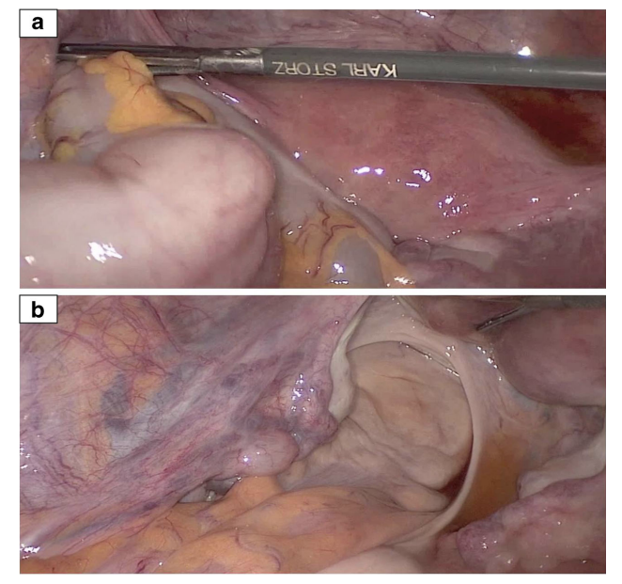
Abdominal approach
rectal mobilization
sigmoid resection
fixation of the rectum
Mobilize the rectum posteriorly down to levators
Females: mobilize the rectum anteriorly to the level of the mid to upper-third of the vagina
Males: mobilize the rectum anteriorly for a few centimeters to allow for straightening of the rectum and additional scarring
L Bordeianou Rectal Prolapse: An Overview of Clinical Features, Diagnosis, and Patient-Specific Management StrategiesJ Gastrointest Surg (2014) 18:1059–1069
Notes:
Left lateral peritoneum opened along distal sigmoid , id and preserve ureter, cont in this plane of dissection distally along left pararectal peritoneum and presacral space entered at the level of the sacral promontory. Continue dissection in presacral space as far distally as possible down to pelvic floor
Score the right pararectal peritoneum after id ureter. Continue plane of dissection joining in presacral space of dissection on the left leading to full circumferential dissection in bloodless plane down to pelvic floor.
Place sponge stick in vagina to best identify rect vaginal septum
Rectum dissected completely down to top of the anal canal confirmed by DRE
Right pararectal tissue sutured to sacral promontory

Slide 13
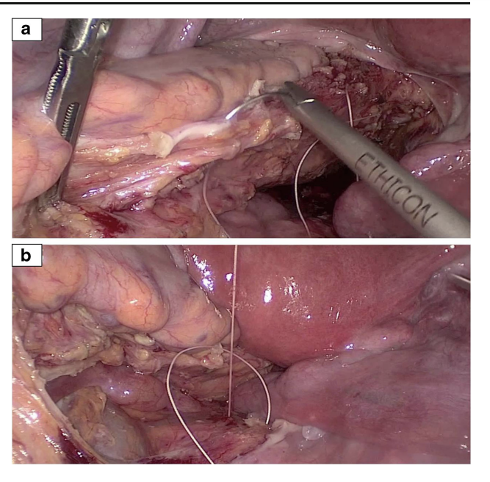
Posterior suture rectopexy +- resection
mobilization and upward fixation
Suture rectopexy to sacral promonter
healing by fibrosis tends to keep the rectum fixed in an elevated position as adhesions form, attaching the rectum to the presacral fascia
Madiba TE, Baig MK, Wexner SD. Surgical management of rectal prolapse. Arch Surg 2005; 140: 63–73
L Bordeianou Gastrointest Surg (2014) 18:1059–1069

Slide 14
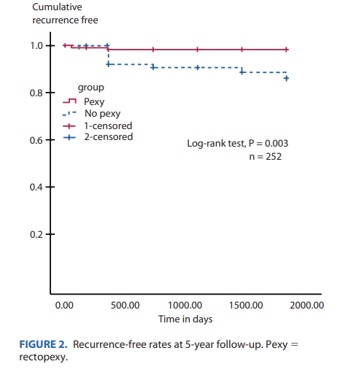
Rectopexy versus no rectopexy
One multi-centre trial examined this comparison
The only primary outcome measured was recurrence
Statistically significant increase in no rectopexy group
8.6% vs 1.5% 5yrs
Karas JR, et al. No rectopexy versus rectopexy following rectal mobilisation for full-thickness rectal prolapse: a randomised controlled trial. Diseases of Colon and Rectum 2011;54(1):29–34.

Slide 15
Resection versus no resection
The addition of sigmoid resection to rectopexy (resection rectopexy; Frykman-Goldberg procedure)
rectal compliance, which was significantly higher in the non-resection group= more constipation
complications in 16/47 (34%) in the resection group compared to 11/50 (22%) in the non-resection group
6% risk of anastomotic leak
Madiba TE, Baig MK, Wexner SD. Surgical management of rectal prolapse. Arch Surg 2005; 140: 63–73
Mik M, Trzcinski R, Kujawski R, Dziki L, Tchorzewski M,Dziki A. Rectal prolapse in women-outcomes of perineal and abdominal approaches. Indian J Surg 2015; 77

Slide 16
Preservation versus division of the lateral ligaments during mesh rectopexy
Division of the lateral ligaments: associated with less recurrent prolapse but more post operative constipation
small numbers
Preservation: less constipation, increased recurrence
Brazzelli M, Bachoo P, Grant A. meta-analysis, Surgery for complete rectal prolapse in adults. Cochrane Database Syst Rev. 2002

Slide 17
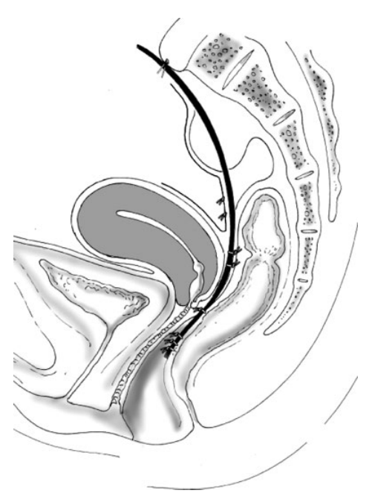
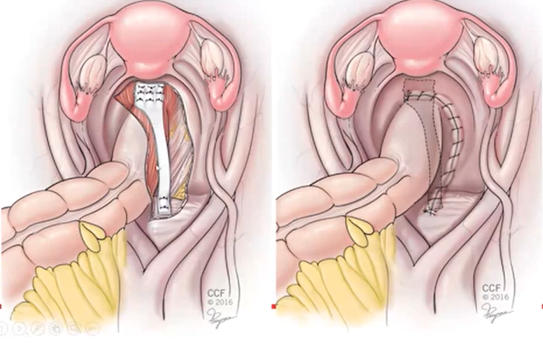
ventral mesh rectopexy
most frequently performed intervention in Europe
Fix the full thickness intussusception
Correct concomitant enterocoele
Closure of peritoneum over mesh
Minimal dissection
Reproducible, safe, minimally invasive
Long-term outcome of laparoscopic ventral rectopexy for total rectal prolapse A. D’Hoore, Department of Abdominal Surgery, University Clinics Gasthuisberg, Leuven, Belgium
Notes:
The ventral position of the mesh allows correction. of rectorectal intussusception, reinforcement of the rectovaginal septum and performance of a colpopexy. Closure of the peritoneum above the mesh elevates the pouch of Douglas
And restoration of support at all 3 levels of the vagina and rectum . 1. uterosacral complex, the rectovaginal septum and the perineal body
Dissection is limited to the rectovaginal septum and avoids extensive rectal mobilization. Despite a limited dissection, recurrence rates have been comparable to other more extensive techniques

Slide 18
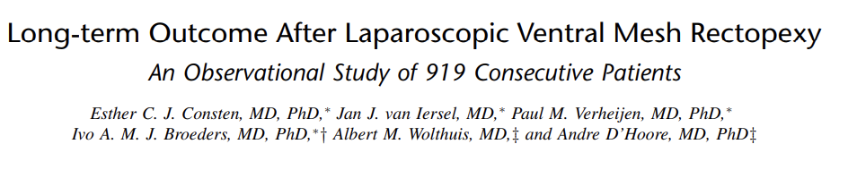
919 patients (869 women; 50 men)
10-year recurrence rate of 8.2%
Mesh-related cx: 18 patients (4.6%)
erosion to the vagina in 7 patients (1.3%)
incontinence and obstructed defecation decreased significantly (P < 0.0001)

Slide 19
Abdominal versus perineal approach
no significant difference between the two approaches
19% abdominal, 28% after perineal procedures (P = 0.2)
no significant difference in Vaizey incontinence scores
no difference in
    Mortality
    post op complications
    bowel function
PROSPER: a randomised comparison of surgical treatments for rectal prolapse A. Senapati et al Colorectal Disease 2013 The Association of Coloproctology of Great Britain and Ireland.

Slide 20
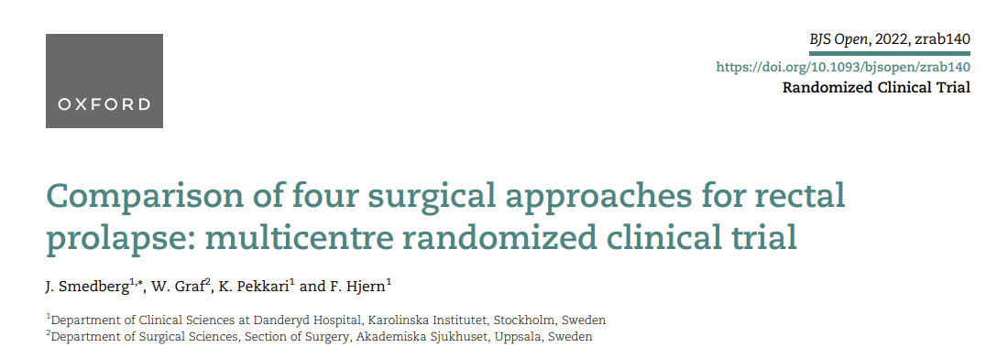
The Swedish Rectal Prolapse Trial
A multi-centre randomized trial- 2000 to 2009, 136 pts
Perineal group: Delorme’s or Altemeier’s procedures
Abdominal group: suture rectopexy or resection rectopexy
Mean follow-up was 2.6 years
Wexner and RAND36 scores improvements: no significant difference
Recurrence: 21, 15, 36 and 44%

Slide 21
Use of mesh?
Recommendation: In patients with full-thickness rectal prolapse, mesh could be used for abdominal rectopexy as it may reduce the chance of recurrence
moderate and very low-quality evidence
All studies showed a trend of benefit of using mesh
recurrence reduced by 67% (recurrence with mesh 2.6% vs no mesh 7.8%). (3xRCT)
< 5% cumulative risk at 10 years for LVMR
ESCP Guidance on use of mesh in pelvis in colorectal surgery Yasuko Maeda et al.
Consten ECJ et al (2015) Long-term outcome after laparoscopic ventral mesh rectopexy an observational study of 919 consecutive patients. Ann Surg 262(5):742–748
Notes:
The group considers it is good clinical practice to discuss alternative options with the patient given that there was no statistically significant evidence to support the use of mesh and to explain possible benefits and risks/harm associated with both the use and non-use of a mesh. The group encourages all surgeons who perform abdominal mesh rectopexy to be vigilant about the latest information available regarding mesh.
There were three RCTs assessing the efficacy of abdominal mesh rectopexy against a controlled intervention [Lundby 2016][Emile 2016][Luukkonen 1992].
Consten et al., in a large series documented a < 5% cumulative risk at 10 years [2]. There should be ongoing efforts to develop the ideal mesh (material) and sutures to further minimize this risk. The media exposure on the subject impact patients and surgeons’ perception. A major effort is needed to explain the subtle differences in surgical techniques to treat pelvic organ prolapse and to convince patients that the risk of mesh related problems after LVMR is low. Large prospective registries to document long-term outcomes are needed
In 2008 and again in 2011, the US Food and Drug Administration (FDA) expressed its concern about the high rate of meshrelated complications in pelvic organ prolapse (POP) surgery.13 Although this warning was primarily intended for transvaginal procedures, also considerable uncertainty was created about the safety of abdominally placed meshes.

Slide 22
Ideal mesh?
Any of the currently available meshes can be considered for rectopexy to prevent recurrence
This is based on limited and low to very low quality of evidence.
No RCT available, only observational studies
 | Synthetic | Biologic | P value
Recurrence | 3.7% | 4% | 0.78
Mesh cx | 0.7% | 0 | 1
Smart N, Pathak S, Daniels I. Which mesh to use for laparoscopic ventral rectopexy–a systematic review. Colorect Dis 2012
ESCP Guidance on use of mesh in pelvis in colorectal surgery Yasuko Maeda et al.

Slide 23
Laparoscopic versus open procedure
Primary outcomes measured were recurrence, incontinence and constipation
Recurrence similar
Faecal incontinence: both groups improved from baseline
trials were too small to detect a significant difference
no statistically significant difference from baseline or between groups in a Visual Analogue Scale for constipation
Generic advantages of laparoscopic approach: post op cx, LOS
Tou S, Brown SR, Nelson RL. Surgery for complete (full-thickness) rectal prolapse in adults. Cochrane Database of Systematic Reviews 2015

Slide 24
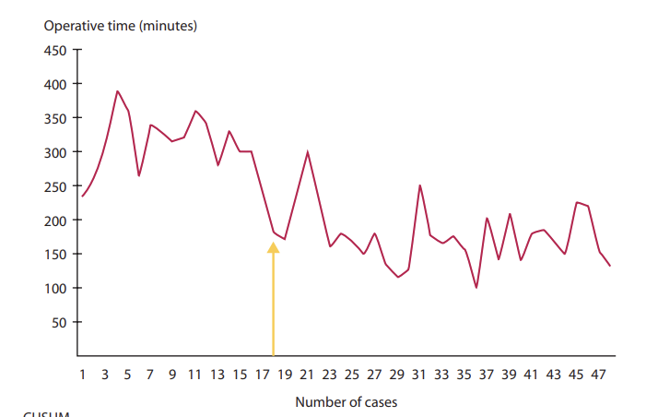
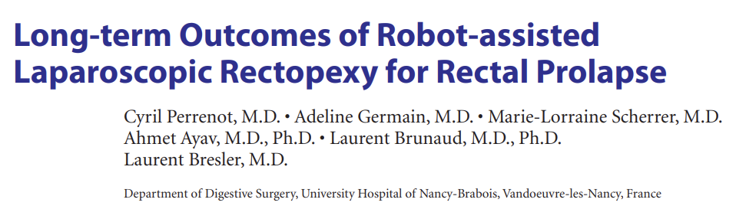
Robotic VMR
96 patients
37 months
Recurrence rate was 12.5%.
Constipation significantly
reduced p=0.01
Faecal incontinence reduced: 59 patients were incontinent before surgery versus 14 after surgery p<0.0001
No mesh related cx
Notes:
2 Our data confirmed that the learning curve in robotic surgery is short,11 at ≈18 patients, similar to that of Bokhari et al,12 whose results described a CUSUM curve plateau following 15 patients in robot-assisted laparoscopic colorectal surgery. This is particularly interesting for rectal prolapse, because it is a low-incidence operation

Slide 25
Abdominal | Perineal
LVMR Avoids extensive dissection theoretically preserves pelvic nerves better functional outcome low recurrence rates lower short-term morbidity long-term mesh complications | Delorme less invasive better option for elderly and medically unﬁt patients Mucosal prolapse higher recurrence rates (10%-30%) than rectopexy (0%–11%) Not burning any bridges
Suture rectopexy Dissection with theoretical injury to nerves No mesh Low recurrence | Altemeier >2-3cm full thickness prolapse patients with incarcerated, strangulated recurrence after another perineal repair
Notes:
Should we repair? No head to head comparison from Cochrane review but surgery is the only cure
Recurrence, incontinence, constipation,
Recurrence: abdominal mesh repair best, but possibility of major complications
Perineal safest with regards to peri operative risk, but with minimally invasive probably able to offer to high risk patients
Not burning any bridges with this approach
Constipation: probably adding a resection would benefit patient
Incontinence: pt with decreased tone on manometry and rectal prolapse will probably benefit, from an incontinence point of view, if increased or normal tone with incontinence probably wont benefit, other underlying pathology contributing to incont, will still offer surgery
Abdominal vs perineal

Slide 26
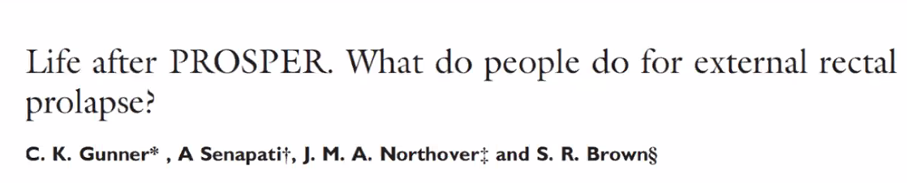
What are surgeons doing?
Questionnaire: members of ACPGBI pre and post PROSPER
Similar nr of procedures performed per year: 6
favoured an abdominal approach in fit patients: 63.5% to 81.7% in 2014 (p<0.01)
Ventral rectopexy: preferred abdominal approach in 2014 (48.6% vs 5.9% (p<0.01)
96.3% laparoscopically
Delorme most popular perineal approach
Notes:
An almost identical trial to PROSPER was conducted in Sweden starting in 2002. One hundred and eighteen patients were recruited. The full thickness recurrence rates were 21, 15, 36 and 44% for suture rectopexy, resection rectopexy, Delorme’s and Altemeier’s respectively. The recurrence rates after all procedures were higher than expected and support the findings from PROSPER, suggesting that when rectal prolapse is treated in a multicentre prospective trial, the results are not as good as those reported in retrospective case series by enthusiasts for particular procedures.

Slide 27
Conclusion
Manage the patient as a whole
Surgery (any surgery) improves QOL –Prosper
A good operation on the wrong patient
Incarcarated: Altemeier
Elderly, high surgical risk: Perineal approach
Young male: avoid extensive dissection
Mucosal: Delorme
Constipation: resection
As a surgeon, have a perineal and transabdominal approach

Slide 28
References
EPIDEMIOLOGIC ASPECTS OF COMPLETE RECTAL PROLAPSE M. V. Kairaluoma, I. H. Kellokumpu Pelvic Floor Research and Therapy Unit, Department of Gastroenterological Surgery, Central Hospital of Jyväskylä, Jyväskylä , Finland
Rectal Prolapse Surgery in Males and Females: An ACS NSQIP-based comparative analysis of over 12,000 patients. Jon D. Vogel et al, American journal of Surgery 2020
Epidemiological trends in surgery for rectal prolapse in England 2001–2012: an adult hospital population-based study Y. El-Dhuwaib Colorectal Disease
Madiba TE, Baig MK, Wexner SD. Surgical management of rectal prolapse. Arch Surg 2005; 140: 63–73
PROSPER: a randomised comparison of surgical treatments for rectal prolapse A. Senapati et al Colorectal Disease 2013 The Association of Coloproctology of Great Britain and Ireland.

Slide 29


Slide 30

Management options
Curative treatment: surgical
no accepted standard procedure
100 different operations described
Conservative
Surgical
  Abdominal
    Posterior rectopexy +- resection
    Ventral mesh rectopexy
  Perineal
    Altemeier’s
    Delorme’s
Epidemiological trends in surgery for rectal prolapse in England 2001–2012: an adult hospital population-based study Y. El-Dhuwaib Colorectal Disease

Slide 31
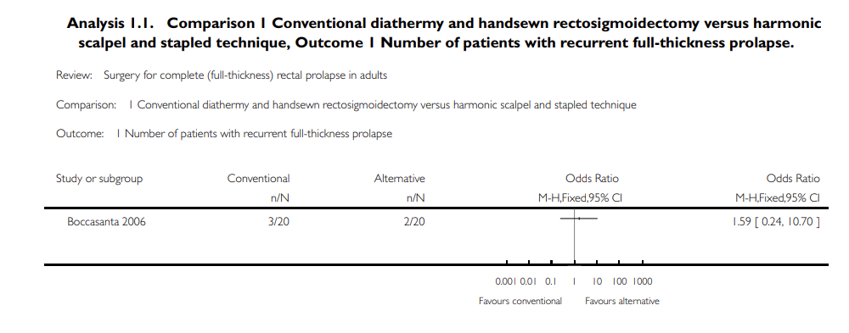
recurrent rectal prolapse: 3/20 (15%) people in the handsewn group compared to 2/20 (10%) in the stapled group
incontinence score at 12 months after surgery between both groups: no significant difference
Tou S, Brown SR, Nelson RL. Surgery for complete (full-thickness) rectal prolapse in adults. Cochrane Database of Systematic Reviews 2015, Issue 11. Art. No.: CD001758.

Slide 33
+- levatorplasty
 | Recurrence | Residual faecal incontinence | Constipation | Operating time
Delorme with levatorplasty | Decreased but not statistically significant | Significantly lower | Similar | 20min
Delorme w/o levatorplasty |  |  | Similar
Tou S, Brown SR, Nelson RL. Surgery for complete (full-thickness) rectal prolapse in adults. Cochrane Database of Systematic Reviews 2015, Issue 11. Art. No.: CD001758.
Notes:
A levatorplasty (ie, suture approximation of the levator muscles) is performed anteriorly to lengthen the anal canal and provide additional support.

