Slide 1
Surgery for Constipation
By Nicola MacRobert
Charlotte Maxeke Johannesburg Academic Hospital
ColoEscape
July 2024

Slide 2
Majority of patients with constipation do not need surgery

Slide 3
…in the minority who can be considered for surgery
Important principles:
1. exhausted conservative measures
2. well defined surgical target – need work up and investigations
3. MDT
4. extensively counselled patient

Slide 4

What do they mean? What do they want fixed?
Constipation = patient unhappy with their defecation
Subjective and can mean a whole lot of different things
Infrequency
Or can’t get it out
Or bloating, pain, scooping, splinting, stretchors, digitators etc

Slide 5
Definitions: Rome IV
Functional Constipation = 2 or more of:
Straining
Lumpy/hard stools
Incomplete emptying
Sense of blockage
Digitation
Less than 3 stools per week
Obstructed defecation =
FC + 2/3 abnormal tests (ARM, BET, Defecography)
> 1month

Slide 6
Exclude secondary causes

Slide 7
Colonoscopy – poor diagnostic yield
Chronic Constipation in adults, contemporary perspectives and clinical challenges. Scott et al, 2021

Slide 8

Conservative measures – mainstay of Mx
Diet
NB: caloric intake?
Laxatives
Use combination, and regularly, tailor to patient
Fybogel, Movicol…enough water to add the bulk to stool
Review chronic medications
NB: opioid induced constipation
Habit training
Notes:
Bulking agents – increase stool bulk, need water. Eg fybogel
Stimaulant laxatives eg Dulcolax, senna. Increase contractility
Stool softeners – lactulose
Osmotic agents – PEGs
Prokinetics
Prosecretory agents

Slide 9
Habit Training?
Toileting/stooling
Position
Avoid straining
Defecation manoevres
How to support perineum
Splint rectocoele
Relax pelvic floor if + anismus
Improving coordination between abdominal contraction and pelvic floor relaxation

Slide 10
Versus Biofeedback and pelvic floor physiotherapy
Biofeedback
Pelvic floor physiotherapy
Notes:
Biofeedback – real time education and feedback with physiological tests
Pelvic floor physio - ? How to define this. Physiotherapy and exercises

Slide 11
Referred for surgery - the surgical targets:
1. Slow transit constipation
2. Obstructed defecation – with an anatomical component

Slide 12
1. Surgical target – slow transit constipation
Chronically constipated – for years
<1% (minority) of constipated patients
Often since young
Very infrequently stool
Often no urge to stool
Slow transit studies (ROM test, Hinton test, scintigraphy)
Knowles et al, Systematic review Colorectal dise, 2017

Slide 13
Surgical options for STC
Loop ileostomy (50% - no regret, 25% minimal regret, not complication free)
  Need to then remove the colon?
  Screening, diversion colitis, mucous leakage
Total colectomy + end ileostomy/IRA/ISA
  Pre-colectomy ileostomy predicts outcome of TC
Subtotal colectomy + caeco-rectal anastomosis (retrograde/antegrade)
Ileostomy for chronic constipation: a good idea or just asking for more trouble? Davis et al 2021

Slide 14
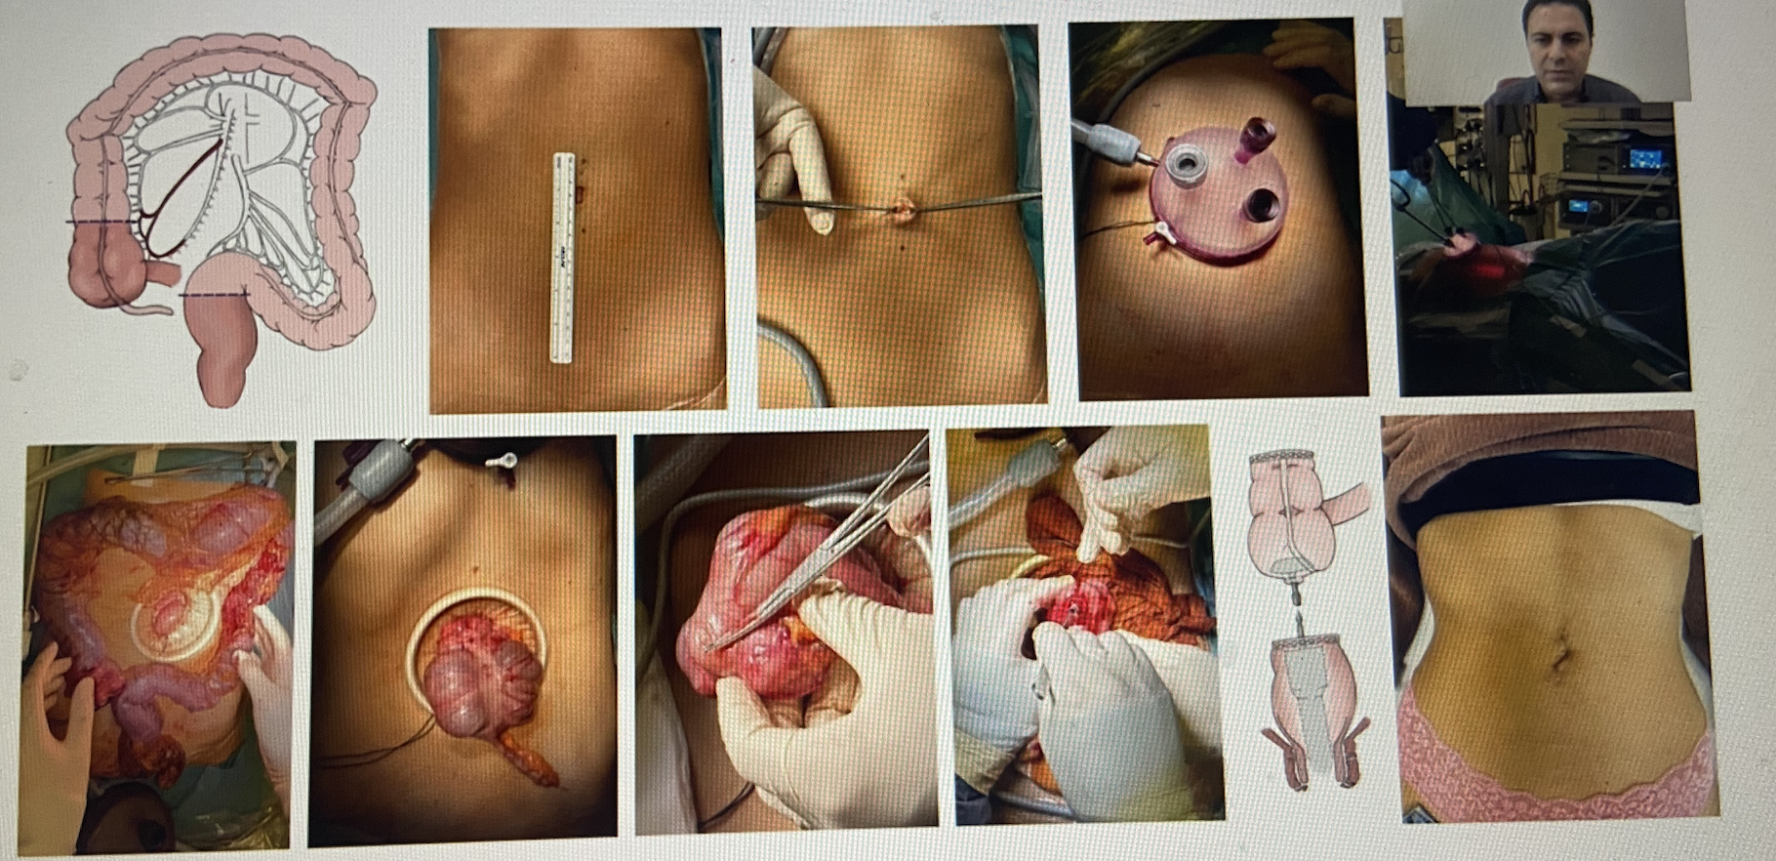
Ugo Grossi, ESCP FI webinar 2023, ODS talk

Slide 15
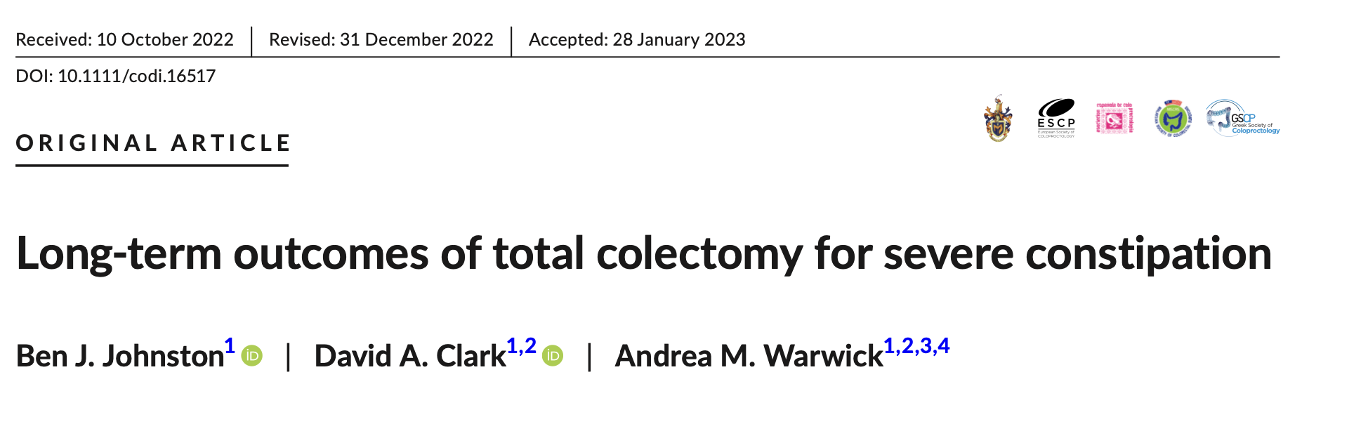
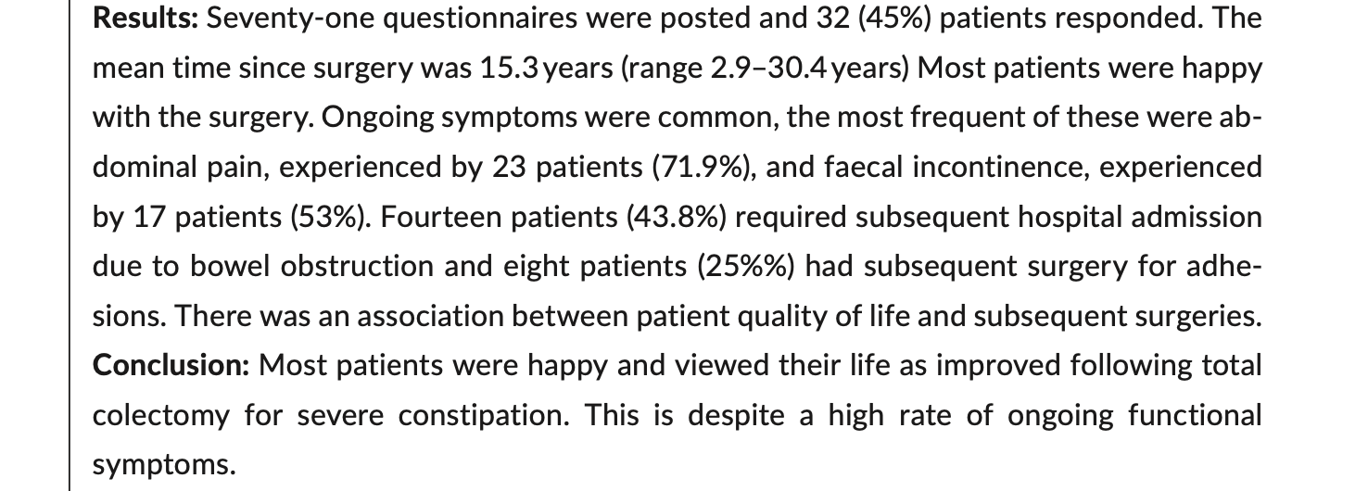

Slide 16

+ colectomy is not risk free
Periop morbidity
And long term issues
SBO, adhesions, etc
Ongoing laxative use still quite high
Outcome of colectomy for severe idiopathic constipation, Kamm et al 88
Surgery for constipation: systematic review and practice recommendations, Knowles et al

Slide 17
No help with bloating and abdominal pain – be cautious if these are the predominant symptoms (IBS-C)
Knowles et al, Systematic review Colorectal dis, 2017

Slide 18
Important exclusion criteria for TC in STC: no foregut/small bowel dysmotility no outlet problems normal anal sphincters
Slow transit constipation and criteria for colectomy: a cross sectional study of 1568 patients, Chaichanavichkij et al 2021

Slide 19
Patient selection is key for TC and < 1% of patients referred for constipation will potentially qualify for colectomy
Pre-colectomy loop ileostomy?

Slide 20
2. Surgical target – ODS
Can be anatomical
  But is the abnormal anatomy a result of abnormal function
  A lot of functional + anatomical overlap
  Functional issues – anismus/dysnnergia
Need a lot of functional rehab and +++ conservative measures
The abnormal anatomy + function must be defined – to identify a surgical target
  Defecography - Ba/MRI
  ARM
  BET

Slide 21
The surgical targets in ODS
ERP (ERP = surgery)
Enterocoele
Rectocoele (should be trapping, > 4cm)
(High grade IRP/intussusception (how to define this? – Oxford 3-5))
A lot of asymptomatic patients have rectocoeles/IRP/intussusception on imaging
Anatomical severity doesn’t predict symptoms either
Palit et al, Colorectal Dis 2016

Slide 22
Before surgery – triple assessment, it must all add up
History
Multiparous, pelvic floor issues, obstructed defecation, splinters, scooper,
Examination
Bulge into vagina on straining, other bulges, weak pelvic floor,
Investigations
Rectocoele, retention, large

Slide 23
NB: surgery does not fix…
Function
Anismus, dysnergia
Pain
Chronic pelvic pain, dyspareunia

Slide 24
How to fix this abnormal anatomy? – Ventral Mesh Rectopexy
Why VMR?
  Weakened rectovaginal septum
  rectum bulges into vagina instead of evacuating
  Where prolapse begins – anteriorly on a weak rectovaginal septum
  Deep POD and enterocoele
VMR – aims to reinforce this weakened rectovaginal septum with mesh and suspend up the rectum (restores anatomy)
  And is nerve sparing
  And is quite safe
  And can be done minimally invasively
  And has decent functional outcomes
  Patients quite happy post VMR
Long term outcome after laparoscopic ventral mesh rectopexy, Costen et al 2015
Andre D’Hoore

Slide 25
…but when you get morbidity in VMR you get real morbidity
Mesh morbidity
  Biologic mesh (safer but…cost, long term RR???) – and not risk free,
  Needs a lot of suturing. Sutures also cause issues and erosions. – so somewhat different surgical technique
  Autoimmune reactions
Chronic pelvic pain
And VMR ‘restores anatomy’ but not function
So, need a lot of pelvic floor functional work
A multicentre collaboration to assess the safety of Laparoscopic Ventral Rectopexy Evans et al
Mesh related complication and recurrence after ventral mesh rectopexy with synthetic versus biologic mesh: a systematic review and meta-analysis, Schans et al

Slide 26
And there are non-mesh approaches, - suture rectopexy, resectional rectopexy (eg + sigmoid redundancy or pathology), perineal repair of rectocoele, intraanal delormes,
STARR etc each with its own pros and cons so VMR – not one fits all
Muhtaseb E et al Tech Coloproct 2014
Functional outcome after laparoscopic posterior suture rectopexy versus ventral mesh rectopexy for rectal prolapse Hidaka, Lundby et al

Slide 27
What do you want fixed the most?
Do you want to wake up every morning and do an easy BM?
Do you want to have no bloating and abdominal pain?
Do you want a quick fix?
Do you have chronic pelvic pain and dyspareunia?
Surgery unlikely to solve these issues
Patient must have realistic expectations of outcome

Slide 28
And NB: pelvic floor – is it multicompartment urinary incontinence – patient may be overclenching the pelvic floor multicompartment issues should be addressed

Slide 29
Descending perineum – will VMR hold up the perineum???

Slide 30
ODS – patient selection for surgery is key

Slide 31
Surgery is no quick fix for the pelvic floor patient

Slide 32

Other options
Transanal irrigation
Small volume
Higher volume
PEC – and prograde irrigation
ACE – antegrade colonic enema

Slide 33
And…
Stoma
  STC – ileostomy
  ODS – colostomy
Combined STC + ODS (up to 45% of patient with chronic constipation)
  Treat the ODS first, consider VMR
SNS – not effective for ODS
Bharucha and Knowles, Surgery of the anus, rectum and colon, 4th edition.
Chronic constipation in adults, contemporary perspective and clinical challenges, Corsetti et al 2021

Slide 34
So yes, – some pelvic floor patients can be helped with surgery mad people get sick and sick people get mad don’t forget the psychological stuff…

Slide 35
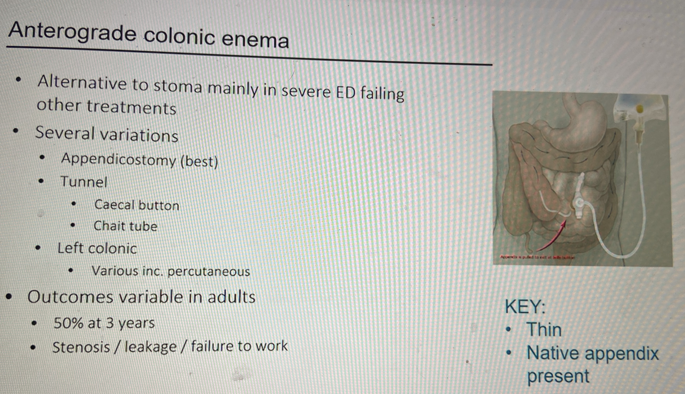
C Knowles slide ACPBGI 2023 Constipation

Slide 36
Radio-opaque marker test – Spink’s Test
CVP
Cut up into 27 little pieces
Swallow with some yoghurt etc
AXR D1 and D5
D5 – look at the markers
And number of markers remaining

Slide 37
