Slide 1


Management Synchronous liver metastasis
DR W. MTIMKULU
Coloescape - 2024

Slide 2
INTRODUCTION
Develop in 50% of the cases
Synchronous in 15-25%
Synchronous ~ poor biology
Surgical resection is the only hope for cure
5 year survival of about 48-58%
High recurrence rate ~ 80%
Advances in surgical approaches

Slide 3
Synchronous liver mets
Defined as CRLM detected concurrently or before the primary CRC
no consensus on timing before 3/6/12 months from diagnosis
? Misnomer ? Poor radiology pic up
post-resection survival – 5-year survival was 39% vs 48% in metachronous CRLM

Slide 4
Radiological evaluation
CT chest, abd and pelvis is gold standard
CT [91%] & MRI [94%] almost equivalent sensitivities
MRI INDICATED
Diagnostic doubt
Fatty liver
Smaller Sub centimeter & multiple lesions
Post NAT & trx response evaluation

Slide 5
Approach for synX CRLM
CRLM
Options
Primary first
Combined approach
Liver first approach
Notes:
For those who present with resectable disease, a multidisciplinary approach and consultation with a liver surgeon is imperative to ensure the best possible outcomes. For patients with primary CRC and synchronous CLM, there are 3 approaches: traditional staged approach (primary-first), combined approach, or the liver-first approach.

Slide 6
TRADITIONAL APPROACH
Resection of primary
Systemic chemo trx
Liver resection
Starting point
Advantages
Disadvantages
Notes:
The conventional approach comprises of resection of the primary CRC followed by liver metastasectomy, commonly with chemotherapy applied between the two surgeries. This avoids potential complications of the primary tumour, but carries significant risk of CRLM progression beyond resectability; less than 30% patients completed the whole treatment and underwent liver resection.
Benefits of this approach may include reduction in possible complications from the primary tumor, pre- vention of the development of further metastatic disease from the primary tumor, and to allow for systemic therapy to judge individual tumor biology prior to hepatectomy

Slide 7
Optimal surgical sequencing for : resectable synchronous disease
Optimal strategy remains controvetial
Liver fist
CRC first
Decision based
Primary symptomatic
Extent of liver burden
Fitness of patient
Tumour biology

Slide 8
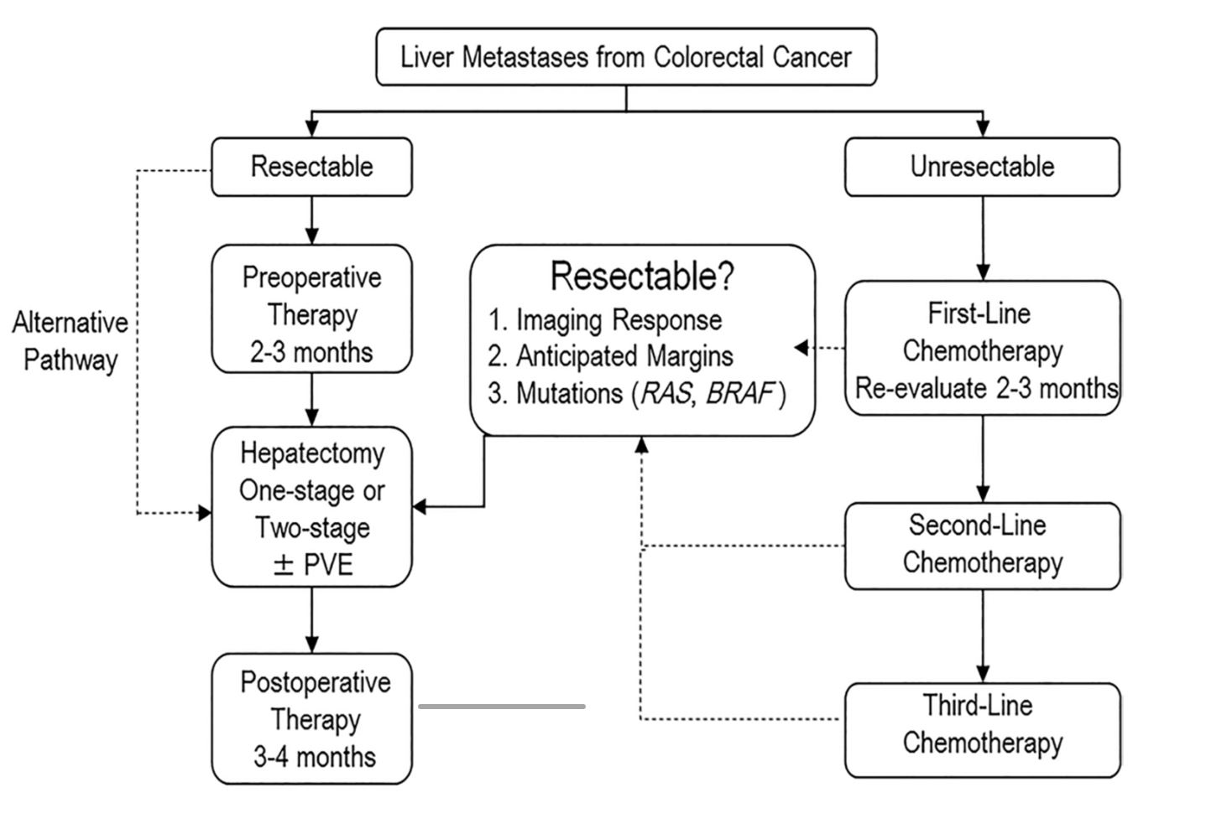
Timothy E. New hook. Langenbeck's Archives of Surgery (2022) 407:1765–1778

Slide 9
ROLE OF NAT : in clearly R0 resettable disease.
RATIONALE
Natural history & selection tumor biology
Downsize, allow more liver sparing resection
Eradication of micro mets
NCCN : state that initial resection is preferred
ESMO : Upfront surgery is justified in patients with clearly resectable disease
Notes:
Commonly cited rationale for preoperative therapy is to gain insight into CLM response that may aid decision-making, decrease size of the tumor to facilitate resection, and treatment or possible eradication of occult metastatic and micrometastatic disease. Moreover, response to preoperative chemotherapy may inform post- operative chemotherapy regimen selection.

Slide 10
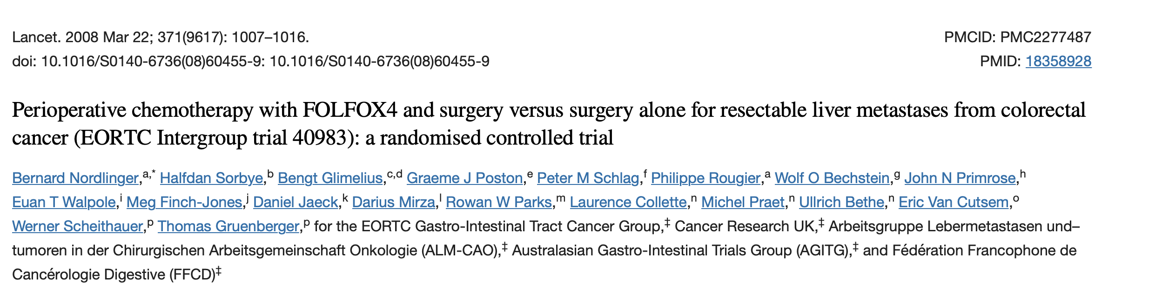
- improved 3-year progression free survival (PFS) modestly
– 42.4% vs 33.2% in surgery-only patients, an absolute 9.2% increase
– at the cost of higher peri-operative morbidity (25% vs 16%)
* the long-term outcome showed no OS benefit in the chemotherapy group
Notes:
Although adjuvant therapy approach has shown increases in disease- free survival (DFS) in some studies, there are no rand- omized, controlled trials (RCTs) that show an increase in overall survival (OS) for patients with CLM.

Slide 11
Issues with NACT -CRLM
Chemotherapy induced liver injury –CALI
Oxaliplatin : sinusoidal obstruction syndrome± 38%
Irinotecan :steatosis and steatohepatitis ± 9.3%
Increased morbidity and liver surgery related complication
Wait 4 weeks post NACT before surgery

Slide 12
DETERMINING RESECTABILITY
R0 margin, > 1cM
Presence of extra hepatic disease
Relationship of tumor to major vascular structures
Determine future liver remanent
Number & diameter of the tumors ?

Slide 13
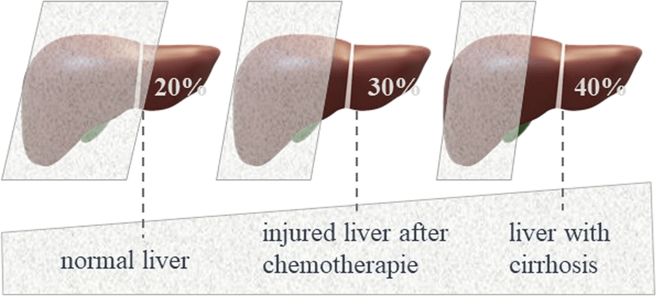
? Future liver remanent
Minimum of 2 contiguous segments
Adequate vascular inflow & out flow
Adequate biliary drainage
Liver volume ± function

Slide 14
Width of resection margin
Contrary to the historic “1-cm rule”, Ro 1mm
Similar survival Ro vs R1
Most recurrence not in resection margin
Margin reresection yield no survival advantage
Aim for wider margins balanced with liver parenchymal preservation.

Slide 15
Surgical options
Parenchymal sparing resection
Anatomical resection
Staged
Allows potential for re intervention
Gold standard
Laparoscopic
vs open

Slide 16
IN-ADEQUATE FLR WHAT TO DO?
P.V.E
Portal vein embolization
Two stage hepatectomy
ALPPS
Increase FLR by 43%
2-3 months interval
FLR hypertrophy 76%
Fails in 5 %
Disease progress
progression
Morbid 2nd stage
M&M (9%)
Conversion chemotherapy

Slide 17
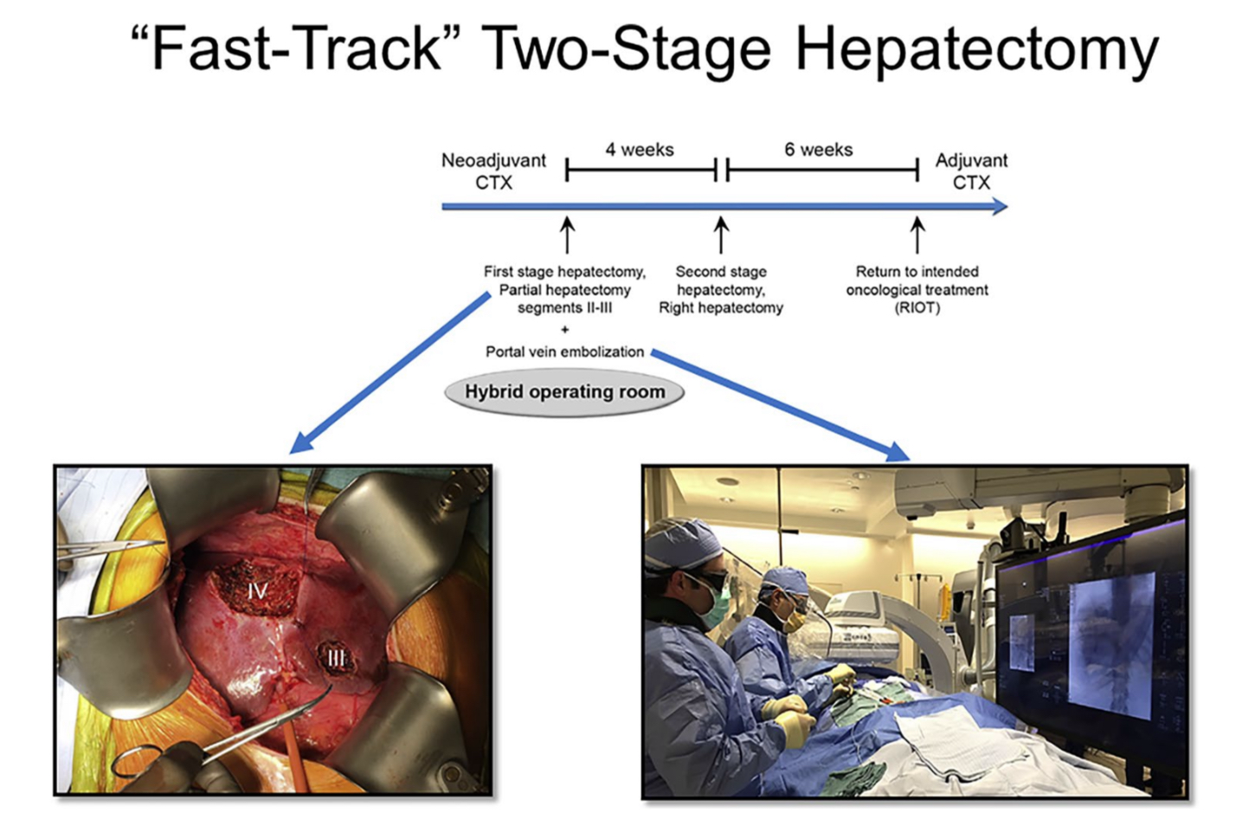

Slide 18
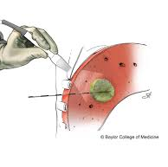
ABLATIVE PROCCEDURES
RFA and MWA methods of choice
RFA might be preferable for peribiliary lesions
MWA may be a better choice for perivascular tumours
MWA was associated with a better 6-year overall survival
Limited by size of the tumor

Slide 19

CONCLUSION

Slide 20
REFERENCES
UPTODATE
NCC guidelines
Felix Che-Lok Chow, Kenneth Siu-Ho Chok. World J Hepatol 2019 February 27; 11(2): 150-172.
Timothy E. Newhook, Langenbeck's Archives of Surgery (2022) 407:1765–1778https://doi.org/10.1007/s00423-022-02496-7.

