Slide 1

Topic : The Surgical anatomy of the Pelvic floor
Shirley Sithole
Registrar
21 July
ColoEscape
2024

Slide 2

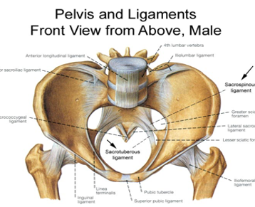
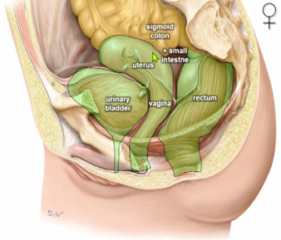
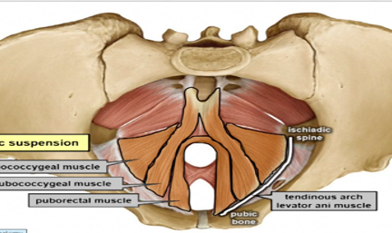

The Pelvic Floor
Functions
Supports hollow organs
Controlled opening
Micturition, defecation and parturition
Controlled closure
Urine and fecal continence
Pelvic diaphragm
Dynamic suspension
Ann Laparosc Endosc Surg 2022;7:20

Slide 3
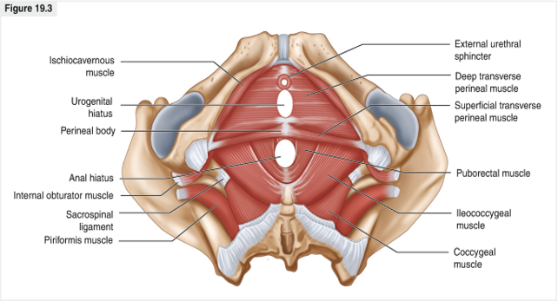
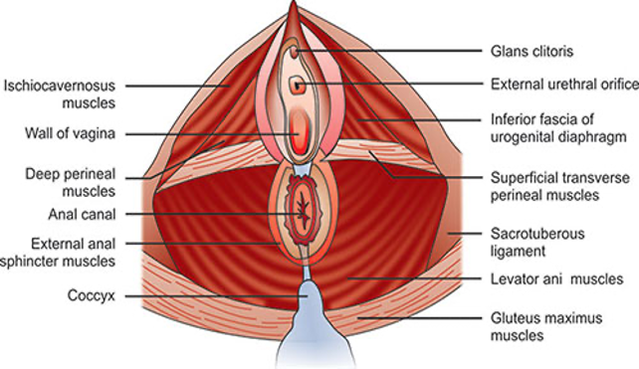
Urogenital diaphragm
Composed of 3 muscles:
Ischiocavernosus
Bulbospongiosus
superficial transverse
Cavernous bodies
Ischiocavernous body
Bulboscavenous body
Wedel, T. (2021). Pelvic Floor/Anal Canal
Notes:
Anteriorly-directed ischiocavernosus fibers arising from the posteromedial portion of the ischial tuberosities insert into the clitoris in females or penile crus in males
The bulbospongiosus arises in the perineal body or central tendon in both males and females.
The perineal body is where both the anal and urogenital structures attach in the midsagital plane,
rupture during delivery predispose pelvic organ prolapse and incontinence.

Slide 4
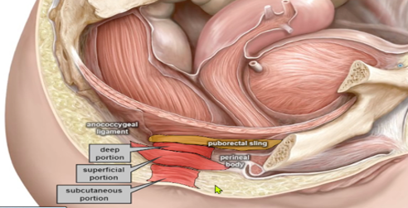
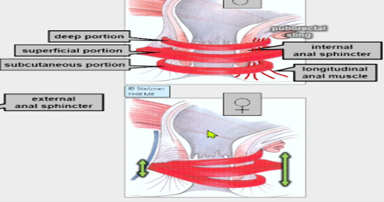
The Anal sphincter complex
External sphincter
Deep
Superficial
Subcutaneous
Internal sphincter
Continuation of circular layer of the rectum
Female ventral sphincter are less cylindrical
prone to rectocele
Ann Laparosc Endosc Surg 2022;7:20
Notes:
The anal sphincter complex is supported anteriorly by the perineal body and its attachments to the anovaginal septum in females and the Denonvilliers’ fascia in males
posteriorly, it is attached to the coccyx by the anococcygeal ligament

Slide 5
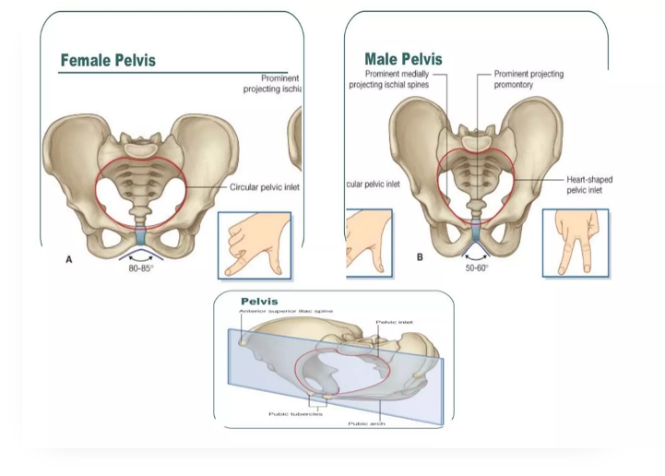
Female Vs Male Pelvis
Laxity of pelvic joints
Females: Hormonal influence during pregnancy and vaginal delivery
Males: Increased age ,chronic constipation and diarrhea
Ann Laparosc Endosc Surg 2022;7:20

Slide 6
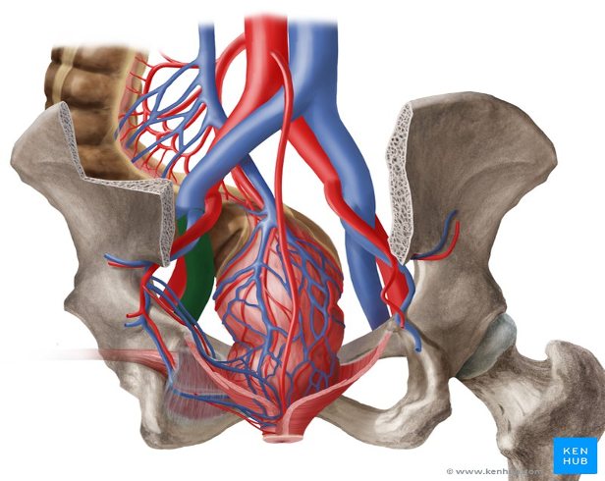
Pelvic Vessels and venous drainage
Blood supply
Internal iliac artery
Internal pudendal artery
IMA
Inferior mesenteric artery
Venous drainage
IMV
Through the portal vein
Internal iliac and femoral vein
Systemic circulation via The internal and external pudendal veins
Ann Laparosc Endosc Surg 2022;7:20

Slide 7
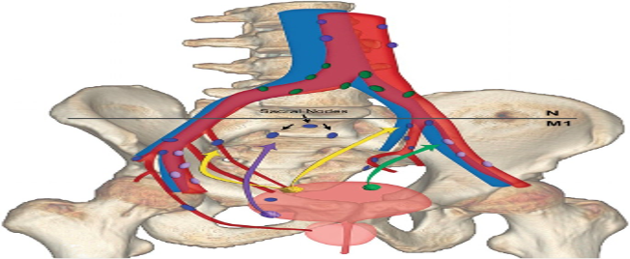
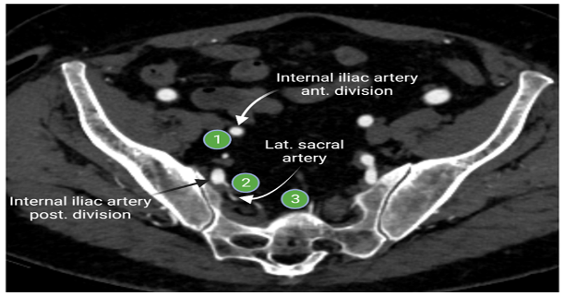
Pelvic lymph nodes
The deep lymphatic
Internal iliac lymph nodes
Lymphatic vessels from the perineum and genitals
Superficial inguinal lymph nodes
Important for staging and prognosis
Shakur, A., O’Shea, A., Harisinghani, M.G. (2021).

Slide 8
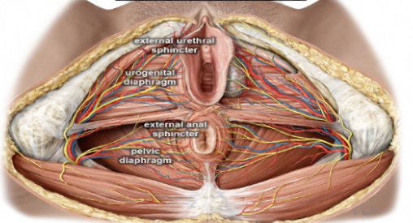
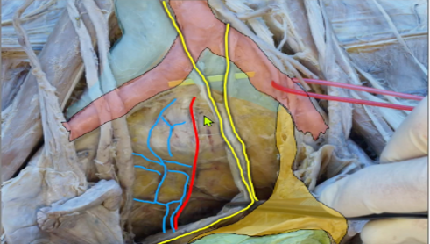
Sacral and Pelvic autonomic nerves
Lumbo-Sacral nerve
L1-S5
Pudendal nerve- motor and sensory-skin and clitoris
Superior hypogastric plexus
Injury results into retrograde ejaculation( males), urinary incontinence and decrease lubrication (females)
European Journal of Ops & Gynae and reproductive biology . Nerve- preserving sacropexy : anatomical study and surgical approach.

Slide 9
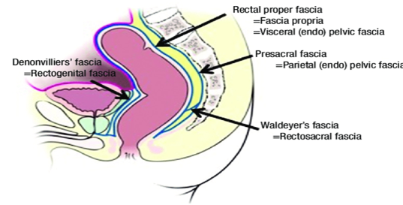
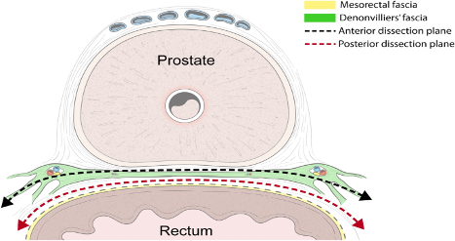
Pelvic Fascial structures
Denovilliers fascia:
separates the rectum from the prostate & seminal vesicles in men and from the vagina in women
The presacral/parietal pelvic fascia:
separates the rectum from the presacral venous plexus and the pelvic nerves
Rectosacral /Waldeyer’s fascia:
extends forward and downward and attaches to the fascia propria at the anorectal junction
Wedel, T. (2021). Pelvic Floor/Anal Canal

Slide 10
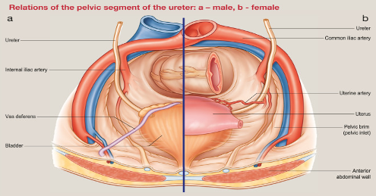
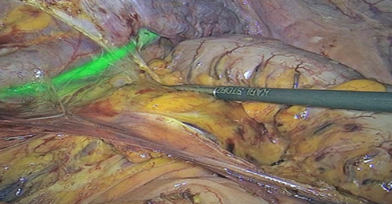
Pelvic Ureter
Adjuncts:
Indocyanine green
Aids in visualizing the ureter
Tissue perfusion
Lymph node mapping
Trans luminating J stent
Mateo G Leon et al 2023

Slide 11
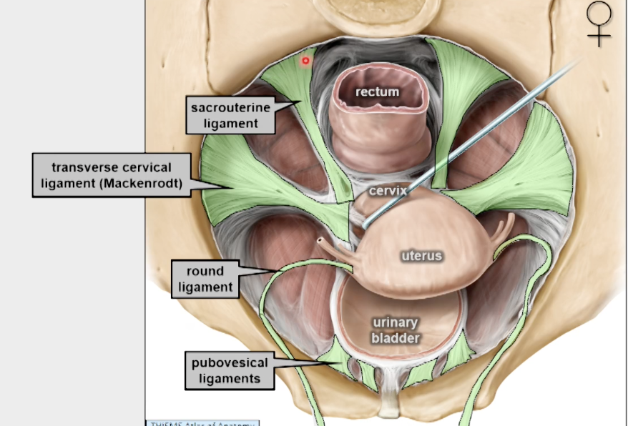
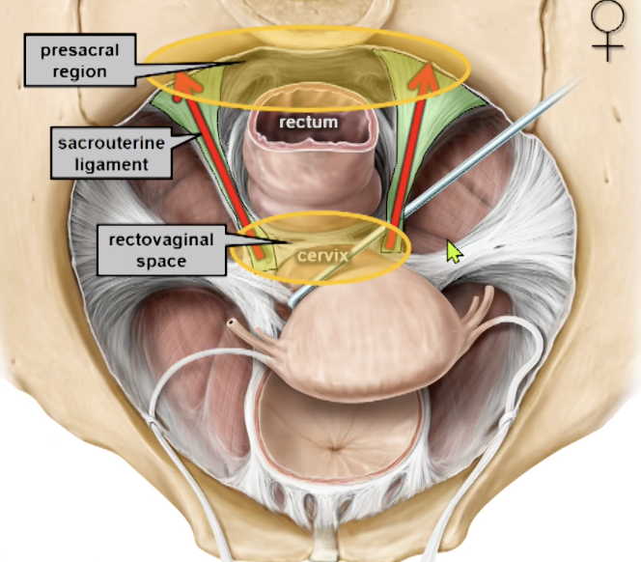

Pelvic ligaments
Sacrotuberous and sacrospinous ligaments for pelvic stability
Relevant for pelvic prolapse
Sacrocolpopexy (mesh fixation at the presacral region)
Ventral rectopexy
Wedel, T. (2021). Pelvic Floor/Anal Canal

Slide 12
Pelvic Dissection : Robitic Vs Laparoscopic approach for Laparoscopic ventral mesh rectopexy (LVMR)
3D Laparoscopy | Robotic
Avoid nerve injury with better functional outcomes | Nerve sparring
Less operative time | Longer operative time and high cost
Similar outcomes | Similar outcomes
Difficult ergonomics | Improved surgeon ergonomics and improved technical ease
Andrew D’Hoore et al. 2022

Slide 13
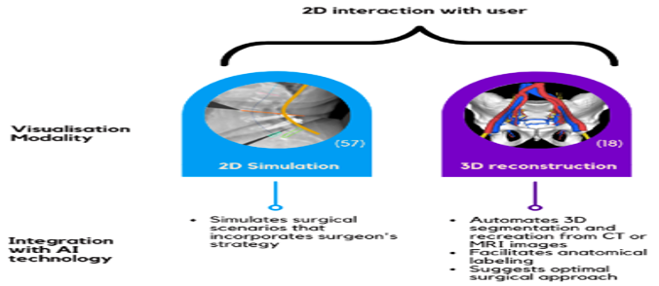
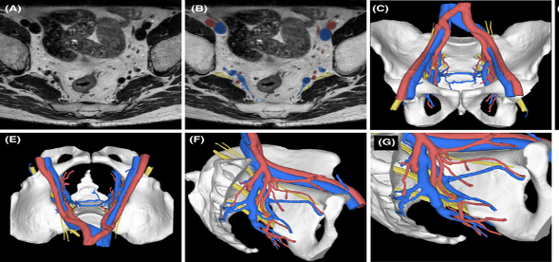
The use of artificial intelligence
Facilitate preoperative planning
Improve surgical outcomes
Decrease operation duration
Andrew D’Hoore et al. 2022

Slide 14
Reference
1.Wedel, T. (2021). Pelvic Floor/Anal Canal: Surgical Anatomy and Embryology. In: Hohenberger, W., Parker, M. (eds) Lower Gastrointestinal Tract Surgery. Springer Surgery Atlas Series. Springer, Cham.
2.C. Anderin, F. Granath, A. Martling and T. Holm. Local recurrence after prone vs supine abdominoperineal excision for low rectal cancer. The Association of Coloproctology of Great Britain and Ireland 2013
3. Bayer, A.; Heinze, T.; Alkatout, I.; Osmonov, D.; Stelzner, S.; Wedel, T. Embryological Development and Topographic Anatomy of Pelvic Compartments—Surgical Relevance for Pelvic Lymphonodectomy. J. Clin. Med. 2021, 10, 708.
4. Kai Li, Xiaobo He, Shilun Tong, Yongbin Zheng. Nerve plane: An optimal surgical plane for laparoscopic rectal cancer surgery?. Medical Hypotheses 154 (2021) 110657
5.Shakur, A., O’Shea, A., Harisinghani, M.G. (2021). Pelvic Lymph Node Anatomy. In: Harisinghani, M.G. (eds) Atlas of Lymph Node Anatomy. Springer, Cham.
6.Faucheron, J. L. (2005). Pelvic Anatomy for Colorectal Surgeons. ActaChirurgica Belgica, 105(5), 471–474. https://doi.org/10.1080/00015458.2005.11679762

