Slide 1
Nhlamolo Makumbila
ColoEscape 20/07/2024
Risk factors, pathophysiology and screening of anal squamous carcinoma

Slide 2
Introduction
The anal canal and the cervix share embryogenic, pathologic and histologic characteristics
Both develops from the embryogenic cloacal membrane
Both areas may display metaplastic change related to HPV
HPV is the most common STI in USA
Its link with anogenital malignancies is well established
Anal neoplasia associated with HPV can manifest as pre- invasive or invasive cancer

Slide 3
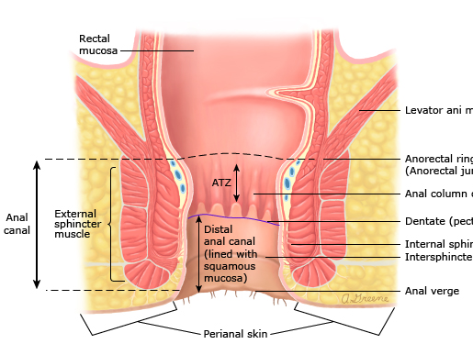

Slide 4
Epidemiology
Anal cancer accounts for about 2.8% of GI malignancies
Incidence increasing by 2.1 % per year
According to SEER:
  Annual incidence of anal ca 2014-2018 was 2.0 per 100 000
  Death was 0.3 per 100 000
Life time risk of developing anal ca is 0.2% as per SEER 2016-2018 data

Slide 5
Risk factors
Active HPV infection-16 and 18 (Scandinavian 73% both 84%)
Smoking
Men having sex with men
Anoreceptive sex
Immunosuppresion
HIV infection
Solid organ transplantation
HPV related gynae precancerous lesions
Autoimmune disease
(McCloskey, Kast et al. 2017)

Slide 6
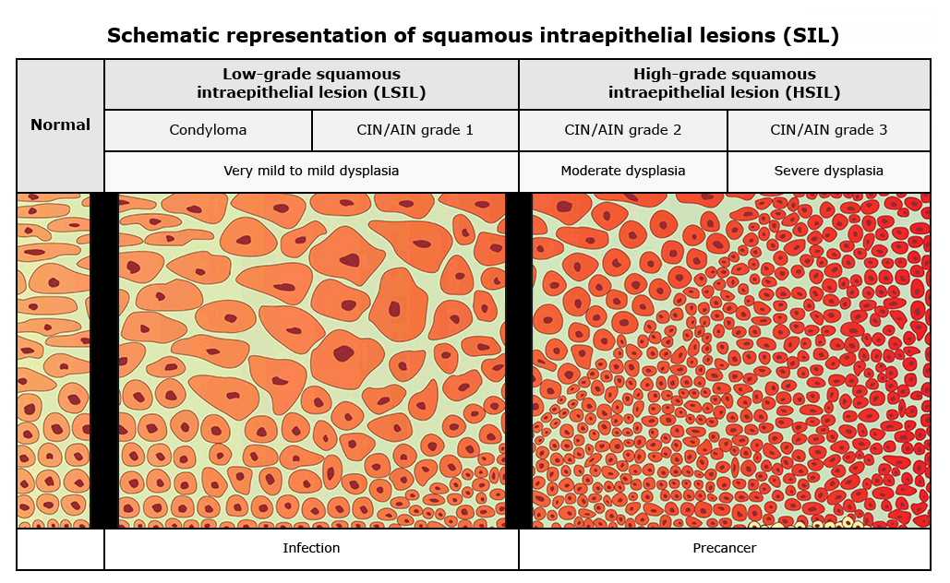
Figure 1: Schematic representation of squamous intraepithelial lesion (SIL)
Blaustein's Pathology of the Female Genital Tract, 5th ed, R.J. Kurman (Ed), Springer-Verlag 2002.
.

Slide 7
Histopathology and nomenclature
AIN 1 LSIL-AIN 1,AIN 2 P16 neg
AIN 2 HSIL AIN 2 p16 pos,AIN 3
AIN 3

Slide 8
Physiopathology
HPV associated oncoproteins (Shenoy 2022).
  E6
    Inactivates p53, allowing survival of cells with genotoxic damage
    Inhibits p21, leading to loss of cyclin E / CDK2 inhibition and progression through the cell cycle
  E7
    Inhibits RB1, leading to a continuous proliferation of mutation bearing cells
    Loss of RB1 leads to overexpression of p16, which is used as a diagnostic surrogate marker

Slide 9
Natural history
LSIL - Marker for risk rather than a direct precursor
  Risk factors for progression to HSIL
    HIV (Low CD4)
    Anal HPV Infection
    Presence of multiple HPV types including high risk types
Study in HIV + MSM showed 16.4% progression to HSIL (Jongen, Richel et al. 2020)

Slide 10
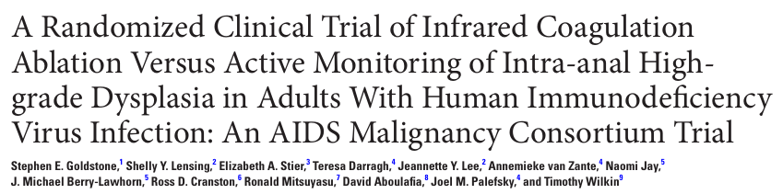
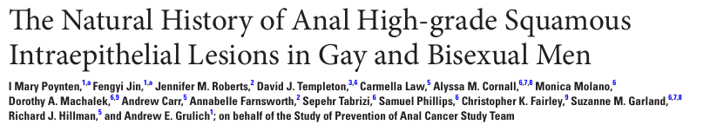
Natural history cont’d
  HSIL- direct precursor to invasive cancer
Notes:
Some proportion resolve without intervention

Slide 11
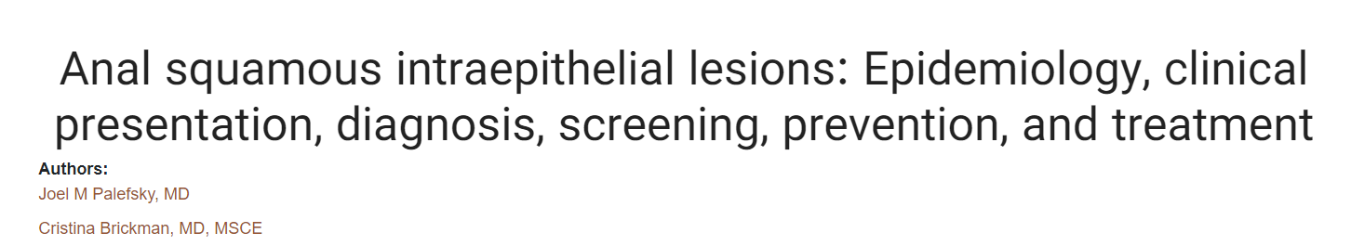
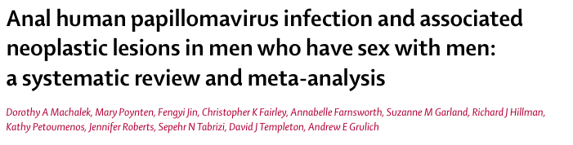
Risk of progression to invasive cancer
PLWH -1.8%
People without HIV - data limited

Slide 12
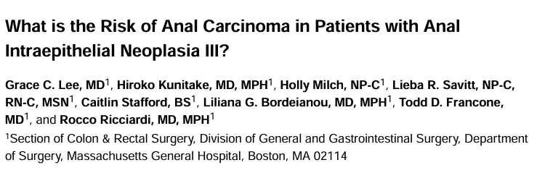
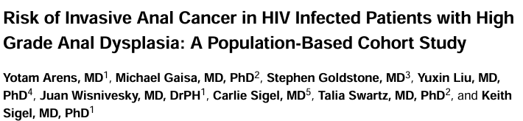
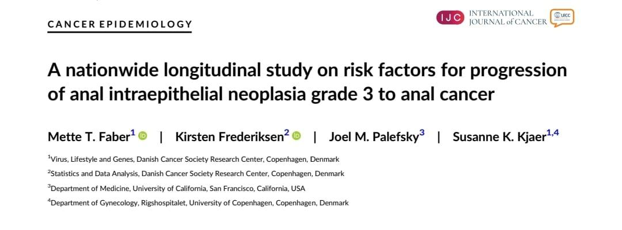
Risk of progression to invasive cancer
SEER review
HIV and autoimmune disease - increased change to invasive progression
Notes:
In 2 separate reports from seer d 5 year inci and prev of anal ca post hsil dx was 5.7 n 9.5 0r aprox 1.2 to 1.9 per year-median time to dx was 2.7 yrs
Population based study 1222 ,association by interplay of hpv and immunosup

Slide 13
Timing and screening
No consensus on the optimal time
Immunosuppressed <25yrs
Low incidence of anal cancer
Immunocompetent >25yrs
Screening is suggested for patients >25 yrs ( immunosuppression and PLWH) → annual screening
Defer screening at-risk immunocompetent after 40 years ( Goldie, Kuntz et al. 2000)
Screen at-risk individuals without HIV every 2 to 3 years (Goldie, Kuntz et al. 1999)
Age of discontinuing screening not well defined.

Slide 14
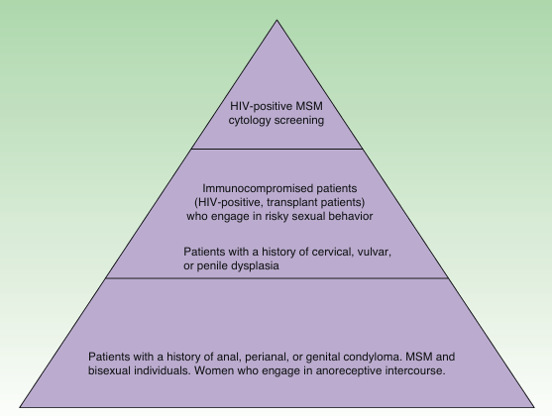
Screening continued
Figure 2: Patients at risk of developing anal squamous cell carcinoma, with lower-risk groups shown at the base of the pyramid and higher-risk groups at the top

Slide 15
Screening modalities
Anal PAP smear sensitivity 85% specificity 43% (Kimura, Nahas et al. 2021)
High resolution anoscopy –gold standard
Digital rectal examination
HPV testing
Notes:
Cytology used as initial screening test if pos to hra,

Slide 16
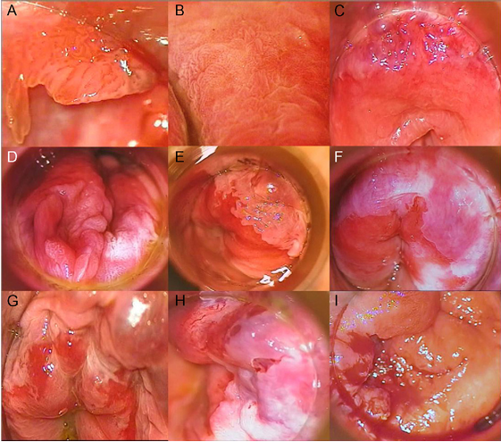
Image 1: Pathologic lesions in pre-invasive and malignant AIN
Sendagorta, Herranz et al. 2011
Notes:
1 condyloma with grade 1 ain,2 papillomatous pattern 3acetowhite plaque with abnormal vascularization, f circumferential acetowhte plaque g3 ain I mass

Slide 17
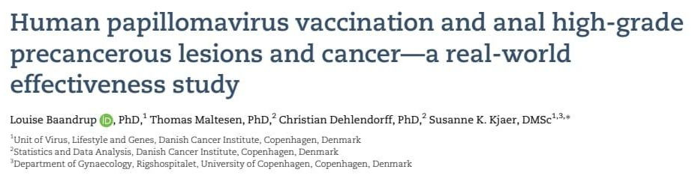

Prevention
HPV vaccine of all males and females aged 11 to 12 years old, starting at 9 continuing though to 26. (Palefsky, Brickman 2022)
Notes:
Fda approved use for adults 27-45,in usa 9 valent Gardasil which targets hpv 6 11 16 18 and 31,33,45,52,58 is available
These are prophylactic vacines used to prevent initial hpv and subsequent hpv associated ,9 valent cerv,vul,vag in f and anogenital,anal oropharn and hnn in m and f
lesion

Slide 18
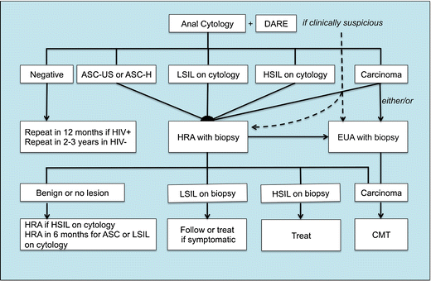
Figure 3: Schematic representation
Current Infectious Disease Reports, 2010.
Algorithm

Slide 19
References
McCloskey, J.C., Kast, W.M., Flexman, J.P., McCallum, D., French, M.A. and Phillips, M., 2017. Syndemic synergy of HPV and other sexually transmitted pathogens in the development of high-grade anal squamous intraepithelial lesions. Papillomavirus Research, 4, pp.90-98.
Palefsky, J.M. and Brickman, C., 2022. Anal squamous intraepithelial lesions: Epidemiology, clinical presentation, diagnosis, screening, prevention, and treatment.
Shenoy, S., 2022. Anal human papilloma viral infection and squamous cell carcinoma: need objective biomarkers for risk assessment and surveillance guidelines. World Journal of Gastrointestinal Oncology, 14(2), p.369.
Jongen, V.W., Richel, O., Marra, E., Siegenbeek van Heukelom, M.L., Van Eeden, A., De Vries, H.J.C., Cairo, I., Prins, J.M. and Schim van der Loeff, M.F., 2020. Anal squamous intraepithelial lesions (SILs) in human immunodeficiency virus–positive men who have sex with men: Incidence and risk factors of SIL and of progression and clearance of low-grade SILs. The Journal of infectious diseases, 222(1), pp.62-73
Goldstone, S.E., Lensing, S.Y., Stier, E.A., Darragh, T., Lee, J.Y., van Zante, A., Jay, N., Berry-Lawhorn, J.M., Cranston, R.D., Mitsuyasu, R. and Aboulafia, D., 2019. A randomized clinical trial of infrared coagulation ablation versus active monitoring of intra-anal high-grade dysplasia in adults with human immunodeficiency virus infection: an AIDS malignancy consortium trial. Clinical Infectious Diseases, 68(7), pp.1204-1212.
Poynten, I.M., Jin, F., Roberts, J.M., Templeton, D.J., Law, C., Cornall, A.M., Molano, M., Machalek, D.A., Carr, A., Farnsworth, A. and Tabrizi, S., 2021. The natural history of anal high-grade squamous intraepithelial lesions in gay and bisexual men. Clinical Infectious Diseases, 72(5), pp.853-861
Lee, G.C., Kunitake, H., Milch, H., Savitt, L.R., Stafford, C.E., Bordeianou, L.G., Francone, T.D. and Ricciardi, R., 2018. What is the risk of anal carcinoma in patients with anal intraepithelial neoplasia III?. Diseases of the Colon & Rectum, 61(12), pp.1350-1356
Arens, Y., Gaisa, M., Goldstone, S.E., Liu, Y., Wisnivesky, J., Sigel, C.S., Swartz, T.H. and Sigel, K., 2019. Risk of invasive anal cancer in HIV-infected patients with high-grade anal dysplasia: a population-based cohort study. Diseases of the Colon & Rectum, 62(8), pp.934-940
Faber, M.T., Frederiksen, K., Palefsky, J.M. and Kjaer, S.K., 2022. A nationwide longitudinal study on risk factors for progression of anal intraepithelial neoplasia grade 3 to anal cancer. International Journal of Cancer, 151(8), pp.1240-1247.
Goldie, S.J., Kuntz, K.M., Weinstein, M.C., Freedberg, K.A. and Palefsky, J.M., 2000. Cost-effectiveness of screening for anal squamous intraepithelial lesions and anal cancer in human immunodeficiency virus–negative homosexual and bisexual men. The American journal of medicine, 108(8), pp.634-641.
Goldie, S.J., Kuntz, K.M., Weinstein, M.C., Freedberg, K.A., Welton, M.L. and Palefsky, J.M., 1999. The clinical effectiveness and cost-effectiveness of screening for anal squamous intraepithelial lesions in homosexual and bisexual HIV-positive men. Jama, 281(19), pp.1822-1829
Kimura, C.M., Nahas, C.S., Silva-Filho, E.V., Ribeiro, V.L., Segurado, A.C., Alcântara, F.F., Cecconello, I. and Nahas, S.C., 2021. High-risk human papillomavirus test in anal smears: can it optimize the screening for anal cancer?. Aids, 35(5), pp.737-745

