Slide 1


Ischaemic colitis (IC): Diagnosis and management
Mpho Ramabulana
FCS(SA), Mmed(UP), Cert Gastro(SA)
Kalafong Hospital

Slide 2
TABLE OF CONTENTS:
INTRODUCTION
ANATOMY REVIEW
PATHOPHYSIOLOGY
DIAGNOSTIC APPROACH
CLASSIFICATION
MANAGEMENT
SUMMARY
CONCLUSION

Slide 3
INTRODUCTION
Definition: Colon ischaemia due to compromised blood supply that is insufficient to meet metabolic demands
Rare diagnosis with unknown incidence
Often transient with reversible clinical symptoms
Spontaneous vs Postoperative ischaemic colitis
No consensus on treatment of IC

Slide 4
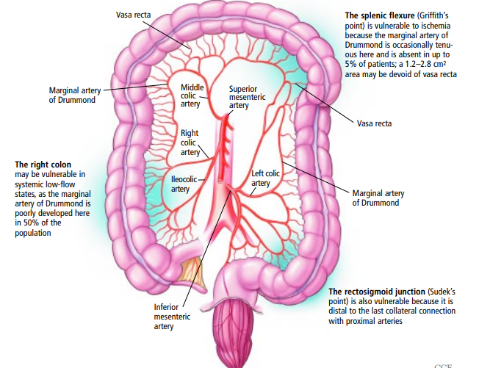
Anatomy overview

Slide 5
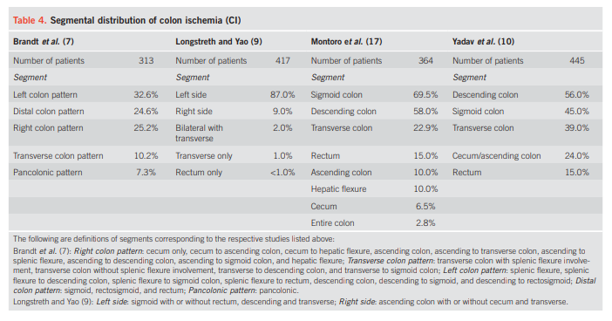
PATHOPHYSIOLOGY
Implicated pathophysiologic mechanism is an ischaemia-reperfusion phenomenon.
Occlusive (rare) vs non-occlusive (type 1 vs type 2)
Distribution:
  Left colon (75%) with Splenic flexure (25%)
  Isolated right colon ischaemia (10%)
Downloaded from http://journals.lww.com/ajg by BhDMf5ePHKav1zEoum1tQfN4a+kJLhEZgbsIHo4XMi0hCywCX1AWn
YQp/IlQrHD3i3D0OdRyi7TvSFl4Cf3VC4/OAVpDDa8K2+Ya6H515kE= on 07

Slide 6
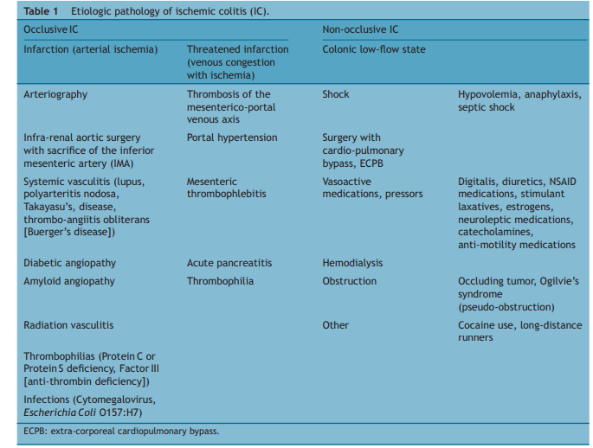
Moszkowicz D, Mariani A, Trésallet C, Menegaux F. Ischemic colitis: The abcs of diagnosis and surgical management. J Visc Surg. 2013; 150(1):19-28.

Slide 7
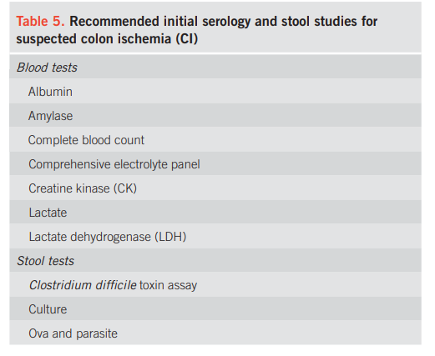


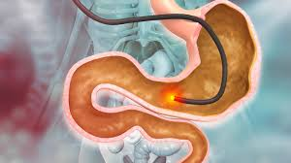
DIAGNOSTIC APPROACH
Clinical +
Laboratory tests
-Abdominal pain(87%)
-Rectal bleeding (84%) –left>right colon
-Diarrhoea (56%)
-No specific or sensitive lab test
-Low HB, low serum albumin, and the presence of metabolic acidosis can be used to predict severity
-CT abdomen
-Target or double halo
-Severe – pneumatosis , portal air, pneumoperitoneum, free fluid
-Lacks specificity
Radiological
-Most sensitive for diagnostic
-Topographic location
-Segmental erythema, oedema, haemorrhagic submucosal nodules
-Favier classification
Endoscopic

Slide 8
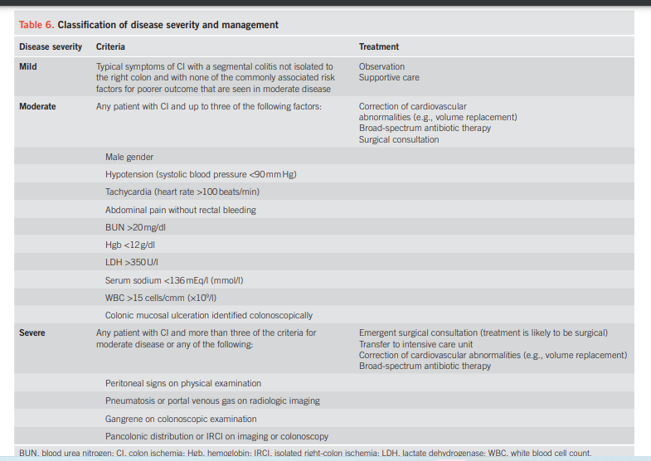
CLASSIFICATION OF IC

Slide 9

Medical management
Stage 1 or 2 IC and no evidence of systemic compromise
Conservative management is an appropriate initial approach.
Bowel rest is achieved through fasting, and in the presence of ileus a nasogastric tube placement
Minimal robust evidence regarding antibiotic choice.
Consensus suggests combining anaerobic cover with a third-generation cephalosporin or fluoroquinolone
No evidence to support the use of amino salicylates, corticosteroids or immunomodulators
Prophylactic low molecular weight heparin is generally recommended

Slide 10

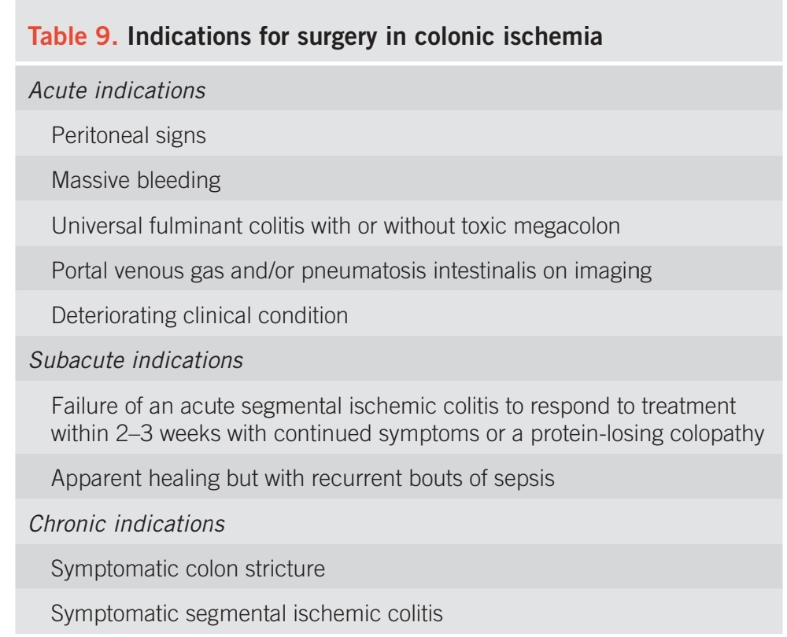
Surgical management
Stage 2 IC and systemic compromise (i.e, circulatory collapse and/or organ failure), operative intervention should be considered
Stage3 IC is generally accompanied by systemic compromise and necessitates surgery
Surgical intervention in IC is associated with higher morbidity and mortality
Surgical intervention usually involves segmental resection and colostomy formation

Slide 11
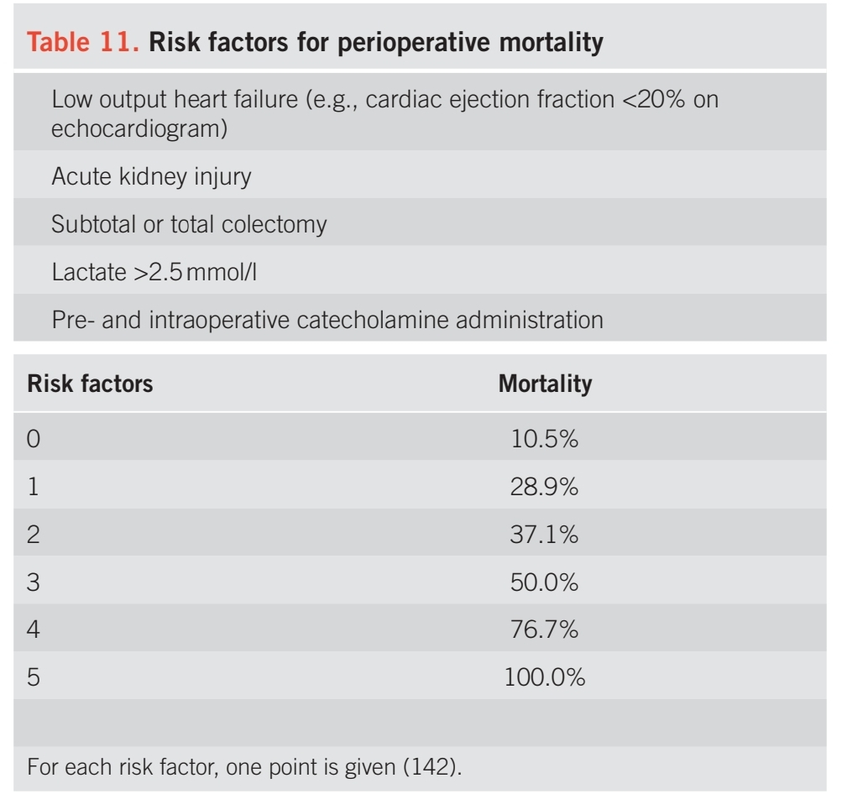


Slide 12
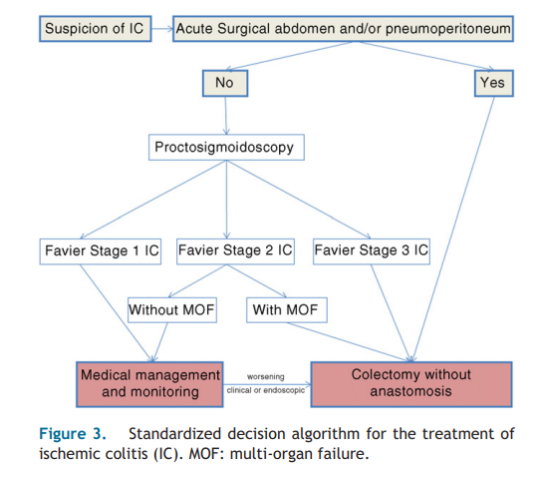
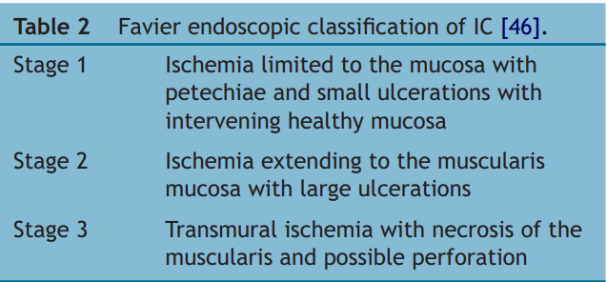
Making the decision in IC:
Moszkowicz D, Mariani A, Trésallet C, Menegaux F. Ischemic colitis: The abcs of diagnosis and surgical management. J Visc Surg. 2013; 150(1):19-28.

Slide 13
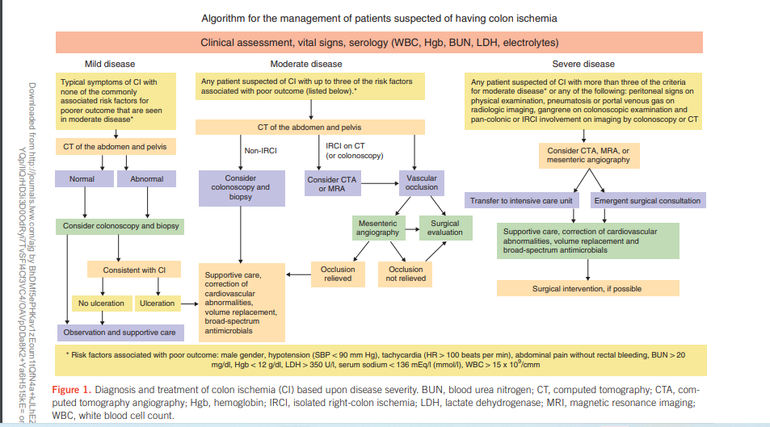
SUMMARY

Slide 14
Conclusions
Management of IC depends on severity at presentation
The presence or absence of poor prognostic features.
Prompt recognition and appropriate investigation
  initially with CT and then with lower gastrointestinal endoscopy,
  are key to making the diagnosis and risk-stratifying patients.
majority of cases will settle with conservative management
minority will require operative intervention
  mortality among this group is high

Slide 15


Slide 16
REFERENCES
1. Hung A, Calderbank T, Samaan MA, Plumb AA, Webster G. Ischaemic colitis: Practical challenges and evidence-based recommendations for management. Frontline Gastroenterol. 2021; 12(1):44-52.
2. O'Neill S, Yalamarthi S. Systematic review of the management of ischaemic colitis. Colorectal disease : the official journal of the Association of Coloproctology of Great Britain and Ireland. 2012; 14:e751-63.
3. Washington C, Carmichael JC. Management of ischemic colitis. Clin Colon Rectal Surg. 2012; 25(4):228-35.
4.Sreenarasimhaiah J. Diagnosis and management of ischemic colitis. Current Gastroenterology Reports. 2005; 7(5):421-6.
5.Moszkowicz D, Mariani A, Trésallet C, Menegaux F. Ischemic colitis: The abcs of diagnosis and surgical management. J Visc Surg. 2013; 150(1):19-28.
6.Xu Y, Xiong L, Li Y, Jiang X, Xiong Z. Diagnostic methods and drug therapies in patients with ischemic colitis. Int J Colorectal Dis. 2021; 36(1):47-56.
7. Theodoropoulou A, Koutroubakis IE. Ischemic colitis: Clinical practice in diagnosis and treatment. World J Gastroenterol. 2008; 14(48):7302-8.
8. 1. Brandt LJ, Feuerstadt P, Longstreth GF, Boley SJ. Acg clinical guideline: Epidemiology, risk factors, patterns of presentation, diagnosis, and management of colon ischemia (ci). Official journal of the American College of Gastroenterology | ACG. 2015; 110(1).

